Slide 1

Exam Seating
Arrangement System
2520030049 – Sarvesh Reddy
2520090030 – Jagadeesh
2520090071 – Vignesh

Slide 2
Introduction
“
The Examination Seating Arrangement System is designed to automate the process of arranging students during examinations. It helps educational institutions manage seating efficiently and reduce manual effort. The system stores student and room details and automatically allocates seats based on availability. It minimizes errors and avoids confusion during examinations. The project improves organization, saves time, and ensures proper seating management. This system is highly useful for schools, colleges, and universities during examinations.

Slide 3
Abstract
The Examination Seating Arrangement System helps automate student seating during examinations.
It stores student details, room information, and seating capacity systematically.
1
2
The system generates seating arrangements quickly and efficiently.
It reduces manual work, confusion, and human errors during exams.
3
4
The project saves time and improves examination hall management.
This system is useful for schools, colleges, and universities.
5
6

Slide 4
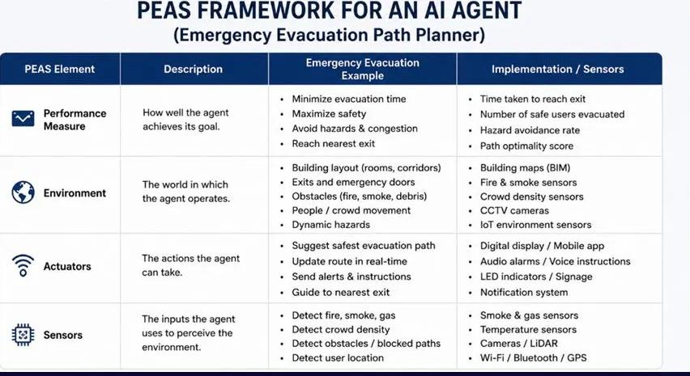
PEAS Framework for AI Evacuation Planning

Slide 5
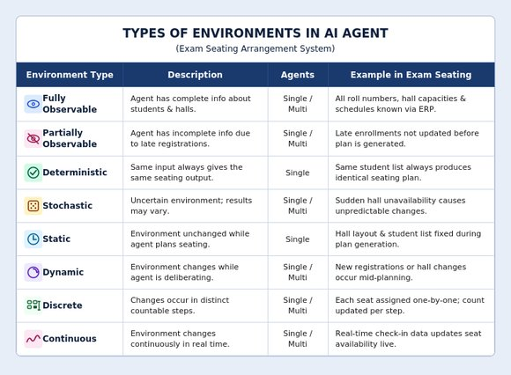
Types of Environments in AI System

Slide 6
Features
⚙
👥
⚡
✓
Automatic Seat Allocation
Student & Room Management
Fast Seating Arrangement Generation
Reduces Manual Errors
📄
🏛
⏱
Easy Seating Report Generation
Proper Exam Hall Management
Saves Time and Effort

Slide 7
Applications
1
2
3
Schools
Colleges & Universities
Competitive Exam Centers
Automate seating for school examinations
Manage large-scale hall arrangements
Handle thousands of candidates efficiently
4
5
6
Training Institutes
Online Exam Management
Educational Organizations
Organize assessment seating quickly
Coordinate hybrid exam environments
Streamline exam logistics institution-wide

Slide 8
Conclusion
The Examination Seating Arrangement System helps automate the process of arranging students during examinations. It reduces manual work, saves time, and minimizes errors in seating allocation. The system improves exam hall management and provides organized seating arrangements efficiently. It is useful for schools, colleges, and universities for conducting examinations smoothly.
Automates seating
Reduces errors
Saves time
Supports all institutions

Slide 9
Thank You
Exam Seating Arrangement System
2520030049 – Sarvesh Reddy | 2520090030 – Jagadeesh | 2520090071 – Vignesh

