Slide 1
VIGNESH MADHAV S
Final Project

Slide 2
Facial Expression Recognition:
*The Facial Expression Recognition (FER) project employs Artificial Neural Networks (ANNs) to discern emotions like happiness, sadness, and anger from facial images or video frames.
* This technology offers real-time analysis for applications in healthcare, entertainment, security, and human-computer interaction

Slide 3


AGENDA
PROBLEM STATEMENT
PROJECT OVERVIEW
END USERS
SOLUTION
MODELLING
RESULTS
3/21/2024 Annual Review

Slide 4

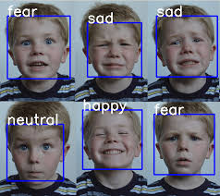
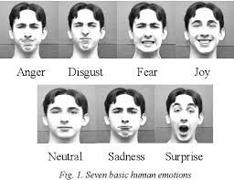
PROBLEM STATEMENT
*The project aims to develop an Artificial Neural Network (ANN) model capable of recognizing facial expressions from images or video frames. The goal is to accurately identify emotions such as happiness, sadness, anger, etc., depicted on human faces in real-time.

Slide 5

PROJECT OVERVIEW
The Facial Expression Recognition (FER) system will leverage machine learning techniques, particularly ANNs, to analyze facial features and classify expressions.
This technology can find applications in various domains such as healthcare, entertainment, security, and human-computer interaction.

Slide 6

WHO ARE THE END USERS?
Healthcare professionals using emotion analysis for patient monitoring and mental health assessment.
Entertainment industry for creating interactive experiences based on user emotions.
Security systems for emotion-based surveillance and access control.
Human-computer interaction in devices like virtual assistants and emotion-aware applications.

Slide 7

YOUR SOLUTION AND ITS VALUE PROPOSITION
Our solution leverages Artificial Neural Networks (ANNs) to accurately recognize facial expressions in real-time, offering a seamless and efficient method for emotion analysis.
This technology provides invaluable insights into user sentiments, enabling applications in personalized services, mental health monitoring, interactive entertainment, and improved human-computer interactions.

Slide 8

THE WOW IN YOUR SOLUTION
The wow factor in our solution lies in its ability to analyze facial expressions with a high degree of accuracy and speed, enabling real-time emotion recognition in diverse applications.
This technology not only enhances user experiences by providing personalized interactions but also opens up new possibilities in fields such as mental health monitoring, customer sentiment analysis, and immersive virtual environments, making it a game-changer in human-computer interaction.
3/21/2024 Annual Review

Slide 9
MODELLING
Data Collection: Gather a diverse dataset of facial expression images.
Data Preprocessing: Clean, normalize, and augment the collected data.
Model Selection: Choose a suitable neural network architecture (e.g., CNN, ANN).
Hyperparameter Tuning: Optimize learning rate, batch size, and other parameters.
Training: Train the model using the preprocessed data.
Validation: Evaluate model performance using validation datasets.
Testing: Assess the model's accuracy and generalization on unseen test data.
Deployment: Implement the model for real-time facial expression analysis in applications.

Slide 10
RESULTS
High accuracy in recognizing basic facial expressions like happiness, sadness, anger, etc.
Real-time processing capabilities for analyzing facial expressions from live video streams.
Smooth integration into applications or systems requiring emotion recognition functionality.
By achieving these results, the Facial Expression Recognition system can provide valuable insights into human emotions and enhance user experiences across various domains.
https://github.com/vigneshmadhav/GenerativeAI

