Slide 1

Introduction

Slide 2
Why I’ve did internship at MNC IT Company instead of core companies…??

Slide 3
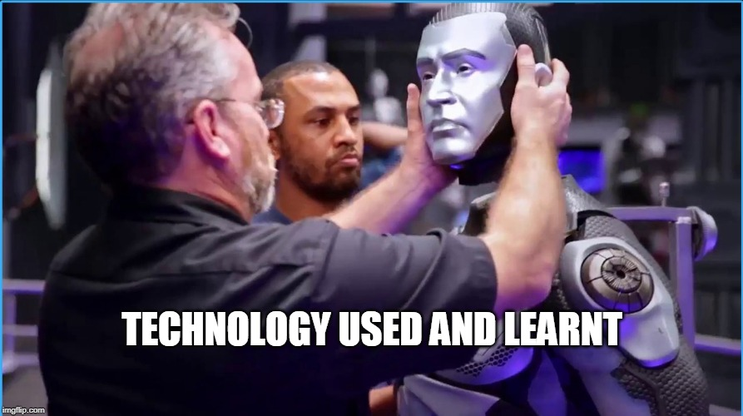

Slide 4


Slide 5


Slide 6

TECHNOLOGIES THAT ARE USED IN PRODUCT IT COMPANIES

Slide 7

Problems during the project

Slide 8



Slide 9


