Slide 1
IBM Finish Line Challenge Watson Smart Shopper A virtual shopping assistant
Team 19 – Jasmine, Paul, Raveerna, Vignesh and Yash

Slide 2





Team
Yash Nimkar
Rochester Inst. Of Tech
Raveerna Movva
Univ. of Florida
Vignesh Nandakumar
NC State
Paul Novacovici
Univ. of Illinois - UC
Jasmine Mou
Univ. of Michigan

Slide 3

Agenda
MVP Brainstorming
Lean Canvas
Technical Architecture
Use case Demo
Future Expectations
Technical Challenges
Financial Viability
The Ask
Questions

Slide 4
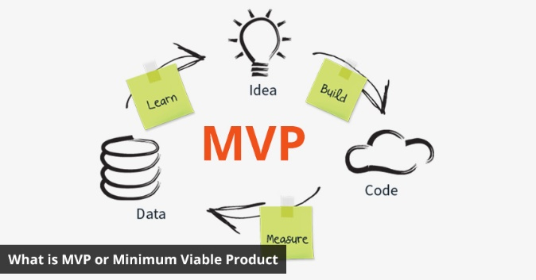
MVP Brainstorming
Some of the ideas that we thought about
Cancer or Disease diagnosis
Depression Recognition
Stock Predictor
Health Insurance Assistant
Meeting Transcripts Generation
Our Idea
Interactive Chatbot to enable smart shopping, compare prices between retailers, interact with the user, and suggest the best possible price
51% of Americans prefer to shop online
96% of Americans with internet access have made an online purchase in their life, 80% in the past month alone

Slide 5
Lean Canvas
Watson Smart Shopper
29th November, 2017
Iteration #1
Problem
Help users find the things they want to buy
Too many retailers and options to choose from
It is really inconvenient for the user to compare and check for lowest prices
Solution
Chatbot to talk to users and find products across different retailers at lowest price
Make the chatbot interactive and make it convenient and easy to use
Value Proposition
Individual App Create a smart cognitive interactive chatbot to talk to the user and find the best deal for the user in terms of the product specifications and price. The process will be really easy and convenient
Retail as a Service Partner with major retailers like Amazon or Walmart to assist them with matching prices and competing in the market
Unfair Advantage
Watson Analytics to analyze customer behavior and harness more data
Retailers – Information and IBM connections
Customer Segments
Consumers shopping for the specific product (laptop, clothes, watches and so on)
Major retailers like Walmart, Amazon and Best Buy who want to match lowest prices
Key Metrics
Redirects
Number of Users
User ratings and reviews
Partnership with key retailers
Channels
Make the app available on App stores
Partnership with Retailers
Market using Amazon or IBM Watson connections
Cost Structure
Cost of maintaining a database (for Knowledge API)
IBM Cloud and Watson API licenses and services
Expansion of product features
Updates and Patches for every iteration
Revenue Streams
Take a x% cut for every redirect to retailer
Free app with advertisements
Or charge a small $ fee to use the app for each account
Watson Retail as a service – Offer it to major retailers like Walmart, Amazon, or Best Buy for a partnership
PRODUCT
MARKET

Slide 6
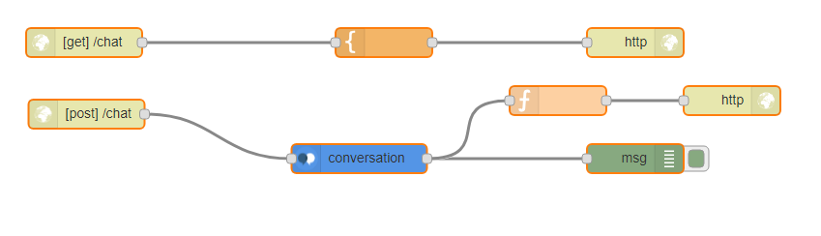
Technical Architecture
Node red platform for app
Watson Conversation service
Configuring the Intents and Entities for Products
Configured context to access entities globally
Built the Dialog flow for chatbot to make it interactive
HTTP Get and Post requests for web interface
Debug module
Used the payload message to input/output data from user

Slide 7
Use Case and Demo
Looking to buy a laptop based on specifications
Get the best possible price
Find the laptop based on specifications or price
Compare prices between different retailers
Chat with interactive Watson Retail chatbot to find the best product and price
Demo Link
https://nvbot19.mybluemix.net/chat

Slide 8
Future Expectations
Consumers
expand the available products for search
expand the pricing sources for the same product
analyze consumer behaviors from the historical conversation data Watson Toner Analyzer for Sentiment Analysis
enable low price subscription alert
enable image input from consumers (Watson Visual Recognition API)
Retailer
Basic Version
provide a separate interface for retailers
Enterprise Version
list competitive prices from other retailers
enable product-specific low price alert from competitors
provide coupons for users
provide the option to purchase prioritization

Slide 9

Technical Challenges
Collect real-time prices with a web crawler for the products hosted
Integrate Database Service to the application:
IBM Watson Discovery API
Visual Recognition API in future
Notes:
Web scraping prices: the existing tools unknown, real-time prices
Discovery API: integration of database to enhance the performance; connection to the Visual Recognition API.
Visual recogtion: have a higher accuracy once the technology of recognizing product details improves.

Slide 10
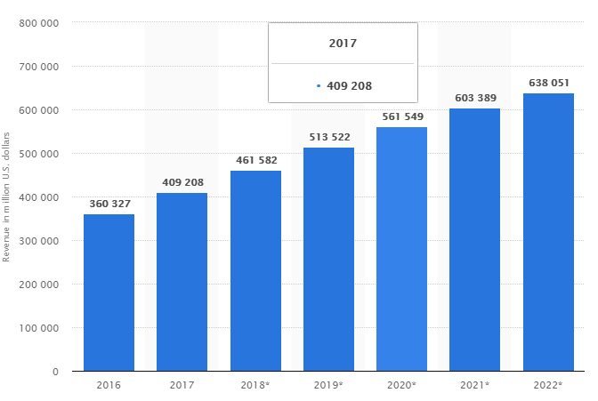
Financial Viability
Global E-retail sales
1.9 trillion U.S. dollars
Projections for 2020
4.06 trillion U.S. dollars by 2020
Pricing
x % or $x for every sale or redirect based on product type and market trend
Competition
Chrome Extension that suggest better prices for online shopping

Slide 11

The Ask
$200,000 for 10% stake in the company
5 founding members
Team could expand to up to 10 people
Profitability to IBM
IBM Watson can harness consumer behavior and data
Dictating the traffic through e-commerce world
Potential profitability from e-commerce sales
Good marketing and branding opportunity for IBM Watson and IBM Cloud services

Slide 12
Questions?

Slide 13
Thank You

