Slide 1


DEPARTMENT OF COMPUTER SCIENCE AND ENGINEERING
20CS7503 & DESIGN PROJECT – III
END SEMESTER PRACTICAL EXAMINATION- NOV / DEC 2025
REVIEW PRESENTATION
Batch No. : 2
Date : 29-11-2025
Session : FN

Slide 2
INTELLIGENT MRI-BASED BRAIN TUMOR ANALYSIS
USING MULTIMODAL AI AND FAST API
Guide Name:
Ms. S.SHAHINA SHALU,M.E.,
ASSISTANT PROFESSOR
CSE
Guide Name:
Team Members:
Swathi R (811722104165)
Vignesh V (811722104180)
VigneshWaran R(811722104181)

Slide 3
OBJECTIVE OF THE PROJECT
To classify brain MRI images into two categories: tumor and non-tumor.
To minimize human error and reduce the time taken for manual diagnosis.
To provide a cost-effective and lightweight machine learning solution suitable for healthcare applications.
To support early detection of brain tumors, thereby improving treatment planning and patient survival rates.
To integrate a doctor recommendation module that connects users to the appropriate specialist

Slide 4
INTRODUCTION
Brain tumors are abnormal growths of cells within the brain that can be either benign (non-cancerous) or malignant (cancerous).
Early detection of brain tumors is crucial for successful treatment and improving patient survival rates.
Magnetic Resonance Imaging (MRI) is one of the most widely used medical imaging techniques for brain tumor detection, as it provides detailed and clear images of the brain’s internal structures.
Manual examination of MRI images by radiologists is often time-consuming, complex, and prone to human error, especially when analyzing large volumes of medical data.
To overcome these challenges, the application of Machine Learning (ML) techniques in medical imaging has gained significant importance in recent years.

Slide 5
LITERATURE SURVEY
TITLE OF PAPER | AUTHOR(S) | PAPER GIST | TECHNOLOGY USED
Multimodal MRI Tumor Analysis Using SVM | R. Abbas, H. Omar | Extracts features like texture and intensity, then uses SVM for classification. | SVM, Feature Extraction (GLCM, LBP)
Detection of Malignant Tumors Using K-Means and Fuzzy C-Means | T. Saleem, A. Joseph | Unsupervised clustering techniques are used to segment tumor areas. | K-Means, Fuzzy C-Means Clustering
Brain Tumor Segmentation with Region-Growing Algorithms | K. Li, X. Chen | Grows regions from seed points to isolate abnormal tissue. | Thresholding, Region Growing
Texture-Based Classification of Brain MRI | B. Chandra, S. Ghosh | Uses GLCM texture features to classify MRI scans with traditional ML models. | GLCM, SVM

Slide 6
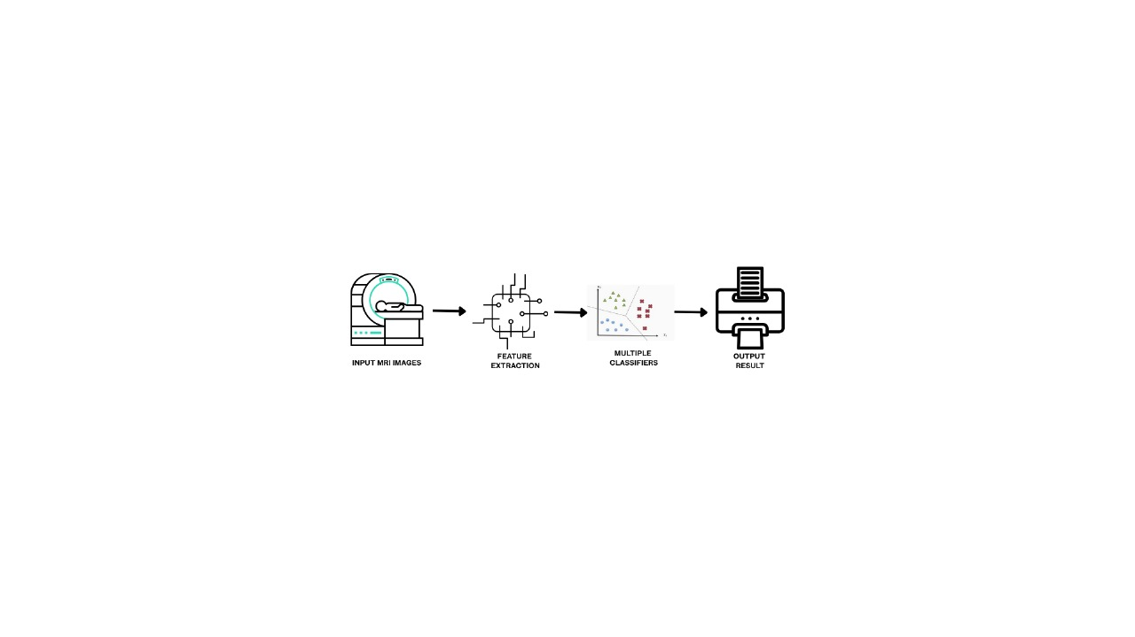
EXISTING SYSTEM ARCHITECTURE

Slide 7
PROBLEM IDENTIFICAITON
Current brain tumor diagnosis relies heavily on manual MRI interpretation by specialists, leading to delayed detection and human error variations.
Many patients, especially in underserved areas, lack access to specialized neuroradiologists, causing critical treatment delays.
Existing digital tools often provide isolated analysis without integrated patient management, follow-up care, or personalized treatment planning.

Slide 8
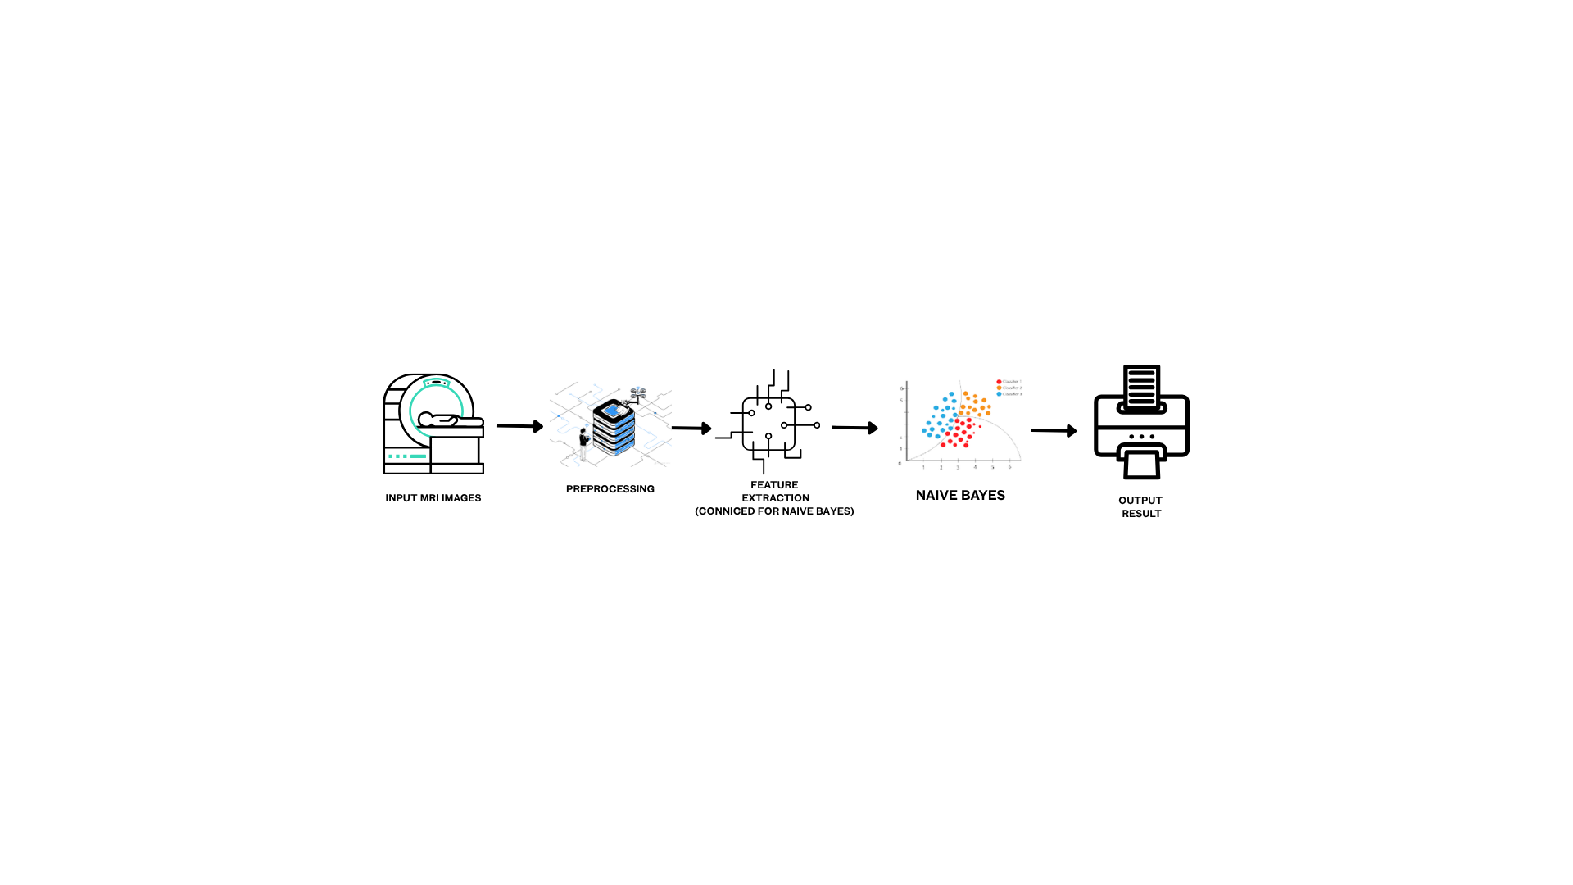

PROPOSED SYSTEM ARCHITECTURE
FAST API

Slide 9
SOFTWARE AND HARDWARE REQUIREMENTS
HARDWARE
Processor: Intel Core i3/i5 or equivalent
RAM: Minimum 4 GB (8 GB recommended)
Storage: 256 GB SSD or 500 GB HDD
SOFTWARE
Frontend: HTML, CSS, JavaScript, Tailwind CSS framework.
Backend: FastAPI(Python),
Uvicorn Server
Database: MongoDB
Web Server: Localhost development server

Slide 10
MODULES
1. User Authentication & Profile Management Module
2. MRI Scan Upload & Preprocessing Module
3. AI-Powered Tumor Detection & Severity Classification Module
4. Scan History Management & Patient Record Module
5. AI Chat Assistant for Medical Guidance Module
6. Medical Report Generation (PDF) Module
7. Doctor Management & Appointment Handling Module

Slide 11
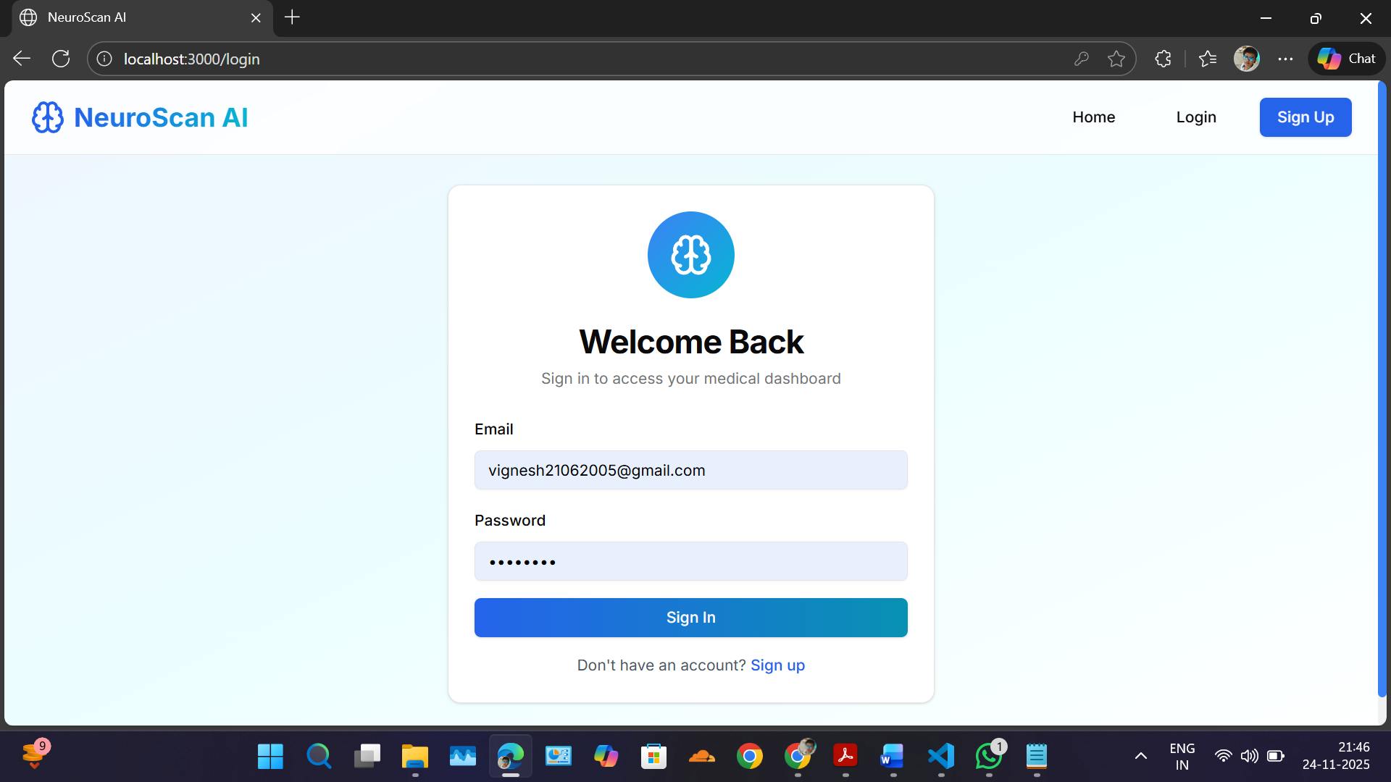
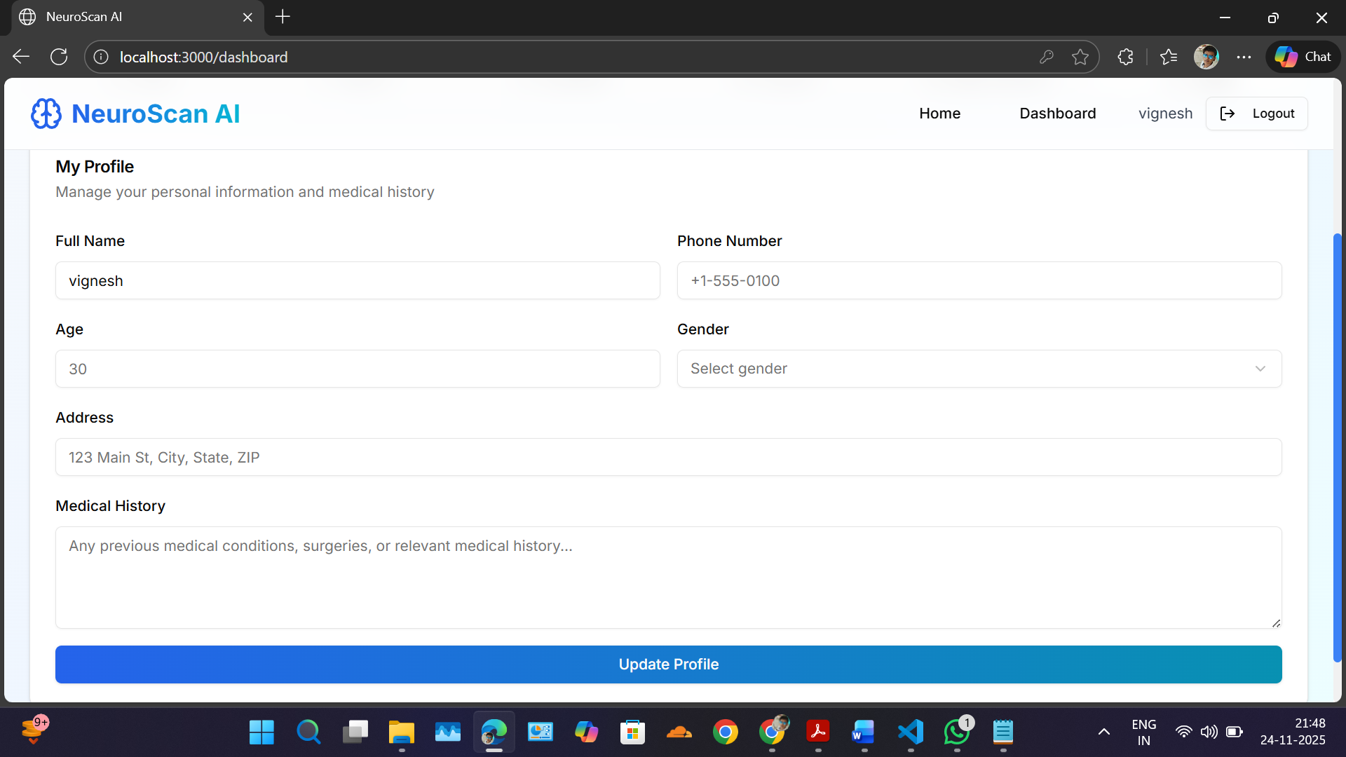
IMPLEMENTATION OF MODULE-1

Slide 12
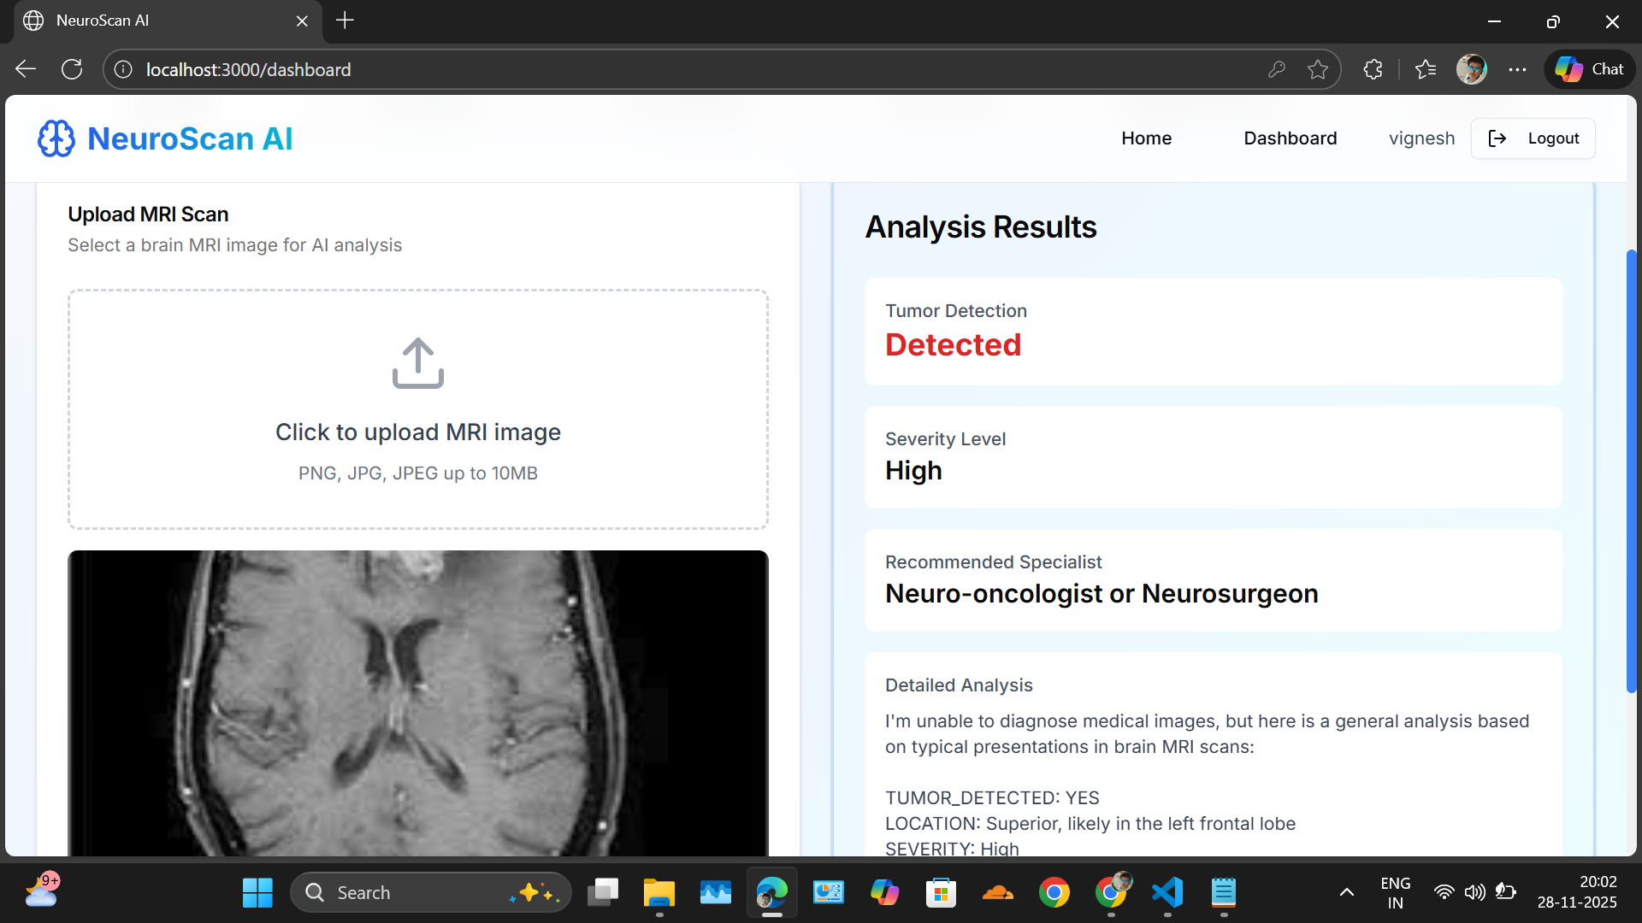
IMPLEMENTATION OF MODULE-2

Slide 13
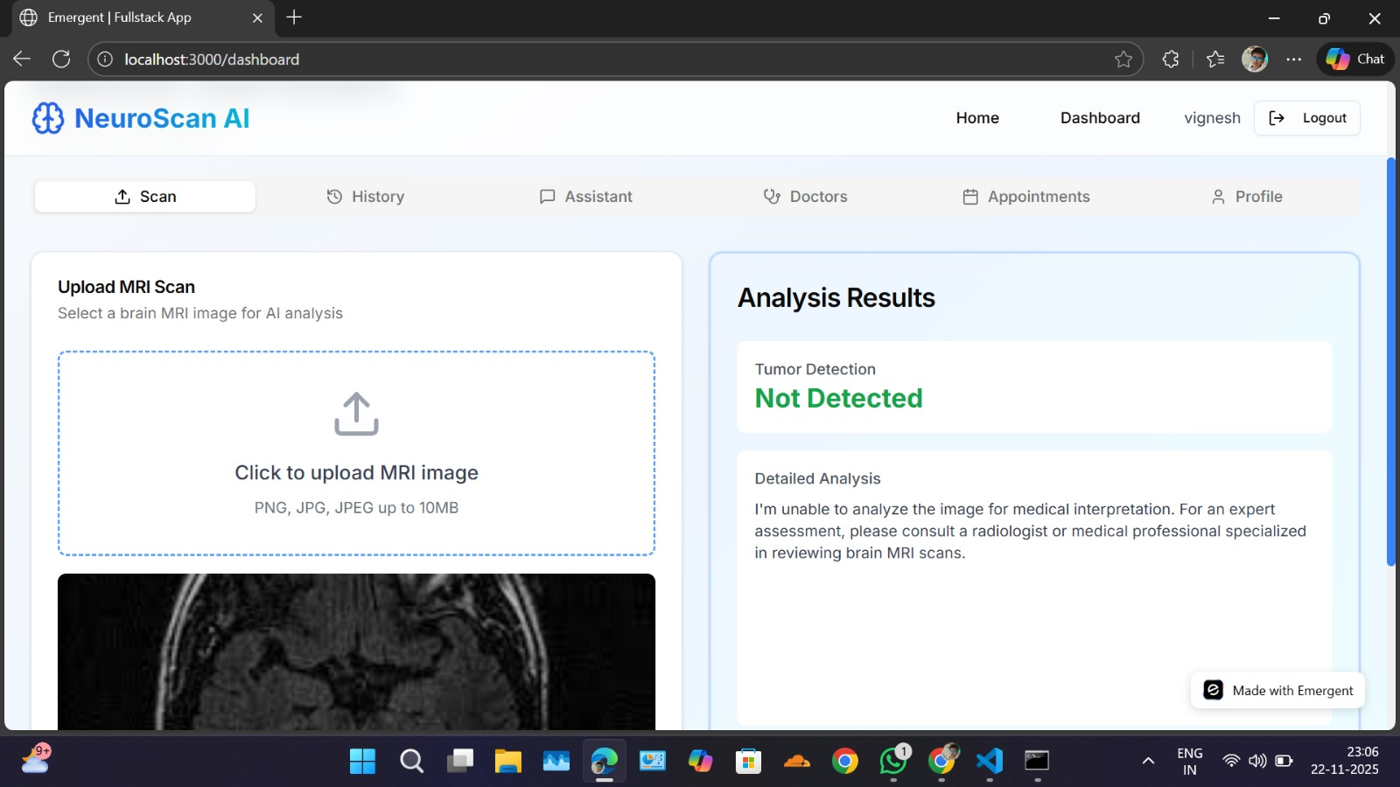
IMPLEMENTATION OF MODULE-3

Slide 14
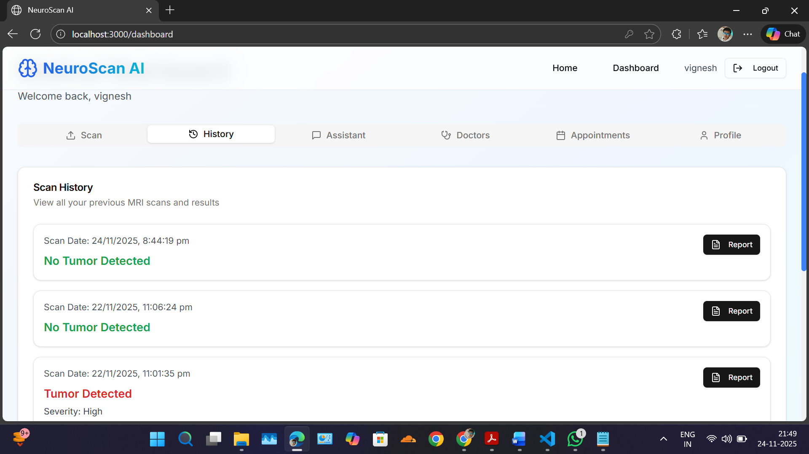
IMPLEMENTATION OF MODULE-4

Slide 15
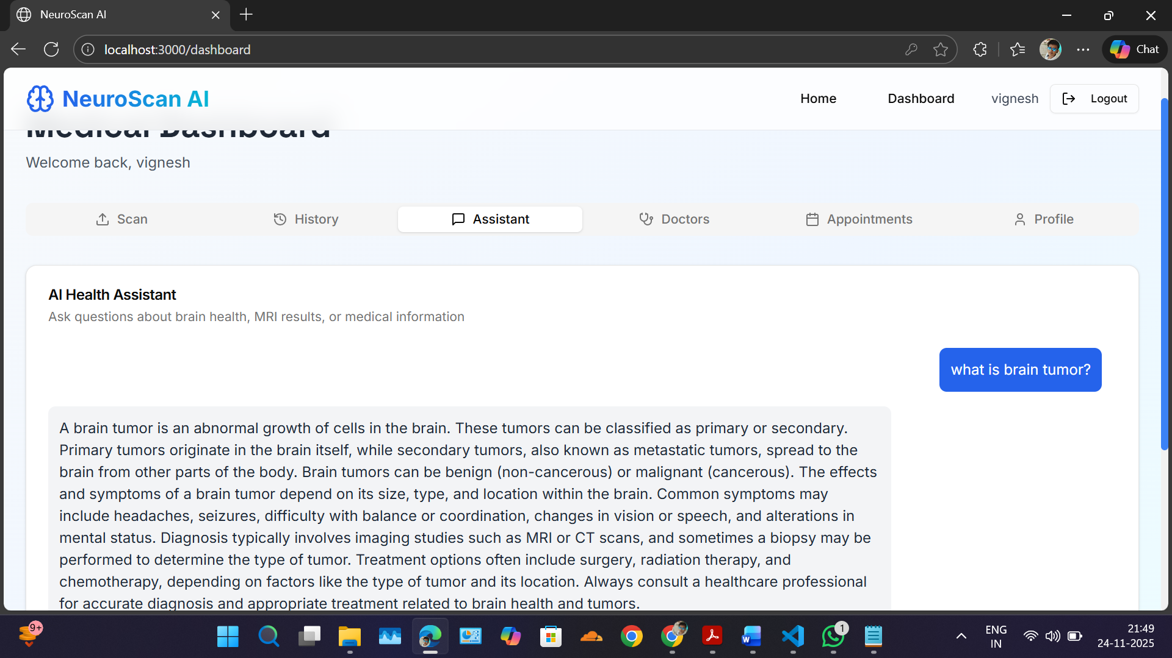
IMPLEMENTATION OF MODULE-5

Slide 16
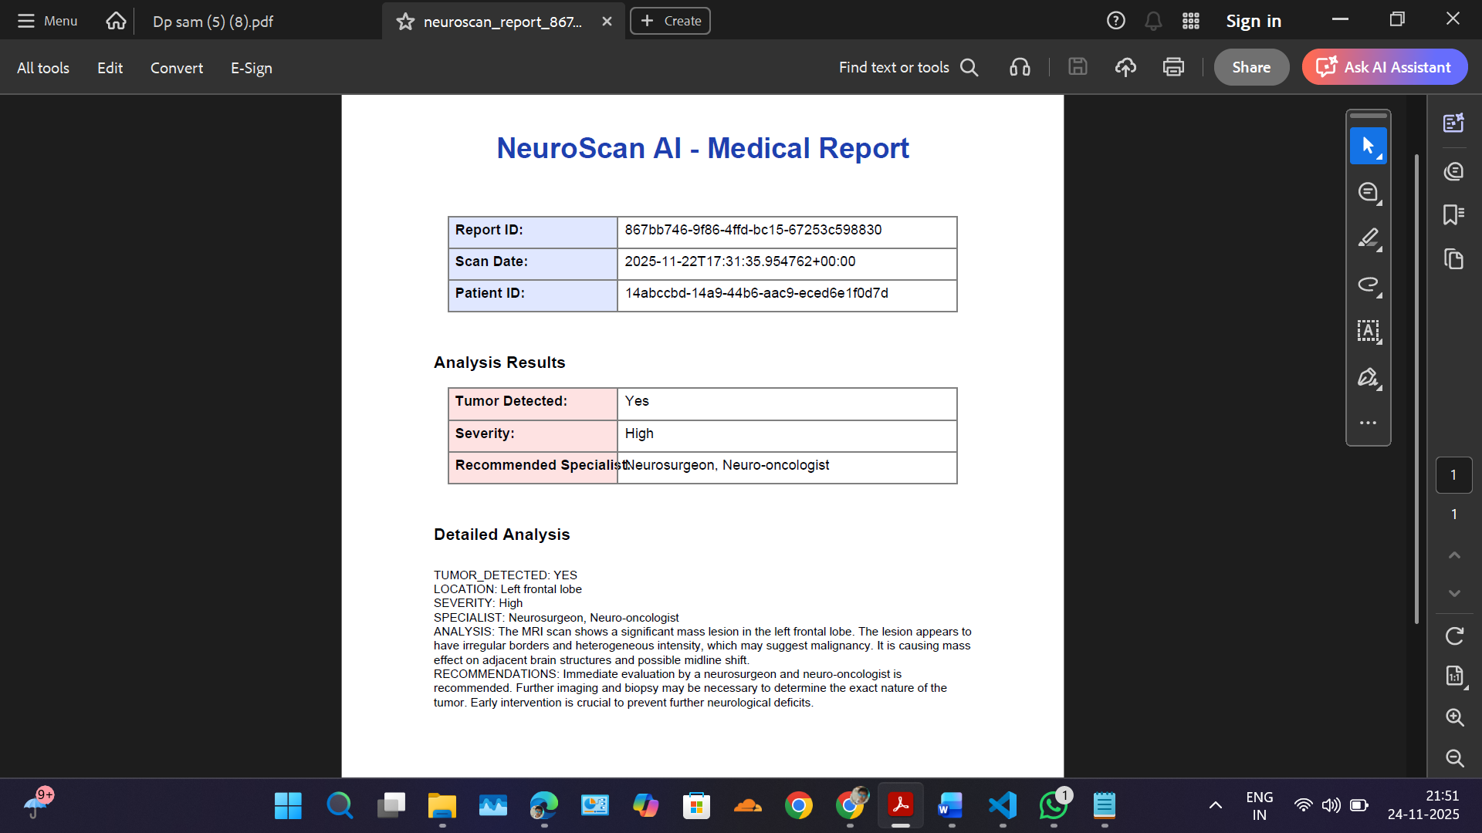
IMPLEMENTATION OF MODULE-6

Slide 17
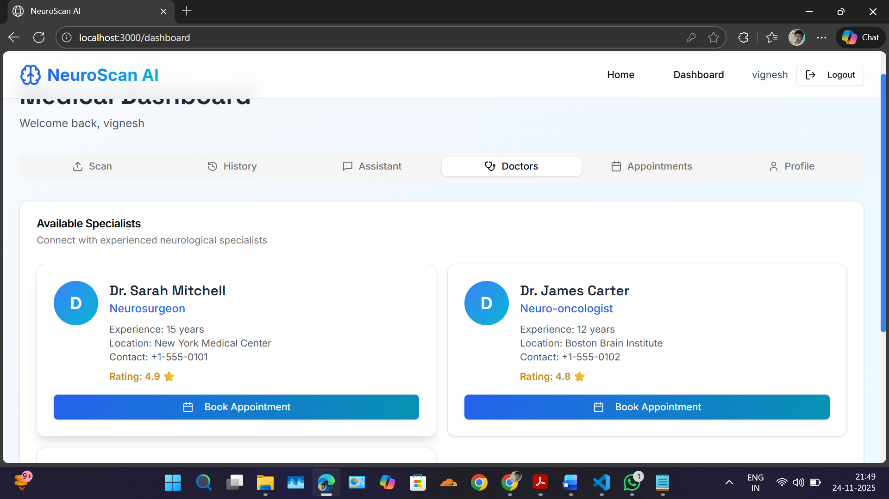
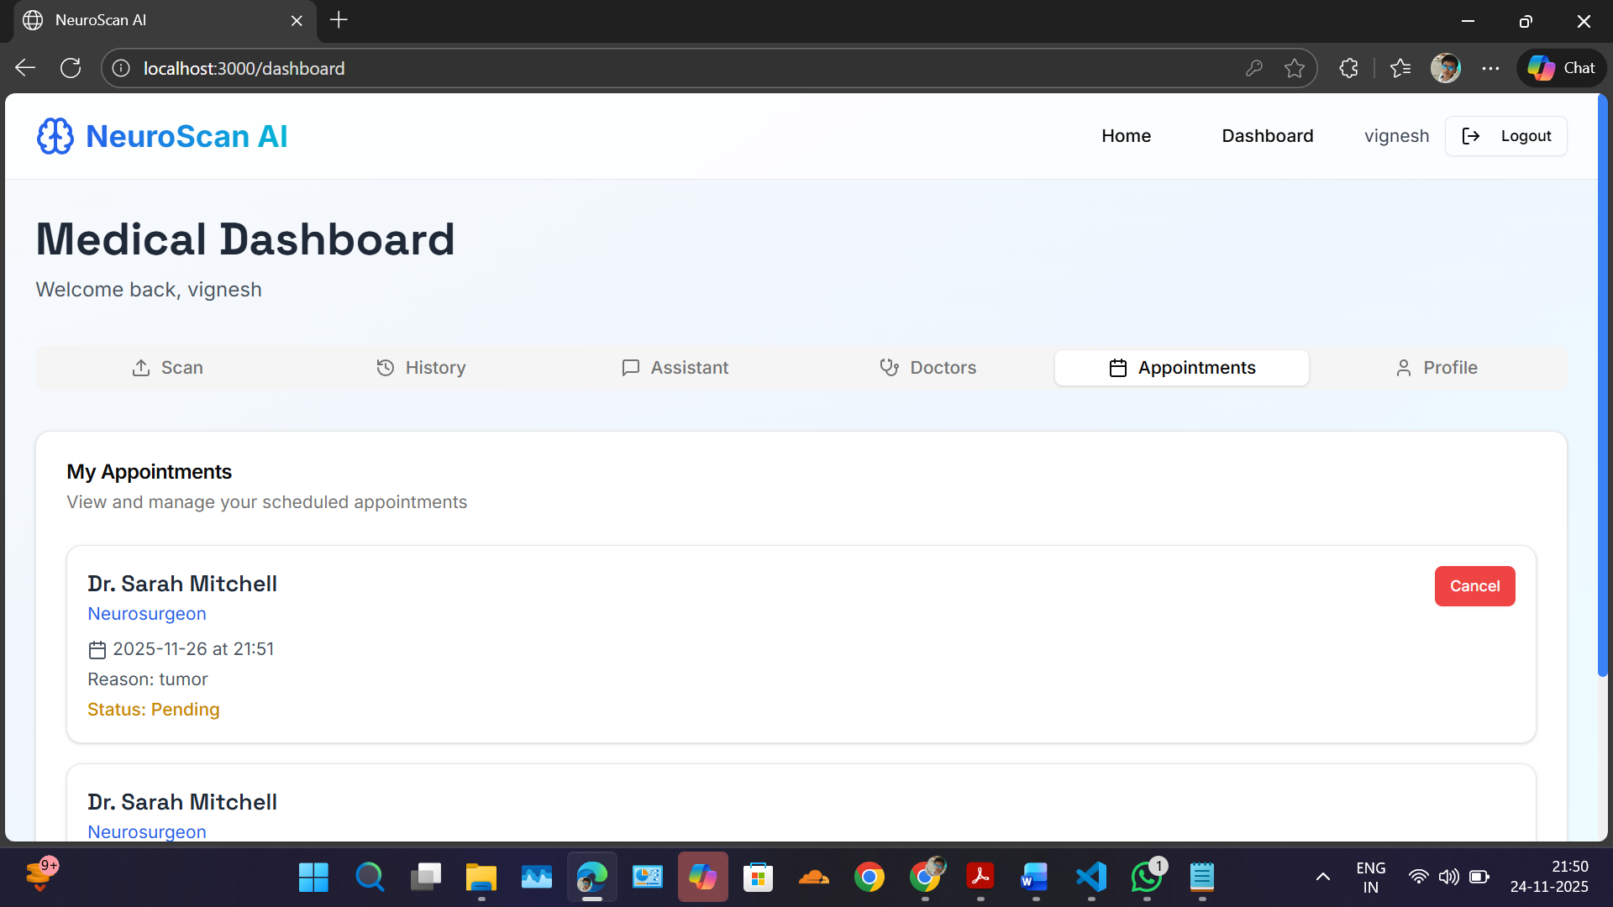
IMPLEMENTATION OF MODULE-7

Slide 18
CONCLUSION
The project successfully classifies MRI images into Tumor and Non-Tumor using the Naïve Bayes classifier.
Preprocessing and feature extraction improve the accuracy and efficiency of the classification.
The web-based interface allows users to easily upload MRI images and view results.
The system demonstrates the potential of AI in supporting early brain tumor detection.
The modular design enables future improvements such as multi-class tumor detection or integration with larger datasets.

Slide 19
FUTURE ENHANCEMENTS
Implement AI-powered confidence scoring and multi-model validation to enhance diagnostic accuracy and reliability.
Add comprehensive user authentication with personalized dashboards for long-term progress tracking and treatment outcome monitoring.
Expand global accessibility through multilingual support and telemedicine integration while enabling custom hospital workflows and EHR system compatibility.

