Slide 1
FITNESS AND MEDICAL
ADVISOR

Slide 2
TEAM MEMBERS
Vignesh Praveen
Zubaidhu Zeckariah
Vikram Kumar

Slide 3
Abstract :
Centralized management of patient medical records using a unique patient ID and QR code system.
Provides access to patients, family members, and doctors across multiple hospitals.
Features medication reminders, AI-driven health insights, and secure data handling.
Enhances patient care with streamlined communication, data access, and reminders.

Slide 4
Introduction :
Challenges in Healthcare :
Fragmented patient records across hospitals.
Difficulties in tracking appointments, prescriptions, and medical history.
Proposed Solution :
A mobile app to centralize health records, medication tracking, and family access.
Enables secure sharing of patient data with family and healthcare professionals.

Slide 5
Existing Systems :
Google Health & Apple Health :
General fitness and health data tracking with wearables.
Telemedicine Apps :
Apps like Practo enable remote consultations.
Electronic Medical Records (EMRs) :
Fragmented across hospitals, lacking inter-hospital access.

Slide 6
Existing Challenges :
Data Fragmentation : Incomplete view of patient history across different hospitals.
Lack of Real-Time Updates : Missing features like real-time medication tracking.
Family Involvement : Limited secure sharing of health data with family members.
Cross-Hospital Access : Privacy and infrastructure limitations prevent seamless access

Slide 7
Proposed System Features :
Cross-Hospital Access: Unique patient ID & QR code for data access across hospitals.
Family Member Involvement: Secure invitations to allow family access to patient data.
Medication Reminders: Custom notifications for prescribed medication schedules.
Centralized Health Data: Secure storage and access to medical records via app.
Advanced Security: 2FA, and role-based access control.

Slide 8
Further/Future Plans :
AI-Driven Health Insights: Predictive health analysis based on patient history.
Telemedicine Integration: Remote consultations with doctors.
Lab Reports Upload: Easy upload and access to medical test results.
Health Metric Tracking: Integration with wearable devices to log vitals.
Emergency SOS: One-tap emergency feature with location sharing.

Slide 9
Workflow :
Patient Registration: Signup using mobile number, email, and unique patient ID.
Data Entry: Doctors upload visit details into the system during each hospital visit.
QR Code for Doctors: Doctors scan QR code to access patient history.
Medication Reminders: App sends custom reminders based on the schedule input.
Family Invitations: Family members are invited via a link or QR code for data access.

Slide 10
Model Description :
Front-End:
User Interface for easy access by patients, family, and doctors.
QR Code Scanner for doctors to access medical records.
Reminder System for medication and appointments.
Back-End:
Centralized, Secured database.
Secure API integration for data syncing between hospitals and app.
Authentication and role management for secure access.
Security Features:
Two-factor authentication.
Role-based access control.

Slide 11
Conclusion :
Benefits: Centralized health management, improved patient-doctor communication, and enhanced family involvement.
Future Enhancements: Expand the integration with wearable devices and AI-driven health analytics for more personalized care.

Slide 12
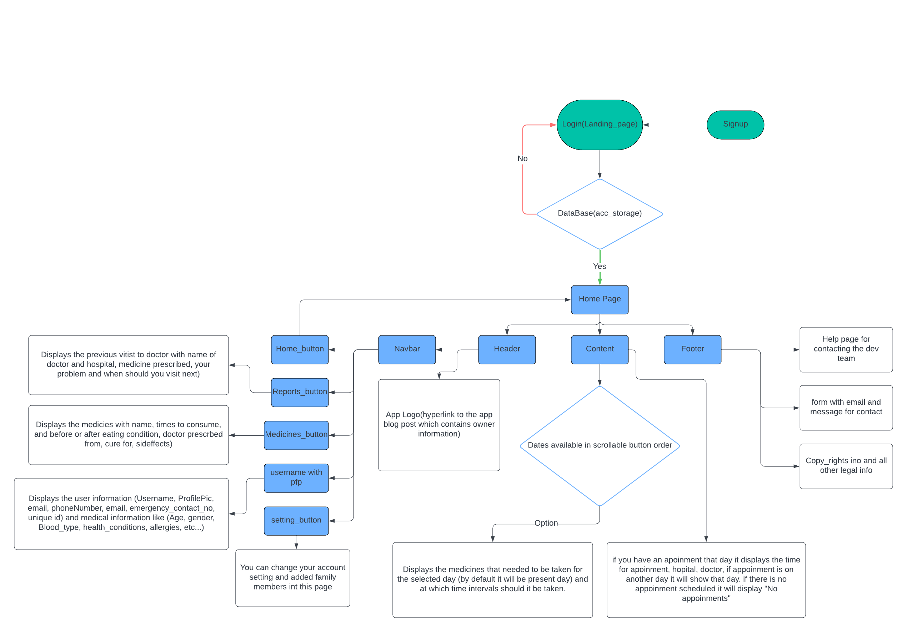
Flowchart :

