Slide 2
Introduction
The City of New York, is the most populous city in the United States. It is diverse and is the financial capital of USA. It is multicultural. It provides lot of business oppourtunities and business friendly environment. It has attracted many different players into the market. It is a global hub of business and commerce. The city is a major center for banking and finance, retailing, world trade, transportation, tourism, real estate, new media, traditional media, SPORTS, advertising, legal services, accountancy, insurance, theater, fashion, and the arts in the United States.

Slide 3
This also means that the market is highly competitive. As it is highly developed city so cost of doing business is also one of the highest. Thus, any new business venture or expansion needs to be analysed carefully. The insights derived from analysis will give good understanding of the business environment which help in strategically targeting the market. This will help in reduction of risk. And the Return on Investment will be reasonable.

Slide 4
Business problem
The City of New York has a huge population and major part of the population is young people and most of them are intrested in playing sports .With the increase in health conciousness people are more intrested in playing sports .So there is a great need of sports facility in the city. This is a good investment if one establish the facility in the right place. So we will try to find a best place to establish a stadium or a sport facility.

Slide 5
Find a suitable location
To be a bussiness successful ,we have to find a best place to establish. Here we are trying to find the best palce for a stadium or a sport facilty .Establishing a sport facility in a place wherethere is a compition is very risky,and also we should look to find a best place to find a place where there is a demand for sports and a place to find a econmical and risk free place to find profits.

Slide 6
Target Audience:
My Client wants to open his business in NewYork , so I only focus on that borough during my analysis. The objective is to locate and recommend to the management which neighborhood of Newyork city will be best choice to start a sports facility.
This would intrest people who wants to start a sports facility in NewYork.

Slide 7
Data
Data 1: Neighborhood has a total of 5 boroughs and 306 neighborhoods. In order to segement the neighborhoods and explore them, we will essentially need a dataset that contains the 5 boroughs and the neighborhoods that exist in each borough as well as the the latitude and logitude coordinates of each neighborhood. This dataset exists for free on the web. Link to the dataset is: https://geo.nyu.edu/catalog/nyu_2451_34572.

Slide 8
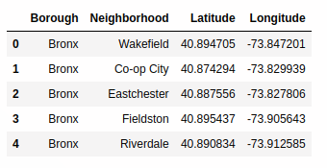

Slide 9
Data2: Newyork city geographical coordinates data will be utilized as input for the Foursquare API, that will be leveraged to provision venues information for each neighborhood.We will use the Foursquare API to explore neighborhoods in New York City.

Slide 10
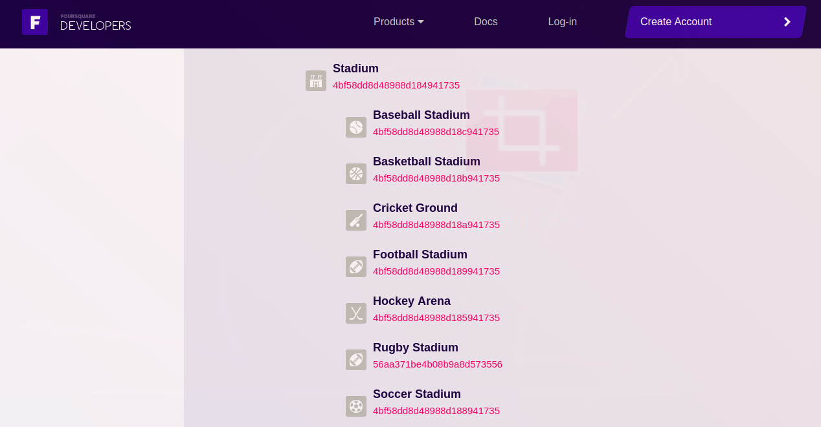

Slide 11
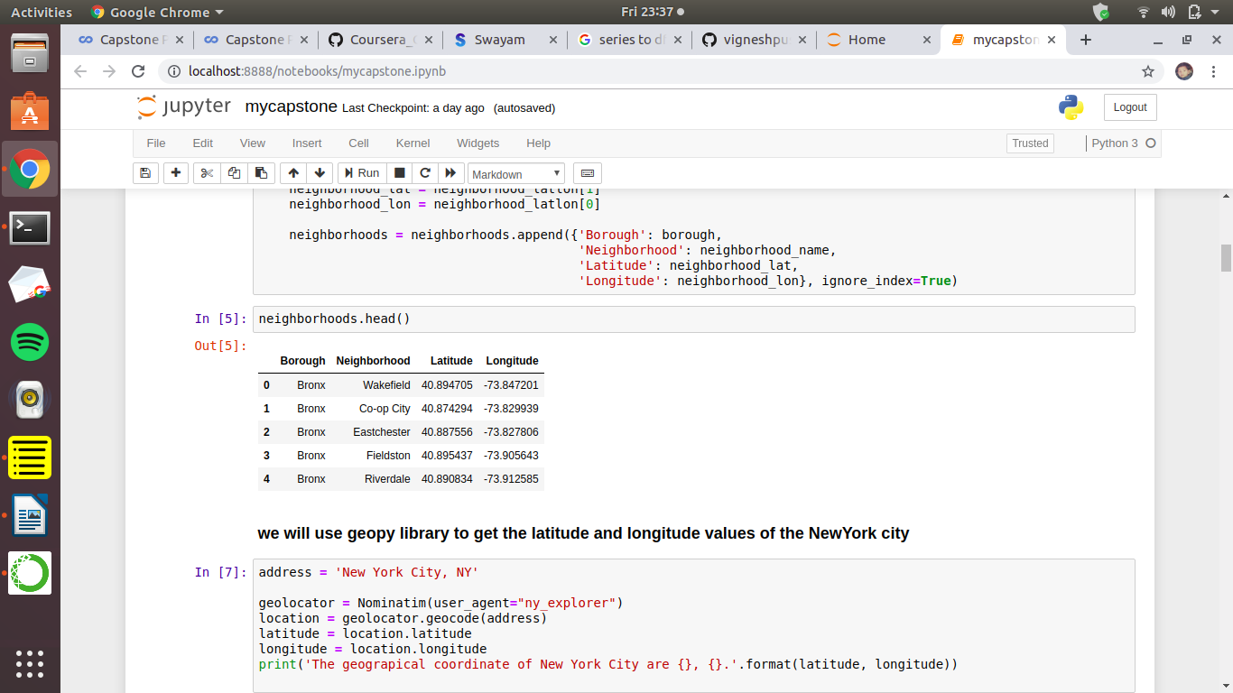
Methodology:
First we will convert data from the various resources into a dataframe

Slide 12
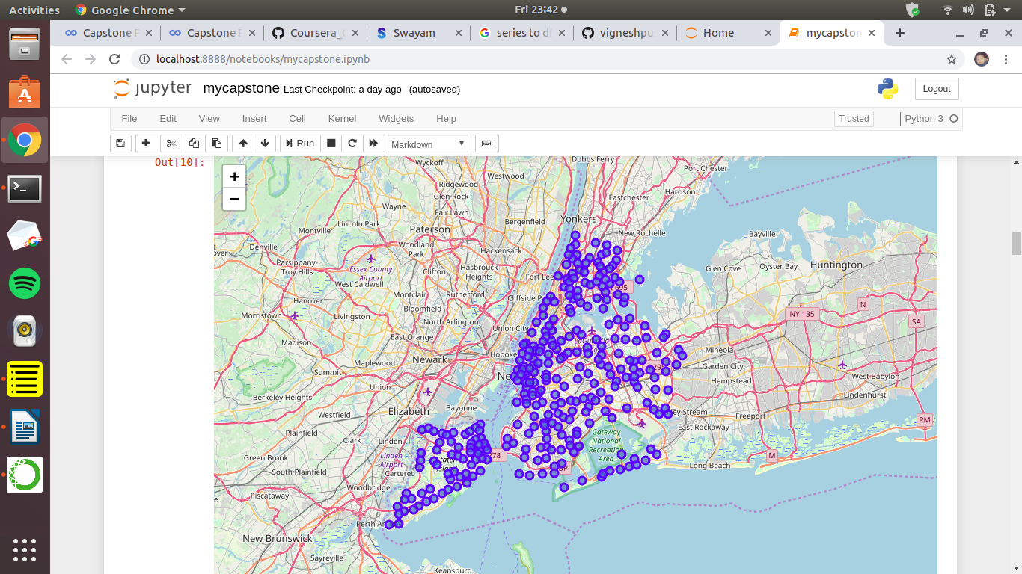
A MAP OF NEWYORK WITH NEIGHBORHOODS SUPER IMPOSED ON IT

Slide 13
FOURSQUARE
The data is taken from the foursqare.com
https://developer.foursquare.com/docs/resources/categories is the link to get the different catagories of resources in the newyork city
In this project we have taken Stadium as the categories and the Id of the Stadium is 4bf58dd8d48988d184941735
we retrive the data from the foursquare data using the Id and above data will be obtained.

Slide 14
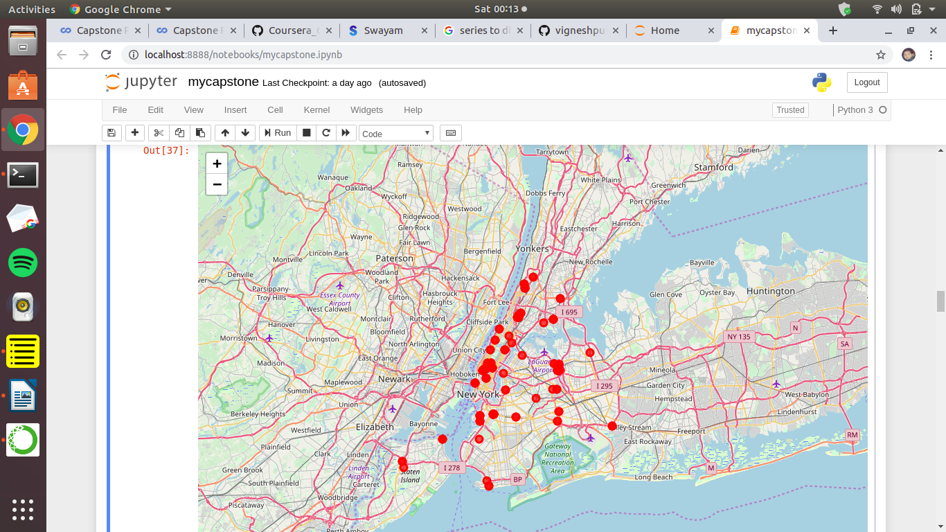
This is the map of newyork superimposing the places where the sports facilities are present.

Slide 15
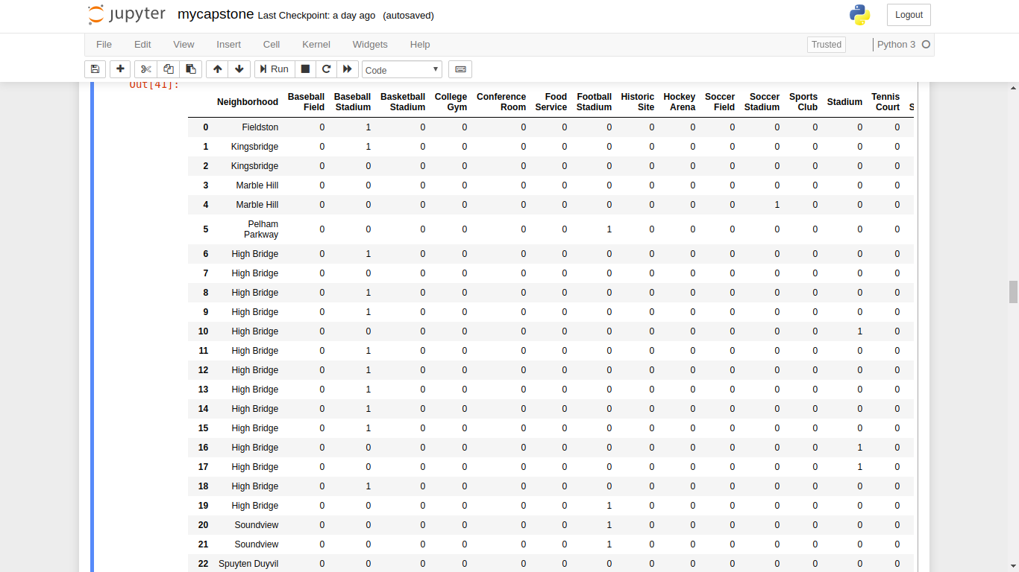
analyise each neighborhood

Slide 16
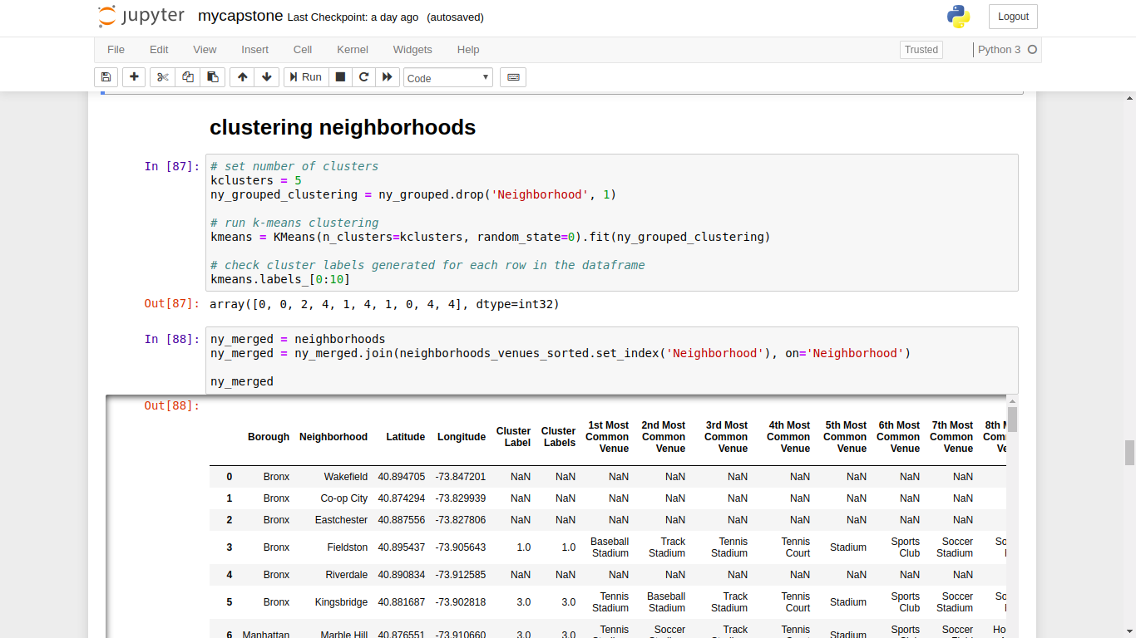
K-means clustering (machine learning algorithm)

Slide 17
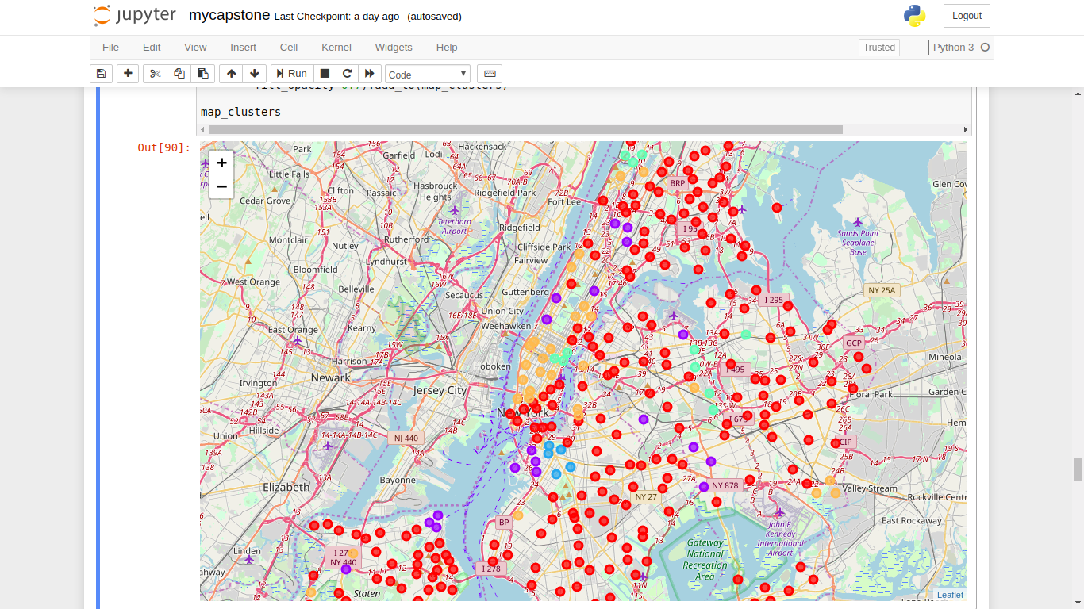
Clustering

Slide 18
RESULTS

Slide 19
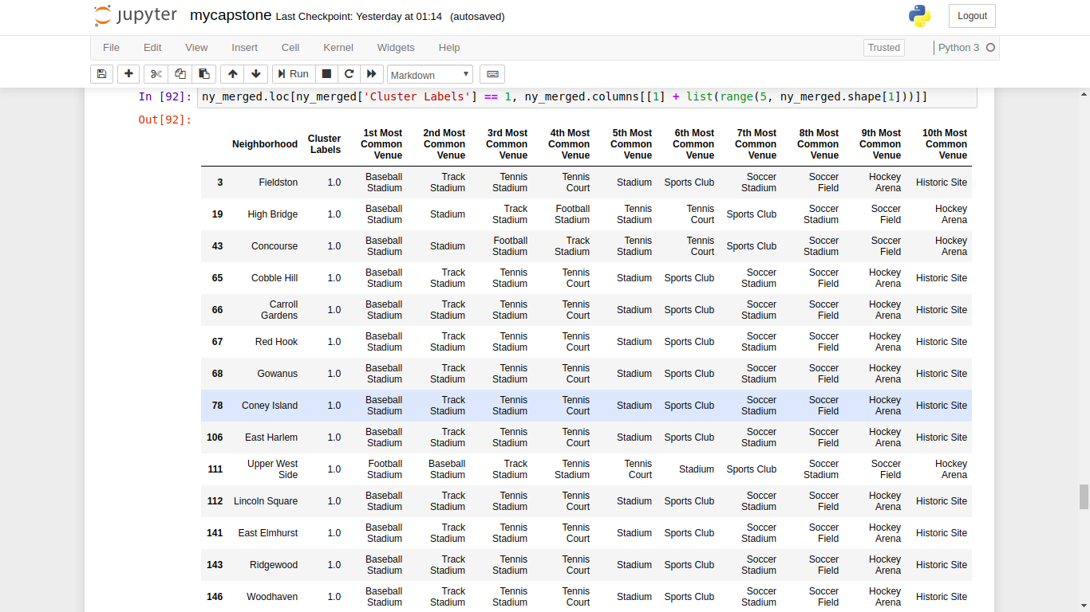
1st cluster

Slide 20
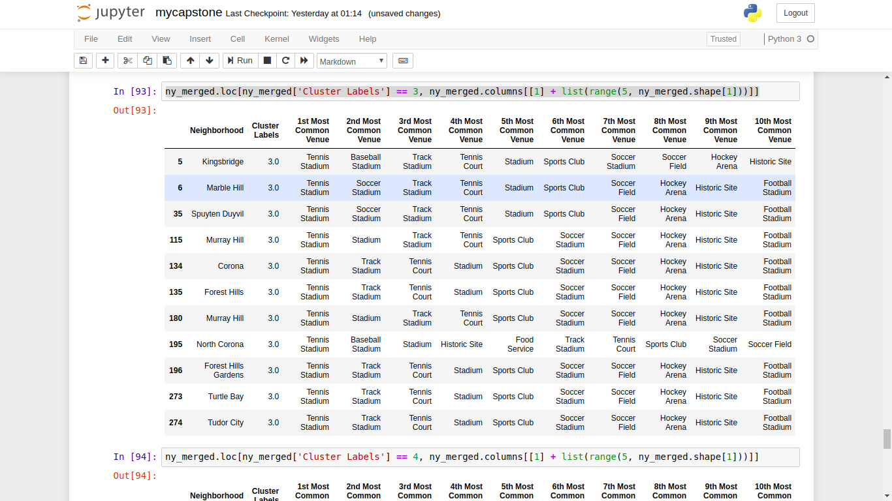
2nd cluster

Slide 21
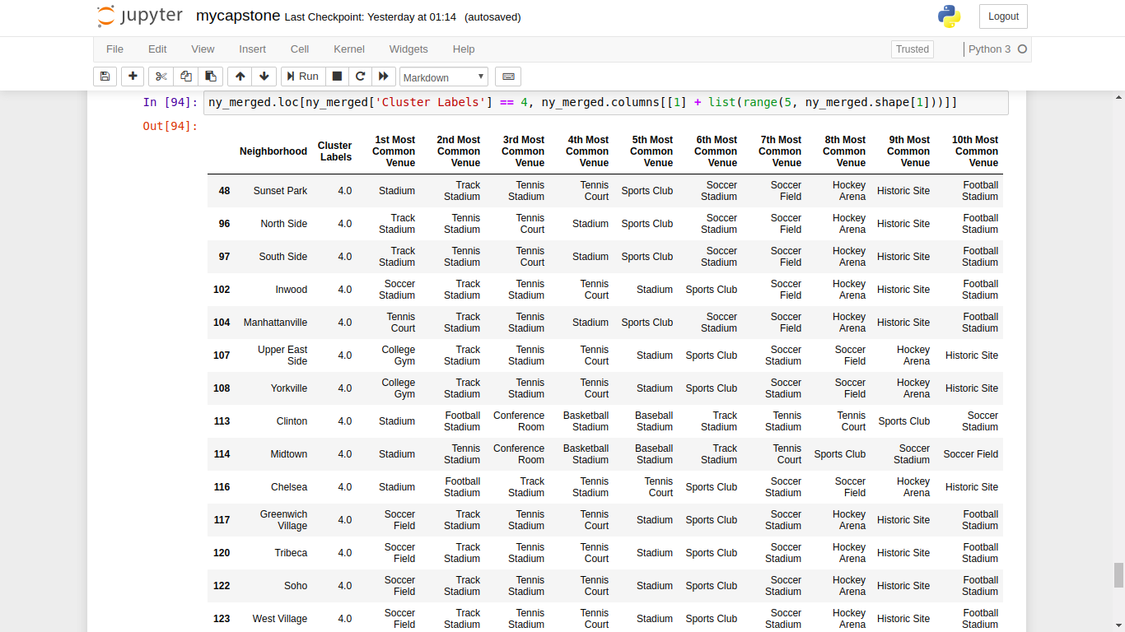
3rd cluster

Slide 22
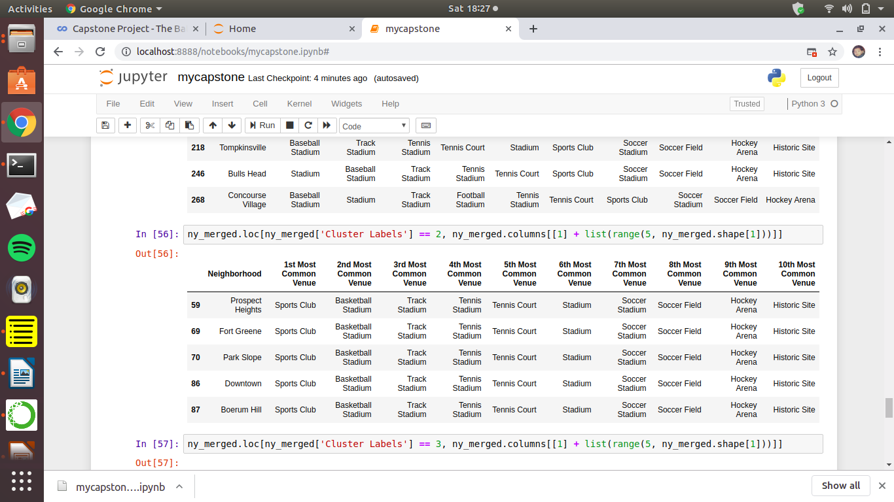
4th cluster

Slide 23
Final observation
Here we can observe the different common venues for the different clusters.By observing the clusters.
If my client want to build a football stadium then cluster 2 and 3 will be the best places where there is less competiton for the football stadium and there people are very intrested in participating in sports activities.

Slide 24
Discussion
In this section, I would be discussing the observations I have noted and the recommendation that I can make based on the results. This analysis is performed on limited data. This may be right or may be wrong. But if good amount of data is available there is scope to come up with better results.

Slide 25
There is high competition in Midtown and Soho so it is very risky to open business in these areas.
Central Harlem has also potential where closes to Morningside Heights area.
It can be done more detailed analysis by adding other factors such as transportation, demographics of inhabitants.

Slide 26
Conclusion
Although all of the goals of this project were met there is definitely room for further improvement and development as noted below. However, the goals of the project were met and, with some more work, could easily be devleoped into a fully phledged application that could support the opening a business idea in an unknown location.

