Slide 1
The Effect of Surface Temperature and Salinity on the Maximum Acidification of Ocean Water by Carbon Dioxide Dissolution
by Vignesh Rajmohan

Slide 2
Introduction
The amount of carbon dioxide emitted into Earth’s atmosphere is increasing substantially every year. This carbon dioxide is brought into the atmosphere and is also absorbed by oceans. So far, the ocean has absorbed half of all carbon dioxide released to the atmosphere since the beginning of the Industrial Revolution. (Ocean Acidification Nat) When the water absorbs carbon dioxide, it converts it to form carbonic acid. (Ocean Acidification.) This reaction increases the acidity of the water. The increased acidity harms creatures living in the ocean by deteriorating shells and causing differences in organism size, metabolic activity and growth rates during blooms. (Stories.)

Slide 3
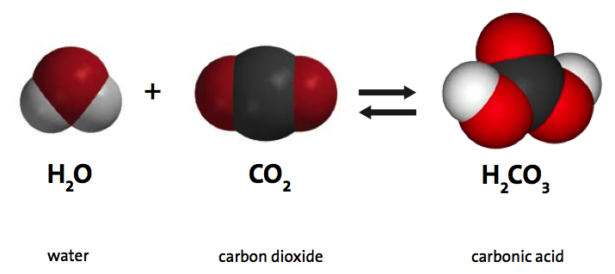
Introduction Cont.
This poses as a threat to the food web, which can cause a multitude of problems. It is interesting to research this topic because of its magnitude and global problem-causing potential. When carbon dioxide is dissolved in water, it reacts with water molecules to produce carbonic acid. This makes the water acidic. It can be visually observed using a universal pH indicator.
A pH indicator is a mixture of several special chemical compounds that is added in small amounts to a solution so that the pH (acidity or basicity) of the solution can be determined visually.

Slide 4
Introduction Cont.
The ocean’s salinity that is generally expressed as Parts Per Thousand (ppt) varies throughout the ocean. The Atlantic Ocean’s salinity is the highest between North America and Africa as well as South American and Africa. Ocean salinity ranges from 28-38 ppt. Generally, salinity values are lower close to the north and south poles. The ocean’s temperature varies depending on the location. The temperature of the ocean gets higher as one goes closer to the equator. Ocean temperatures range from 33 – 86 degrees Fahrenheit. (Note: Colder than 32 degrees F will form ice.)

Slide 5
Introduction Cont.
Corals and coralline algae are being deteriorated because of ocean acidification. Their enamels are fading away and reefs are deteriorating. Scientists predict that it will not be long before all of the coral reefs are deteriorated and gone. These creatures are one of the starting points of the enormous food web in the ocean. Aragonite, the material that the pteropods use to build their shells, is becoming weaker and more brittle, because of ocean acidification. (The Dangers) Several other sea creatures with shells are losing shell quality and in turn, are starting to die out. The loss of these creatures will lead to a terrible disaster in the food web. Plankton is also another key element in the food web. Ocean acidification is going to have major impacts on plankton physiology and cause differences in organism size, metabolic activity and growth rates during blooms. This will lead to problems in the food web.

Slide 6
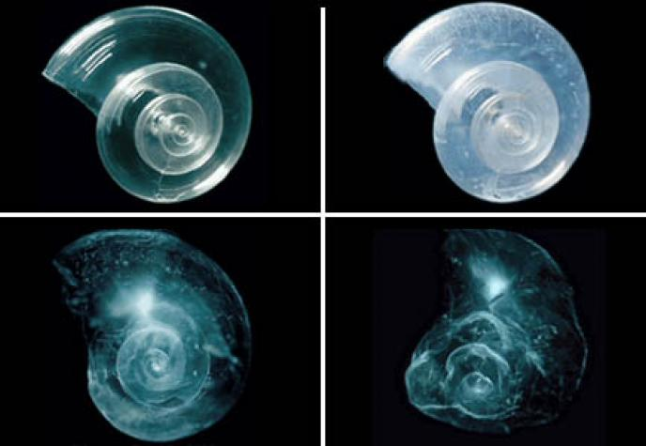
Introduction Cont.
Any acid can be neutralized through the usage of a base. This method can be used to quantify the level of acidity with help of a pH indicator. Using a basic solution, one can record the amount needed to neutralize the acid, which then quantifies the acidity of a solution. This method is a lot more accurate than the usual color matching method because scientists are able to count the amount of drops needed to neutralize a solution. This amount of drops can be recorded to give the scientist numbers that can be used to make proper calculations. Usually, a conventional dropper is used to complete this process.
The Effect Of Ocean Acidification on a Sea Butterfly (Ocean.)

Slide 7
Introduction Cont.
The varying temperatures and salinities of ocean water from around the world might plays a role in the amount of CO2 that can be absorbed by that part of the ocean. If patterns could be found to those amounts and the carbon dioxide dissolution limit, then one could create a diagram of the world’s oceans and display where the most carbon dioxide could be absorbed, which also leads to where the most damage will be caused because of the maximum amount of ocean acidification. This will be of great use to several people because of this diagram’s importance to finding out the safety and survival of the creatures of the different parts of the ocean.

Slide 8
Testable Question
Does the carbon dioxide absorption potential of salt water change depending on the salinity and the surface temperature?

Slide 9
Variables
The independent variables are the salinity of the water and the temperature of the water
The dependent variable is amount of carbon dioxide absorbed (the amount of baking soda solution needed to neutralize the acidic water)
The controlled variables are the weights of the materials, the temperature during the salinity experimentation, the salinity during temperature experimentation, and the atmospheric air pressure

Slide 10
Hypotheses
If the temperature of ocean water is increased, then the oceans water’s potential carbon dioxide absorption amount increases.
If the salinity of ocean water is increased, then the oceans water’s potential carbon dioxide absorption amount increases.

Slide 11
Materials and Methods
The materials used to complete this experimentation consist of chemicals and tools. The chemicals used were de-ionized water [H2O], baking soda [NaHCO2], salt [NaCl], dry ice (for carbon dioxide [CO2]), and a universal pH indicator. The tools used were 2 thermometers, a measuring cup, 19 beakers, flasks, and bottles, an electronic kitchen-weighing machine (grams), an oven, a refrigerator, a syringe, a pipet, a TI-84 Plus Silver Edition Graphing Calculator, a funnel, a pad, pen and 15 data collecting tables, a pair of safety glasses, and an iPhone app for color detection (RGB).

Slide 12
Materials and Methods cont.
In order to complete this experimentation, one must first prepare 28, 34, and 38 ppt (parts per thousand) saline water solutions by taking 4.2g, 5.1g, and 5.7g, respectively, of sea salt in 150g of deionized water. Then he/she must prepare 5 ppt baking soda solution by taking 0.75 g of baking soda in 150g of deionized water for neutralizing acid solutions. Then one must take a clear bottle and add 10 g of prepared 28 ppt saline water. Name this bottle #1. Similarly, prepare another 3 bottles with 10 g of 28 ppt saline water in each bottle and name these bottles #2, #3, and “Control”. Then the experimenter should add 2 drops of universal pH indicator in each bottle. Shake the bottles individually to mix the universal pH indicator thoroughly. Notice that the color is close to green (pH = 7) at this stage in each bottle. The solutions should be kept at room temperature (70 F) for 30 minutes.

Slide 13
Materials and Methods cont.
Now one must add 2 g of dry ice in bottle #1, #2 and #3 and shake it well for a few seconds, then notice the color change as the solution turns from neutral to an acid. The experimenter must remember not to add dry ice in the 4th (Control) bottle and use this bottle for referencing color in the following steps (pH is close to 7). At this stage the pH is close to 2 in bottles #1, #2 and #3. One must then measure the weight of bottle #1. Add the baking soda solution little by little and shake the solution at the same time till the solution changes color to the original pH 7 color (green). The experimenter should then compare the color of Control bottle for reference. He or she must then use the RGB iPhone app for an exact color comparison and note down the weight of the added baking soda solution. He or she must then repeat the step 8 for bottle #2 and #3 and record the weights of the baking soda solution in each bottle.

Slide 14
Materials and Methods cont.
The experimenter must then repeat the steps 3 to 10 for the rest of the salinities and temperatures. A total of 36 experiments will be completed by the end of the experimentation. Also, the reasons for the certain salinities used are because of the actual salinities of parts of the ocean. The reasons for the certain temperatures used are because of the temperatures needed to get a good spread of the temperatures in the ocean to create a convenient graph for extrapolation and interpolation.

Slide 15
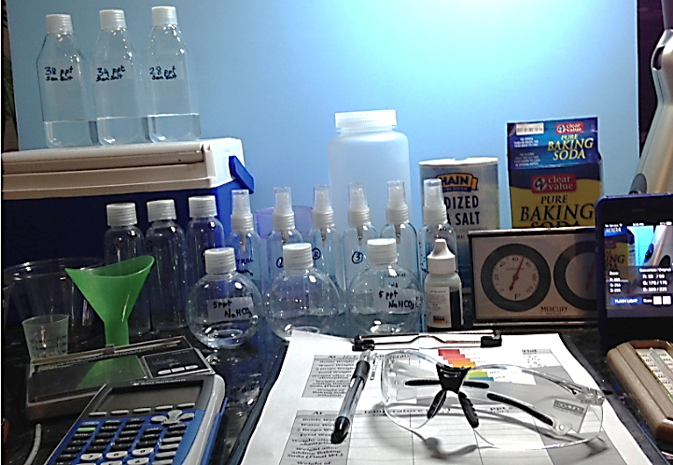
Experimental Setup

Slide 16
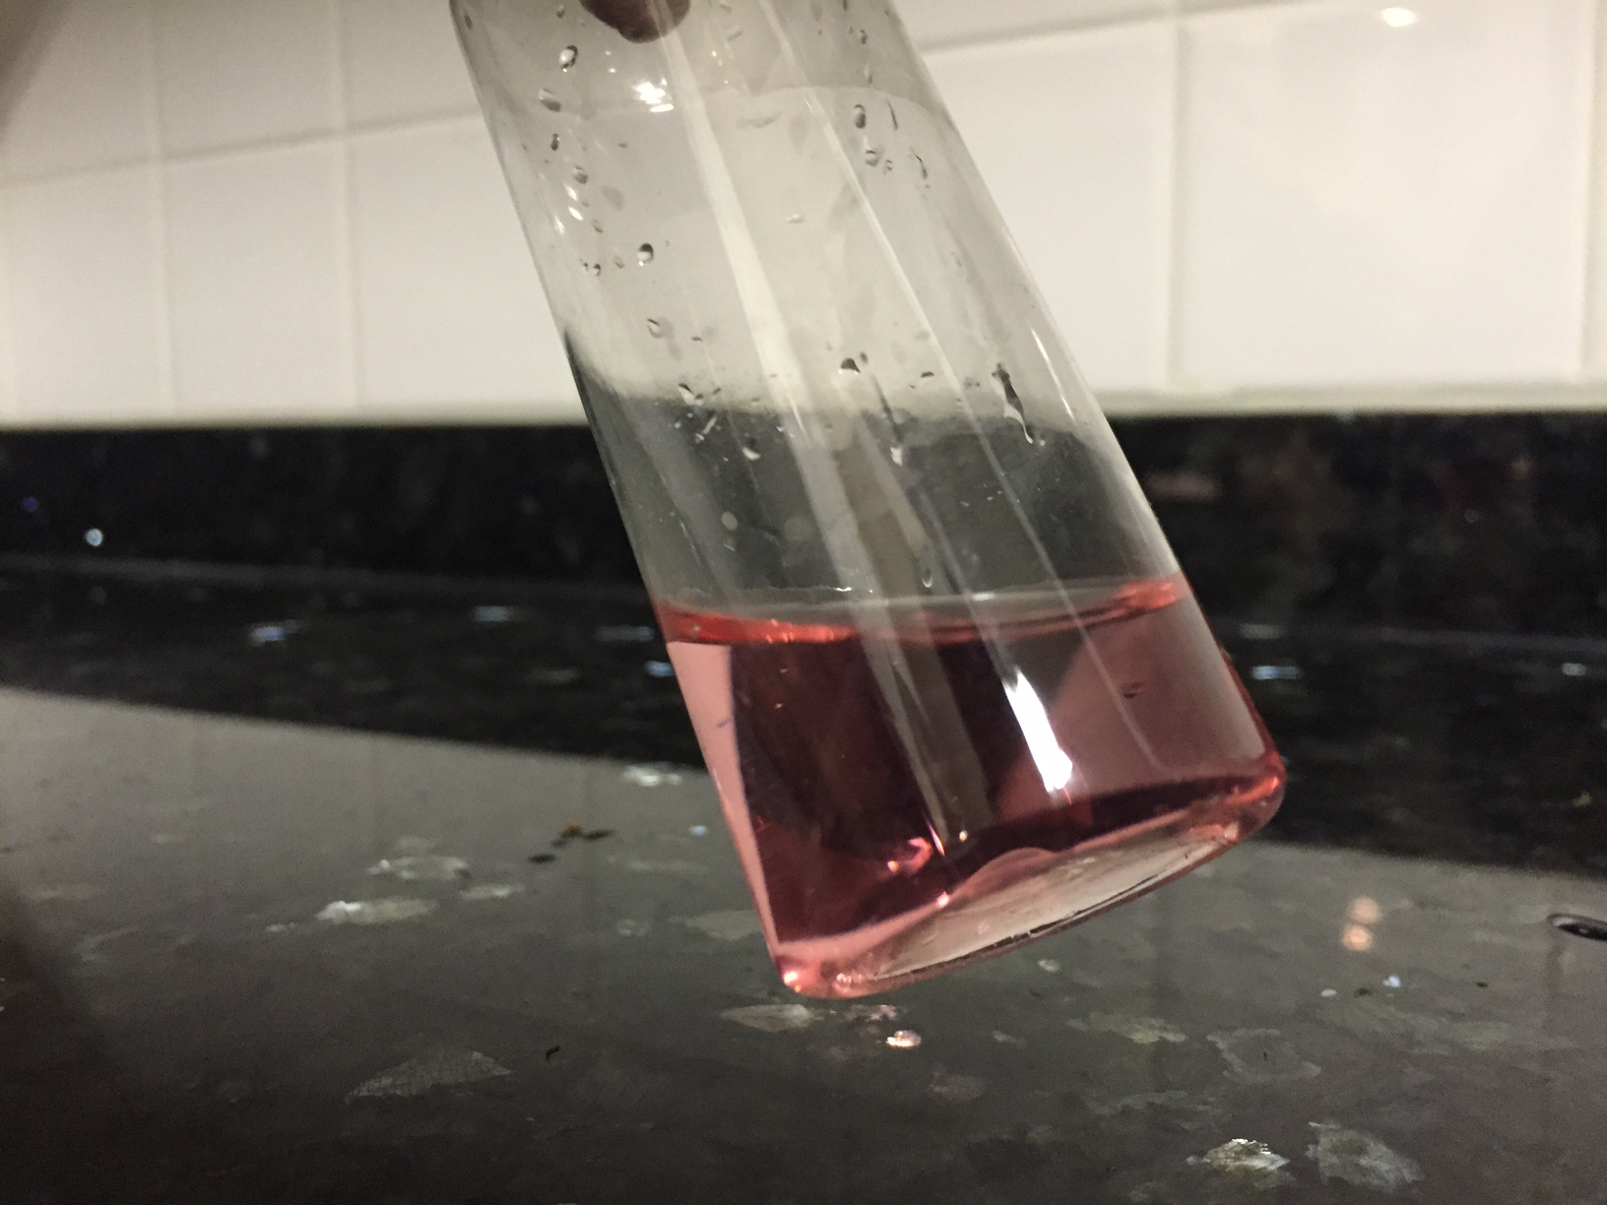
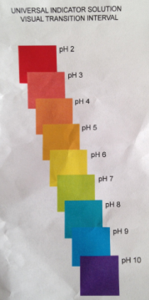
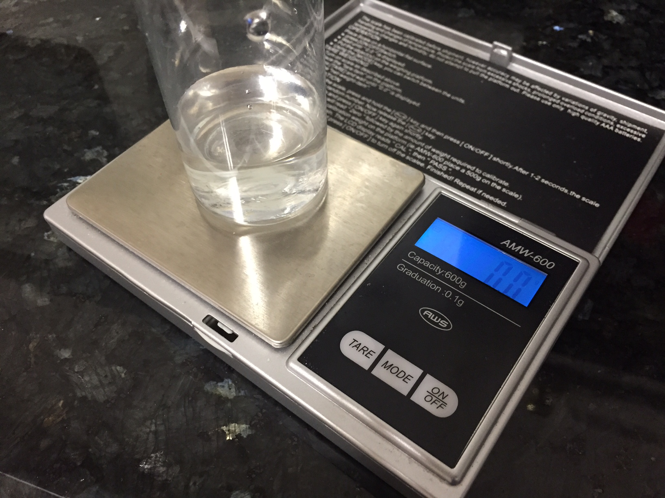
Carbon Acid
pH Indicator
Using the Electronic Balance

Slide 17
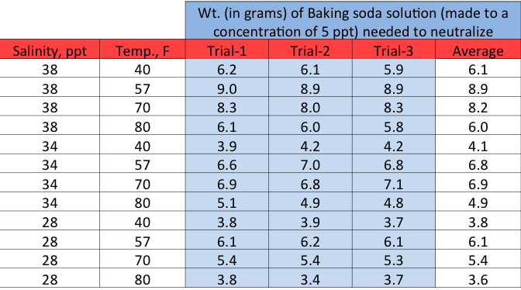
Results

Slide 18
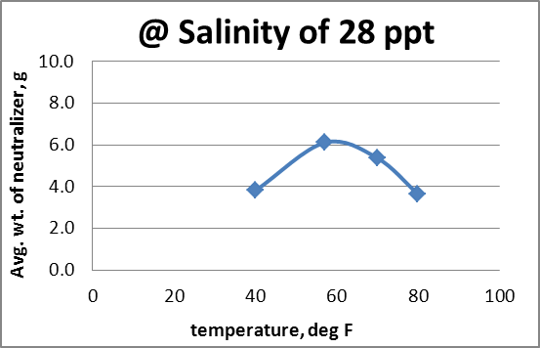
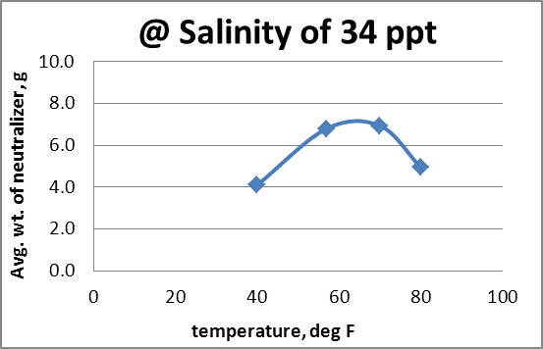
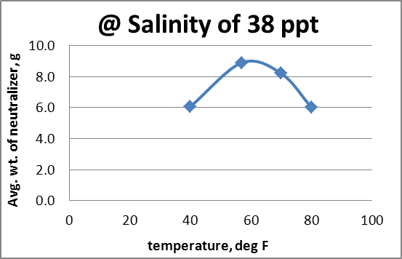
The Effect of Various Temperatures on the Amount of Neutralizer Needed to Neutralize the Liquid Given (Maximum Acidification of Ocean Water by Carbon Dioxide Dissolution)

Slide 19
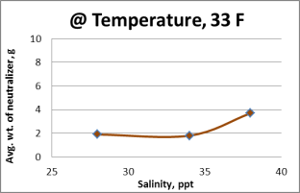
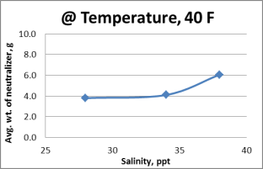
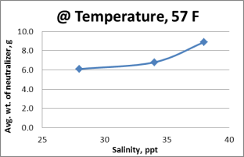
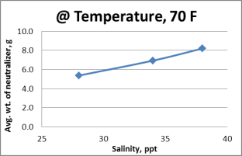
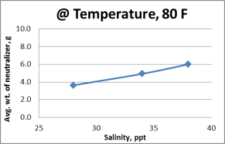
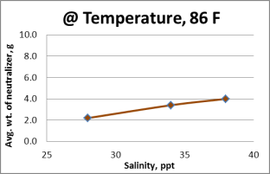
The Effect of Various Salinities on the Amount of Neutralizer Needed to Neutralize the Liquid Given (Maximum Acidification of Ocean Water by Carbon Dioxide Dissolution)
Experimentally, the weight of neutralizer was determined at temperatures 40° F, 57° F,
70° F & 80° F. Then the data was extrapolated to 33° F and 86° F

Slide 20
List of Quadratic equations derived by curve fitting the weight (in grams) of baking soda solution (5 ppt) used to neutralize the acidity created by dissolved CO2 in solutions of various salinity at various temperatures
Equations @ constant salinity
Equations @ constant temperature
y = -0.0059x² + 0.7073x - 14.977
@ 28 ppt
y = 0.0492x² - 3.065x + 49.173
@ 33° F
y = 0.0442x² - 2.6883x + 44.447
@ 40° F
y = -0.0064x² + 0.7927x - 17.405
@ 34 ppt
y = 0.0408x² - 2.415x + 41.707
@ 57° F
y = -0.0073x² + 0.875x - 17.243
@ 38 ppt
y = 0.0056x² - 0.0833x + 3.3444
@ 70° F
Here:
y = wt. of baking soda solution.
x = Temperature in degree F
y = 0.005x² - 0.0933x + 2.3267
@ 80° F
y = -0.005x² + 0.51x - 8.16
@ 86° F
Here:
y = wt. of baking soda solution.
x = Salinity in ppt

Slide 21
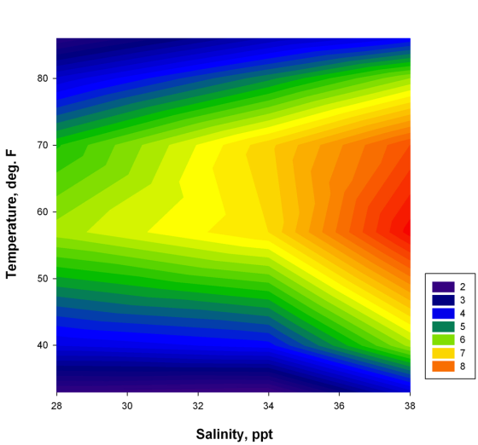
The Effect of Surface Temperature and Salinity on the Amount of Neutralizer Needed to Neutralize the Liquid Given (Maximum Acidification of Ocean Water by Carbon Dioxide Dissolution)
Neutralizer weight in gram

Slide 22
Results cont.
The data table shows that the combination of a salinity of 38 ppt and a temperature of 57 degrees Fahrenheit has the highest carbon dioxide absorption potential of all of the tested combinations. The combination with the lowest carbon dioxide absorption potential is 28 ppt salinity and a temperature of 80 degrees Fahrenheit. The graphs where salinity was the independent variable show that as salinity goes up, the amount of baking soda needed to neutralize the acidic solution goes up as well. The graph that uses salinity as the independent variable shows that as the temperature reaches a middle point of around 60 degreed F, the amount of carbon dioxide the ocean water absorbs goes up. There are two graphs that aren’t straight from the data that are extrapolated from the data collected. Interpolation and extrapolation use data and patterns to calculate the numbers in between data points and outside of data points. This makes use of math to get rid of the need for more experimentation, although the more experiments the better. The 3-D graph shows that as temperature reaches a middle point and as salinity goes up, the potential carbon dioxide absorption amount goes up as well.

Slide 23
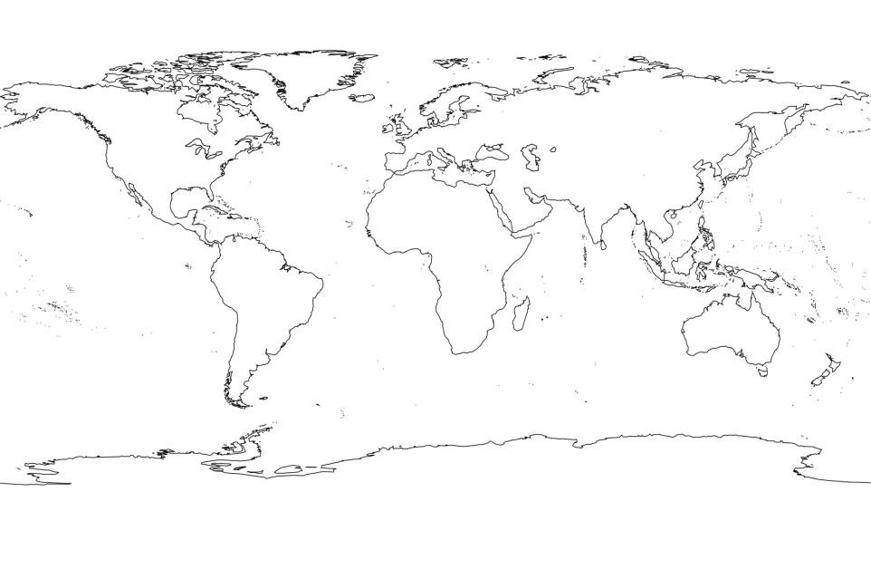
Locations, where oceanic water could potentially become more acidic when the atmospheric concentration of CO₂ increases
Very high acidity
high acidity
Moderate acidity

Slide 24
Discussion and Conclusions
The results show that as temperature reaches a middle point and as salinity goes up, the potential carbon dioxide absorption amount goes up. Using the information derived from the data collected, one may be able to fuse it with that of a world map. Using information already available regarding the salinity and surface temperature of certain parts of the ocean, one may be able to make a world map that shows scientists how high acidity levels can get in certain regions of the ocean. For example, this may help biologists know where to focus their efforts on protecting the marine life in the water, rather than wasting their time in an area that might not ever get acidic enough to kill anything. The experimentation also concludes that neutralizing using a baking soda solution provides an excellent way for quantifying the acidity levels of a liquid. The hypothesis was also disproven because of the results received for temperature affecting the absorption potential. Rather than the potential carbon dioxide amount that could be absorbed in ocean water increasing with the rise of the temperature, the potential amount peaked at around 60 degrees F and decreased as the temperature decreased or increased from 60 degrees F.

Slide 25
Discussion and Conclusions
These experiments takes very long time, it is better to plan very well to avoid time crunch before the deadline. A few more temperature points can be tested to increase the accuracy of the predictions. An error that may have occurred would probably be the maintenance of the certain temperatures during testing. After about 2 minutes of being in room temperature, the temperatures may have changed a small amount from what they originally were. Using that data, a contour world map of maximum carbon dioxide dissolution can be made (in terms amount of baking soda needed to neutralize). Similar to this experiment, ocean samples can be taken from various parts of the world and can be experimented on to predict the maximum acidity due to CO2 dissolution accurately. Scientists, using this experimentation, can proactively find out where there will be problems in aquatic life, and concentrate efforts for the remediation of the area.

Slide 26
Abstract
The varying temperatures and salinities of ocean water from around the world might plays a role in the amount of CO2 that can be absorbed by that part of the ocean. If patterns could be found to those amounts and the carbon dioxide dissolution limit, then one could create a diagram of the world’s oceans and display where the most carbon dioxide could be absorbed, which also leads to where the most damage will be caused because of the maximum amount of ocean acidification. To test this question, solutions with various salinities (28, 34 and 38 ppt) were prepared. Dry ice was added to the solutions to find the maximum CO₂ dissolution by identifying or measuring the pH using the pH indicator.

Slide 27
Abstract Cont.
Then the acidic solution was neutralized using baking soda and weighed to quantify the amount of baking soda dissolved. Then those steps are repeated at these temperatures (40, 57, 70 and 80° F) for each salinity to understand the dependency of temperature. Then using the data, plots are made to locate the maximum acidification by carbon dioxide in the oceans of the world. In general the results stated that as salinity rises, the amount of carbon dioxide that can be absorbed by the ocean rises. As temperature reaches a medium temperature at around 60 degrees Fahrenheit, the ocean water reaches its highest absorption potential. As temperatures get farther away from about 60 degrees Fahrenheit, the carbon dioxide absorption potential decreases.

Slide 28
References
Ocean. (n.d.). Retrieved February 26, 2015, from http://www.nrdc.org/oceans/acidification/
Ocean Acidification. (n.d.). Retrieved February 26, 2015, from http://ocean.si.edu/ocean-acidification
Ocean Acidification Nat Geo -- National Geographic. (n.d.). Retrieved February 26, 2015, from http://ocean.nationalgeographic.com/ocean/critical-issues-ocean-acidification/
Stories. (n.d.). Retrieved February 26, 2015, from http://www.pmel.noaa.gov/co2/story/OceanAcidification
The Dangers of Ocean Acidification. (n.d.). Retrieved February 26, 2015, from http://www.scientificamerican.com/article/the-dangers-of-ocean-acid/

