Slide 1
Comparing Antioxidants Using an Oscillating Chemical Reaction

Slide 2
Abstract
The Briggs-Rauscher Oscillating Chemical reaction once started with colorless solutions repeats colors from light yellow to amber to purple. The change of color depends on the free radicals and different form of Iodine present in the reaction mixture. Adding antioxidants affects the chemical changes by reacting with free radicals and thereby delaying the color change. Using this technique a comparative method was devised to evaluate the amount of antioxidants in commonly available juices on the market. Among the juices tested, 100% Pomegranate juice from POM Wonderful contained the most antioxidants compared to Tropicana Ready to Shine Orange juice, Ocean Spray Cranberry juice and Bolthouse Farms 100% Carrot juice.

Slide 3
Variables
Independent Variable:
The presence and amount of antioxidants from different types of juices added to the oscillating chemical reaction.
Dependent Variable:
The time taken for the first appearance of the purple color after initiating the oscillating chemical reaction.
Constants:
Amount of chemicals and their initial concentrations used for creating Briggs-Rauscher Oscillating Chemical reaction
Number of drops of juices with antioxidants added to the reaction mixture

Slide 4
Testable Question
Is it possible to use an oscillating chemical reaction to test a substance for the presence and/or amount of antioxidants?
Hypothesis
It is possible to use an oscillating chemical reaction to test for the presence and/or amount of antioxidants in a substance.

Slide 5
Materials
Chemicals used
De-ionized water
Sodium Iodate [NaIO₃] solution (0.5 g in 20 ml of water)
Sulfamic Acid [HSO₃NH₂] solution (1.2 g in 20 ml of water)
Malonic Acid [CH₂(COOH)₂] solution (0.5 g in 10 ml of water)
Manganese Sulfate [MnSO₄] solution (0.2 g in 15 ml of water)
3% Hydrogen Peroxide (H₂O₂) as purchased solution
Starch solution
Juices tested
POM Wonderful 100% Pomegranate Juice
Tropicana Ready to Shine Orange Juice,
Ocean Spray Cranberry Juice and
Bolthouse Farms 100% Carrot Juice.
Other Materials used
Beakers – 4, Flasks – 4, Pipette – 1, Bottles – 2, Stirrer – 2,
Electronic kitchen weighing machine – 1,
Electronic stop watch – 1, Liquid Measuring cup - 1

Slide 6
Research
Briggs-Rauscher Oscillating Reaction:
This reaction can be described by the following sequence of reactions and each step is responsible different colors:
2 H₂O₂ O₂ + 2 H₂O (colorless)
5 H₂O₂ + 2 IO₃⁻ + 2 H⁺ I₂ + 5 O₂ + 6 H₂O (Amber)
I₂ + CH₂(COOH)₂ ICH(COOH)₂ + H⁺ + I⁻ (colorless)
2 I₃⁻ + Starch Starch-I₅⁻ + I⁻ (purple)
5 H₂O₂ + I₂ 2 IO₃⁻ + 2 H⁺ + 4 H₂O (colorless)
ICH(COOH)₂ + H⁺ + I⁻ I₂ + CH₂(COOH)₂ (Amber)
2 IO₃⁻ + 2 H₂O 2 H₂O₂ + 2 O₂ + 2 I₂ (Amber)
Mn⁺⁺
Mn⁺⁺

Slide 7
Antioxidants
These are molecules that prevent oxidation of other molecules by preferentially undergoing oxidation them selves. Therefore, antioxidants are generally reducing agents they transfer electrons or hydrogen to oxidizing chemicals.
In a living cell, oxidation creates free radicals that could initiate a chain reaction. These chain reactions could be damaging to that cell. Antioxidants could react with free radicals and arrest the oxidation process.
Though, oxidation reaction is important for the living cells, it also damages the cell. Therefore, plants and animals maintain a complex systems of antioxidants such as vitamine A, vitamine C, vitamine D, glutathione, etc.

Slide 8
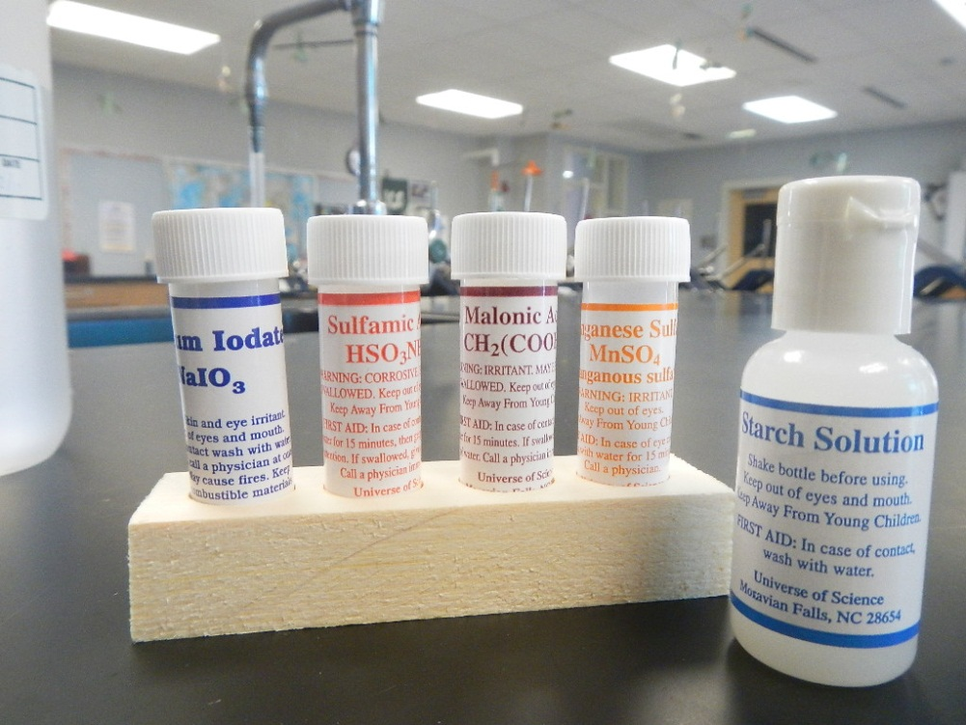
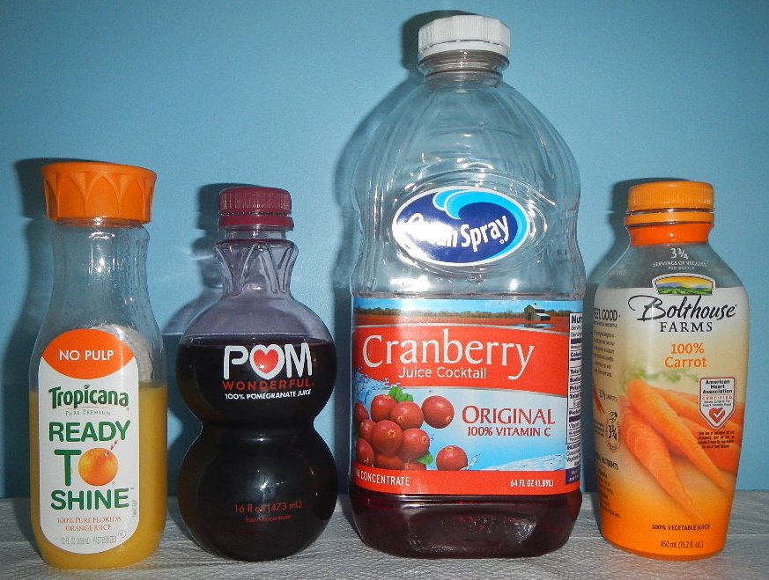
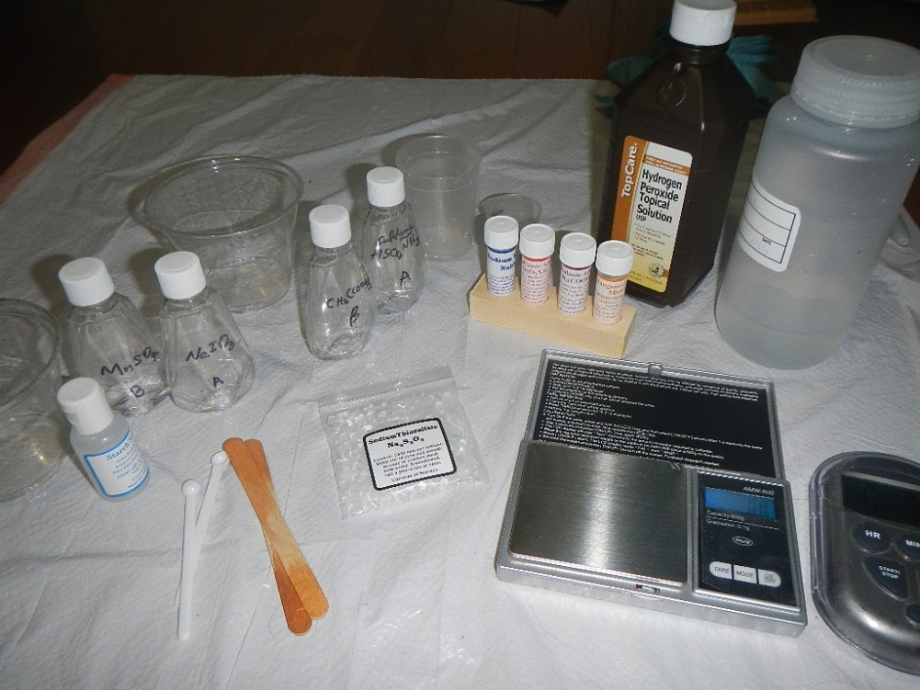
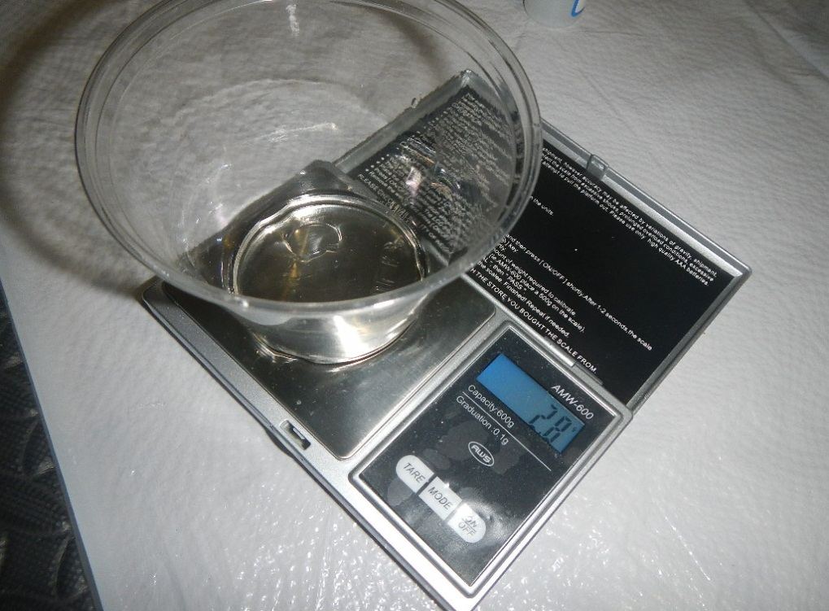
Chemicals used
Juices tested
Experimental Setup
Experimental Setup

Slide 9
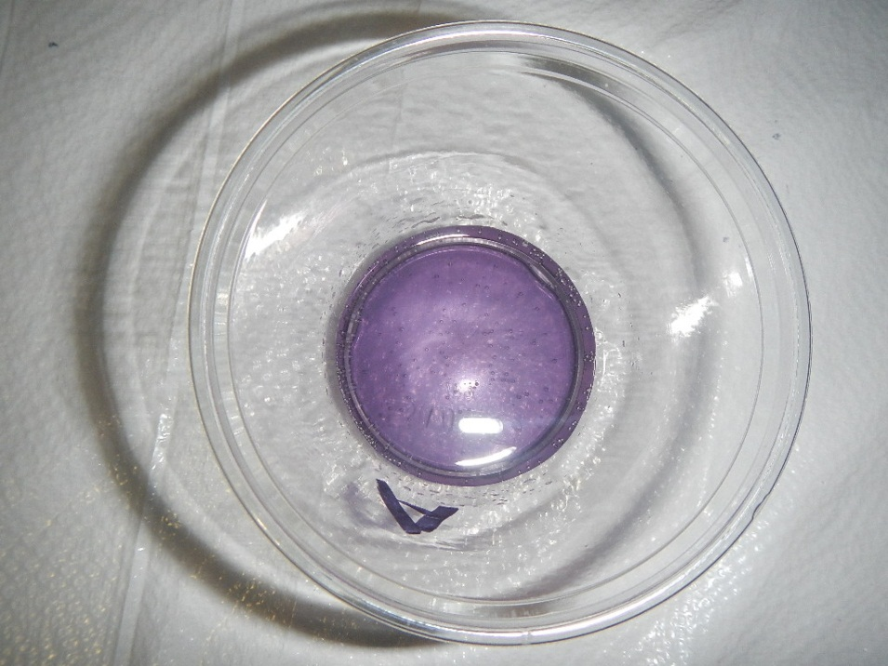
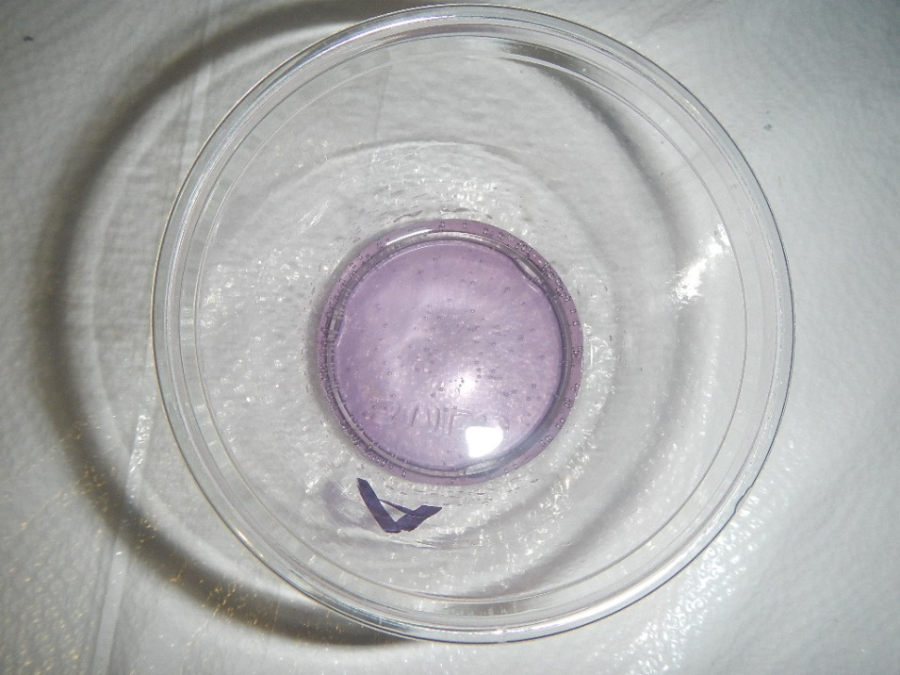
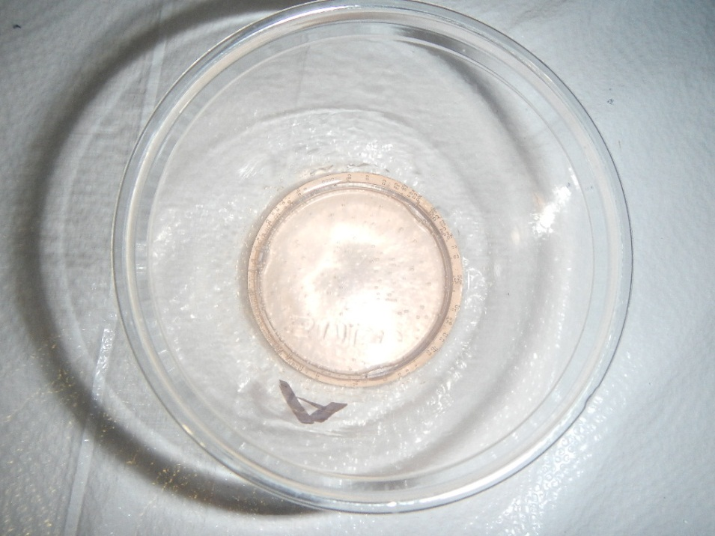
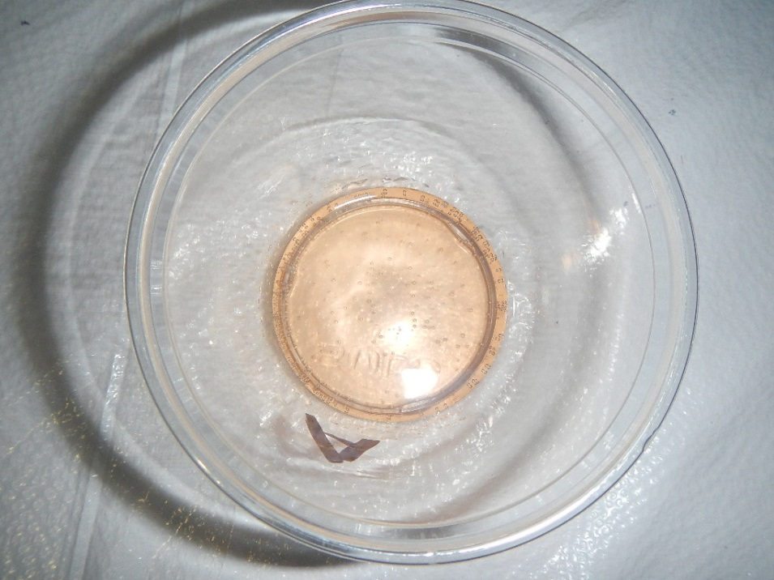
Colors of Oscillating Chemical Reaction

Slide 10
Procedure
1. Take beakers marked A and B
2. Take the following solutions in beaker A:
  Water
  Sodium Iodate
  Sulfamic acid
3. Take the following solutions in beaker B:
  3% Hydrogen peroxide
  Malonic acid
  Starch
  Manganese Sulfate
  Add 6 drops of juice (or none for the control)
4. Mix solutions in both beakers A & B and start the clock at the same time.
5. Note down the time of first appearance of purple color.

Slide 11
Relationship Between the Type of Juice and the Time of First Appearance of the Purple Color
Experiment No. | Type of juice | No. drops | First appearance of purple (sec) | Average (sec) | % ratio compared to Control
1 | No Juice (control) | 0 | 18
3 | No Juice (control) | 0 | 16
4 | No Juice (control) | 0 | 16 | 17 | 100 %
16 | Carrot Juice | 6 | 29
15 | Carrot Juice | 6 | 31
14 | Carrot Juice | 6 | 39 | 33 | 194 %
5 | Cranberry Juice | 6 | 49
10 | Cranberry Juice | 6 | 51
11 | Cranberry Juice | 6 | 56 | 52 | 306 %
17 | Orange Juice | 6 | 47
19 | Orange Juice | 6 | 51
18 | Orange Juice | 6 | 52 | 50 | 294 %
13 | Pomegranate Juice | 6 | 962
8 | Pomegranate Juice | 6 | 1092
12 | Pomegranate Juice | 6 | 1118 | 1057 | 6218 %

Slide 12
Relationship Between the Number of Drops of Cranberry Juice and the Time of First Appearance of the Purple Color
Experiment No. | Type of Juice | No. drops | First appearance of purple (sec)
11 | Cranberry Juice | 6 | 52
7 | Cranberry Juice | 10 | 132
6 | Cranberry Juice | 15 | 231

Slide 13
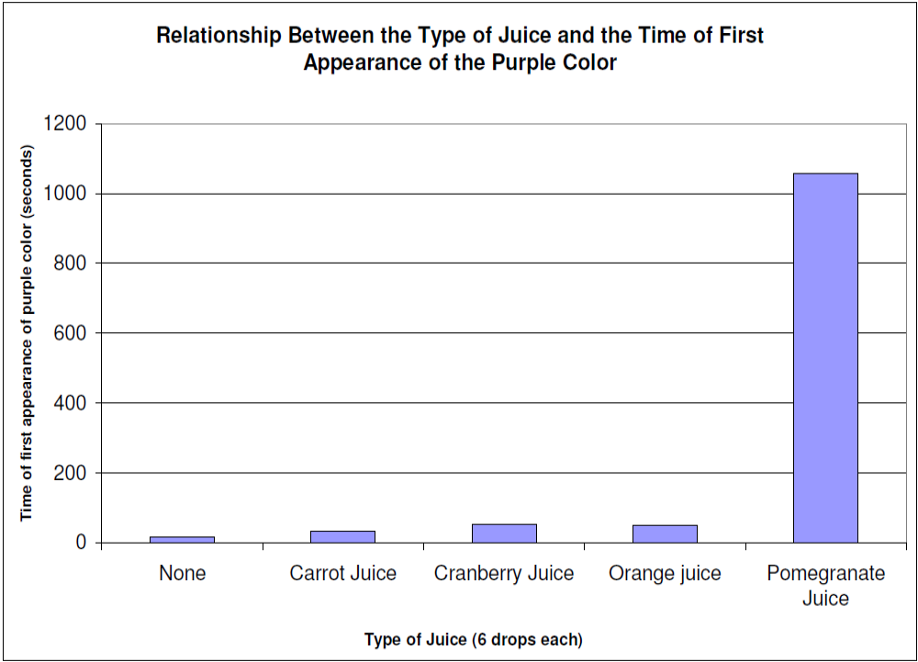

Slide 14
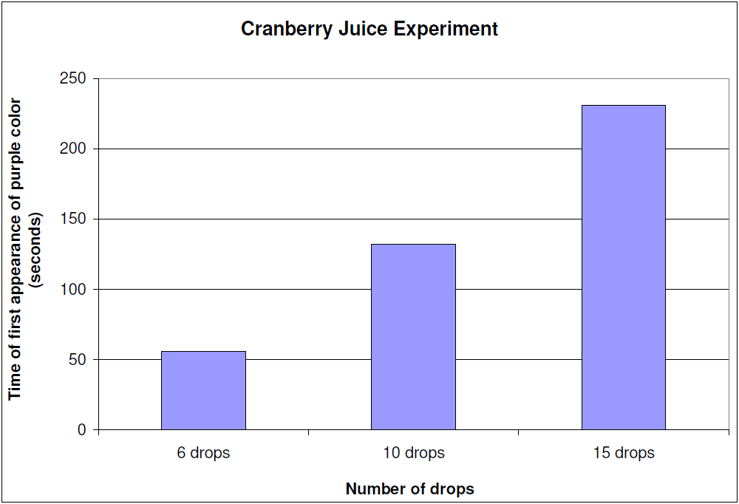

Slide 15
Conclusion
The hypothesis of using Briggs-Rauscher oscillating chemical reaction to test for the presence and amount of antioxidants in a substance has been proven true.
Based on the test, 100% Pomegranate juice from POM Wonderful has the highest antioxidant by delaying the appearance of first purple by an average of 17 minutes 37 seconds in the standardized reaction mixture setup explained in the presentation.
Reaction without the addition of any juices (control test for comparison) produced the first purple color at 17 seconds.
Ocean Spray Cranberry Juice took the second place by delaying the appearance of first purple by an average of 52 seconds.
Tropicana Ready to Shine Orange Juice produced the first purple color at around 50 seconds very close to Cranberry Juice.
Bolthouse Farms 100% Carrot Juice finished last among the juice selected for this experiment by delaying the appearance of first purple by 33 seconds.
Addition higher amounts of Ocean Spray Cranberry Juice delayed the appearance of the first purple indicating the presences of higher amount of antioxidants in the reaction mixture.

Slide 16
Reflection

