Slide 1
ENTERPRISE RETAIL INTELLIGENCE PLATFORM
Demand Forecasting · Inventory Optimization · AI Decision Support
M5 Forecasting Dataset — Store CA_1 | 3,049 products | 2011 – 2016
GUVI Data Science Program — Final Capstone Project
Vignesh R K · Centre for Post Harvest Technology, TNAU Coimbatore

Slide 2
The Business Problem
1
Demand is volatile
Intermittent, SKU-level daily demand across 3,049 products makes manual forecasting unreliable and error-prone.
2
Stockouts & overstock both cost money
Understocking loses sales; overstocking ties up capital and shelf space — both are common without data-driven policy.
3
No feedback loop
Forecasts that aren't explainable or tied to concrete reorder actions don't change day-to-day decisions.
Objective: forecast 28-day-ahead demand accurately, and translate that forecast directly into safety stock, reorder points, and ABC-prioritized action.
2

Slide 3
Scope & Dataset
3,049
5.25 yrs
5.75M
32
Products (SKUs)
2011-01-29 → 2016-05-22
Model-ready rows
Engineered features
Store CA_1 was chosen as a full-size, real single-store slice of the M5 dataset (10 stores / ~57M rows total) — large enough to be a genuine enterprise-scale problem, small enough to keep the entire pipeline reliably reproducible end-to-end. Every script is store-agnostic: one config change reruns the whole analysis for any other store.
Raw Data Sources
sales_train_evaluation.csv — daily unit sales, wide format
calendar.csv — dates, weekday, events, SNAP flags
sell_prices.csv — weekly selling price per store-item
3

Slide 4
End-to-End Pipeline
Data
Pipeline
Feature
Engineering
EDA
Model
Training
Inventory
Optimization
Explain-
ability
Dashboard
→
→
→
→
→
→
01 Filter to CA_1, melt wide→long, merge calendar + prices → 5.9M rows 02 Clean, build 32 leakage-safe features (28+ day lags/rolling stats) 03-04 Explore demand patterns, then train Linear / XGBoost / LightGBM / CatBoost + ensemble 06-07 Convert forecasts into safety stock / reorder points, and explain the model with SHAP
4

Slide 5
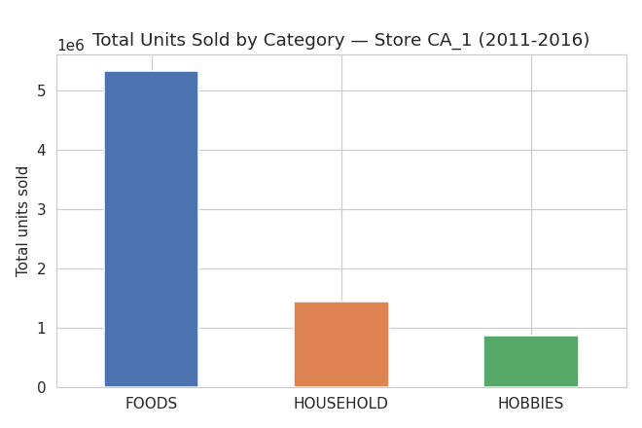
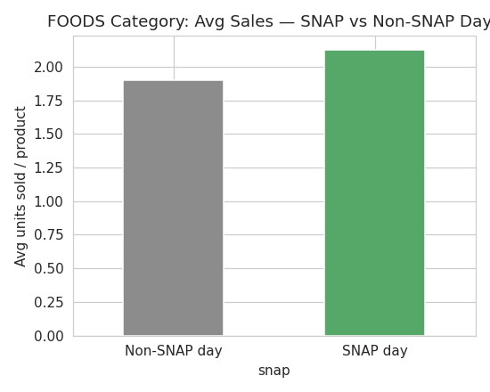
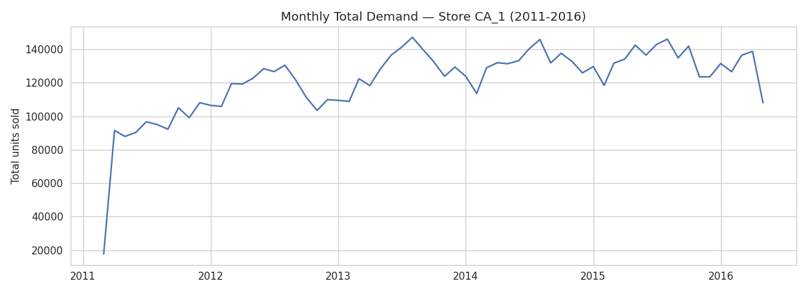
What the Data Shows
FOODS dominates
5.34M of 7.66M units sold — 3.7× HOUSEHOLD, 6.2× HOBBIES
SNAP lifts FOODS demand
+12.1% average sales on SNAP benefit days vs non-SNAP days
Weekend-skewed, growing
Steady multi-year growth with a consistent weekend demand pattern
Monthly demand shows steady 2011-2016 growth with a repeating seasonal wave each year.
5

Slide 6
32 Engineered Features — Leakage-Safe by Design
9
Date
4
Lag
8
Rolling Stats
day/week/month/quarter, weekend & month-boundary flags
sales 28/35/42/56 days ago
mean & std at 7/14/28/56-day windows
4
Price
4
Event / SNAP
3
Category
sell price, price change %, price vs dept/store avg
event flags, SNAP flag, days to Christmas
item / dept / category encodings
Anti-leakage rule: the forecast horizon is 28 days, so every lag/rolling feature uses a minimum 28-day offset. A naive lag_7 would use information that doesn't exist yet at real prediction time — silently inflating offline metrics in a way that fails in production.
6

Slide 7
Model Comparison — Validation Results
Model | RMSE | WRMSSE
Ensemble | 2.271 | 0.9252
LightGBM | 2.271 | 0.9269
CatBoost | 2.282 | 0.9270
XGBoost | 2.286 | 0.9278
Linear Reg. | 2.350 | 0.9534
All models beat the naive baseline (WRMSSE < 1.0). Ensemble = 0.5×LightGBM + 0.5×CatBoost.
7

Slide 8
Engineering Under Constraints
Built and validated inside a ~4GB RAM, single-CPU container.
1
Problem
Training 4 models sequentially in one process exhausted memory — Python doesn't reliably return freed RAM to the OS mid-process.
2
Fix
Each model now trains in its own OS subprocess, guaranteeing a fully-reclaimed memory space before the next model starts.
3
CatBoost tradeoff
Its Ordered-boosting mode is the most memory-intensive of the three GBMs — switched to Plain mode + a representative 1M-row sample.
A real-world lesson: know your hardware constraints, and design around them rather than being blocked by them.
8

Slide 9
From Forecast to Inventory Action
Formulas Applied
Safety Stock = Z × σ(demand) × √(lead time)
Reorder Point = (avg. daily demand × lead time) + safety stock
EOQ = √( (2 × annual demand × order cost) / holding cost )
95% service level · 7-day lead time · ₹500 order cost · 20% holding cost/yr
1,085 products flagged High Stockout Risk Class A/B products with erratic demand (CV > 1.5) — prioritized for manual demand-planning review.
9

Slide 10
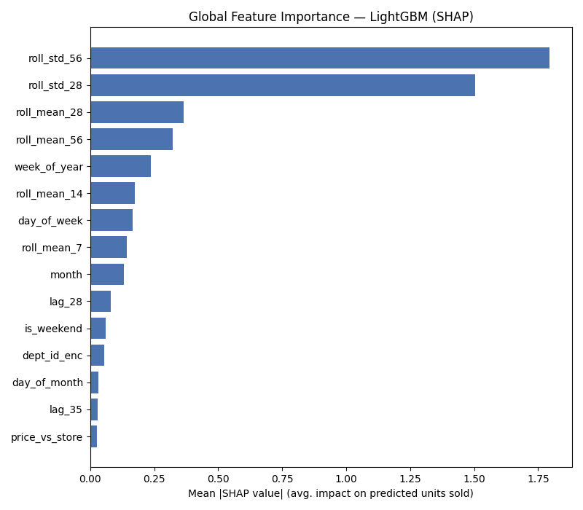
Explainability — What Drives the Forecast
Top Insight
roll_std_56 & roll_std_28 (recent demand volatility) are the strongest predictors — ahead of average demand level itself.
The model has learned that how erratic a product's recent demand has been matters as much as its average level — correctly treating volatile products differently from stable ones.
This directly supports the inventory layer:
Volatility-driven forecasts → volatility-driven stockout-risk flags → the same 1,085 high-CV products surfaced by SHAP are exactly the ones flagged for tighter safety stock.
10

Slide 11
Interactive Decision-Support Dashboard
Streamlit application — 6 tabs, tying every layer of this project together for a non-technical stakeholder.
🏠 Overview
📊 EDA
🤖 Model Performance
Project snapshot, model leaderboard
Category, department, seasonal charts
RMSE/MAE/MAPE/WRMSSE comparison
🔮 Forecast Explorer
📦 Inventory Optimizer
🧠 Explainability
Per-product actual vs predicted, model overlay
Filterable safety stock / ROP / EOQ / ABC table
SHAP charts + plain-English driver table
Run locally with: streamlit run dashboard/app.py
11

Slide 12
Recommendations & Next Steps
Deploy the Ensemble model for production 28-day-ahead forecasting
Prioritize the 1,085 flagged high-risk Class A/B products for review
Align staffing/replenishment with SNAP disbursement dates (+12.1% lift)
Extend to all 10 stores with hierarchical reconciliation
A complete, defensible pipeline: raw data → leakage-safe features → multi-model forecasting on the industry-standard WRMSSE metric → concrete inventory policy → explainability that closes the loop back to the business.
Thank you.
12

