Slide 1
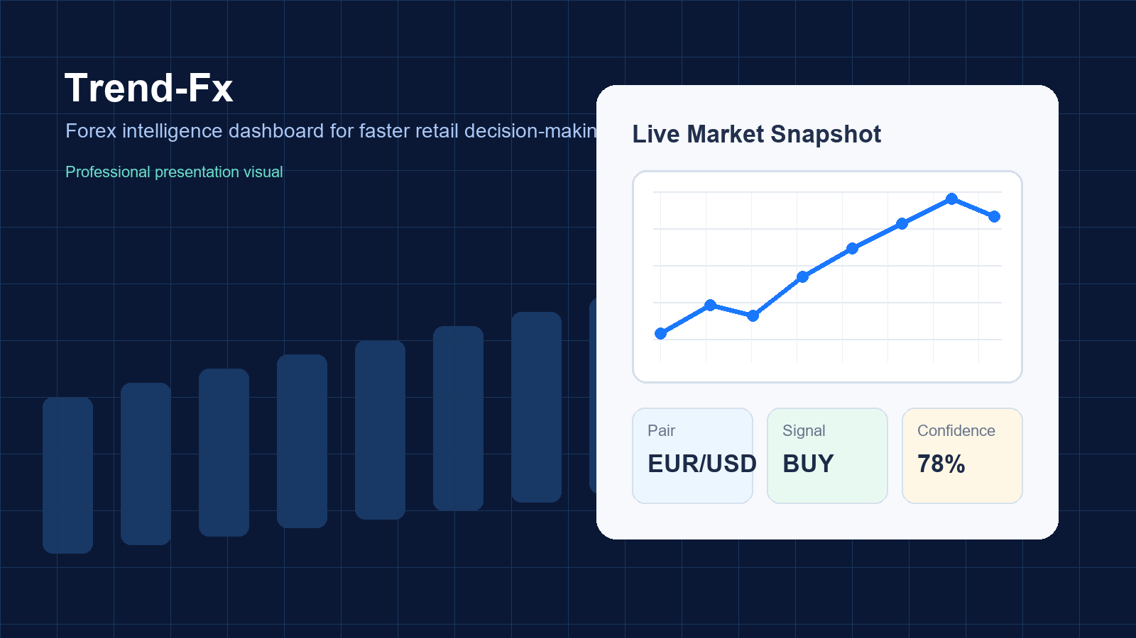
Trend-Fx
Final Project Presentation
Forex market prediction dashboard with live data, authentication, analytics, and project-managed delivery.
Team: Vignesh Venkatesan & Preet Soni
Final review deck
1

Slide 2
1. Project Introduction
Problem statement, target users, goals, and unique value proposition
Problem Statement
Project Goals
Retail forex learners struggle to interpret fast-moving market data and technical indicators in one place.
Most beginner workflows depend on multiple fragmented tools for price checks, signals, and account access.
Deliver live forex visibility with RSI and MACD-based insights
Support secure login, registration, reset, and logout flows
Provide an intuitive React dashboard backed by FastAPI services
Target Users
Students learning forex concepts
Retail traders who need a lightweight dashboard
Project evaluators looking for a complete full-stack workflow
Unique Value Proposition
Trend-Fx combines authentication, market data, indicators, and a learning-oriented dashboard in one focused product.
2

Slide 3
2. Technical Overview
End-to-end stack, integrations, and engineering choices
Frontend
Backend
Database
Tools
Integrations
React 19
Vite 7
React Router DOM
Recharts
Custom CSS
FastAPI
Uvicorn
SQLAlchemy
JWT auth
Passlib password hashing
SQLite test.db
users table
password_reset
Git + GitHub
Feature branches
Pull requests
VS Code
PowerShell
Node js
SQL
Vite
Fast API
Twelve Data API
SMTP email flow
dotenv environment config
3

Slide 4
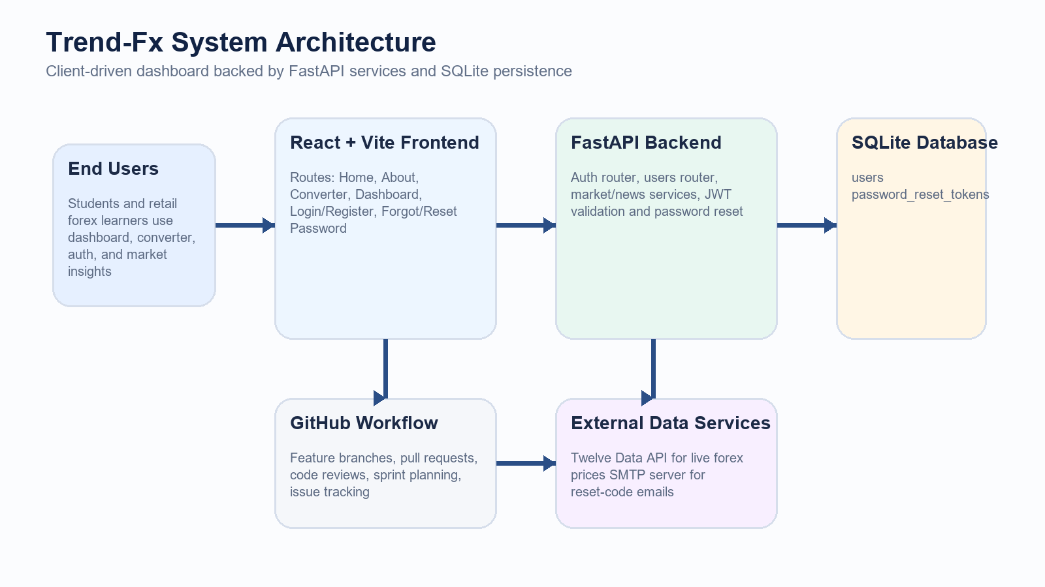
3. System Architecture
How data, authentication, and UI layers interact
4

Slide 5
4. Backend API Overview
Core routes powering auth, user state, market data, and news
Auth
User
Market
News
/api/auth/register
/api/auth/login
/api/auth/forgot-password
/api/auth/reset-password
/api/users/me
/market-data
/price
/api/market/live
/api/market/candles
/api/news/latest
API design separates concerns cleanly: authentication and user state are secured, while market/news routes support analytical and UI needs.
5

Slide 6
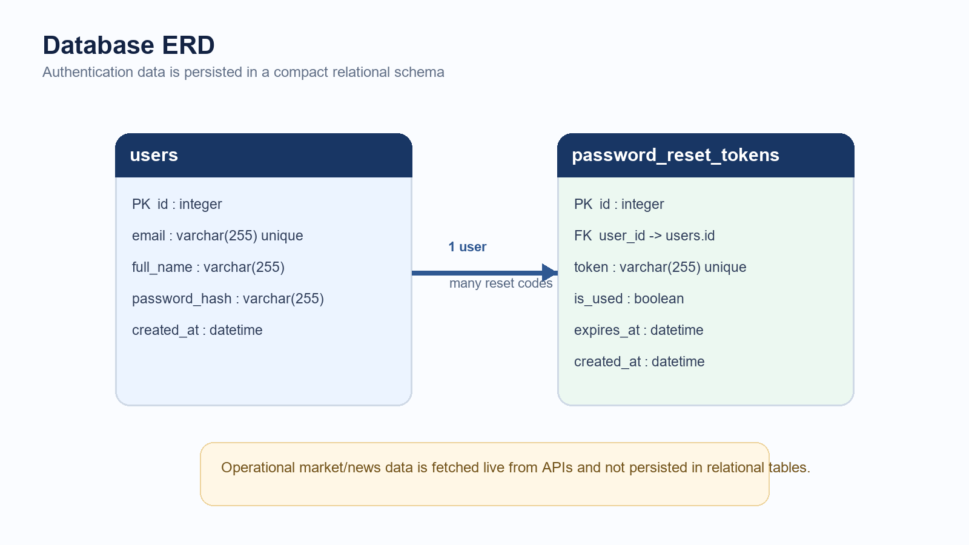
5. Database Schema
Entity relationship diagram for authentication and password recovery
6

Slide 7
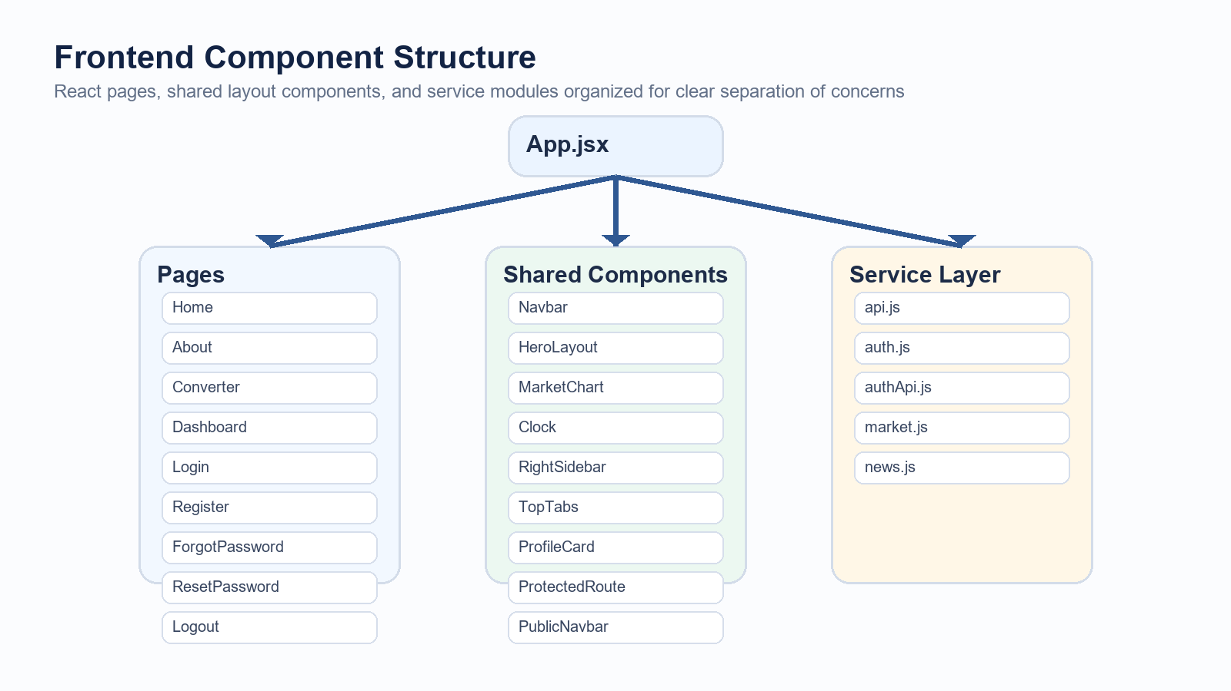
6. Frontend Structure
Pages, shared components, and service modules
7

Slide 8
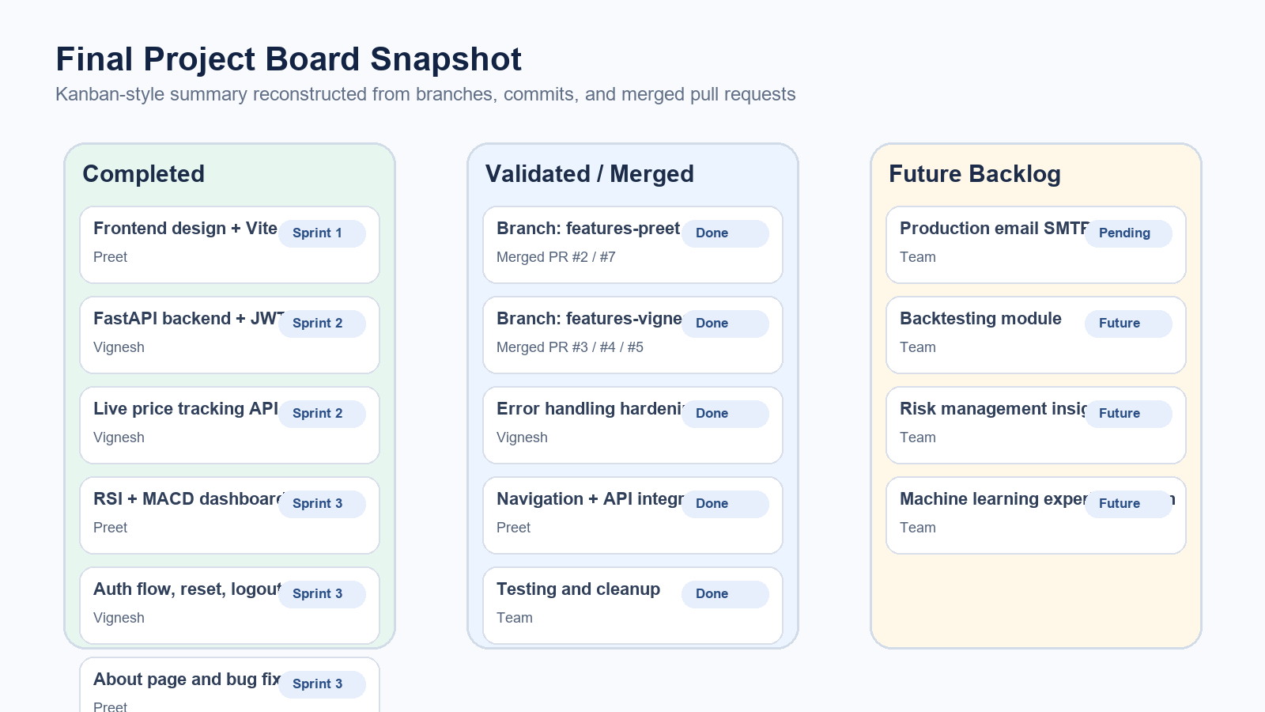
7. Team Workflow & Project Management
Branching, merged pull requests, and a final project board view
8

Slide 9
8. Coordination Reflection
How planning and version control improved team delivery
Evidence from Repository Workflow
Reflection on Board Usage
Feature branches: features-preet and features-vignesh
Merged pull requests observed in history: #2, #3, #4, #5, #7
Commit split shows Preet focused on UI, charts, and navigation while Vignesh focused on backend, APIs, auth, and stabilization
Issue-style iteration visible through repeated bug-fix and enhancement commits
Clear task ownership reduced duplicate work across frontend and backend streams
Sprint grouping helped the team move from foundation -> APIs -> analytics -> polish
Branches and PRs made integration safer and easier to review before merging
A visible board improved communication on status, blockers, and completion readiness
9

Slide 10
9. Closing Summary
What the final project demonstrates
A complete full-stack academic product from UI to API to database
Live forex data visualization with technical indicators
Secure user lifecycle: register, login, logout, reset-password
Team delivery supported by branches, PRs, and sprint-based coordination
Trend-Fx turns fragmented forex monitoring into a guided dashboard experience that is easier to learn, safer to access, and faster to evaluate.
10

Slide 11
THANK YOU
GROUP 3

