Slide 1
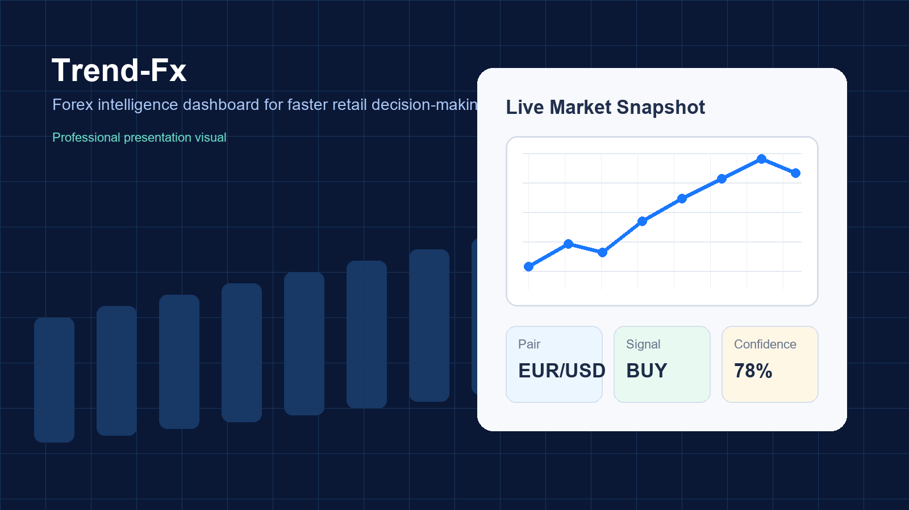
Trend-Fx
Final Project Presentation
PSD final review deck covering problem, implementation, sprint journey, and future scope.
Presentation Timeline (15-18 minutes)
Introduction / Idea
Problem Statement
Solution + Implementation
Sprint Reviews, Challenges, Future Work
Team: Vignesh Venkatesan & Preet Soni
1

Slide 2
2. Problem Statement
Understanding forex signals is difficult for beginners because data is fragmented and fast-moving.
Core Challenges
Forex markets move quickly and are difficult to track manually.
Beginners often switch between many tools for price, indicators, and news.
Technical indicators like RSI and MACD are useful, but not easy to interpret without a unified interface.
Many learners need a guided dashboard instead of raw market feeds.
The project addresses complexity, fragmentation, and learning barriers.
2

Slide 3
3. Idea / Objective
Build a simplified forex dashboard that combines authentication, market data, and indicators in one product.
Simplify analysis
Support learning
Bring live prices, charts, and indicators into a single interface.
Help students understand how RSI, MACD, and basic signals relate to price action.
Provide secure access
Show full-stack delivery
Offer register, login, logout, and password-reset flows for user accounts.
Demonstrate frontend, backend, database, API integration, and team workflow.
3

Slide 4
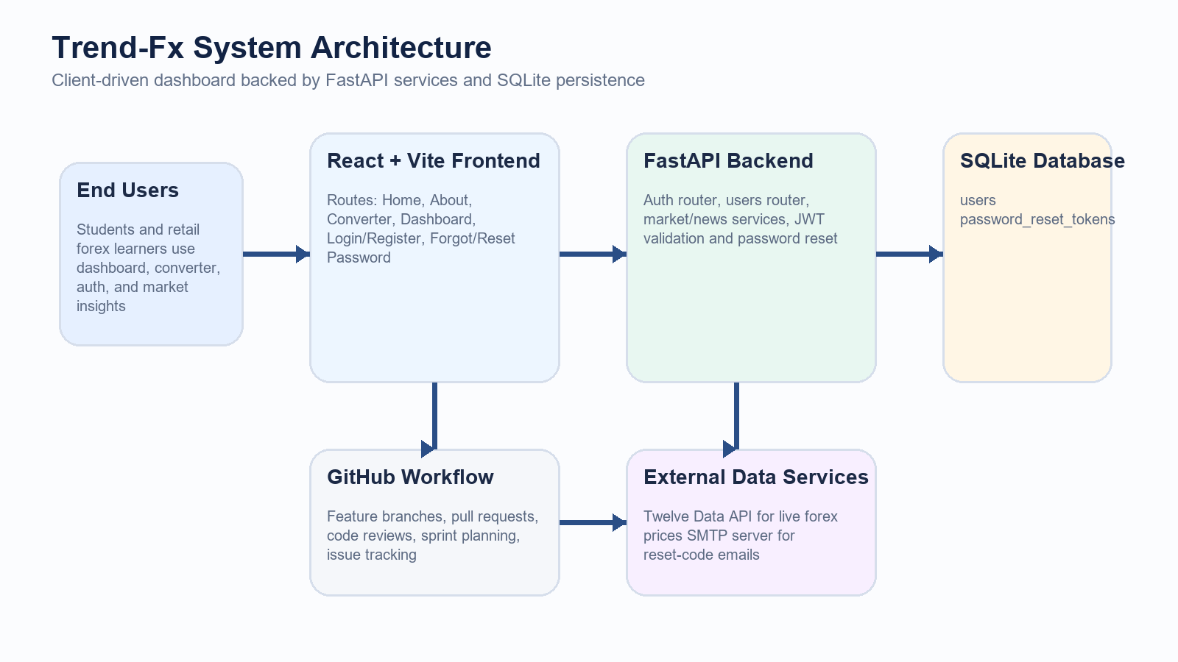
4. System Overview
High-level flow from user interaction to frontend, backend, and external market data APIs.
4

Slide 5
5. Technology Stack
Planned and implemented technologies used across the project.
Frontend
Backend
Database
Tools
React
Vite
React Router DOM
Recharts
FastAPI
Uvicorn
SQLAlchemy
JWT auth
SQLite test.db
SQL model design
Sprint plan referenced MySQL
Git
GitHub
Branches
Pull Requests
PowerShell / VS Code
5

Slide 6
6. Implementation
How the app pulls data, computes indicators, and presents charts to users.
Implementation Highlights
Indicator Flow
FastAPI backend exposes auth and market endpoints.
Twelve Data API provides live forex values and time-series data.
RSI and MACD are calculated in backend logic before being sent to the dashboard.
Recharts renders line, area, and composed visualizations in the React UI.
1
Fetch forex candles
2
Calculate RSI / MACD
3
Return structured API payload
4
Render dashboard charts
6

Slide 7
7. Dashboard Demo
Live market snapshot, graphs, and quick user-facing analytics.
Demo Walkthrough
User selects a currency pair.
Live price updates appear in the dashboard.
RSI and MACD charts help interpret momentum and trend.
Auth-enabled flow lets users access dashboard after login.
7

Slide 8
8. Code Explanation
Recharts powers the dashboard visuals using reusable React components.
<ResponsiveContainer width="100%" height={280}> <LineChart data={chartData}> <CartesianGrid strokeDasharray="3 3" /> <XAxis dataKey="time" /> <YAxis /> <Tooltip /> <Legend /> <Line dataKey="price" stroke="#67a4ff" /> </LineChart> </ResponsiveContainer>
Explanation
ResponsiveContainer makes the chart resize with the layout.
LineChart uses API response data directly from React state.
Tooltip and Legend improve readability during demo and analysis.
The same pattern is reused for RSI and MACD visual sections.
8

Slide 9
9. Sprint Planning
Three sprint phases guided the team from setup to analytics and final integration.
1
2
3
Sprint 1
Sprint 2
Sprint 3
Project setup, frontend base, layout, routing
Backend APIs, authentication, live data integration
Indicators, dashboard polish, bug fixes, presentation prep
Planning helped divide ownership clearly between frontend/dashboard work and backend/API/auth work.
9

Slide 10
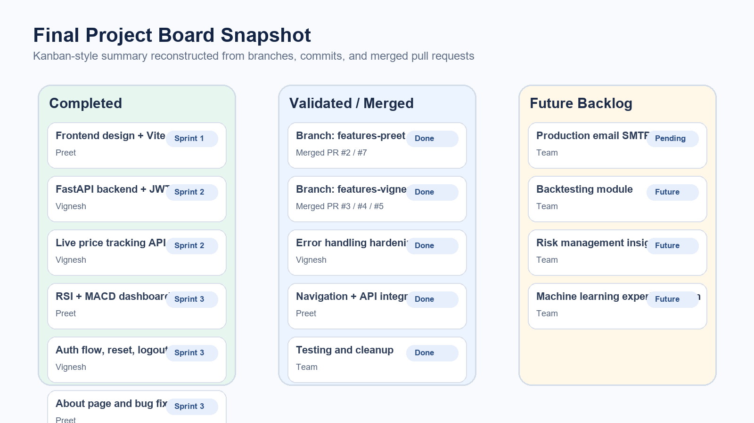
10. Sprint Review
Completed work, merged features, and remaining scope after final integration.
Status Summary
Completed: auth flows, live market integration, charts, dashboard pages, navigation
Validated: feature branches merged through PRs and review
Pending / future: production email credentials, deeper prediction logic, additional indicators
10

Slide 11
11. Challenges
Technical and delivery hurdles encountered during the project.
API connectivity and live-data consistency
Indicator calculations and dashboard synchronization
Authentication bugs and route handling
Time management across frontend and backend streams
11

Slide 12
12. Solutions
How the team resolved blockers and stabilized the final build.
Backend fixes
Chart optimization
Refined FastAPI routing, improved auth flow, and cleaned API integration issues.
Used structured payloads and Recharts components to simplify rendering logic.
Iteration via branches
Focused sprint reviews
Separated work into feature branches and merged after validation.
Used sprint checkpoints to identify bugs early and keep the scope realistic.
12

Slide 13
13. Future Work
Planned enhancements after the current academic version.
Add more technical indicators and stronger signal explanations
Improve prediction logic and confidence scoring
Introduce richer news sentiment and backtesting support
Move toward production-ready email delivery and deployment
Long-Term Vision
Evolve Trend-Fx from a learning-focused dashboard into a stronger decision-support platform with deeper analytics and more robust forecasting.
13

Slide 14
14. Conclusion
Trend-Fx demonstrates a complete full-stack solution to simplify forex learning and analysis.
We identified a real usability problem in forex learning and built a focused dashboard solution.
The project integrates React UI, FastAPI services, authentication, database persistence, and live market data.
Sprint-based teamwork and repository workflow helped deliver the final result with clear ownership.
The platform now provides a strong academic foundation for future prediction improvements.
14

Slide 15
Thank You
Questions?
Trend-Fx Final Presentation
15

