Slide 1

Problem Statement:
Churn Prediction is essentially predicting which clients are most likely to cancel an account with the bank based on their usage of the service.
From a Bank point of view, it is necessary to gain this information because acquiring new customers is often arduous and costlier than retaining old ones.

Slide 2
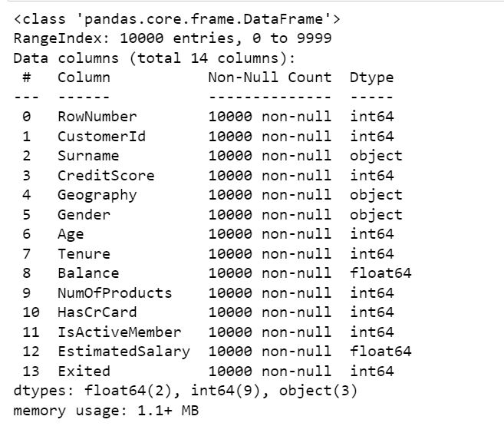
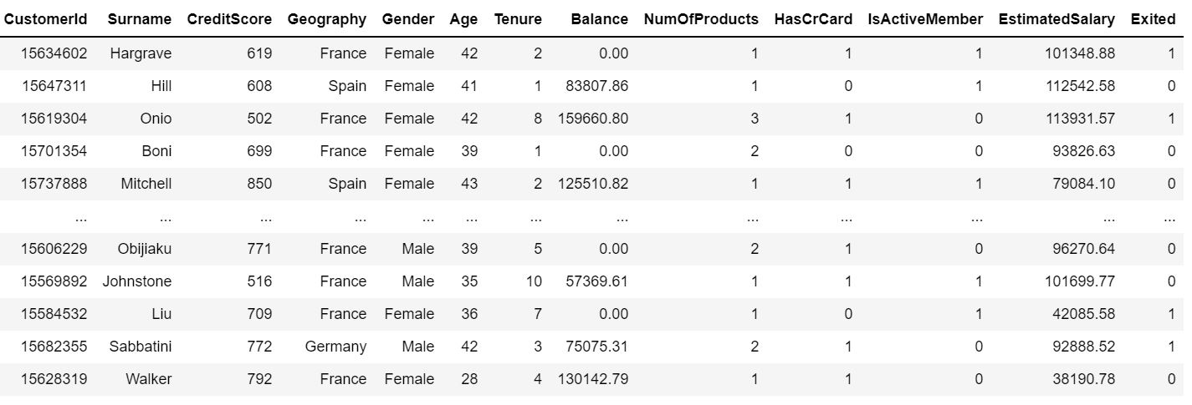
Dataset
The dataset is collected from Kaggle website
It has 14 columns and 10,000 rows
There are no null values.

Slide 3
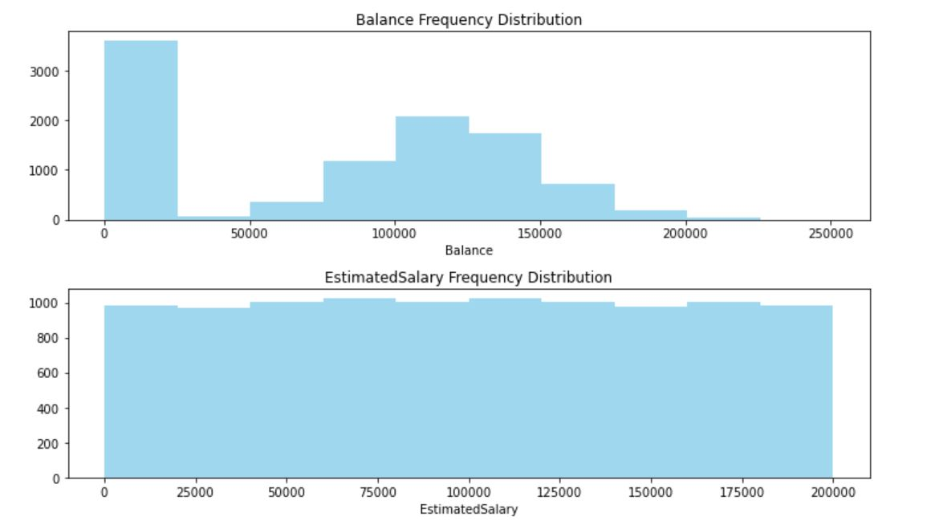
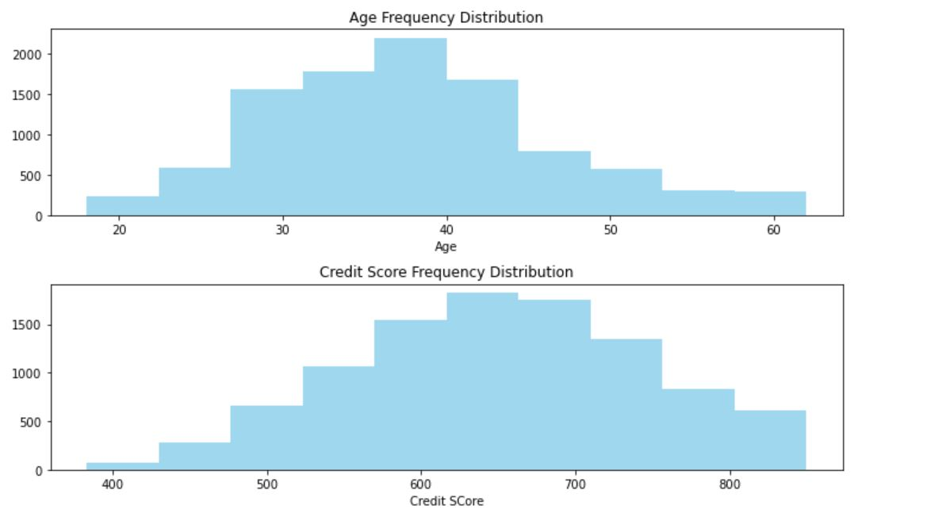
Exploratory Data Analysis
The Age and Credit Score features are normally distributed
The EstimatedSalary feature is uniformly distributed.
Most of the customers have balance between $0 to $25,000.

Slide 4
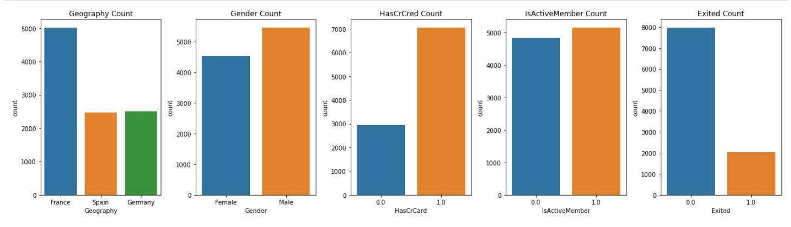
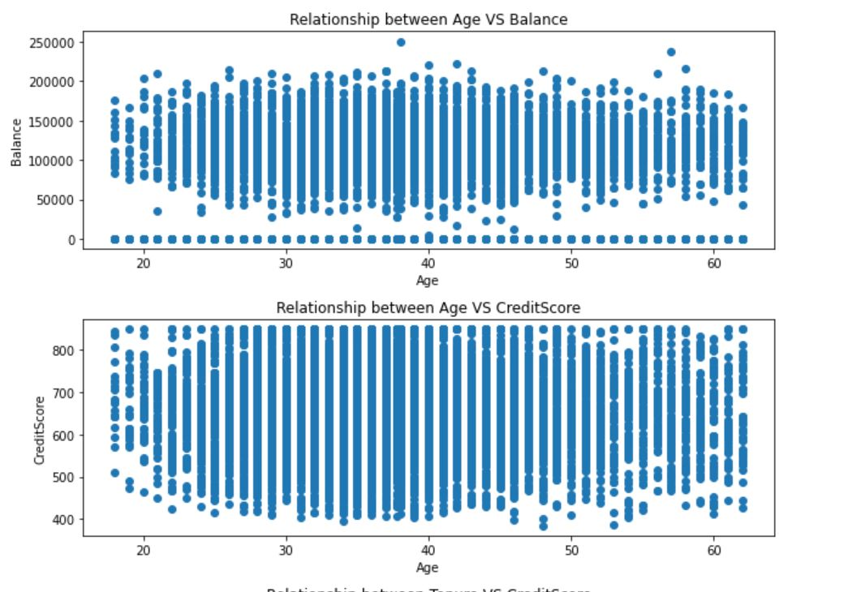
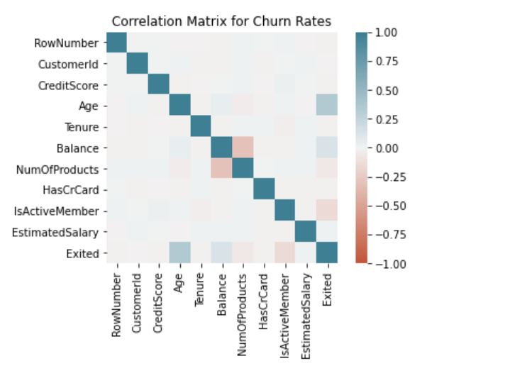
Exploratory Data Analysis

Slide 5
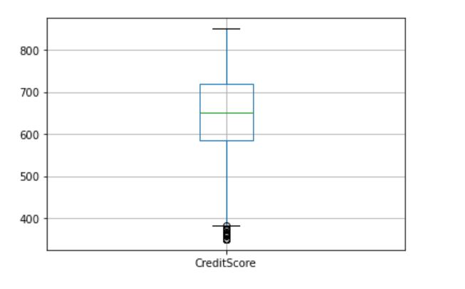
Outliers Detection
From the box plot, we can understand that CreditScore has some outliers
We removed such outliers from our features.

Slide 6
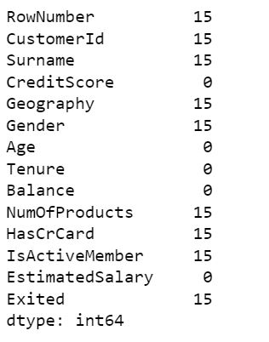
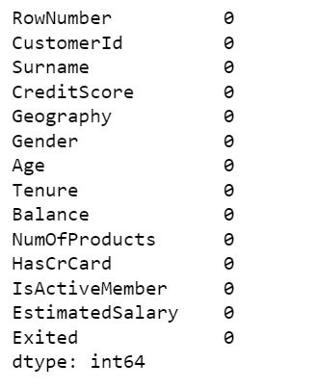
Handling Missing Data
As we can see, the missing values in the numerical features are replaced by mean of the feature.
For categorical values, we removed the data.

Slide 7
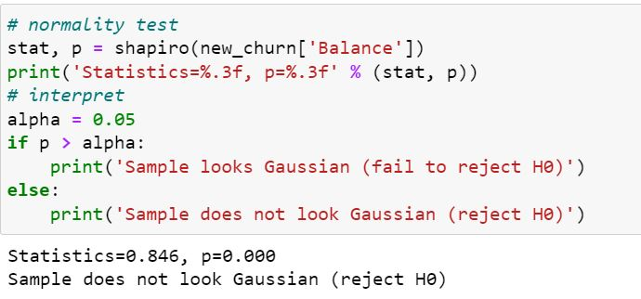
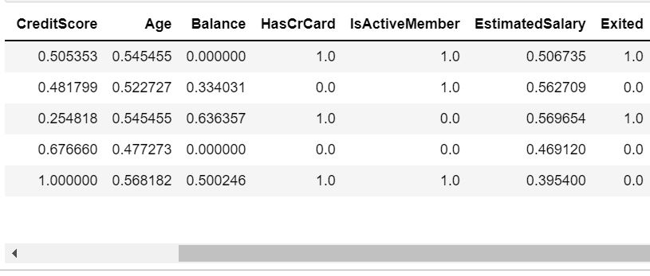
Normalization
We performed Shapiro Wilk test and checking if the p-value > 0.05.
As you can see Balance has p value less than 0.05 so it is not normally distributed.
After Normalization:

Slide 8
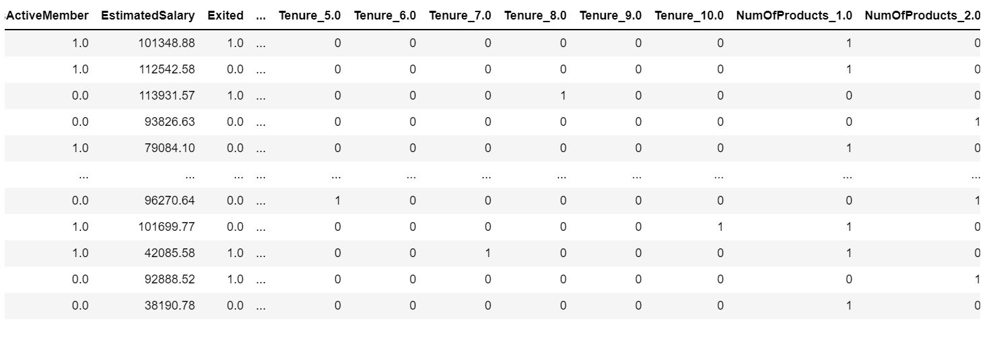
One Hot Encoding
We performed One Hot Encoding to convert the categorical features into binary data.

Slide 9
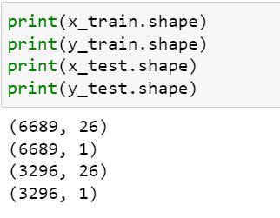
Train Test Split
We removed Rownumber, CustomerID and Surname features as they don’t add any value in training the model.
We split the entire dataset into 66.66% as train data and 33.33% as test data.

Slide 10
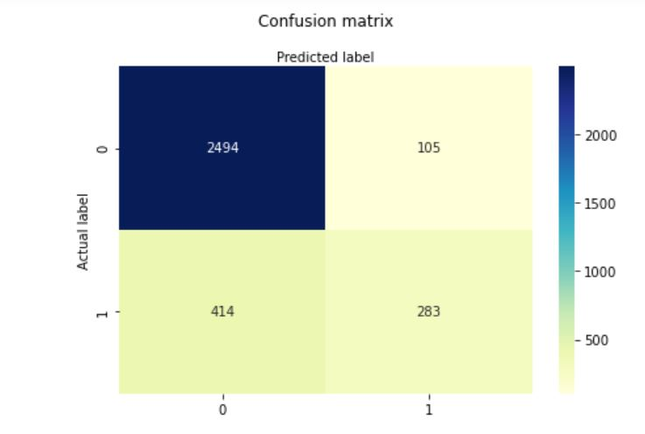
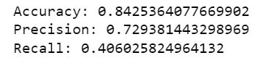
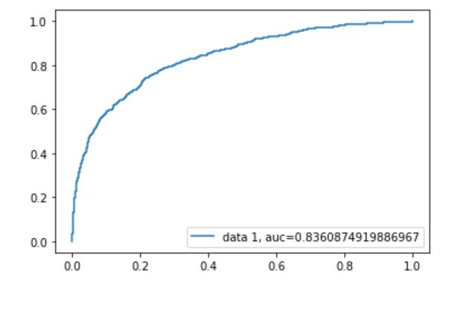
Model Building and it’s Evaluation Logistic Regression
Though accuracy is good, our precision and recall have dropped drastically.
The probability for any datapoint to be under the curve is 0.836

Slide 11
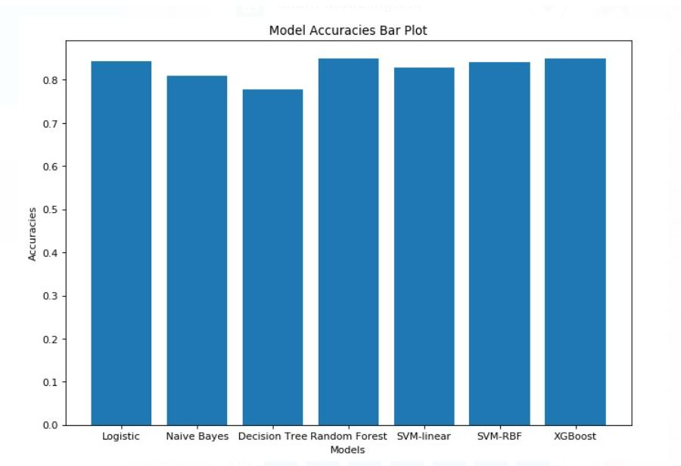
Model Accuracy Comparison
Most of our models gave us accuracies above 80% .
Random forest has the highest accuracy.

Slide 12
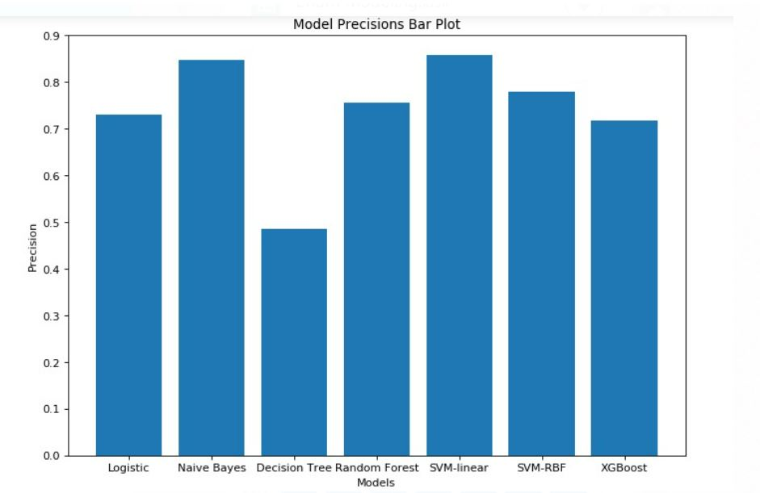
Model Precision Comparison
Though the accuracies looks good, our precision is not at the desired level.

Slide 13
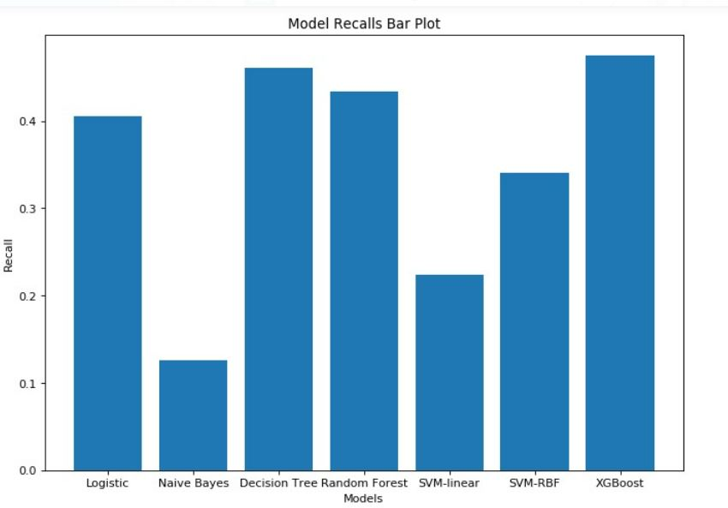
Model Recall Comparison
Though the accuracies looks good, our recall is not at the desired level.
Also, we see that the models with high precision tend to have lower recall values and vice versa.

Slide 14

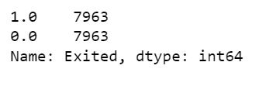
Handling imbalanced data
Before Up sampling :
The target values are not in same ratio which results in biased output due to which the model is underfitting.
By performing up sampling, we maintained the same ratio
After Up sampling :

Slide 15
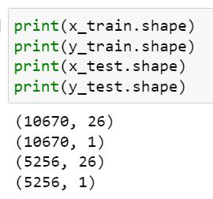
Train Test Split
We split the entire dataset into 66.66% as train data and 33.33% as test data.
We can also see that the number of observations has increased, as we performed up sampling.

Slide 16
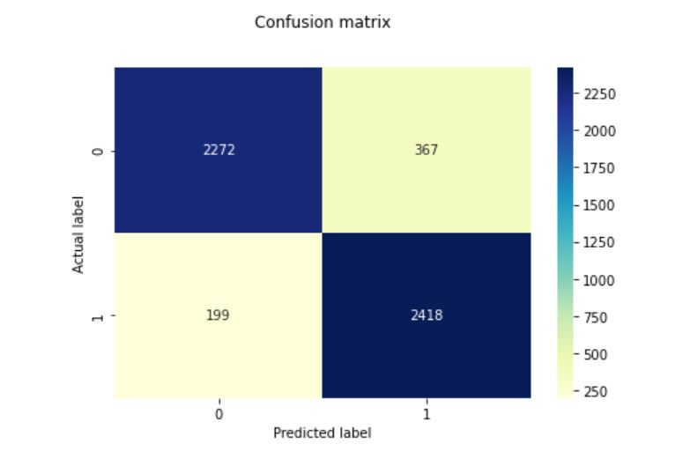

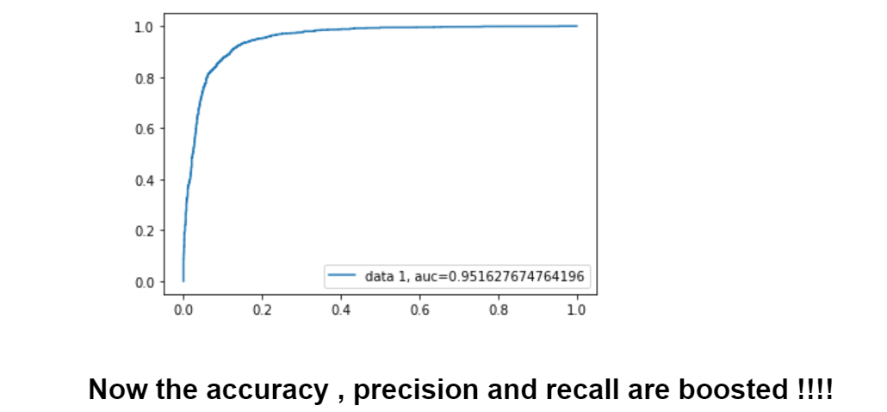
Model Building and it’s Evaluation After Re-Sampling
We implemented the XGBoost model.
From previous observations, we see that the metrics like precision and recall have dropped but after re-sampling, our metrics have boosted.

Slide 17
Conclusion
Our model is capable enough to know the customers who are about to leave the bank. So it helps the bank well before to retain them with attractive offers.
Furtherly, our model can be incorporated into the bank’s core business strategy

