Slide 1
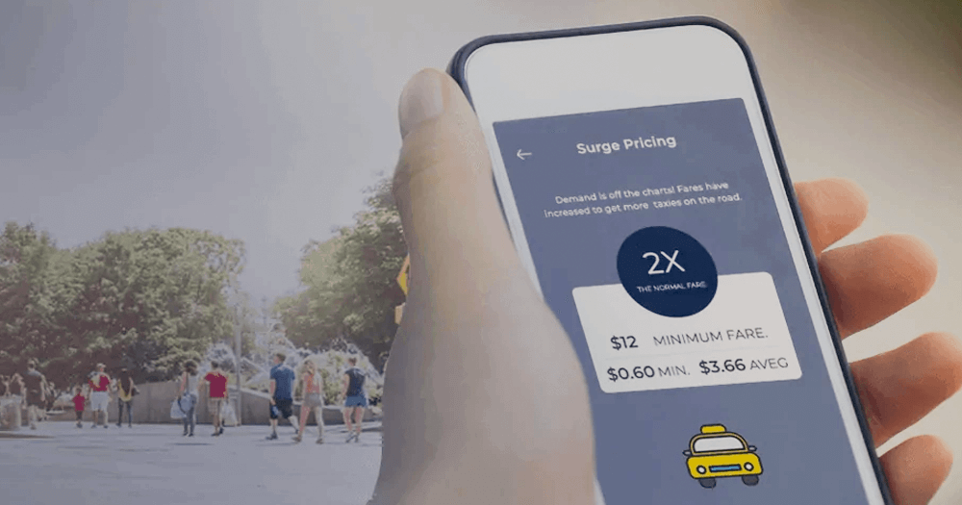
TRIP PRICING WITH TAXI MOBILITY ANALYTICS
Mentor:
Ms. Vibha Santhanam
Done by:
S.Vignesh
Abhijith S Varma
V. Ram Prakash
G. Siva Kumar
M. Vignesh

Slide 2
PROBLEM STATEMENT:
We are predicting the surge price type for Sigma Cabs. Previously surge price was given by service providers, from that information they have captured surge price type, we are building a predictive model based on that surge price type, so that they can fix the fare beforehand.
1
Surge Pricing: Dynamic pricing, also referred to as surge pricing, demand pricing, or time-based pricing is a pricing strategy in which businesses set flexible prices for products or services based on current market demands.
This can happen due to the following factors:
Special events
Rush hour
Bad weather
Y INVOLVED
2
3
IMPORTANCE
We are helping the client to became a cab aggregator.
4
Literature Survey 1: Dynamic pricing model for cruising taxicab based on system dynamics.
Literature Survey 2 : Analysing Bangkok city taxi ride: reforming fares for profit sustainability using big data driven model.

Slide 3
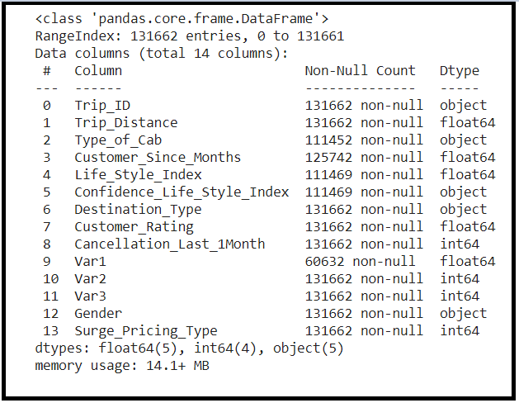
PROPOSED SOLUTIONS AND DATASET CONSIDERED
We are suggesting to build a predictive ML model in order to predict the surge price type effectively.
In depth analysis of the dataset in order to derive deeper insights from the data like discovering the relation of target variable in the data.
Visual analysis of the data to discover the relationship between independent variable and dependent variable.
Dataset: TRIP PRICING WITH TAXI MOBILITY ANALYTICS
VARIABLE CATEGORIZATION:
No of rows: 131662
Total Features/Columns :14
Numerical Features :06
Categorical Features:08
Target : Surge Pricing Type(Multiclassification)
Dataset Link: https://www.kaggle.com/arashnic/taxi-pricing-with-mobility-analytics

Slide 4
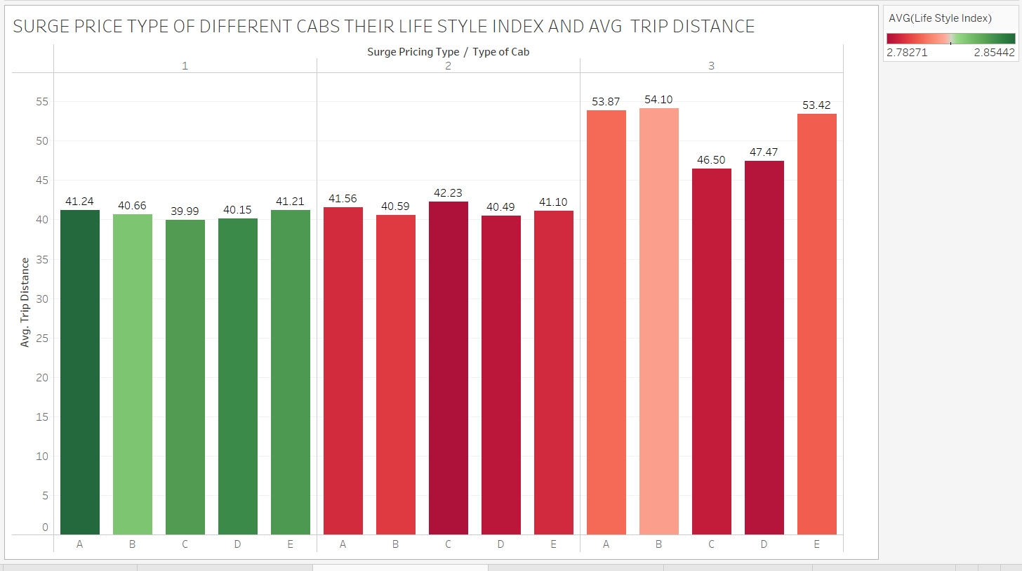
VALUE ADDITIONS
TABLEAU FINDINGS FOR MASKED TARGET VARRIABLE
Based on analysis from Tableau we came to conclusion surge_type_1 price is high,surge_type_2 price is low and surge_type_3 price is medium.

Slide 5
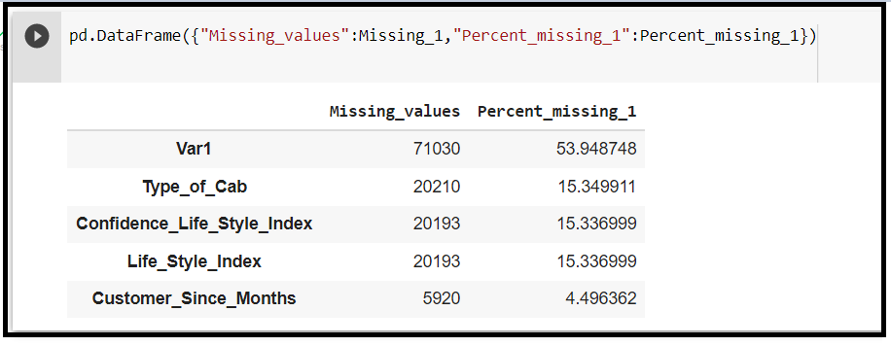
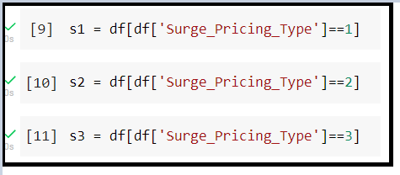
EXPLORATORY DATA ANALYTICS
DATA PREPROCESSING FLOWCHART:
DATA TYPE CONVERSION:
Customer_since_months is in float so we are converting it into object.
Surge_type_pricing is in int so we are converting it into object.
MISSING VALUE TREATMENT:
:
Data type conversion
Missing value Treatment
Outlier Treatment
Feature selection using Multicollinearity
Treating class imbalance
Encoding using dummies
Feature Scaling
Visualization
simple imputation method to impute the Nan Values

Slide 6
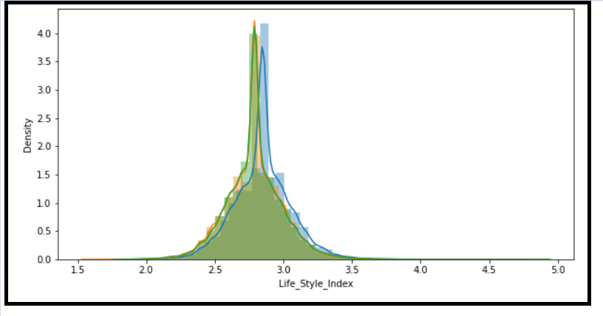
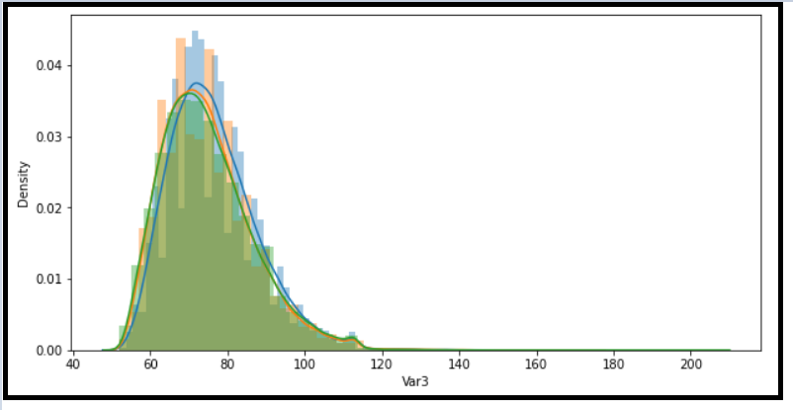
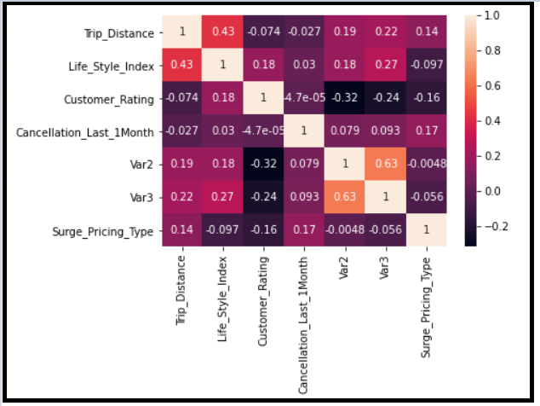
OUTLIER TREATMENT : We are considering only Non linear models ,so no outlier treatment needed.
MULTICOLLINEARITY : All column gives unique information except var 2 and var3.
SCALING: We chose Min Max Scaler because the data is not normal. Min max scaler will help in Normalizing the data.
ENCODING: Dummies is a variant of One Hot Encoding which makes the categorical data machine readable.

Slide 7
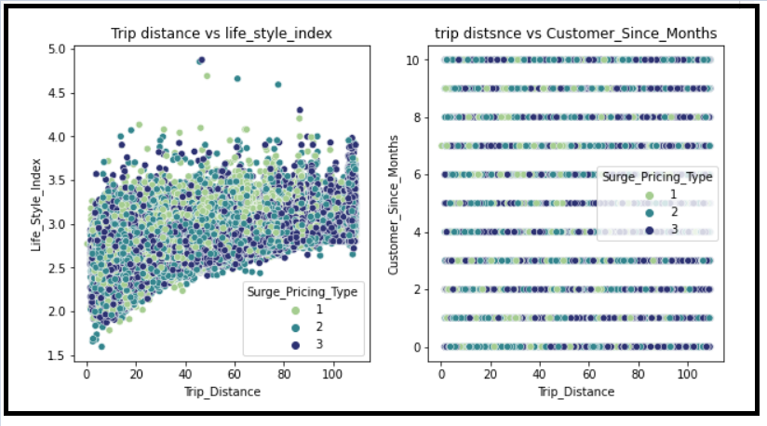
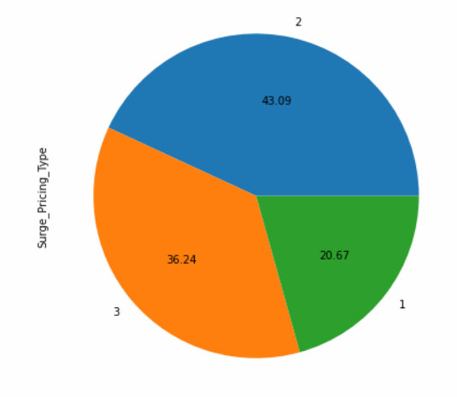
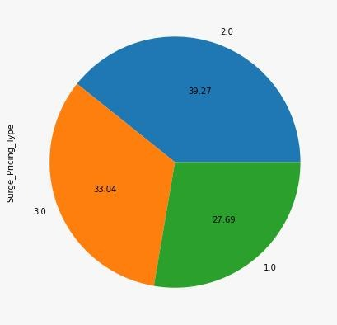
VISUALIZATION:
CHALLENGES ADDRESSED
Var1,var2 ,var3 and Target is masked by the company due to confidentiality.
Null/Missing values were handled by simple imputer.
Initially the dataset to be imbalanced, we handled the issue by oversampling technique-SMOTE.

Slide 8
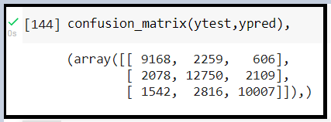
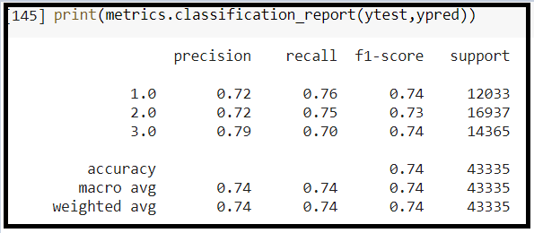

Algorithms considered for the data
K-Nearest Neighbors (Base model)
Advantages
Easy to interpret
No assumptions needed before building the model
As it won’t learn anything in training stage , the distance calculations are fast
Disadvantages
Sensitive to outliers
More memory is required for calculations
Prediction stage of the model requires more time
Results of KNN Model

Slide 9
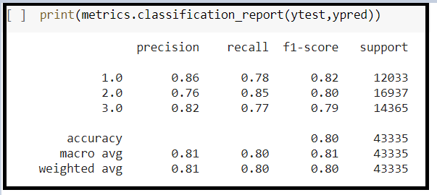
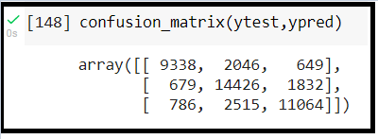

Stacking model ( Final Model )
Advantages
Stacking can yield improvements in model performance
Stacking reduces variance and creates a more robust model by combining prediction of multiple models.
Disadvantages
Stacked models can take significantly longer to train than simpler models and require more memory
Generating predictions using stacked models will be slower and more computationally expensive.
Results of the Stacking Model

Slide 10
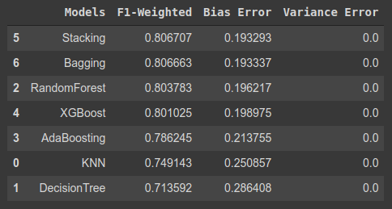
Comparison and summary of all the algorithms
Comparing to base model (KNN) , there is a significant improvement in all the metrics we focused on such as f1-weighted , bias error and variance error
MODEL COMPARISION

Slide 11
Solution architecture
Functional
Technical
Reading and Cleaning Data
Pandas
Machine Learning Model
Sklearn
Numerical Operations
NumPy
Frontend
HTML,CSS
Visualization
Matplotlib and seaborn
Backend
FLASK
Statistical Testing
SciPy

Slide 12
DEPLOYMENT FLOWCHART
PICKLING
Pickling the model using Pickle. Dump
FRONT END
HTML/CSS
BACKEND
FLASK
HOSTING
Local Storage
DEPLOYMENT LINK:
http://127.0.0.1:5000/

Slide 13
TO SUMMARIZE:
PROBLEM STATEMENT
To build a predictive model based on Surge price type
COMPLEXITY INVOLVED
Var1,Var2,Var3 and Target is masked
PROJECT OUTCOME
Commercial purpose
DEPLOYMENT
Frontend: HTML /CSS
Backend: FLASK
MODEL EVALUATION METRICS
Target is multiclass,F1-Weighted score as metric.

Slide 14
Thanks!

