Slide 1

TRIP PRICING WITH TAXI MOBILITY ANALYTICS
Mentor:
Ms. Vibha Santhanam
Done by:
S.Vignesh
Abhijith S Varma
V. Ram Prakash
G. Siva Kumar
M. Vignesh

Slide 2
PROBLEM STATEMENT
We are predicting the surge price type for Sigma Cabs. Previously surge price was given by service providers, from that information they have captured surge price type, we are building a predictive model based on that surge price type, so that they can fix the fare beforehand.
Surge Pricing: Dynamic pricing, also referred to as surge pricing, demand pricing, or time-based pricing is a pricing strategy in which businesses set flexible prices for products or services based on current market demands.
This can happen due to the following factors:
Special events
Rush hour
Bad weather

Slide 3
IMPORTANCE
We are helping the client to became a cab aggregator.
Literature Survey 1: Dynamic pricing model for cruising taxicab based on system dynamics.
Literature Survey 2 : Analysing Bangkok city taxi ride: reforming fares for profit sustainability using big data driven model.

Slide 4
PROPOSED SOLUTIONS AND DATASET CONSIDERED
We are suggesting to build a predictive ML model in order to predict the surge price type effectively.
In depth analysis of the dataset in order to derive deeper insights from the data like discovering the relation of target variable in the data.
Visual analysis of the data to discover the relationship between independent variable and dependent variable.
Dataset: TRIP PRICING WITH TAXI MOBILITY ANALYTICS
VARIABLE CATEGORIZATION:
No of rows: 131662
Total Features/Columns :14
Numerical Features :06
Categorical Features:08
Target : Surge_Pricing_Type(Multiclassification)
Dataset Link: https://www.kaggle.com/arashnic/taxi-pricing-with-mobility-analytics

Slide 5
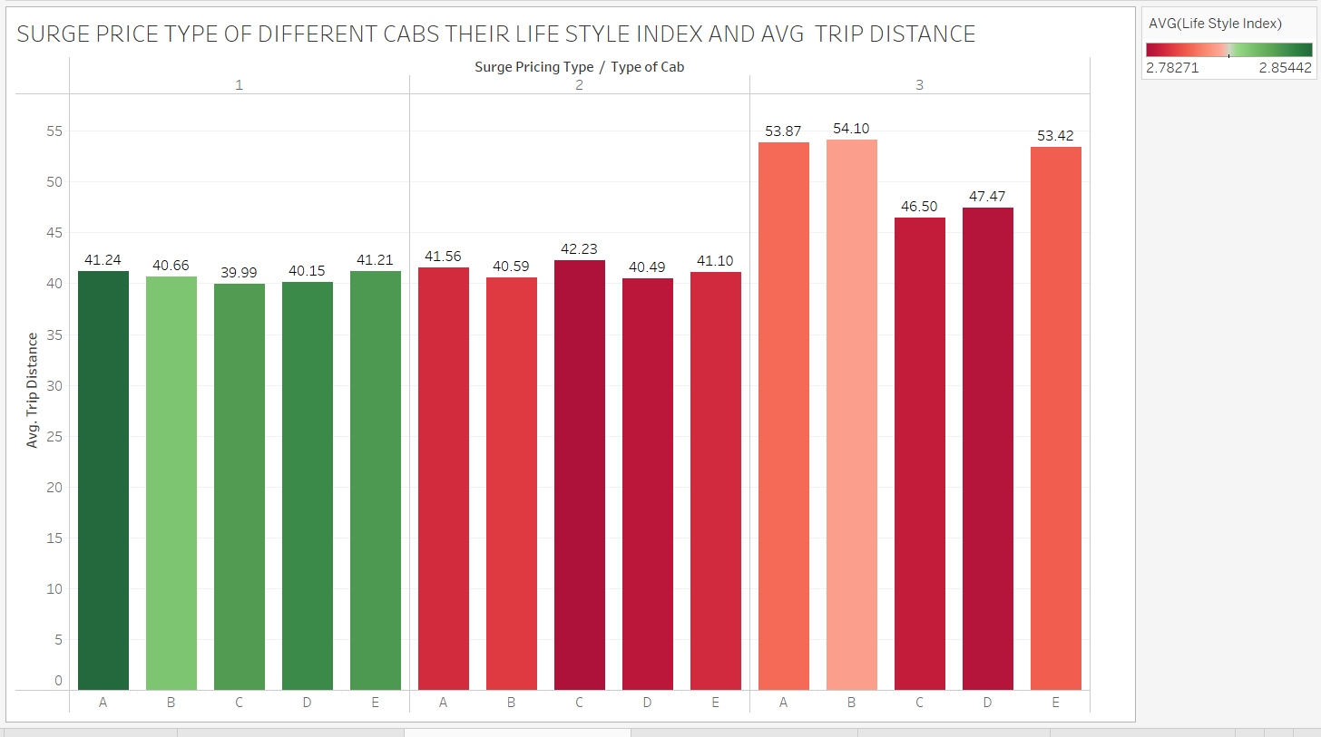
VALUE ADDITIONS
TABLEAU FINDINGS FOR MASKED TARGET VARRIABLE
Based on analysis from Tableau we came to conclusion surge_type_1 price is high,surge_type_2 price is low and surge_type_3 price is medium.

Slide 6
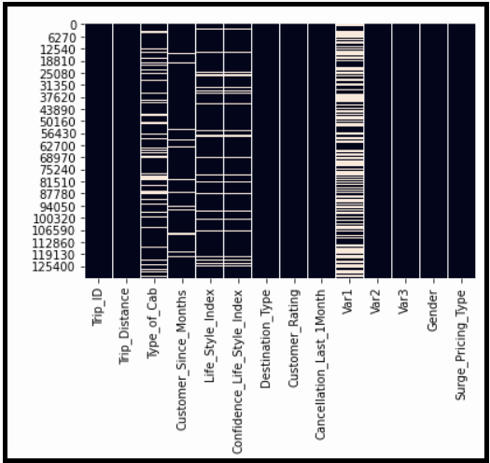
EXPLORATORY DATA ANALYTICS
Data Preprocessing :
Data type conversion
Missing value Treatment
Outlier Treatment
Feature selection using Multicollinearity
Scaling
Encoding using dummies
Treating class imbalance
DATA TYPE CONVERSION:
Customer_since_months is in float so we are converting it into object.
Surge_type_pricing is in int so we are converting it into object.
Missing value Treatment:
:
We are using simple imputation method to impute the Nan Values

Slide 7
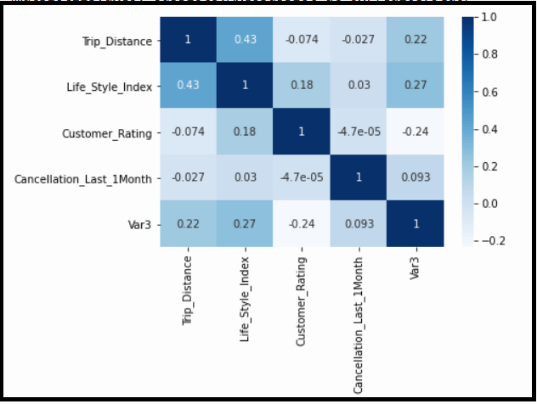
Outlier Treatment: We are considering only Tree based models so no outlier treatment needed.
Multicollinearity:
Scaling: We chose Min Max Scaler because the data is not normal. Min max scaler will help in Normalising the data.
Encoding using Dummies: Dummies is a variant of One Hot Encoding which makes the categorical data machine readable.
Class imbalance: Class is imbalance

Slide 8
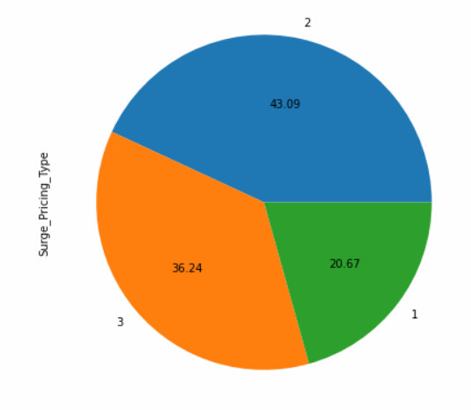
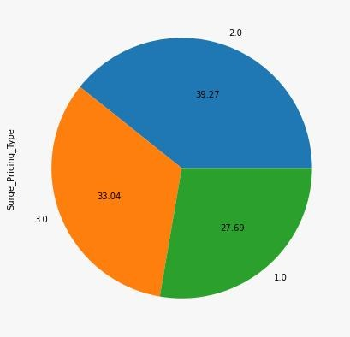
CHALLENGES ADDRESSED
Null/Missing values were handled by simple imputer.
Initially we found the dataset to be imbalanced, we handled the issue by oversampling technique-SMOTE.
Var1,var2 ,var3 is masked by the company due to confidentiality.

Slide 12
Problem Definition
Define the technology and business problem you have solved
Why it is important problem
What are the value additions you planned
Tentative time: 7 minutes

Slide 13
Suggested Solution and EDA
Suggested solution for the defined problem
Data sets considered
Exploratory data analytics done
Any challenges expected/addressed
Tentative time: 6-8 minutes

Slide 14
Algorithms, Solution and Conclusions
Algorithms considered with pros and cons
Solution architecture (technical and functional)
Results
How to take to production
Any follow-up potentional capstone project problems
Conclusions
Tentative time: 6 to 10 minutes

Slide 15
Thanks!

