Slide 1
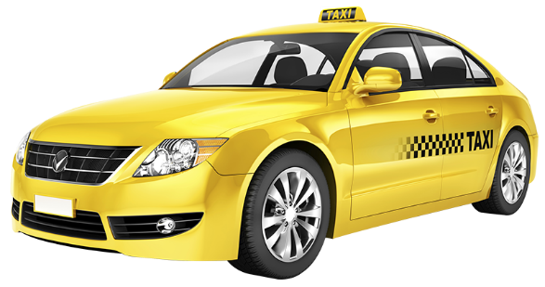
TRIP PRICING WITH TAXI MOBILITY ANALYTICS
Mentor:
Ms. Vibha Santhanam
Done by:
S.Vignesh
Abhijith S Varma
V. Ram Prakash
G. Siva Kumar
M. Vignesh

Slide 2
PROBLEM STATEMENT
We are predicting the surge price type for Sigma Cabs. Previously surge price was given by service providers, from that information they have captured surge price type, we are building a predictive model based on that surge price type, so that they can fix the fare beforehand.
Surge Pricing: Dynamic pricing, also referred to as surge pricing, demand pricing, or time-based pricing is a pricing strategy in which businesses set flexible prices for products or services based on current market demands.
This can happen due to the following factors:
Special events
Rush hour
Bad weather

Slide 3
IMPORTANCE
We are helping the client to became a cab aggregator.
Literature Survey 1: Dynamic pricing model for cruising taxicab based on system dynamics.
Literature Survey 2 : Analysing Bangkok city taxi ride: reforming fares for profit sustainability using big data driven model.

Slide 4
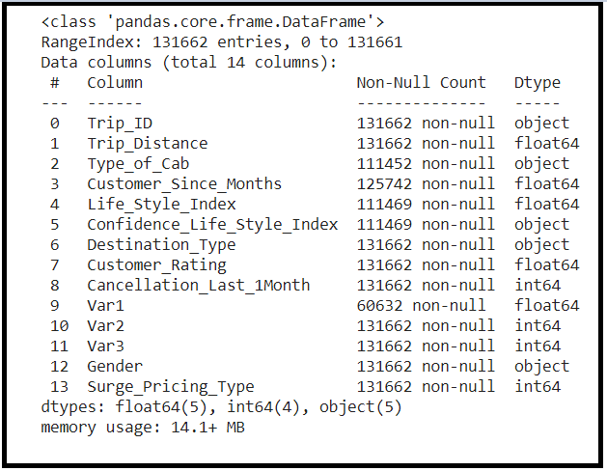
PROPOSED SOLUTIONS AND DATASET CONSIDERED
We are suggesting to build a predictive ML model in order to predict the surge price type effectively.
In depth analysis of the dataset in order to derive deeper insights from the data like discovering the relation of target variable in the data.
Visual analysis of the data to discover the relationship between independent variable and dependent variable.
Dataset: TRIP PRICING WITH TAXI MOBILITY ANALYTICS
VARIABLE CATEGORIZATION:
No of rows: 131662
Total Features/Columns :14
Numerical Features :06
Categorical Features:08
Target : Surge_Pricing_Type(Multiclassification)
Dataset Link: https://www.kaggle.com/arashnic/taxi-pricing-with-mobility-analytics

Slide 5
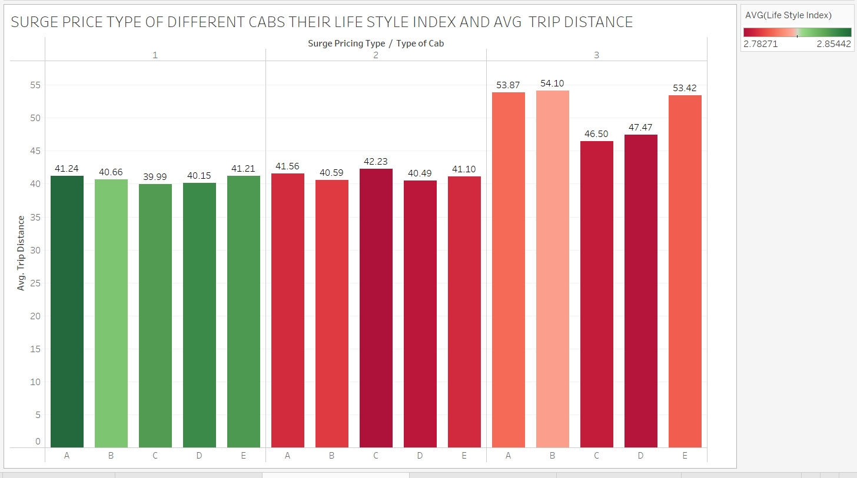
VALUE ADDITIONS
TABLEAU FINDINGS FOR MASKED TARGET VARRIABLE
Based on analysis from Tableau we came to conclusion surge_type_1 price is high,surge_type_2 price is low and surge_type_3 price is medium.

Slide 6
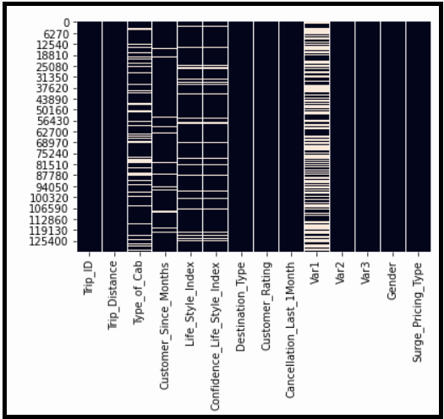
EXPLORATORY DATA ANALYTICS
Data Preprocessing :
Data type conversion
Missing value Treatment
Outlier Treatment
Feature selection using Multicollinearity
Scaling
Encoding using dummies
Treating class imbalance
DATA TYPE CONVERSION:
Customer_since_months is in float so we are converting it into object.
Surge_type_pricing is in int so we are converting it into object.
Missing value Treatment:
:
We are using simple imputation method to impute the Nan Values

Slide 7
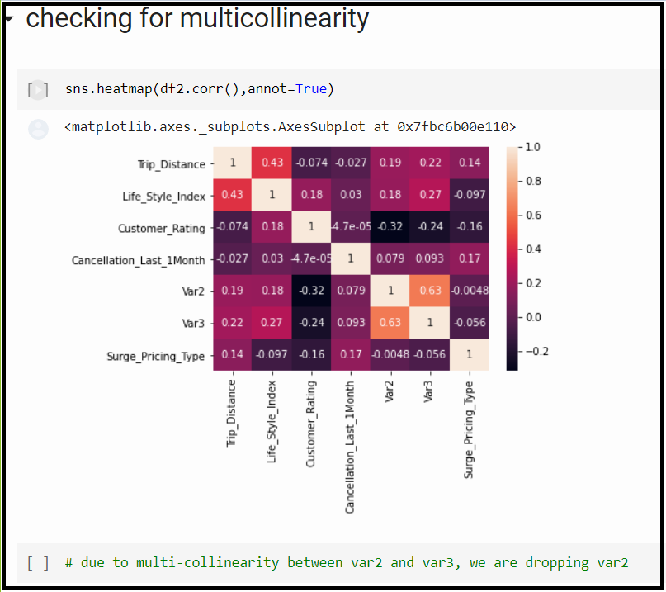
Outlier Treatment: We are considering only Tree based models so no outlier treatment needed.
Multicollinearity:
Scaling: We chose Min Max Scaler because the data is not normal. Min max scaler will help in Normalizing the data.
Encoding using Dummies: Dummies is a variant of One Hot Encoding which makes the categorical data machine readable.
Class imbalance: Class is imbalance

Slide 8
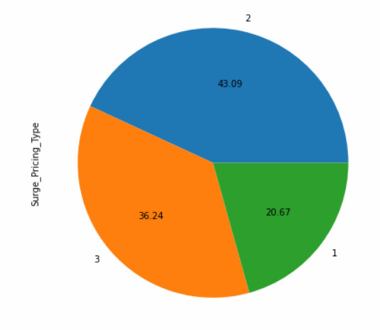
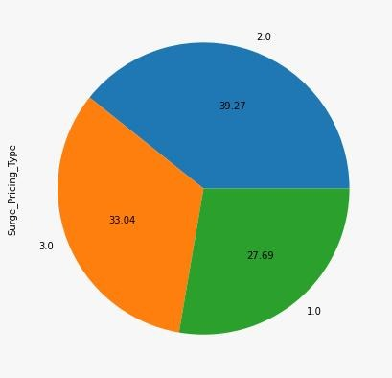
CHALLENGES ADDRESSED
Var1,var2 ,var3 is masked by the company due to confidentiality.
Null/Missing values were handled by simple imputer.
Initially we found the dataset to be imbalanced, we handled the issue by oversampling technique-SMOTE.

Slide 9

Algorithms considered for the data
K-Nearest Neighbors (Base model)
Advantages
Easy to interpret
No assumptions needed before building the model
As it won’t learn anything in training stage , the distance calculations are fast
Disadvantages
Sensitive to outliers
More memory is required for calculations
Prediction stage of the model requires more time
Results of KNN Model

Slide 10

Random Forest with GridSearchCV (Final model)
Advantages
As this is a bagging model , estimators runs parallely which makes model faster to build
Random forest is not susceptible to outliers i.e., outliers have no influence on the model
Reduces variance error (overfitting)
Disadvantages
Needs more computational resources to runs the jobs parallely
Results of the Random Forest Model

Slide 11
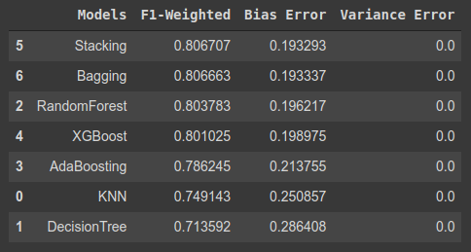
Comparison and summary of all the algorithms
Comparing to base model (KNN) , there is a significant improvement in all the metrics we focused on such as f1-weighted , bias error and variance error

Slide 12
Production Procedure
For production , we need to create a web application to get the input and output of the model predictions
In any kind of application there are two parts:
Frontend : This the “visual” area where we can actually give inputs and see the results. For the frontend, we will have a template create from html. You can make frontend template with html , php or javascript.
Backend : Backend is where all workings of a web applications happens. This is the backbone of a web application where all of application’s integrity lies. We made the backend using the python library known as Flask. Django is another alternative for the backend processes of a web application
The place where you deploy the application is known as host server. We can host a web application in two different ways ,
Local Storage
Cloud Storage - We can host our web application in cloud if the models are complex and hard to run on a local platform. Data Centers used for Cloud storage is strong and powerful and expensive. Examples are : Heroku , GCP , AWS , Azure etc
In this particular case we are going with Local deployment as deploying the model in this case is not necessary.
Initially we create a pickle file out of model we created using pickle libraries `.dump()` function. Pickling makes the model into a byte stream which we can use for the backend and unpickle while deploying.
Then , we create frontend template using Html5 and internal CSS. Then we link the frontend and the pickle file to create a backend using Flask. Here we render the html by using a function in flask library known as render_template

Slide 13
SUMMARIZE:
Problem Statement:
We are predicting the surge price type for our company that is sigma cabs.
Previously prices were determined by service providers, from that information sigma cabs have captured surge price type ,we are building a predictive model based on that surge price_type,so, so that customers can know the fare beforehand.
1
2
COMPLEXITY INVOLVED
The challenge we faced model was able to predict the surge type but type 1 ,type 2 and type 3 is not defined so based on EDA,we assumed that Type 1 is of high price, Type 2 is of low price and type 3 is of medium price.
The company needs to keep confidentiality , as a result of this there are 3 masked variables generated by the company (one of which is removed due to the high occurrence of null values).
Y INVOLVED
3
4
PROJECT OUTCOME
Our project is for commercial purpose. We are helping Sigma Cabs, a startup cab aggregator to predict the surge price type with the data they have provided.
APPLICATIONS
Sigma cab app

Slide 14
Thanks!

