Slide 1
NORTHEASTERN UNIVERSITY EAI6010 APPLICATIONS OF ARTIFICIAL INTELLEGENCE PROJECT TITLE : HUSKY CHATBOT FOR COVID-19 INSTRUCTOR: SERGIY SHEVCHENKO
SUBMITTED BY :
ARVIND PAWAR
ASHWINI KUMAR PATHAK
SHWETA GUPTA
SINCHEN GUNDMI
VIGNESH THULASI DASS

Slide 2
Table of Content
Introduction
Socket programming
Steps for topic identification
Topic identification methods
Sentiment analysis
Recommendations
Challenges
Conclusion
References

Slide 3

Introduction
COVID-19 was declared pandemic by WHO and in order to help us understand the severity of the virus , internet and technology has helped us today.
Our project utilizes the Artificial Intelligence to create a chatbot, with the help of Advanced NLP and data on COVID-19 from the CDC and WHO.
Our chatbot answers the queries on COVID-19 and provides recommendations for people based on sentiment during quarantine.

Slide 4

Socket Programming
It is the concept of connecting more than two nodes on a network to communicate with each other
It has been used as a front end to accept user’s questions and provide the best possible answers
It contains a server script which has the capability to handle multiple client or user who can connect to the server at the same time
Smooth transitioning among major objectives of chatbot has been achieved by developing high performance functions inside socket programming

Slide 5
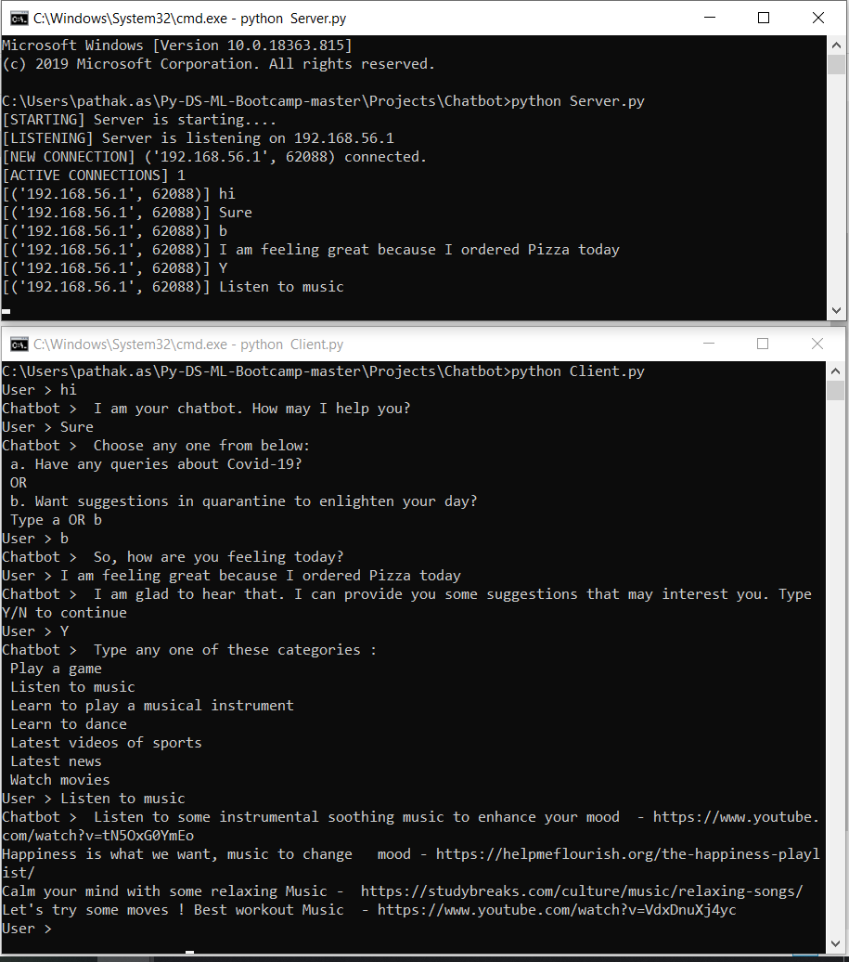
Example
On the server side, logs are being shown which explains that how many active connections are present along with client IP address which is connected to the server.
On the client side, chatbot is answering user’s query based on each question by user.
Whole chatbot is divided into two major objectives:
To resolve queries about COVID-19
To provide recommendations to user’s to improve quarantine life by analyzing their sentiments

Slide 6




Steps for Topic Identification
Converting the text to lower case
Removing Punctuation
Removing Stop words
Word Tokenization
TF-IDF Vectorization

Slide 7
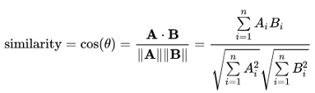
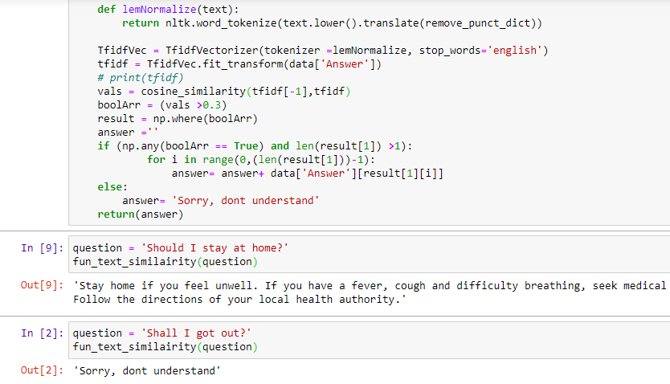
Topic Identification Methods
Cosine Similarity:
Cosine similarity is a metric used to measure how similar the texts are.
It calculates similarity by measuring the cosine of angle between two vectors.
Using TF-IDF, we converted the text into vectors and using the cosine_similarity function from sklearn package, we have calculated the similarity score.
The score will range from 0 to 1,
1 indicating highest similarity
0 indicating no similarity

Slide 8
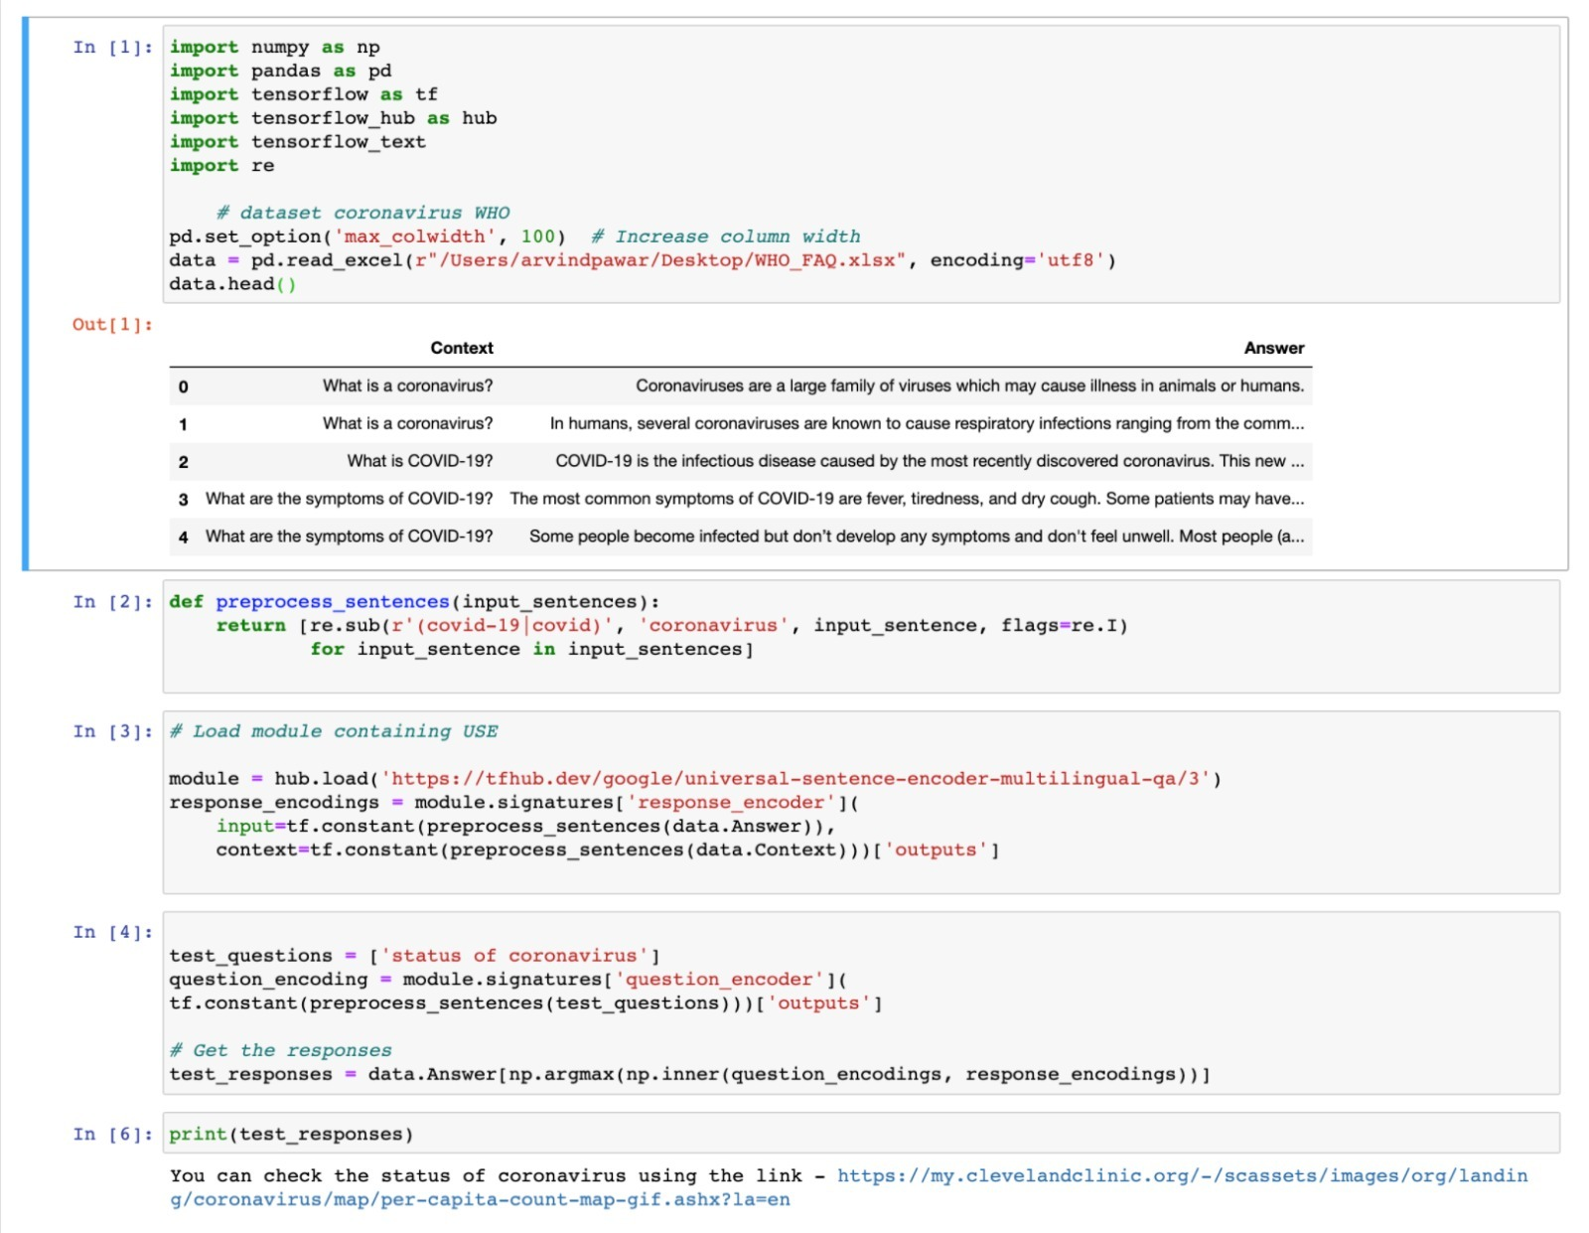
Topic Identification Methods
Tensorflow_hub:
It has Universal Sentence Encoder(USE) module to extract text embedding from titles and from article contents.
It encodes text into high dimensional vectors that can be used for text classification, semantic similarity, clustering and other natural language tasks.
The USE is trained on a total of 16 languages.

Slide 9

Sentiment analysis
VADER (Valence Aware Dictionary and sEntiment Reasoner) is a lexicon and rule-based sentiment analysis tool that is specifically attuned to sentiments expressed in social media.
Advantages of using VADER
It works exceedingly well on social media type text, yet readily generalizes to multiple domains.
It doesn’t require any training data but is constructed from a generalizable, valence-based, human-curated gold standard sentiment lexicon.
It is fast enough to be used online with streaming data.
It does not severely suffer from a speed-performance tradeoff.

Slide 10
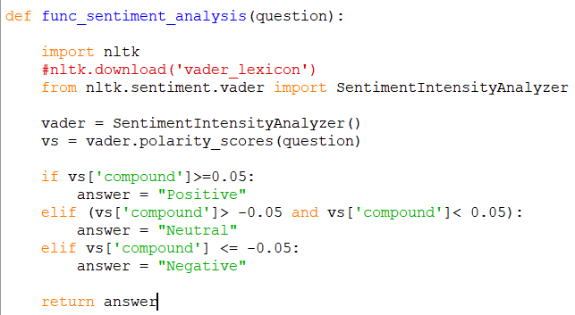
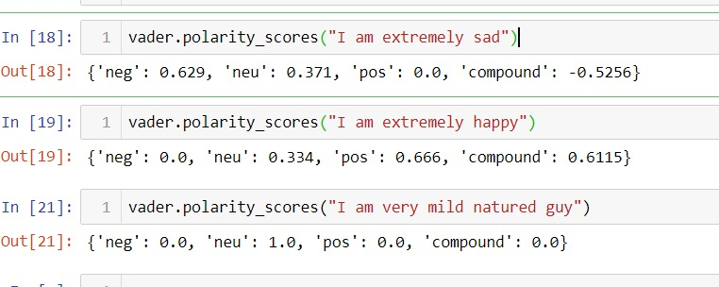
Example
The Positive, Negative and Neutral scores represent the proportion of text that falls in these categories. This means our sentence was rated as 67% Positive, 33% Neutral and 0% Negative. Hence all these should add up to 1.
The Compound score is a metric that calculates the sum of all the lexicon ratings which have been normalized between -1(most extreme negative) and +1 (most extreme positive). In the below example, lexicon ratings for and “Best thing” are 2.9 and respectively 1.3. The compound score turns out to be 0.63 , denoting a very high positive sentiment.
VADER performs very well with emojis, slangs, and acronyms in sentences.

Slide 11
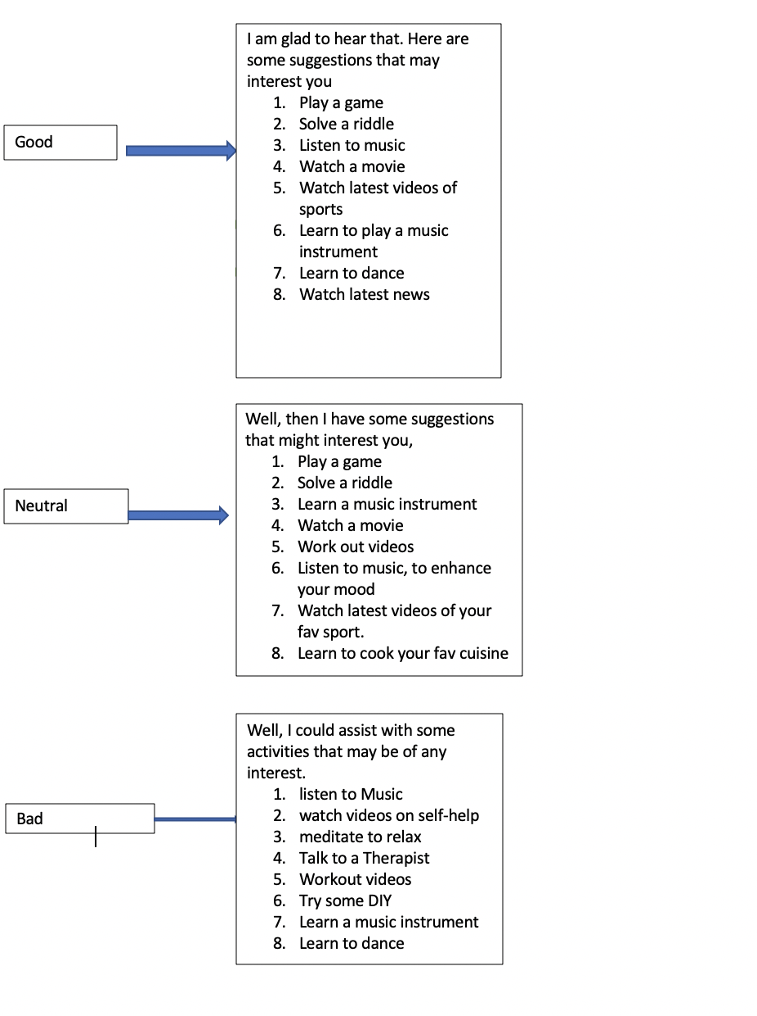
Recommendations
The input from the user is used to understand the sentiment of the user and provide recommendations for the sentiment using the cosine similarity.
The sentiment is classified as Positive, Neutral and Negative using the VADER library.
The recommendations are provided for mental and physical health during quarantine.

Slide 12
Challenges
Tensorflow_text has version compatibility issues with Windows; hence we could not implement Universal Sentence Encoder(USE) on Windows system
Using cosine similarity we can match the similar words in two different sentence, but we cannot find the similarity in the intent of the two.
After merging the separate codes for topic identification, cosine similarity and sentiment analysis in socket programming, integration failed at many instances.

Slide 13

Conclusion
The Tensorflow-hub has been most effective in topic identification as compared to cosine similarity function.
The chatbot can answer to the questions asked in 16 different languages, which is one of the advantages of USE module.
Socket programming acts as easy and effective in connecting more than 1 client to the server and has the capability to handle long texts.
The recommendations on the chatbot are based on the sentiment and these recommendations can uplift the mood during the social distancing.

Slide 14
References
Socket Programming in Python (Guide). Retrieved from https://realpython.com/python-sockets/
Simplifying Sentiment Analysis using VADER in Python (on Social Media Text). (2019). Medium. Retrieved 13 May 2020, from https://medium.com/analytics-vidhya/simplifying-social-media-sentiment-analysis-using-vader-in-python-f9e6ec6fc52f
Adrien Sieg, Jul 2018, Cosine Similarity. Retrieved from https://medium.com/@adriensieg/text-similarities-da019229c894
Introducing TensorFlow Hub: A Library for Reusable Machine Learning Modules in TensorFlow. (2019). Retrieved 13 May 2020, from https://medium.com/tensorflow/introducing-tensorflow-hub-a-library-for-reusable-machine-learning-modules-in-tensorflow-cdee41fa18f9

Slide 15


