Slide 1
Project Title: Implementation of Routing algorithms in data center networks
Student’s Name: Vignesh Vaidyanathan
Course : TELE6400 (SDN), Semester: Fall 2020
Professor’s Name: Prof. Dr. Bhumip KHASNABISH
Presentation Date, Location & Time: 12/15/2020, 6pm to 9.30pm

Slide 2
Outline
Abstract and Summary
Main Focus of the Project
Survey of Previous works
Distinction of the Current Work
Usefulness of the Current Work
Simulation/Emulation Details
Results
Future works
Q&A and Discussion
References
Background and Other Information

Slide 3
Abstract and Summary
In the modern era of data center technology, we have a huge network to works with or to maintain.
In order to make sure that the network is working at its most efficient manner we make use of different routing algorithm so that the traffic is routed to the optimum path and make sure that the network is maintained.
This can be achieved using different routing algorithm in our data centers like the Dijkstra’s and the ECMP algorithm in the software defined network virtualized topologies.
Over here I am making use of the POX controller because it is a Python-based open-source OpenFlow Controller and provides well defined APIs, and I am familiar with Python. And its main advantage is that it supports all and latest versions of OpenFlow protocol and is also been selected as one of the best controllers for SDN based environment.

Slide 4
Main Focus of the Project
My project is focusing on how different routing protocols are used in data center networks for the smooth operation of different SDN virtualized topology. The goal of this final project was to implement a simulation of a Fat Tree / Clos topology for a data center network in Mininet with various routing protocols.
We build a software defined networking (SDN) network using simulated switches with an SDN controller. The First part of the project is to develop a fat tree topology in the Mininet using the script. Next part is run Dijkstra’s algorithm between two pairs of end hosts.
First, we built the algorithm that takes in a nested dictionary list that holds all nodes and every connected node to that given node. Last and the final part of the project is to implement ECMP which uses a hash function to pick a given path through the fat tree network topology from the k different paths.
After application of these routing algorithms, I will run an analysis on which routing algorithm will be the best suited for the modern-day data centers. Apart from analysis I will be making use of Wireshark to run the traces in the messages sent from one host to the other to check the fastest and the shortest path to reach the destination.
I will also be using Mininet to build the fat tree topology. Adding to this project gives us the knowledge of how there is a controllers and routing protocols be used in the designing a complete data center.

Slide 5
Survey of 5 Previous Similar Works (over last 3 years or so)
[1] A Scalable, Commodity Data Center Network Architecture by Mohammad Al-Fares, Alexander Loukissas, Amin Vahdat. http://ccr.sigcomm.org/online/files/p63-alfares.pdf
[2] http://www.brianlinkletter.com/using-the-pox-sdn-controller/
[3] R. Khondoker, A. Zaalouk, R. Marx, and K. Bayarou. Feature-based comparison and selection of Software Defined Networking (SDN) controllers. In Computer Applications and Information Systems (WCCAIS), 2014 World Congress on, pages 1–7, Jan 2014.
[4] Software-Defined Networking: The New Norm for Networks. White Paper, Open Networking Foundation, April 2012.

Slide 6
Survey of 5 Previous Similar Works (over last 3 years or so)
[5] Extending Dijkstra's shortest path algorithm for software defined networking by Jehn-Ruey Jiang ; Hsin-Wen Huang ; Ji-Hau Liao ; Szu-Yuan Chen
[6] A new approach to dynamic routing in SDN networks by Slavica Tomovic ; Nedjeljko Lekic ; Igor Radusinovic ; Gordana Gardasevic
[7]http://www.gilles-bertrand.com/2014/03/disjkstra-algorithm-description-shortest-path-pseudo-code-data-structure-example-image.html

Slide 7
Distinction of the Current Work
What is new in my project is that I have installed a controller which will apply the dijkstras algorithm in the topology (Fattree topology in my case) and then perform the iperf command to see the shortest path traced in the topology.
I have made use of the POX controller because it is used in small scale applications and POX is used for faster development and prototyping of new network applications
The path over here is considered by the use of cost between the link which is considered by the bandwidth. The formula for the cost is determined by
Cost = Reference Bandwidth/Bandwidth of the link

Slide 8
Usefulness of the Current Work
The first use case of this project is to understand the working of a data center network.
Second thing that I have learnt from this project is how can we make use of SDN in todays data center and how can we improve on it.
Advantage of this project is that due to the use of SDN we can improve the over all throughput, speed, efficiency in a data center network.
Also, this gives us the ability for companies to use open-source products in data center networking to improve the overall working of data center.

Slide 9
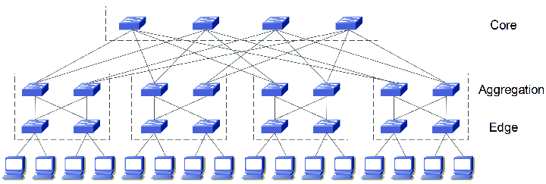
Simulation/Emulation Details (Environment and Setup)
The topology that I have built over here is given in the following diagram below:

Slide 10
Simulation/Emulation Details (Environment and Setup)
In my topology I have made use of 20 switches of which 4 switches are the central switches or the core switches which is also known as number of pods(k).
Then the aggregator and the edge switches are determined by the value of the pods. The number of switches in a topology is calculated by equation k(k+1)
The total number of hosts/servers is calculated by the equation k^2.
Lastly, there are (k/2)^2 paths connecting every pair of host/servers.

Slide 11
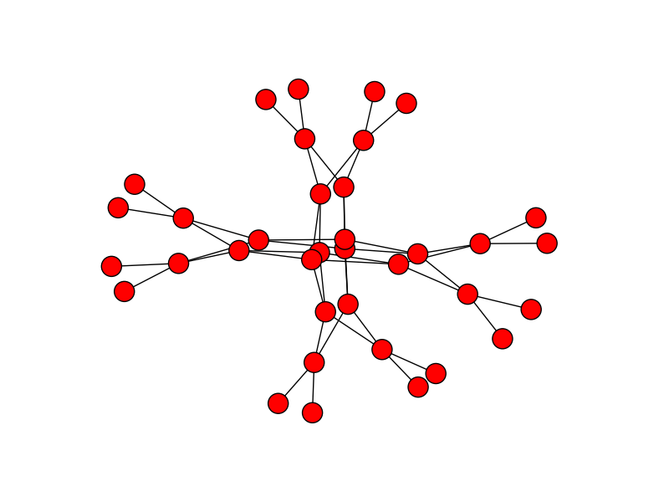
Simulation/Emulation Details (Environment and Setup)
The actual figure or the diagram in a data centre

Slide 12
Simulation/Emulation Details (Environment and Setup)
Next step after designing the topology is to write a algorithm for implementation of Dijkstras Shortest Path First.
Simultaneously implemented the ECMP algorithm as well which is also known as the Hashed Dijkstras.
Wrote a separate script for the POX controller for the working of the topology so that the switches get to know about the destination through the controller.

Slide 13
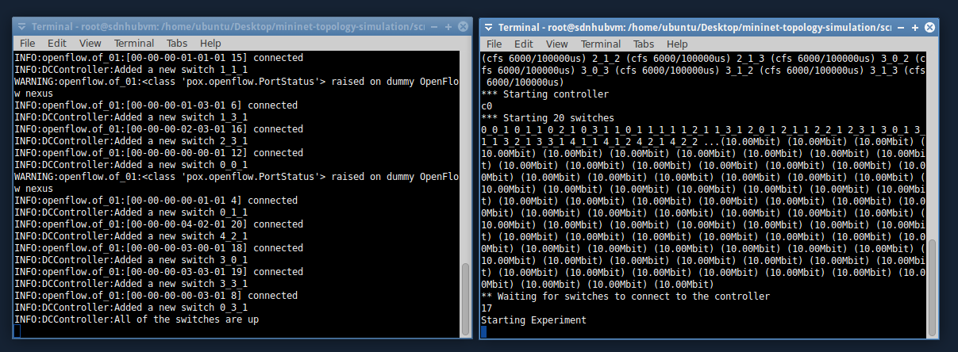
Simulation/Emulation Details (Tools and Monitoring Options)
Now I ran both the scripts for the controller as well as the mininet topology simultaneously in two separate terminals.

Slide 14
Simulation/Emulation Details [Adjustment(s), Adaptations, etc.]
First I run the script for the Dijstras algorithm and the POX controller simultaneously.
Over here I have given the input i.e pinging of host to the another through iperf command through a file.
On execution of the iperf command the output is written in a different file which tells about the bandwidth required to reach the current destination and also whether the destination is reachable or not.

Slide 15
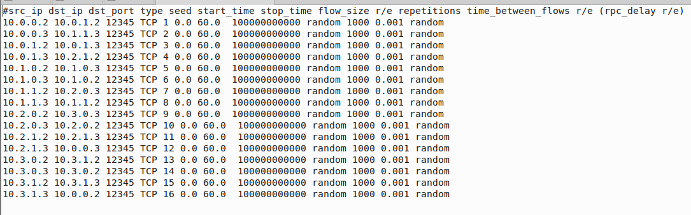
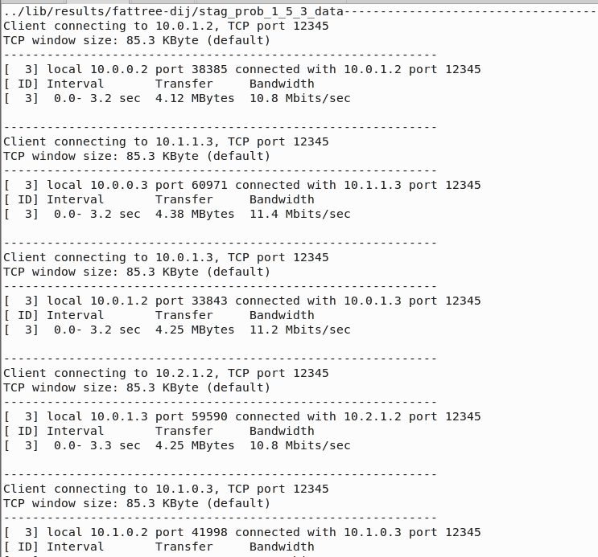
Simulation/Emulation Details [Adjustment(s), Adaptations, etc.]

Slide 16
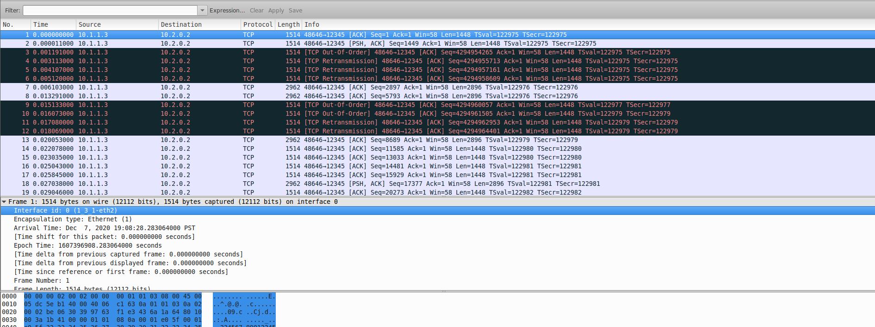
Simulation/Emulation Details [Adjustment(s), Adaptations, etc.]
I also ran the Wireshark simultaneously with the controller and we can see the flow of packets or the flow generated in the topology.

Slide 17
Simulation/Emulation Details [Adjustment(s), Adaptations, etc.]
The same thing is repeated for the ECMP algorithm I ran the controller and the script simultaneously.
Again I had given inputs through a file and recorded the output through iperf command into a separate file.
We can see the reachability of each and every host in the topology.

Slide 18
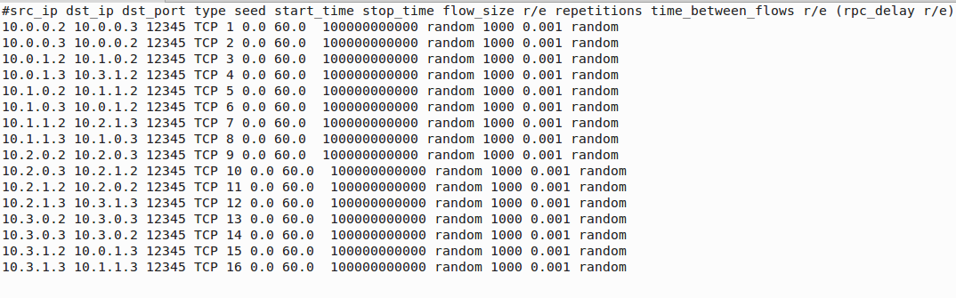
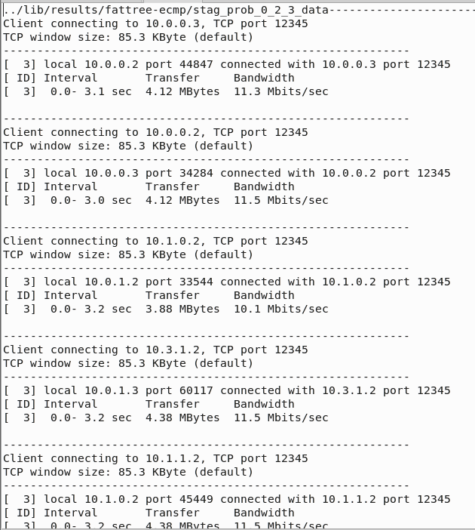
Simulation/Emulation Details [Adjustment(s), Adaptations, etc.]

Slide 19
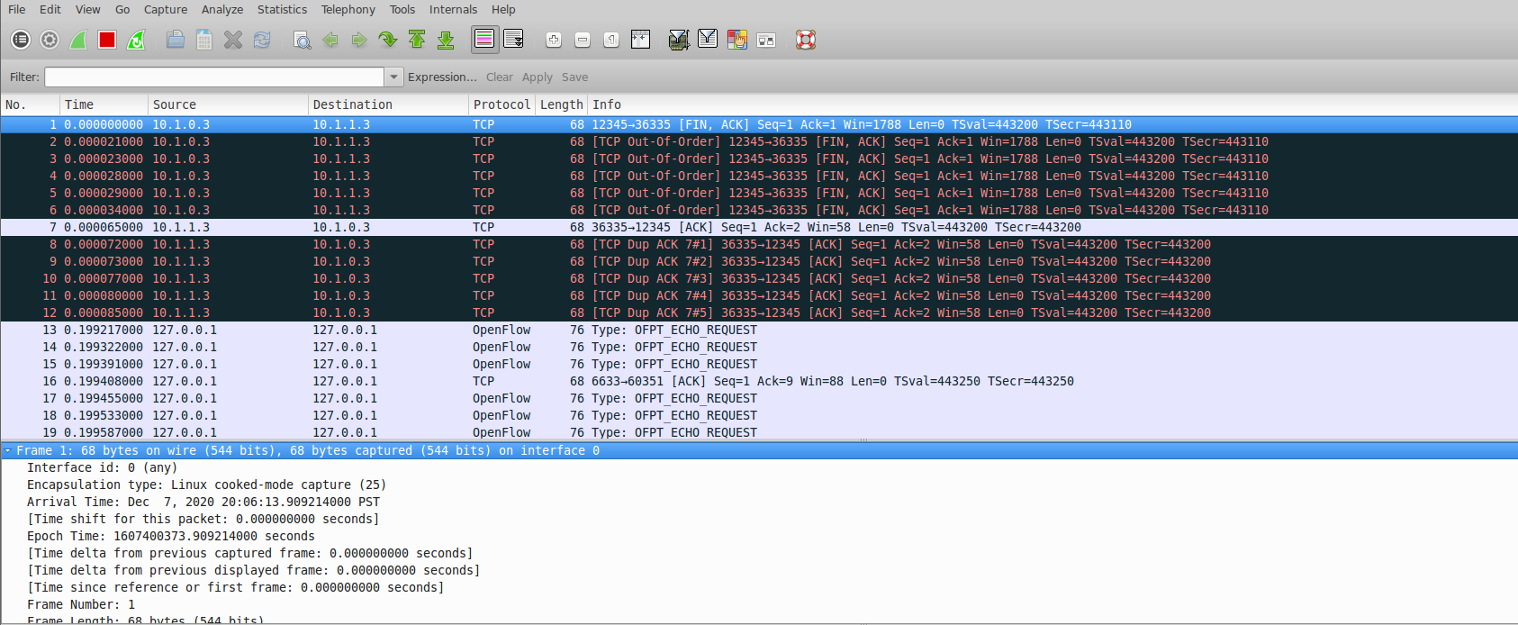
Simulation/Emulation Details [Adjustment(s), Adaptations, etc.]
Apart from the iperf command I even ran wireshark simultaneously while running the script so as to se the flow of packets in the topology.

Slide 20
Results
After the implementation of the project I can say that both Dijkstras and the ECMP algorithm has its own advantages.
If we consider Dijkstras algorithm in a data center only one single path will be considered for packet transfer from one host to another.
While if we consider ECMP then we can send traffic through different paths having same cost. This will indeed increase the throughput significantly.

Slide 21
Future Works
Multiple controllers can be used in a data center network in order to configure different routing algorithms.
Apart from linked state algorithms like the dijkstras and ECMP we can even make use of Path-vector Algorithms and Distance Vector Algorithms.
The link to the video is https://youtu.be/-4w-U5NP5h4

Slide 22





Q&A and Discussion
Thanks for Your KIND Attention
Discussion

Slide 23
References
http://www.gilles-bertrand.com/2014/03/disjkstra-algorithm-description-shortest-path-pseudo-code-data-structure-example-image.html
http://www.gilles-bertrand.com/2014/03/dijkstra-algorithm-python-example-source-code-shortest-path.html
https://tools.ietf.org/html/rfc2992
https://www.sciencedirect.com/topics/computer-science/fat-tree-topology
https://www.researchgate.net/figure/4-Pod-Fat-Tree-topology_fig5_312538681
http://csie.nqu.edu.tw/smallko/sdn/dijkstra_ecmp.htm

Slide 24
Background and Other Information

Slide 25
Weekly Activities Log
Week No. | List of Tasks (Planned) | Log of Achievements, Errors, and Learning
03 | In this week I planned to study about different routing protocols and algorithms that can be used in data center networks | Came across different algorithms like the Dijkstras , ECMP and also the Path Vector Algorithms that are used in Data center Networks.
04 | The plan for this week was to do complete literature survey and select an approach to start the project. | I read around 4-5 technical papers related to data center networking, how the routing is configured in data center and also how to SDNization is implemented in Data Center Networks.

Slide 26
Weekly Activities Log
Week No. | List of Tasks (Planned) | Log of Achievements, Errors, and Learning
05 | The plan for this week is to Finalize and Design a topology for my Project. | Finalising the topology was an issue as I came across difficulties in understanding the layer structure of the fat tree topology, what is the relation between the layers, Formulas to determine the hosts, switches , the links etc.
06 | In this week I planned to select the controller that I would be using in this project. | After a carful and deep understanding of the POX and RYU controller I finalsed to use the POX controller because it can be easily coded using Python and yes mininet is preinstalled in the controller itself.

Slide 27
Weekly Activities Log
Week No. | List of Tasks (Planned) | Log of Achievements, Errors, and Learning
07 | Plan for this week was to create a small topology in minnet. | Running the code for testing the topology and then made an analysis how many switches and host I need to set up for my final topology.
08 | In this I planned to work on the Dijkstras algorithm for my project | Went through a lot websites and researched on the algorithm and wrote the code which will determine the shorted path from one host to the another.

Slide 28
Weekly Activities Log
Week No. | List of Tasks (Planned) | Log of Achievements, Errors, and Learning
09 | In this week , the plan was to work on the ECMP algorithm | Did a lot of research on the algorithm how it can be implemented , how will it work and also got a algorithm in github for the same which can be used for implementation in my project.
10 | Plan was to start with the testing of the project. | Created the virtual machine and ran the code for the controller as well as the dijkstras algorithm. Came across few errors like the mininet not responding, error in the code where it cannot fetch the topology, error in running the controller.

Slide 29
Weekly Activities Log
Week No. | List of Tasks (Planned) | Log of Achievements, Errors, and Learning
11 | Testing of the Dijkstras Algorithm | Created flows and performed testing using iperf command. Also ran wireshark in the background to see how packets flow from one host to another.
12 | Testing of the ECMP algorithm. | Faced an issue of the controller not stopping or quiting even after giving command to quit it. Testing the ECMP algorithm and followed the same process as done for Dijkstras algorithm.

Slide 30
Weekly Activities Log
Week No. | List of Tasks (Planned) | Log of Achievements, Errors, and Learning
13 | In this week the plan was to see what should I change in my code for smooth working of the project. | Created a set of input file to determine the flow from each host to the another and to see if it is working properly or not.
14 | The task for this week is the completion of the ppt for presentation and to have a review of it with the TA. | Completed the presentation according to the guidelines provided by the professor and reviewed it with the TA.

