Slide 1



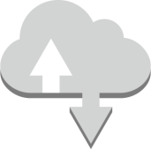










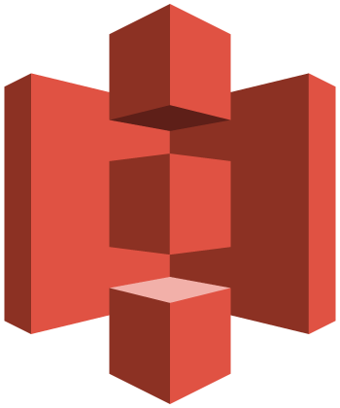





VPC Architecture Icons
virtual private cloud
corporate data center
security group
AWS cloud
customer gateway
elastic network adapter
elastic network interface
endpoints
Internet
VPC subnet
Amazon DynamoDB
flow logs
Internet gateway
router
VPC NAT gateway
Amazon CloudWatch
Amazon S3
instance
Internet gateway
VPC peering
VPN connection
VPN gateway
network access control list

Slide 2
VPC Architecture

Slide 3

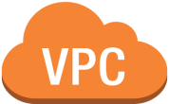

















VPC Architecture
www
Internet gateway
flow logs
Amazon DynamoDB
Internet
Router
Router table
Public
Ec2
Amazon CloudWatch
VPC NAT gateway
network access control list
security group
Public subnet
Amazon S3
VPC peering
Router
Router table
Private
Ec2
endpoints
Private
Ec2
security group
security group
network access control list
corporate data center
Private subnet
VPN gateway
Site to site VPN connection
customer gateway
Availability zone A
virtual private cloud
AWS cloud

Slide 4
Step by Step Process

Slide 5
Create VPC
virtual private cloud
AWS cloud

Slide 6
Adding Two Subnet in one Availability zone
Public subnet
Private subnet
Availability zone A
virtual private cloud
AWS cloud

Slide 7
Create an Ec2 instance for public and private subnet
Public
Ec2
security group
Public subnet
Private
Ec2
security group
Private subnet
Availability zone A
virtual private cloud
AWS cloud

Slide 8
Internet Gateway
www
Internet gateway
Internet
Public
Ec2
security group
Public subnet
Private
Ec2
security group
Private subnet
Availability zone A
virtual private cloud
AWS cloud

Slide 9
Route Table
www
Internet gateway
Internet
Router
Router table
Public
Ec2
security group
Public subnet
Router
Router table
Private
Ec2
security group
Private subnet
Availability zone A
virtual private cloud
AWS cloud

Slide 10
NAT Gateway
www
Internet gateway
Internet
Router
Router table
Public
Ec2
VPC NAT gateway
security group
Public subnet
Router
Router table
Private
Ec2
security group
Private subnet
Availability zone A
virtual private cloud
AWS cloud

Slide 11
NACL
www
Internet gateway
Internet
Router
Router table
Public
Ec2
VPC NAT gateway
network access control list
security group
Public subnet
Router
Router table
Private
Ec2
security group
network access control list
Private subnet
Availability zone A
virtual private cloud
AWS cloud

Slide 12
VPC Peering
www
Internet gateway
Internet
Router
Router table
Public
Ec2
VPC NAT gateway
network access control list
security group
Public subnet
VPC peering
Router
Router table
Private
Ec2
security group
network access control list
Private subnet
Availability zone A
virtual private cloud
AWS cloud

Slide 13
Endpoints
www
Internet gateway
Amazon DynamoDB
Internet
Router
Router table
Public
Ec2
Amazon CloudWatch
VPC NAT gateway
network access control list
security group
Public subnet
Amazon S3
VPC peering
Router
Router table
Private
Ec2
endpoints
Private
Ec2
security group
security group
network access control list
Private subnet
Availability zone A
virtual private cloud
AWS cloud

Slide 14
Flow Logs
www
Internet gateway
flow logs
Amazon DynamoDB
Internet
Router
Router table
Public
Ec2
Amazon CloudWatch
VPC NAT gateway
network access control list
security group
Public subnet
Amazon S3
VPC peering
Router
Router table
Private
Ec2
endpoints
Private
Ec2
security group
security group
network access control list
Private subnet
Availability zone A
virtual private cloud
AWS cloud

Slide 15
VPN
www
Internet gateway
flow logs
Amazon DynamoDB
Internet
Router
Router table
Public
Ec2
Amazon CloudWatch
VPC NAT gateway
network access control list
security group
Public subnet
Amazon S3
VPC peering
Router
Router table
Private
Ec2
endpoints
Private
Ec2
security group
security group
network access control list
corporate data center
Private subnet
VPN gateway
Site to site VPN connection
customer gateway
Availability zone A
virtual private cloud
AWS cloud

