Slide 1
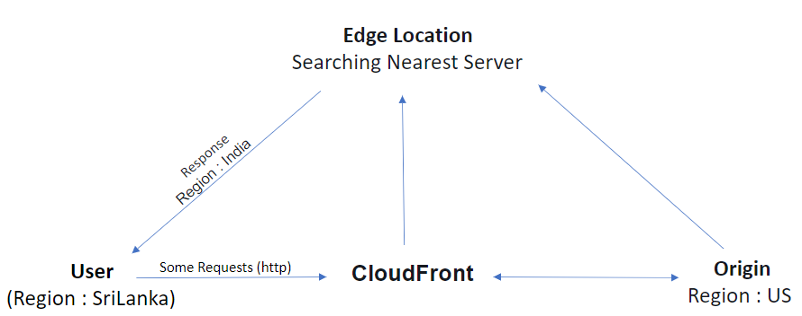
CloudFront
CloudFront is a Web service – Use CDN (Content Delivery Network)
CDN --> Used for keeping content closer(Nearest Server) to the user
Example : Netflix, YouTube, Facebook, ...
Terminology --> Edge Location, Origin, Time To Live (TTL)
Edge Location --> Delivers your content through a worldwide --- Nearest Server
Origin --> Original server
TTL --> Traffic

Slide 2
Key Features
Invalidations
Restrictions --> Geo Restriction
Key Management --> Signed URL & signed Cookies
Invalidations :
For sharing updated files to edge location from origin
Delete cached content in edge location and to add new content
Restrictions - Geo Restriction :
you can specify either a whitelist (countries where they can access your content) or a blacklist (countries where they cannot)
Signed URL :
Allow you to control who can access your content
Restrict access to individual file
Example : Netflix membership --> Those who only access some movies
signed Cookies :
Allow you to control who can access your content – Not change current URL
Restrict Multiple files
Example : Netflix membership --> Those who only access Playlist movies

