Slide 1
Docker ECS - ECR - EKS

Slide 2
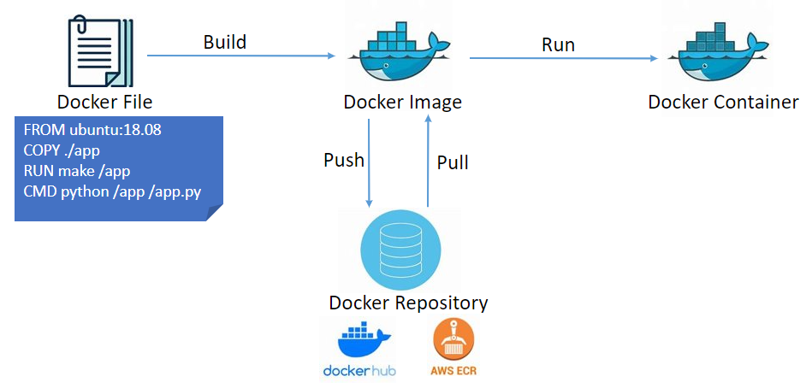
Docker
It is a software development platform to deploy apps
Apps are packaged in containers that can be run on any OS
Apps run the same, regardless of where they're run
--> Any machine
--> No compatibility issues
--> Predictable behavior
--> Less work
--> Easier to maintain & deploy
--> Works with any language, any OS
Docker images are stored in Docker Repositories Public : (Ubuntu, Java, MySQL, NodeJS, ….)
Private : Amazon ECR (Elastic Container Registry)
Public : Amazon ECR Public

Slide 3
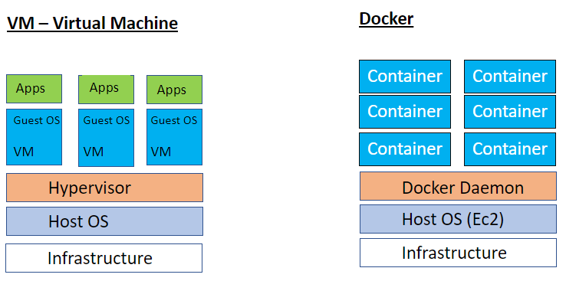
Docker vs VM (Virtual Machines)
Resources are shared with the host --> Many containers on one server

Slide 4
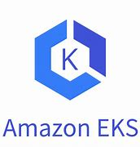

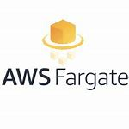
Docker Containers Management
To manage containers , need a Container Management Platforms
ECS : Amazon's own container Platform
Fargate : Amazon's own Serverless container platform
EKS : Amazon's managed Kubernetes (Open Source)

Slide 5
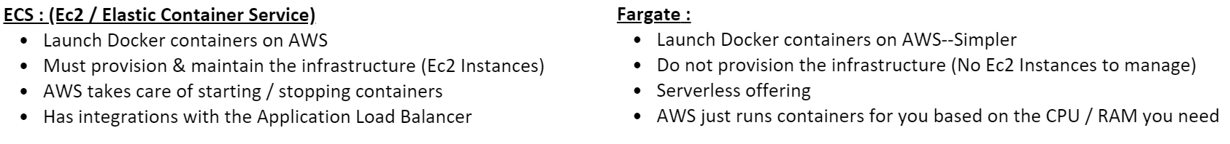
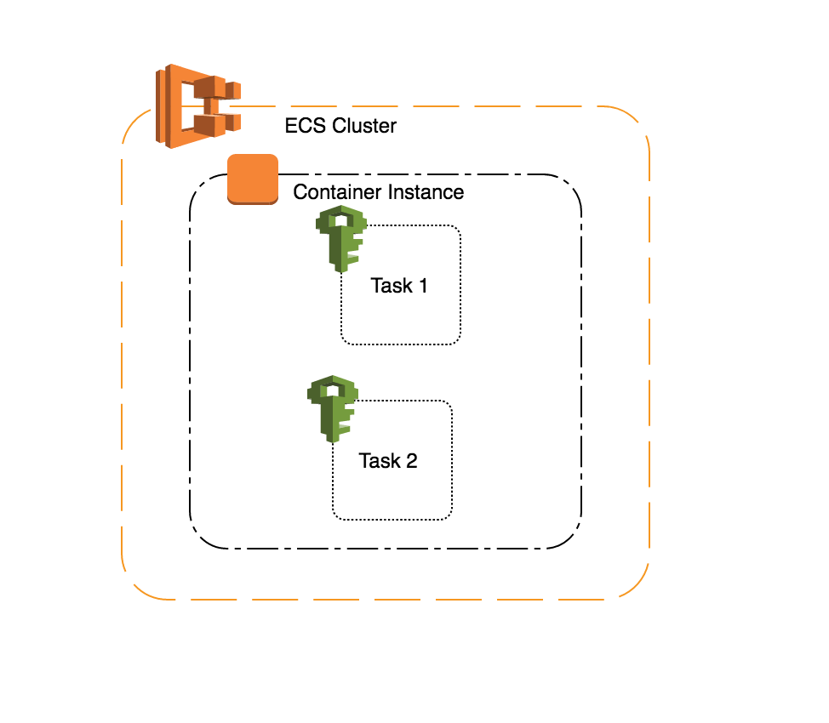
ECS and Fargate

Slide 6
IAM Roles for ECS Tasks
EC2 Instance Profile :
Used by the ECS agent
Makes API calls to ECS Services
Send container logs to CloudWatch Logs
Pull Docker image from ECR
ECS Task Role :
Each task have a specific role
Use diff roles for diff ECS services you run
Task role is defined in the task definition

Slide 7
ECR : Elastic Container Registry :
Store, manage and deploy containers on AWS
Fully integrated with ECS & IAM for security
Backed by Amazon S3
Supports image vulnerability scanning, version, tag, image lifecycle
EKS : Elastic Kubernetes Service :
Alternative to ECS – Similar goal but different API
Way to launch managed Kubernetes clusters on AWS
Kubernetes is an open-source system for automatic deployment, scaling & management of containerized (Docker) application
EKS supports EC2 if you want to do deploy worker nodes or Fargate to deploy serverless containers

