Slide 1
LAMBDA OVERVIEW
Trigger-based code execution
Serverless computing --> AWS manage the Lambda so user does not need to manage this
No infrastructure to manage
High performance at any scale
Pay for use -- (Pay per request and compute time)
Bring your own code
Language support --> Python, Java, Node.js, C# (.NET Core), Go, C#(PowerShell), Ruby
--> Custom Runtime API (Ex : Rust)
--> Lambda Container Image (Ex : Docker images)

Slide 2
FUNCTION
Created IAM role automatically based on function name or use existing role
Attach policy to the role when its needed
Code logs are stored in CloudWatch Logs
Maximum execution time is 15 mins.
Layer --> upload some library packages into the function in ZIP format
--> Zip file Size does not exceed 50 MB

Slide 3
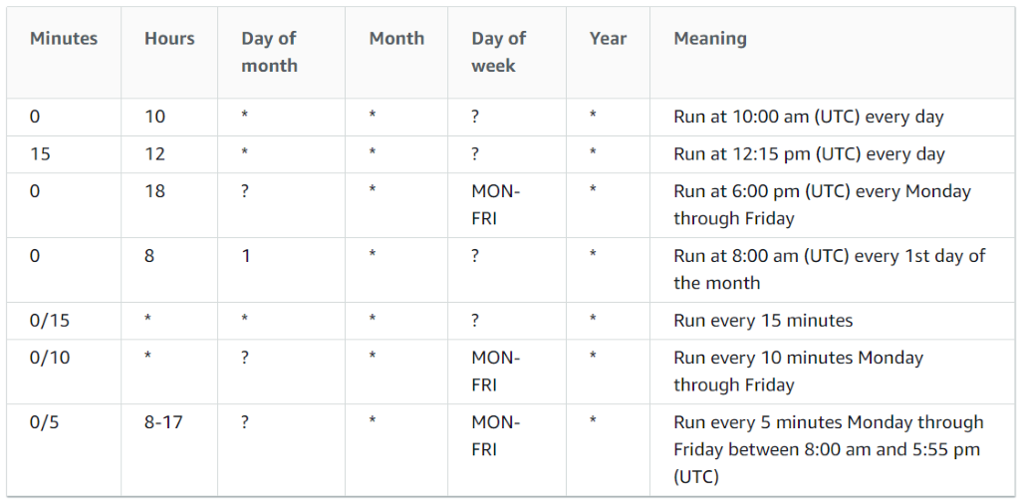
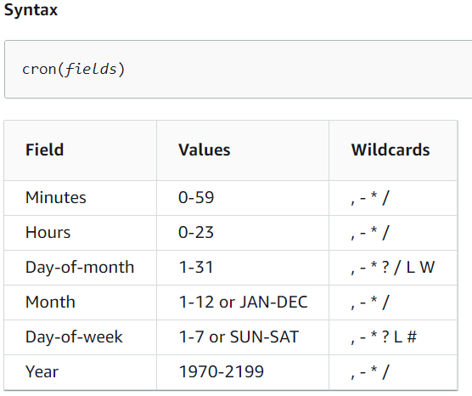
TRIGGER
CloudWatch Events / Event Bridge :
Cron Expressions
Examples :
cron(0 12 * * ? *) --> Triggered every day at 12:00pm UTC
cron(5,35 14 * * ? *) --> Triggered every day, at 5 and 35 minutes past 2:00pm UTC
cron(15 10 ? * 6L 2002-2005) --> Triggered at 10:15am UTC on the last Friday of each month during the years 2002 to 2005.
cron(0 09 ? * MON-FRI *) --> Triggered Monday to Friday at 09.00am UTC

Slide 4
Python code
Stop Instance :
import boto3
region = 'us-east-1'
instances = ['i-05c57dbb45e3ebd54']
def lambda_handler(event, context):
ec2 = boto3.client('ec2', region_name = region)
ec2.stop_instances(InstanceIds = instances)
print ('Stopped your instances : ' + str(instances))
Start Instance :
import boto3
region = 'us-east-1'
instances = ['i-05c57dbb45e3ebd54']
def lambda_handler(event, context):
ec2 = boto3.client('ec2', region_name = region)
ec2.start_instances(InstanceIds = instances)
DryRun=True
print ('Started your instances : ' + str(instances))
S3 List :
import boto3
s3= boto3.resource('s3')
def lambda_handler(event, context):
bucket_list = []
for bucket in s3.buckets.all():
print("bucket -----> " + bucket.name)
bucket_list.append(bucket.name)
return{
'statusCode' : 200,
'body': bucket_list
}

