Slide 1


SMART INDIA HACKATHON 2024
License-Chain
Problem Statement ID – SIH1589
Problem Statement Title- Blockchain based license protection
Theme- Blockchain & Cybersecurity
PS Category- Software
Team ID-
Team Name – Next-us

Slide 2
License-Link
Next-us
PROBLEMS :
Many software and game licenses are pirated or used without permission, causing developers to lose an estimated $50 to $60 billion annually due to piracy.
Current license management systems are not secure enough and don’t provide clear tracking, making them vulnerable to misuse.
Existing methods find it hard to stop unauthorized use of licensed software, making piracy a big challenge.
SOLUTION:
Blockchain keeps license data safe and unchangeable.
Hashing makes license checks secure and unique.
The LicenseChain system (NFTs) on a blockchain to keep track of software licenses.
UNIQUENESS :
Unlike old methods, blockchain provides secure, unbreakable protection.

Slide 3
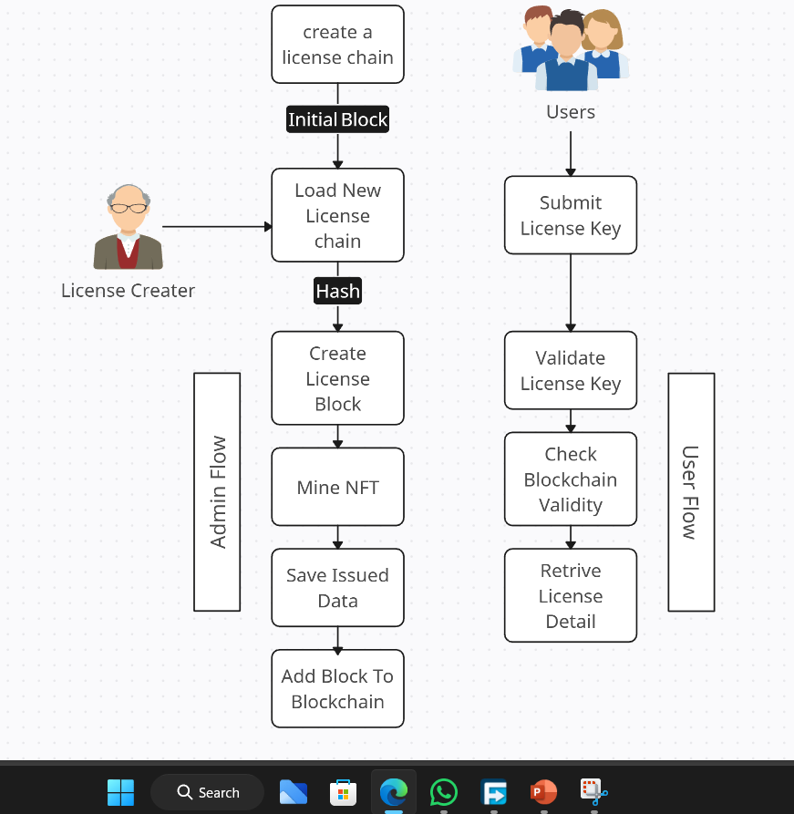
TECHNICAL APPROACH
Next-us
FEASIBILITY :
Setting up blockchain costs money and needs tech skills.
It saves money in the long run by stopping software theft.
Over time, the protection and extra earnings make it worth the cost.
TECHNOLOGY STACK :
FRONT - END
BACK - END
Python
Hashlib
JSON
UUID
React.js
Node.js & Express
HTML/CSS/JavaScript

Slide 4
IMPACT AND BENEFITS
Next - us
•. •.
IMPACT ON USERS :
BENEFITS FOR COMPANIES:.
Less Fraud: Fewer fake keys mean more money for the company
1. Safer : It’s hard for someone to steal or fake your product key.
2. Clear History : You can always see what’s happened with your key.
Better Security: Makes the product safer and improves the company’s reputation
3. Quick Check : The system quickly tells if your key is real or fake.
Economic Benefits:
Boosts Revenue
Supports Innovation
4. Fewer Fakes : Each key is unique, so it’s harder to make fake ones.
REVENUE – STRATEGY :
License-link helps make money by ensuring only paying users can access the software.
People pay because it guarantees they get real and safe software.
5. Stops Cracking : Unique keys on the blockchain make it much harder for hackers to crack and bypass the software.
4

Slide 5
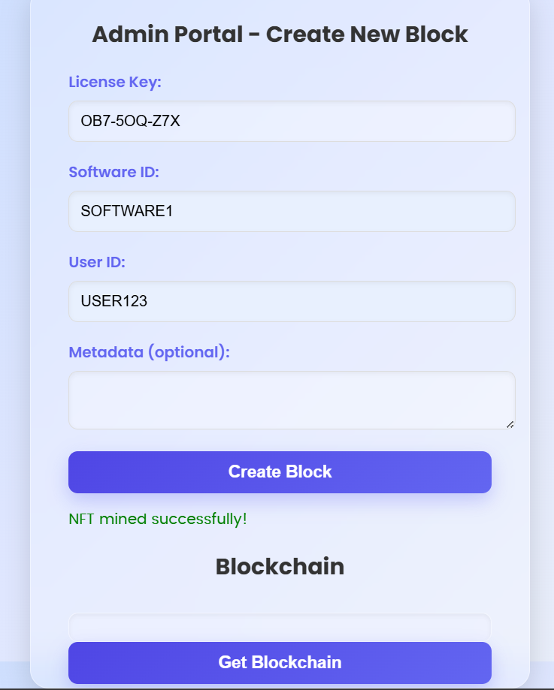
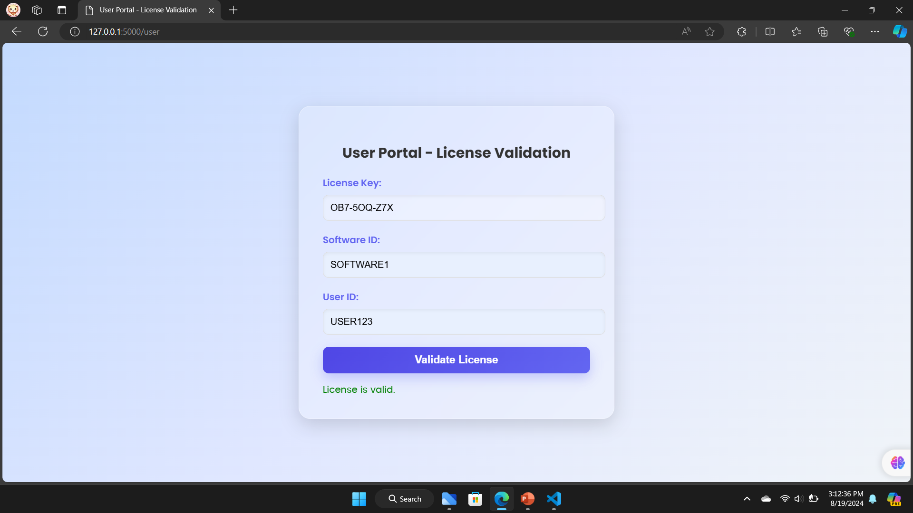
RESEARCH AND REFERENCES
Next-us
Reference: Blockchain-Based Software Subscription and Licenses Management System | IEEE Conference Publication | IEEE Xplore
Our Portal View :

Slide 6
TEAM - MEMBERS
Next – us
Team Leader Name: VIGNESH K
Branch : B. TECH
Team Member 1: SIVARAJ C
Branch : B.TECH
Team Member 2: UDHYAPRAKASH J
Branch : B.TECH
Team Member 3: SHREENIVHAS
Branch : B. TECH
Team Member 4: VIGNESH B
Branch : B. TECH
Team Member 5: SHEREYA B
Branch : B. TECH
Team Mentor 1 Name: SUGANYA Category: Academic
Stream : AI&DS
Year: III
Stream : AI&DS
Year: III
Stream : AI&DS
Year : III
Stream : AI&DS
Year : III
Stream : AI&DS
Year : III
Stream : AI&DS
Year : III
Expertise: CSE
Domain Experience (in years):5

