Slide 1

Software group project CE324
Vignesh Patel-14CE110
Urvish Rana-14CE117
Kushal Reshamdalal-14CE120

Slide 2
INDEX
LOGO
OBJECTIVES
INTRODUCTION
PROBLEM STATEMENTS
WORKING
SCREENSHOTS
CURRENT STATUS

Slide 3


Slide 4
FACE RECOGNITION ATTENDANCE MANAGER

Slide 5
OBJECTIVES
The purpose of this Web App is to make the attendance process easier for college faculties.
To fill the attendance by face recognition and not by regular faculty or CR system.

Slide 6
INTRODUCTION
FRAM is a web app.

Slide 7
INTRODUCTION
FRAM is a web app.
It is very handy, useful web application for faculties as well as students.

Slide 8
INTRODUCTION
FRAM is a web app.
It is very handy, useful web application for faculties as well as students.
It can perform the following operations:

Slide 9
INTRODUCTION
FRAM is a web app.
It is very handy, useful web application for faculties as well as students.
It can perform the following operations:
Face detection.

Slide 10
INTRODUCTION
FRAM is a web app.
It is very handy, useful web application for faculties as well as students.
It can perform the following operations:
Face detection.
Face recognition.

Slide 11
INTRODUCTION
FRAM is a web app.
It is very handy, useful web application for faculties as well as students.
It can perform the following operations:
Face detection.
Face recognition.
Attendance registry.

Slide 12
INTRODUCTION
FRAM is a web app.
It is very handy, useful web application for faculties as well as students.
It can perform the following operations:
Face detection.
Face recognition.
Attendance registry.
Generate report.

Slide 13
PROBLEM STATEMENTS
PROXY PROBLEMS.
TEACHERS FILL ABSENT EVEN THOUGH STUDENT CALLS HIS/HER ROLE CALL BUT NOT AUDIBLE.
TIME CONSUMING.
OBSOLETE METHOD.

Slide 14
WORKING
Login/register.
Face detection.
Face recognition.
Attendance register.
Report.

Slide 15
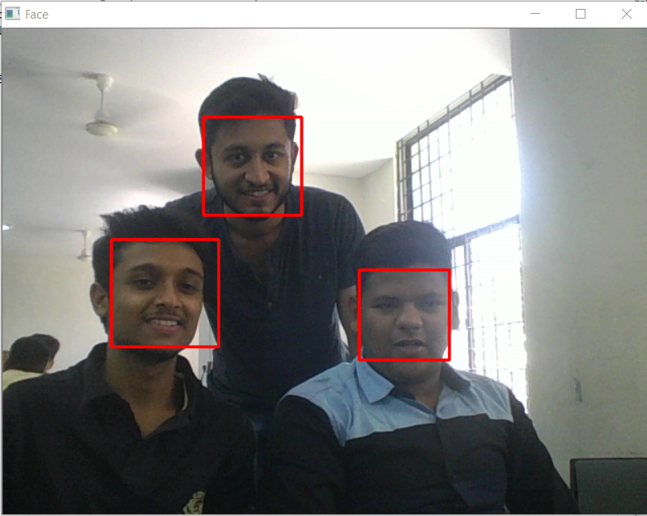
SCREENSHOTS

Slide 16
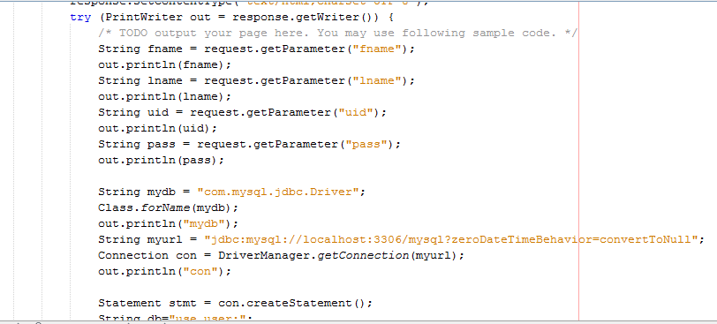
SCREENSHOTS

Slide 17
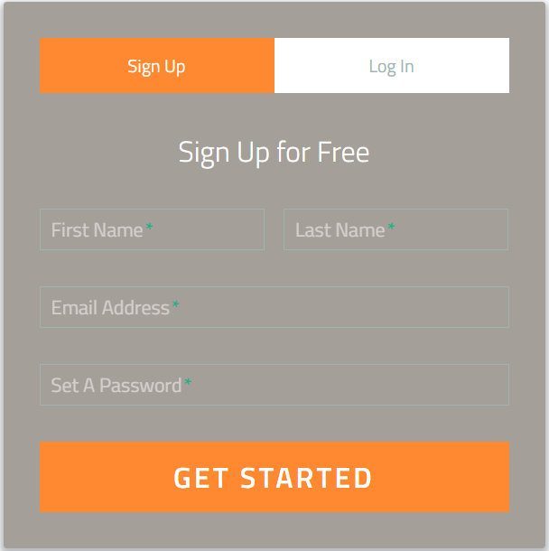
SCREENSHOTS

Slide 18
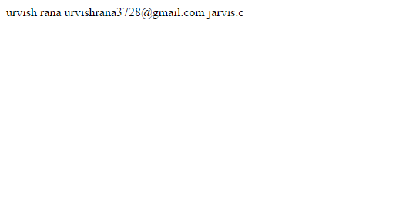
SCREENSHOTS

Slide 19
Thanks for watching.
Have a nice day.

