Slide 1

A Survey System
VIGNESHWAARAR CR (A20392185)
&
LAVANYA SURIKAPURAM (A20392981)
05/04/2017

Slide 2



Final Project Introduction
A Survey System
This application attempts to collect student’s tastes on final projects in ITM classes.

Slide 3
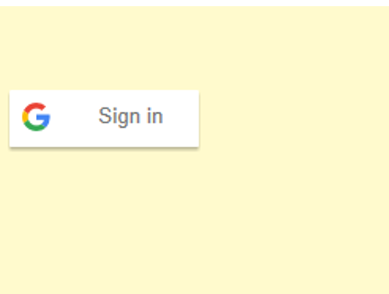
A Survey System Features
Login to this app is through Gmail Hawk ID
The app is splitted into two Applications,
IIT Student Survey Application(This application is for survey feedback by the IIT Students)
IIT Survey Admin Application (This application is for the professor to add list of projects based on courses)

Slide 4
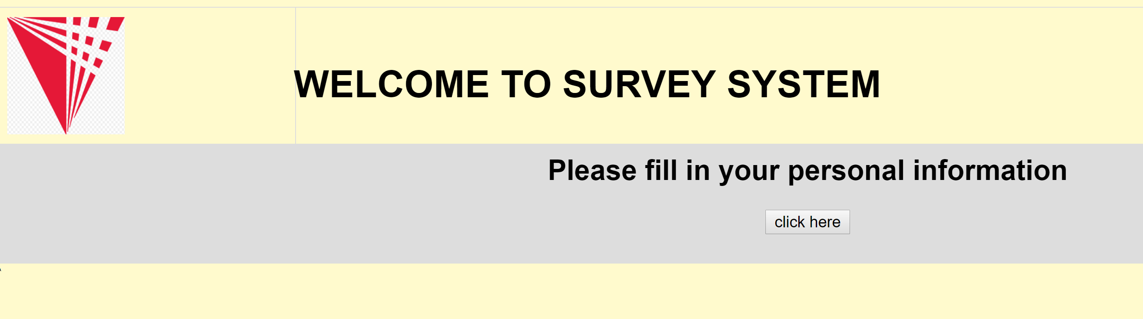
Students Feedback Application Features
Validates if the user has a valid student credentials
If the student is logging in for the first time, the survey will ask to fill up the personal information of the student

Slide 5
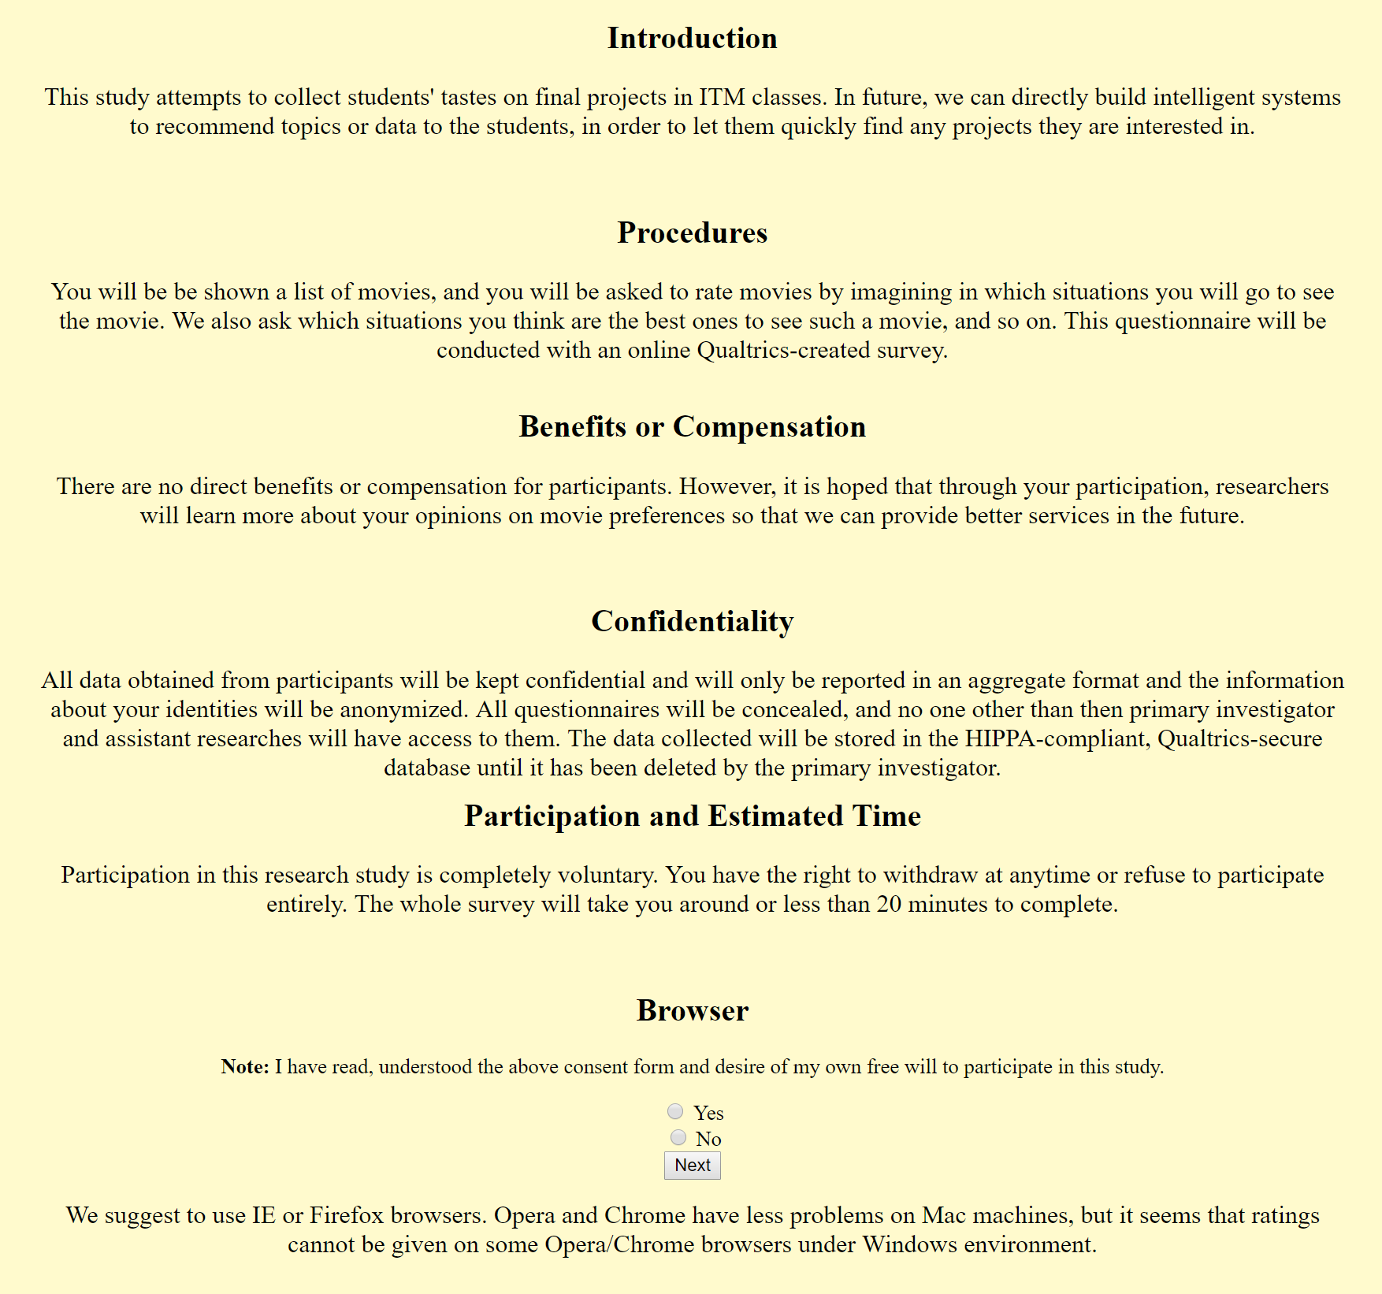
Students Feedback Application Features
Personal Info
Information Consent
Personal info fill up

Slide 6
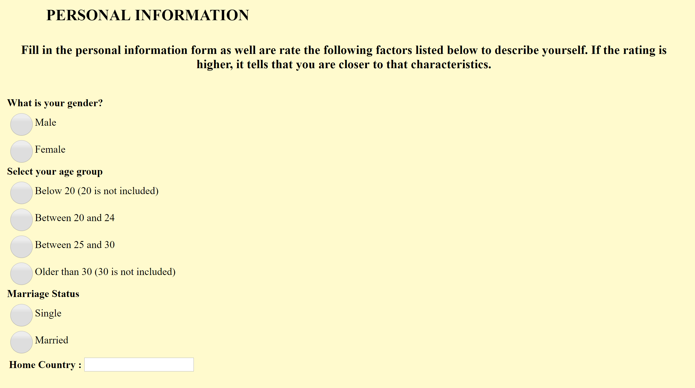
Students Feedback Application Features

Slide 7
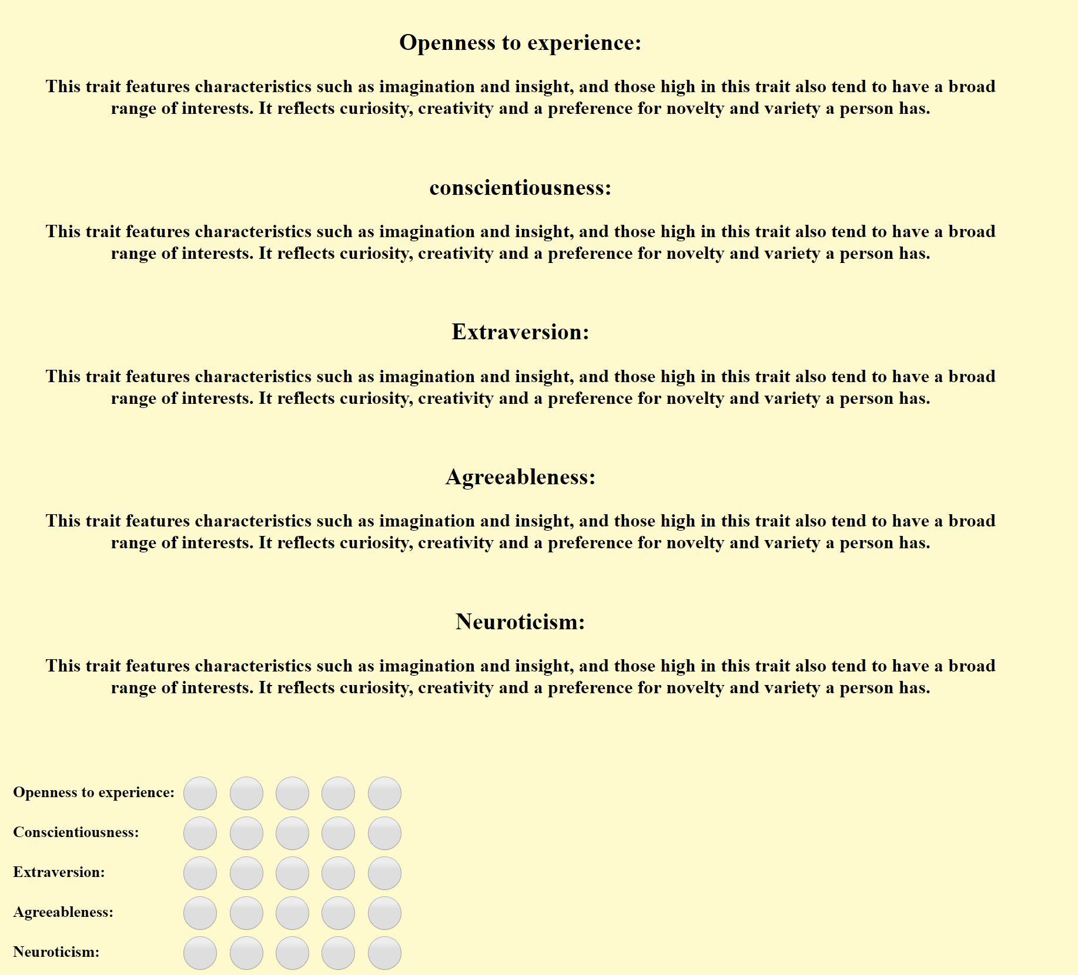
Personal Info Part-2

Slide 8
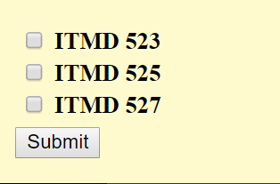
Personal Info Part-3
Course info :
The course info about the student is been asked in the personal info page

Slide 9
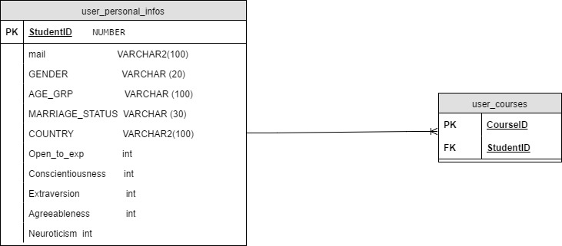
Student Personal Info - DB

Slide 10
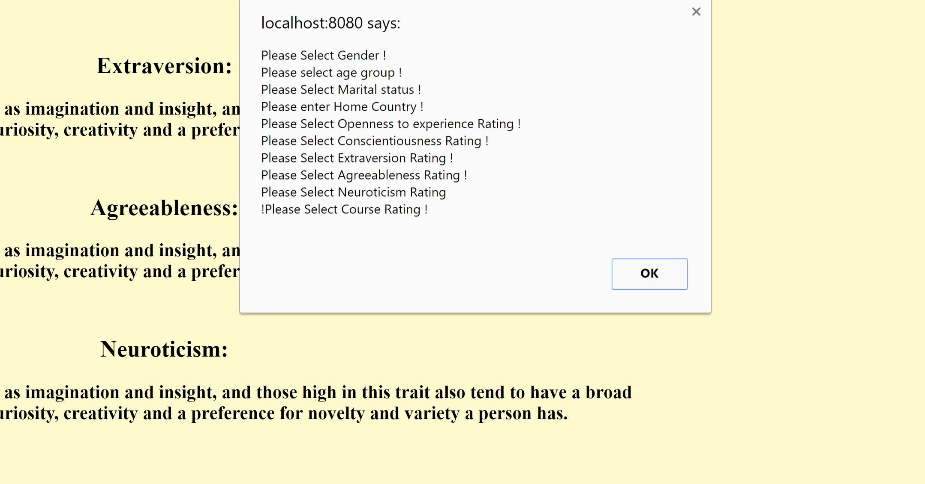
Select Survey Feature

Slide 11
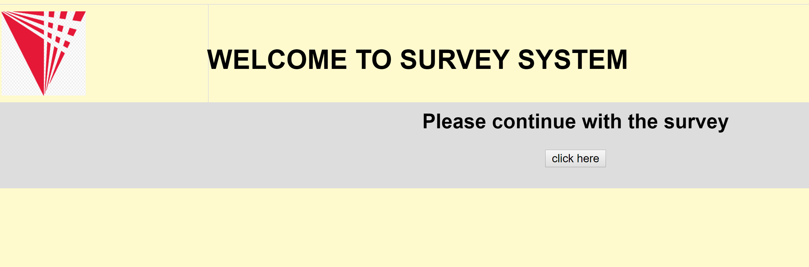
Student logging in 2nd time
If the students loges in for the second time, he will be directed to the survey page as he has already filled up his personal info

Slide 12
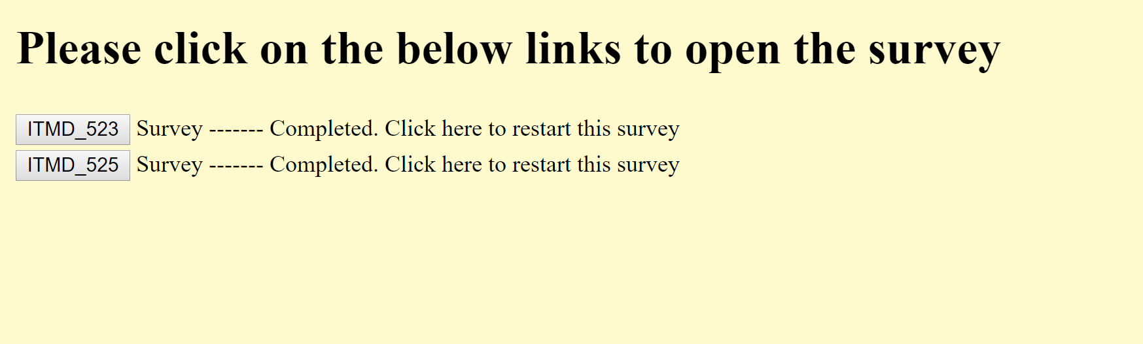
Survey direction page
This the page which directs the student to the corresponding survey page
If the student has completed the survey, a message is notified to the student that he has completed the survey

Slide 13
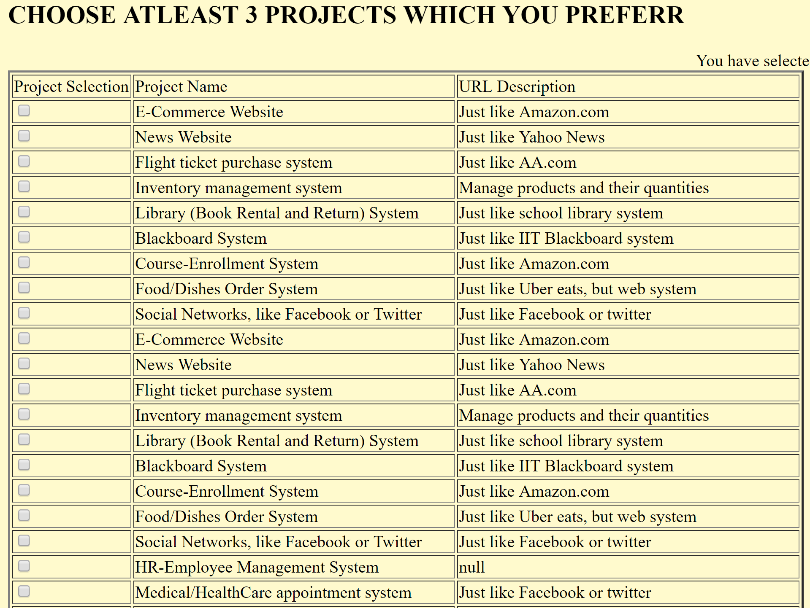
Preferred Project Selection page
As the student clicks the previous link(ITMD_523), he will be directed to this page where he can choose the preferred projects

Slide 14
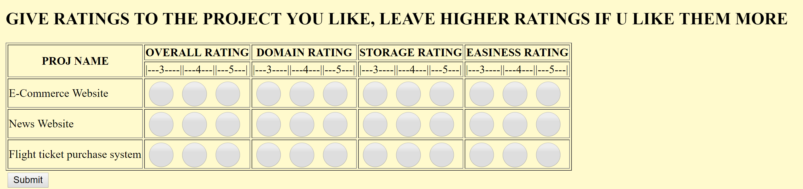
Preferred Project Rating
Here the project ratings is been chosen by the student

Slide 15
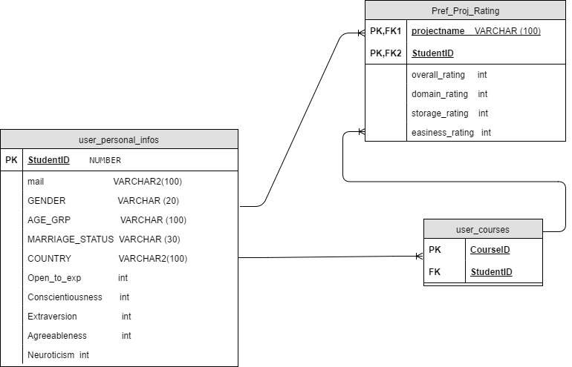
Preferred Project Rating DB

Slide 16
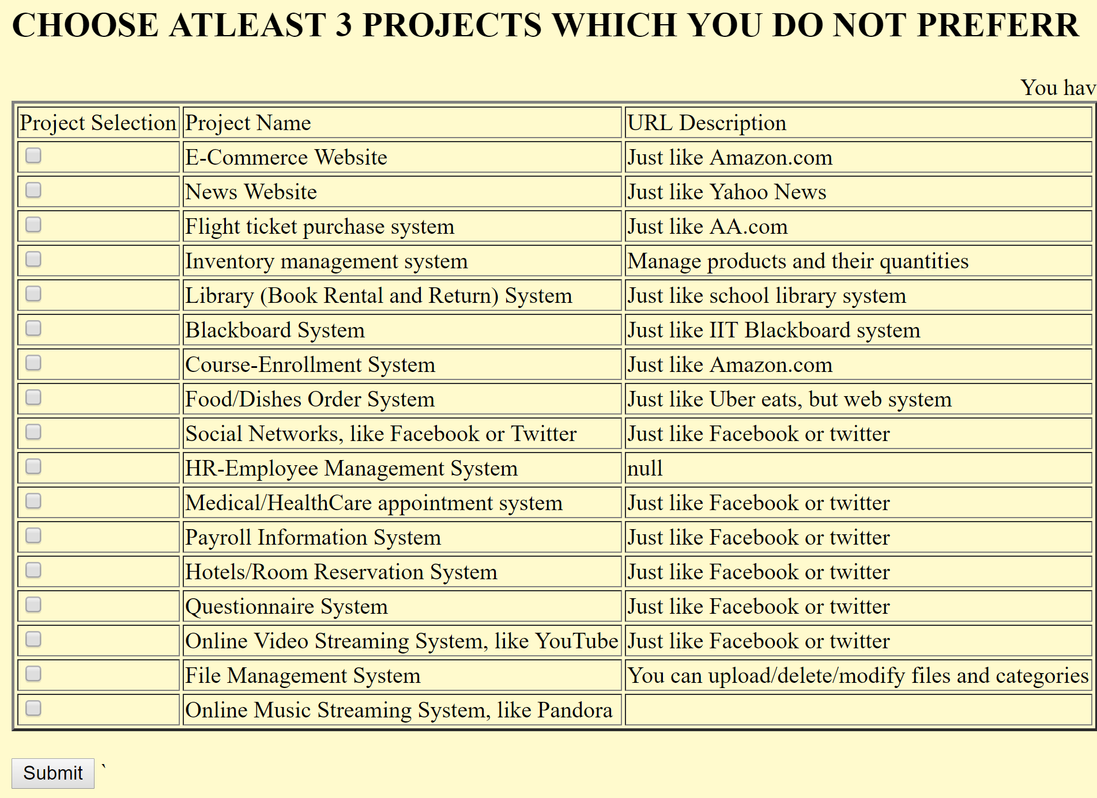
Unpreferred Project Selection page
After filling the ratings for preferred projects he will be directed to this page where he can choose the unpreferred projects

Slide 17
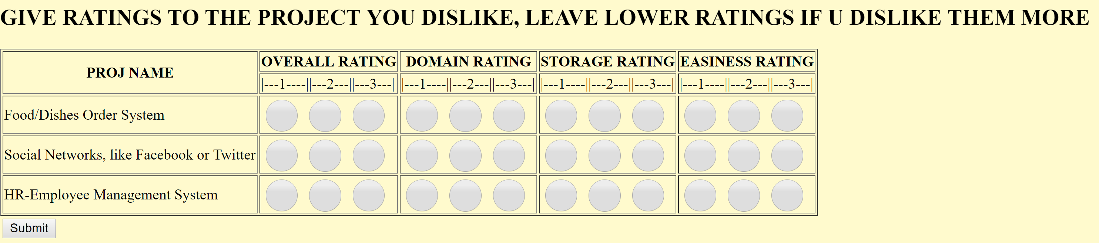
Unpreferred Project Rating
Here the unpreferred project ratings is been chosen by the student

Slide 18
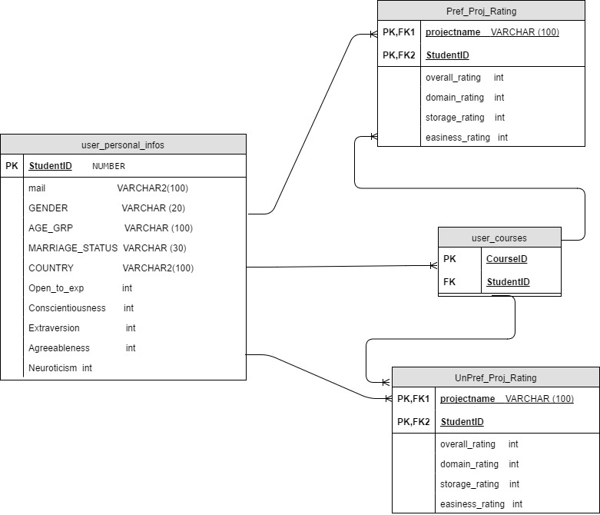
Unpreferred Project Rating DB

Slide 19
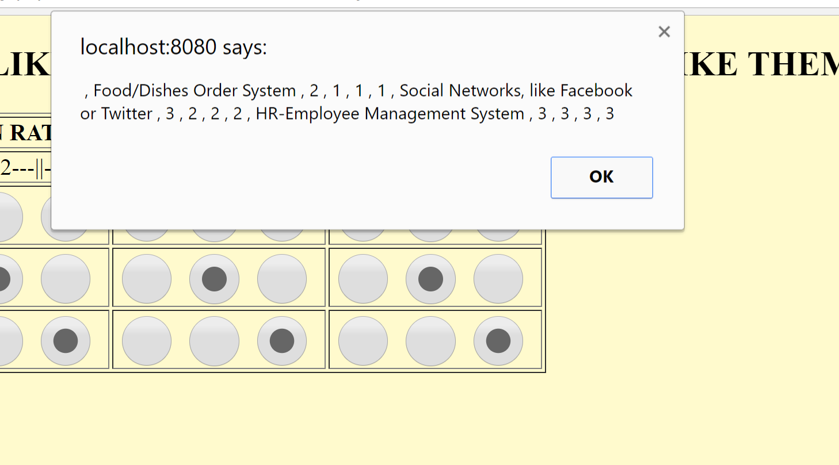
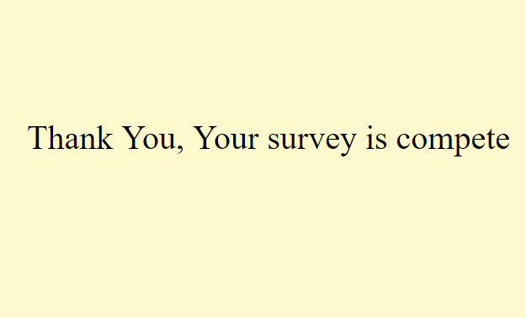
End of Student Survey Application
The student is notified with a warning message for the ratings he has given.

Slide 20

Survey Admin Application
Login is same as the google login, but only the professor mail id is will valid for this application

Slide 21
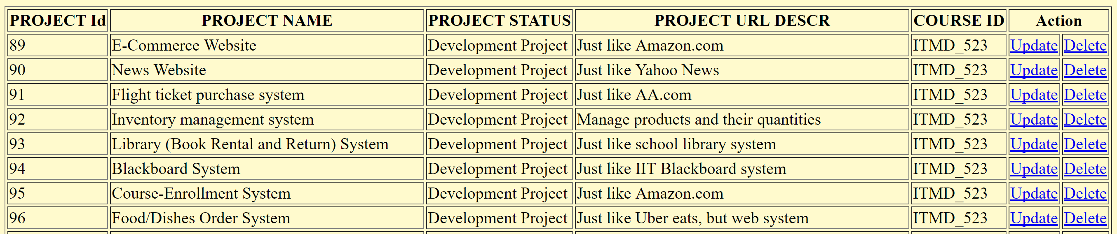
Add/Update/Drop Project

Slide 22
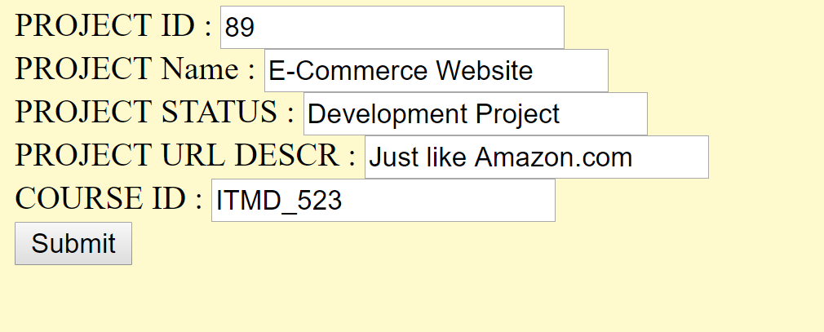
Add/Update Pgae

Slide 23
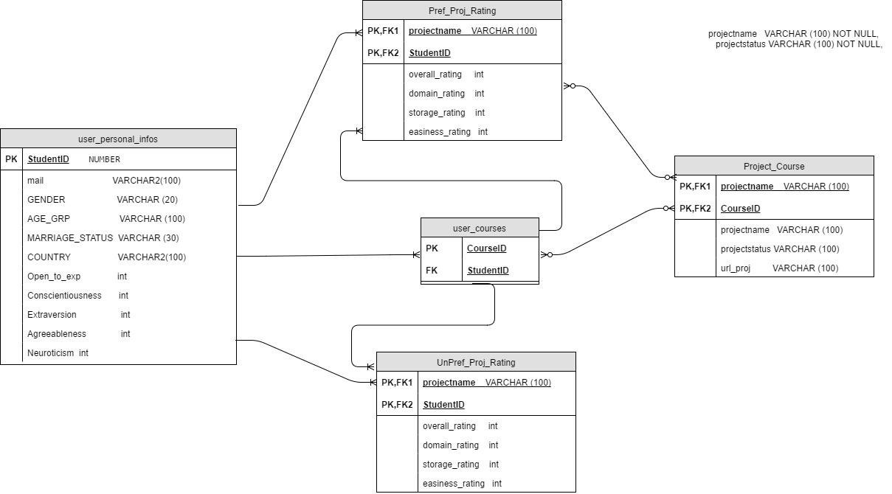
ERD

Slide 24
THANK YOU

