Slide 1
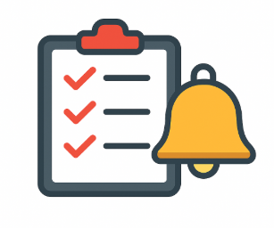
TASK REMAINDER
APPLICATION
A Smart Task management system with Email Notifications
BY:
VALE VIGNESHWAR

Slide 2
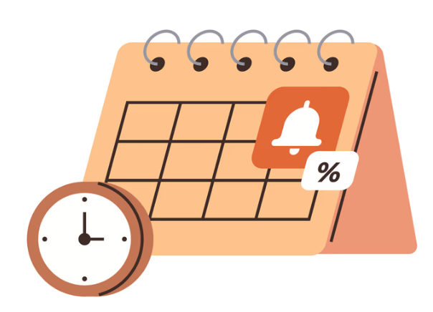
Problem Statement
People often forget tasks due to busy schedules
No proper system to track deadlines
Lack of reminder system leads to missed work
Existing systems are complex or not user-friendly

Slide 3
Why task remainder ?
Helps users manage tasks efficiently
Provides automated reminders
Improves productivity and time management
Simple and user-friendly interface
Reduces missed deadlines

Slide 4
objectives
Develop a task management system
Allow users to add, update, delete tasks
Implement automated reminder mechanism using scheduler
Send email notifications for overdue tasks
Provide clean and easy user interface
//Include authentication and productivity tracking application status checking implementation

Slide 5
Technologies used
Backend: Java, Spring Boot Database: MySQL Frontend: HTML, CSS,javascript,thymeleaf Tool: intelij ,Github,Postman API Platform Email Service: Spring Java Main API Scheduler: Spring Scheduler

Slide 6
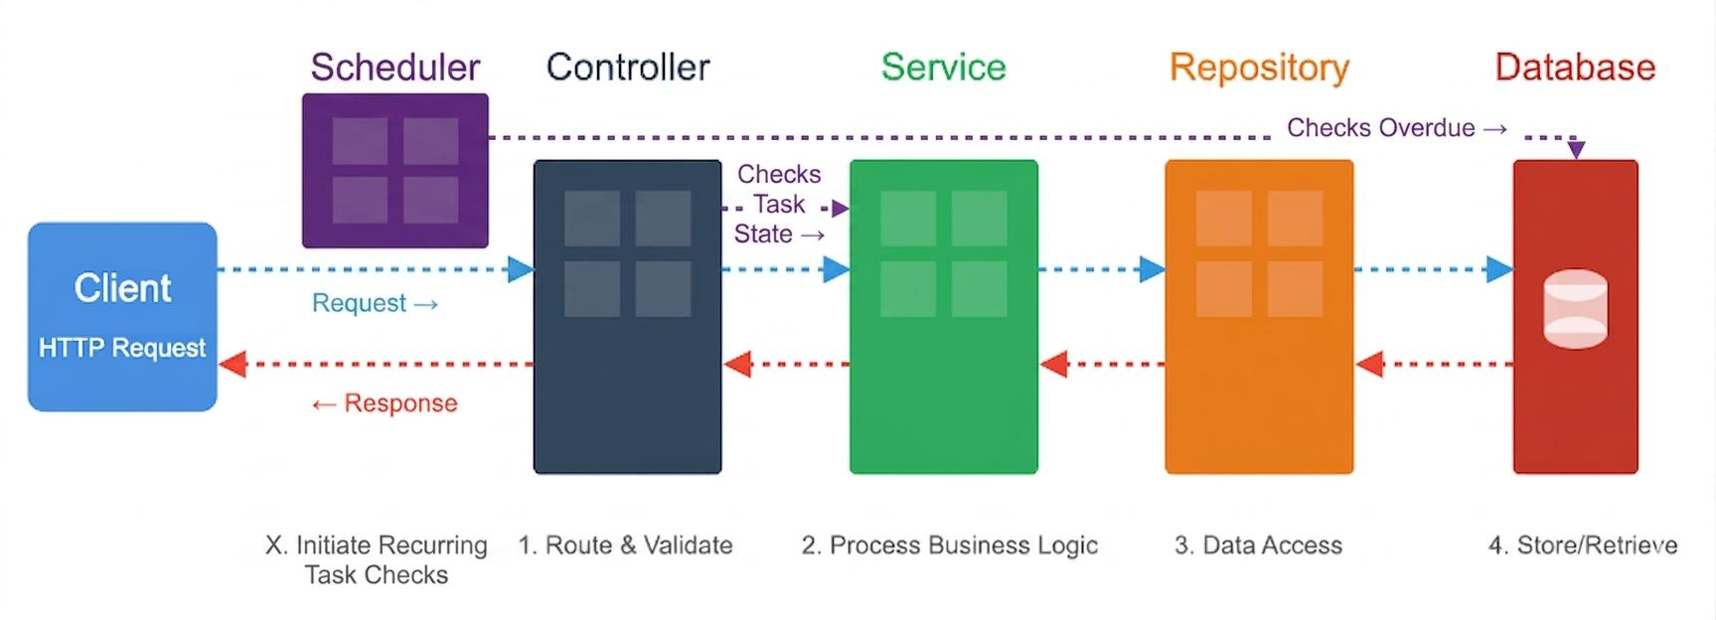
System architecture
The application follows layered architecture:
Controller Layer → Handles requests
Service Layer → Business logic
Repository Layer → Database operations
Database → Stores tasks
Scheduler → Checks overdue tasks

Slide 7
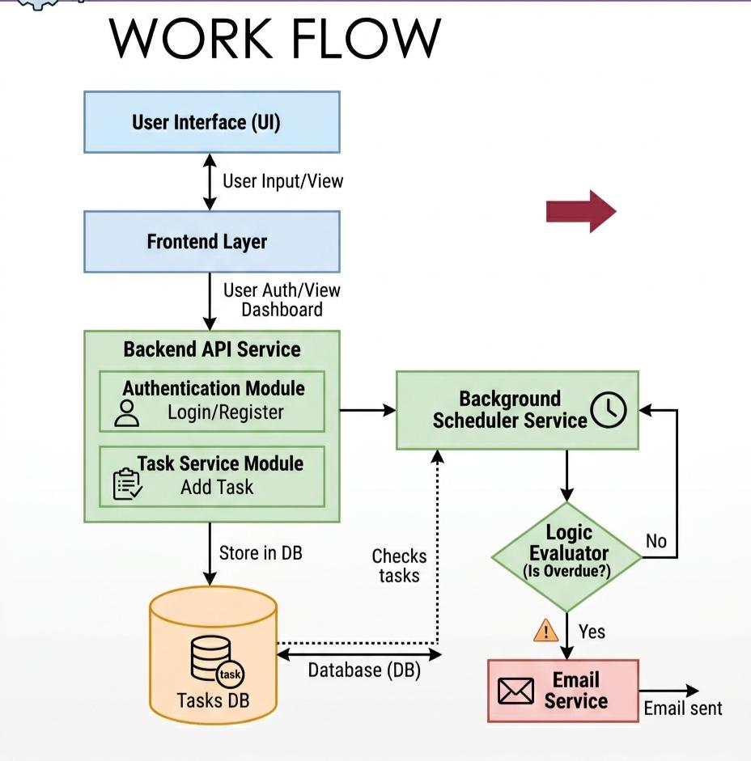
Work flow
User → Login/Register
↓
Dashboard
↓
Add Task → Store in DB
↓
Scheduler checks tasks
↓
If overdue → Email sent

Slide 8
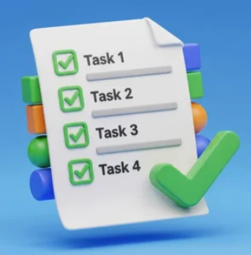
modules
User Module
Registration
Login
Task Module
Add Task
Update Task
Delete Task
View Tasks
Notification Module
Email alerts for overdue tasks
Scheduler Module
Runs periodically to check tasks

Slide 9
implementaTion
Developed REST APIs using Spring Boot
Used JDBC Template for database operations
Designed UI using HTML & CSS
Integrated email service using Spring Mail
Implemented scheduler for task checking

Slide 10
challenges
Configuring email service (App Password)
Handling database connection
Managing scheduler logic
UI design improvements
Debugging API errors

Slide 11
Future Enhancements
Add user authentication (secure login)
Mobile application support
Push notifications instead of email
Cloud deployment
Task categorization & priority system

Slide 12

Conclusion
Task Reminder system helps manage tasks efficiently Reduces missed deadlines Improves productivity Provides automated reminders using email

Slide 13
Thank you

