Slide 1
Decision Trees

Slide 2
Decision Trees -
Classifiers utilize a tree structure to model relationships among the features and the potential outcomes
Decision trees consist of nodes and branches. Nodes represent a decision function while branch represents the result of the function. Thus it is a flow chart for deciding how to classify a new observation:
The nodes are of three types, Root Node (representing the original data), Branch Node (representing a function), Leaf Node (which holds the result of all the previous functions that connect to it)

Slide 3
Decision Trees -
For classification problem, the posterior probability of all the classes is reflected in the leaf node and the Leaf Node belongs to the majority class.
After executing all the functions from Root Node to Leaf Node, the class of a data point is decided by the leaf node to which it reaches
For regression, the average/ median value of the target attribute is assigned to the query variable
Tree creation splits data into subsets and subsets into further smaller subsets. The algorithm stops splitting data when data within the subsets are sufficiently homogenous or some other stopping criterion is met

Slide 4
Decision Trees -
The decision tree algorithm learns (i.e. creates the decision tree from the data set) through optimization of a loss function
For classification problems –
the loss function is a measure of impurity in the target column of nodes belonging to a parent.
The objective is to minimize the impurity as much as possible at the leaf nodes
Impurity at a node is a measure of mixture of different classes in the target column of a node
For regression problems –
The objective is to minimize the variance in the target column at each node
Decrease in variance is equivalent of increase in homogeneity or purity (as in classification case)

Slide 5
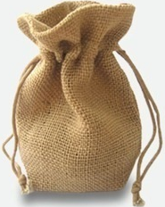


Decision Trees – Measuring impurity / heterogeneity
There is a bag of 50 balls of red, green, blue, white and yellow colour respectively
You have to pull out one ball from the bag with closed eyes. If the ball is -
Red, you loose the prize money accumulated
Green, you can quit
Blue you loose half prize money but continue
White you loose quarter prize money & continue
Yellow you can skip the question
This state where you have to decide and your decision can result in various outcomes with equal probability is said to be state of maximum uncertainty
If you have a bag full of balls of only one colour, then there is no uncertainty. You know what is going to happen. Uncertainty is zero.
Thus, the more the homogeneity, lesser the uncertainty and vice versa
Uncertainty is expressed as entropy or Gini index

Slide 6
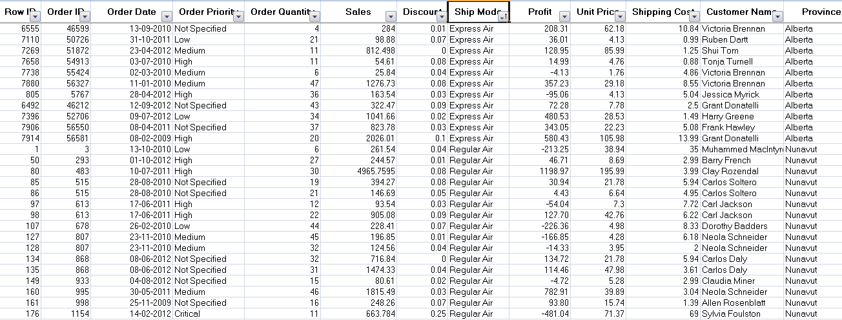
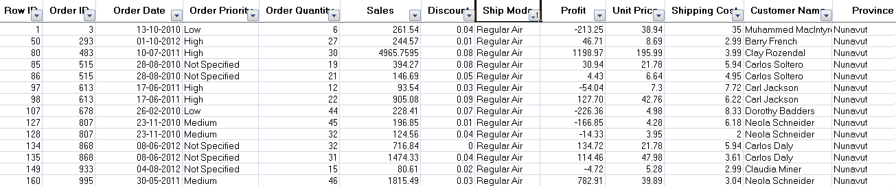
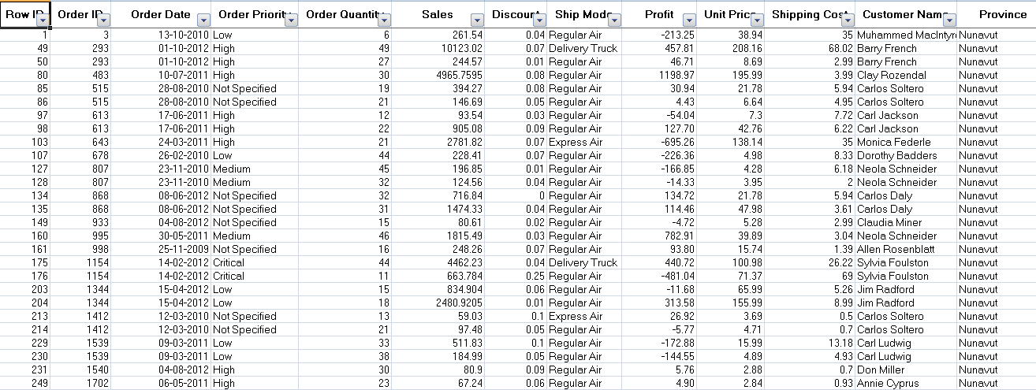
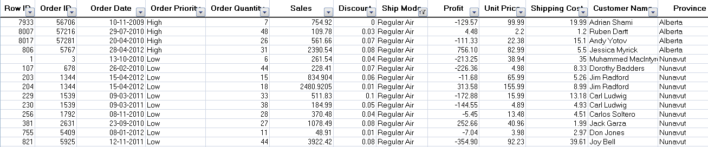
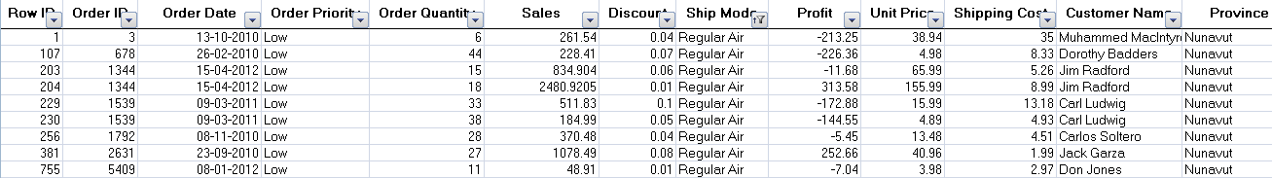
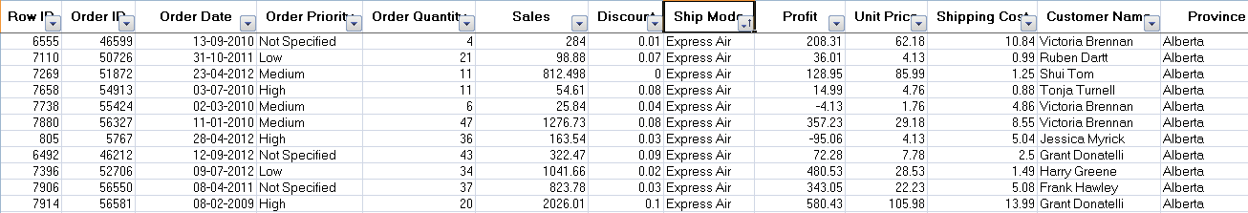
Decision Trees -
Suppose we wish to find if there was any influence of shipping mode, order priority on customer location. Customer location is target column and like the bag of coloured balls
Shipping Mode
Sales
Data
Regular Air
ExpressAir
Low Priority
High Priority
When sub branches are created, the total entropy of the sub branches should be less than the entropy of the parent node. More the drop in entropy, more the information gained

Slide 7

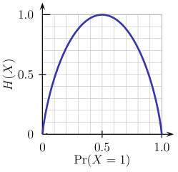
Decision Trees – Shannon's Entropy
Imagine a bag contains 6 red and 4 black balls.
Let the two classes Red -> class 0 and Black -> class 1
Entropy of the bag (X) will be calculated as per the formula
H(X) = - (0.6 * log2( 0.6)) - (0.4 * log2(0.4)) = 0.9709506
Suppose we remove all red balls from the bag and then entropy will be
H(X) = - 1.0 *log2(1.0) – 0.0 * log2(0) = 0 ## Entropy is 0! i.e. Information is 100%

Slide 8
Machine Learning (Decision Tree Classification)
Decision Trees -
Entropy | Info Gain
E0 = max entropy say 1 | 0
E1 = (E1a*700/1000) + (E1b * 300/1000) | E0 – E1
E2 = (E2a * 500/700) + (E2b * 200/700) + (E2c * 100/300) + (E2d * 200/300) | E1 – E2
Shipping
Mode (1000) E0
Regular Air (700), E1a
Express Air (300), E1b
Low Priority (500) E2a
High Priority (200) E2b
Low Priority (100) E2c
High Priority (200) E2d
Tree will stop growing when stop criterion for the splitting is reached which could be -
Tree has reached certain pre-fixed depth (longestt path from root node to leaf node)
Tree has achieve maximum number of nodes (tree size)
Exhausted all attributes to split
Leaf node on split will have less than predefined number of data points

Slide 9
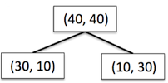




Decision Trees - Information Gain using Entropy
Information Gain = reduction in entropy =

Slide 10
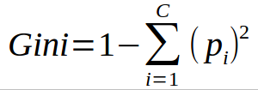



Decision Trees - Information Gain using Gini index
Information Gain = reduction in Gini index =

Slide 11
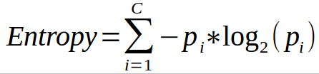
Decision Trees -
Common measures of purity
Gini index – is calculated by subtracting the sum of the squared probabilities of each class from one
Uses squared proportion of classes
Perfectly classified, Gini Index would be zero
Evenly distributed would be 1 – (1/# Classes)
You want a variable split that has a low Gini Index
Used in CART algorithm
Entropy –
Favors splits with small counts but many unique values
Weights probability of class by log(base=2) of the class probability
A smaller value of Entropy is better. That makes the difference between the parent node’s entropy larger
Information Gain is the Entropy of the parent node minus the entropy of the child nodes

Slide 12
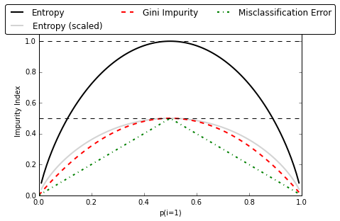
Decision Trees – Gini , Entropy , Misclassification Error
Note: Misclassification Error is not used in Decision Trees
Graph valid only for binary classification

Slide 13
Decision Trees - Algorithms
ID3 (Iterative Dicotomizer 3) – developed by Ross Quinlan. Creates a multi branch tree at each node using greedy algorithm. Trees grow to maximum size before pruning
C4.5 succeeded ID3 by overcoming limitation of features required to be categorical. It dynamically defines discrete attribute for numerical attributes. It converts the trained trees into a set of if-then rules. Accuracy of each rule is evaluated to determine the order in which they should be applied
C5.0 is Quinlan’s latest version and it uses less memory and builds smaller rulesets than C4.5 while being more accurate
CART (Classification & Regression Trees) is similar to C4.5 but it supports numerical target variables and does not compute rule sets. Creates binary tree. Scikit uses CART

Slide 14
Decision Trees -
Advantages -
Simple , Fast in processing and effective
Does well with noisy data and missing data
Handles numeric and categorical variables
Interpretation of results does not required mathematical or statistical knowledge
Dis-advantages -
Often biased towards splits or features have large number of levels
May not be optimum as modelling some relations on axis parallel basis is not optimal
Small changes in training data can result in large changes to the logic
Large trees can be difficult to interpret

Slide 15
Decision Trees - Preventing overfitting through regularization
Decision trees do not assume a particular form of relationship between the independent and dependent variables unlike linear models for e.g.
DT is a non-parametrized algorithm unlike linear models where we supply the input parameters
If left unconstrained, they can build tree structures to adapt to the training data leading to overfitting
To avoid overfitting, we need to restrict the DT’s freedom during the tree creation. This is called regularization
The regularization hyperparameters depend on the algorithms used

Slide 16
Decision Trees - Regularization parameters
max_depth – Is the maximum length of a path from root to leaf (in terms of number of decision points. The leaf node is not split further. It could lead to a tree with leaf node containing many observations on one side of the tree, whereas on the other side, nodes containing much less observations get further split
min_sample_split - A limit to stop further splitting of nodes when the number of observations in the node is lower than this value
min_sample_leaf – Minimum number of samples a leaf node must have. When a leaf contains too few observations, further splitting will result in overfitting (modeling of noise in the data).

Slide 17
Decision Trees - Regularization parameters (Contd…)
min_weight_fraction_leaf – Same as min_sample_leaf but expressed in fraction of total number of weighted instances
max_leaf_nodes – maximum number of leaf nodes in a tree
max_feature_size - max number of features that are evaluated for splitting each node

Slide 18
Decision Tree -
Lab- 5 Model to predict potential credit defaulters
Description – Sample data is available at local file system as credit.csv
The dataset has 16 attributes described at https://archive.ics.uci.edu/ml/datasets/statlog+(german+credit+data)
or in the notes page of this slide
Sol: Regularization+Credit+Decision+Tree.ipynb
Notes:
Attribute 1: (qualitative) Status of existing checking account A11 : ... < 0 DM A12 : 0 <= ... < 200 DM A13 : ... >= 200 DM / salary assignments for at least 1 year A14 : no checking account Attribute 2: (numerical) Duration in month Attribute 3: (qualitative) Credit history A30 : no credits taken/ all credits paid back duly A31 : all credits at this bank paid back duly A32 : existing credits paid back duly till now A33 : delay in paying off in the past A34 : critical account/ other credits existing (not at this bank) Attribute 4: (qualitative) Purpose A40 : car (new) A41 : car (used) A42 : furniture/equipment A43 : radio/television A44 : domestic appliances A45 : repairs A46 : education A47 : (vacation - does not exist?) A48 : retraining A49 : business A410 : others Attribute 5: (numerical) Credit amount Attibute 6: (qualitative) Savings account/bonds A61 : ... < 100 DM A62 : 100 <= ... < 500 DM A63 : 500 <= ... < 1000 DM A64 : .. >= 1000 DM A65 : unknown/ no savings account Attribute 7: (qualitative) Present employment since A71 : unemployed A72 : ... < 1 year A73 : 1 <= ... < 4 years A74 : 4 <= ... < 7 years A75 : .. >= 7 years Attribute 8: (numerical) Installment rate in percentage of disposable income Attribute 9: (qualitative) Personal status and sex A91 : male : divorced/separated A92 : female : divorced/separated/married A93 : male : single A94 : male : married/widowed A95 : female : single Attribute 10: (qualitative) Other debtors / guarantors A101 : none A102 : co-applicant A103 : guarantor Attribute 11: (numerical) Present residence since Attribute 12: (qualitative) Property A121 : real estate A122 : if not A121 : building society savings agreement/ life insurance A123 : if not A121/A122 : car or other, not in attribute 6 A124 : unknown / no property Attribute 13: (numerical) Age in years Attribute 14: (qualitative) Other installment plans A141 : bank A142 : stores A143 : none Attribute 15: (qualitative) Housing A151 : rent A152 : own A153 : for free Attribute 16: (numerical) Number of existing credits at this bank Attribute 17: (qualitative) Job A171 : unemployed/ unskilled - non-resident A172 : unskilled - resident A173 : skilled employee / official A174 : management/ self-employed/ highly qualified employee/ officer Attribute 18: (numerical) Number of people being liable to provide maintenance for Attribute 19: (qualitative) Telephone A191 : none A192 : yes, registered under the customers name Attribute 20: (qualitative) foreign worker A201 : yes A202 : no

Slide 19
Ensemble Methods

Slide 20
Ensemble Methods -
To combine the predictions of several base estimators built with a given learning algorithm in order to improve generalizability / robustness over a single estimator
Two families of ensemble methods are usually distinguished:
Averaging methods, the driving principle is to build several estimators independently and then to average / vote their predictions. On average, the combined estimator is usually better than any of the single base estimator because its variance is reduced.
E.g. Bagging methods, Forests of randomized trees, ...
Boosting methods, base estimators are built sequentially and one tries to reduce the bias of the combined estimator. The motivation is to combine several weak models to produce a powerful ensemble. E.g. AdaBoost, Gradient Tree Boosting, ...

Slide 21
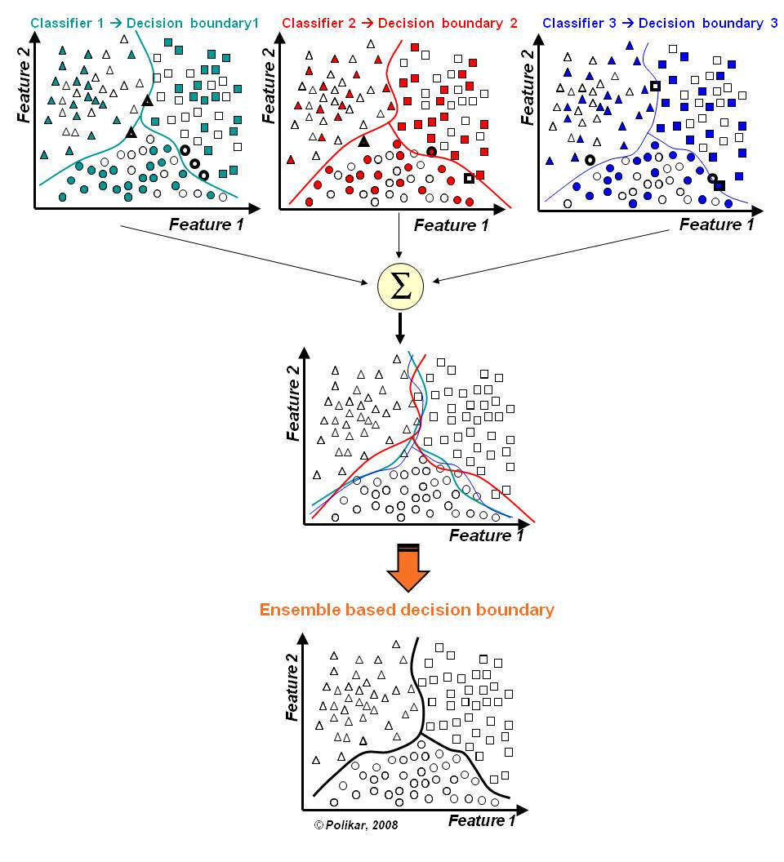
Ensemble Methods -
In the final stage of voting, we essentially have a combined surface resulting from individual surfaces
Source: https://github.com/MenuPolis/MLT/wiki/Bagging

Slide 22
Ensemble Methods – Averaging method - Bagging (Bootstrap Aggregation) :
Designed to improve the stability and accuracy of classification and regression models
It reduces variance errors and helps to avoid overfitting
Can be used with any type of machine learning model, mostly used with Decision Tree
Uses sampling with replacement to generate multiple samples of a given size. Sample may contain repeat data points
For large sample size, sample data is expected to have roughly 63.2% ( 1 – 1/e) unique data points and the rest being duplicates
For classification bagging is used with voting to decide the class of an input while for regression average or median values are calculate
Notes:
Bagging methods come in different flavours but mostly differ by the way they draw random subsets of the training set
When random subsets of the data set are drawn as random subsets of the samples, the algorithm is known as pasting
When samples are drawn with replacement, the method is known as Bagging (Bootstrap Aggregation)
When the random subsets of the dataset are drawn as random subsets of the features, then the method is known as random subspaces
When the base estimators are built on subsets of both samples and features, the method is called random patches
Source: Scikit-learn user guide, chapter 3, page 230

Slide 23
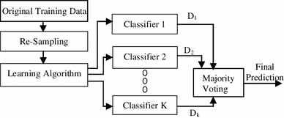
Ensemble Methods – Averaging method - Bagging (Bootstrap Aggregation) :
Re-sampling done for every classifier using a random function. For large n, 63.2% unique samples likely to be selected
Voting could be simple or weighted
Algorithm to generate classifiers. Could be Decision Tree, Naïve Bayes etc
K classifiers created in parallel and independently on respective training data
Source: https://link.springer.com/article/10.1007/s13721-013-0034-x

Slide 24
Ensemble Learning – Bagging:
Lab- 6 Improve defaulter prediction of the decision tree using bagging ensemble technique
Description – Sample data is available at local file system as credit.csv
The dataset has 16 attributes described at https://archive.ics.uci.edu/ml/datasets/statlog+(german+credit+data)
or in the notes page of this slide
Sol: Bagging+Credit+Decision+Tree.ipynb
Notes:
Attribute 1: (qualitative) Status of existing checking account A11 : ... < 0 DM A12 : 0 <= ... < 200 DM A13 : ... >= 200 DM / salary assignments for at least 1 year A14 : no checking account Attribute 2: (numerical) Duration in month Attribute 3: (qualitative) Credit history A30 : no credits taken/ all credits paid back duly A31 : all credits at this bank paid back duly A32 : existing credits paid back duly till now A33 : delay in paying off in the past A34 : critical account/ other credits existing (not at this bank) Attribute 4: (qualitative) Purpose A40 : car (new) A41 : car (used) A42 : furniture/equipment A43 : radio/television A44 : domestic appliances A45 : repairs A46 : education A47 : (vacation - does not exist?) A48 : retraining A49 : business A410 : others Attribute 5: (numerical) Credit amount Attibute 6: (qualitative) Savings account/bonds A61 : ... < 100 DM A62 : 100 <= ... < 500 DM A63 : 500 <= ... < 1000 DM A64 : .. >= 1000 DM A65 : unknown/ no savings account Attribute 7: (qualitative) Present employment since A71 : unemployed A72 : ... < 1 year A73 : 1 <= ... < 4 years A74 : 4 <= ... < 7 years A75 : .. >= 7 years Attribute 8: (numerical) Installment rate in percentage of disposable income Attribute 9: (qualitative) Personal status and sex A91 : male : divorced/separated A92 : female : divorced/separated/married A93 : male : single A94 : male : married/widowed A95 : female : single Attribute 10: (qualitative) Other debtors / guarantors A101 : none A102 : co-applicant A103 : guarantor Attribute 11: (numerical) Present residence since Attribute 12: (qualitative) Property A121 : real estate A122 : if not A121 : building society savings agreement/ life insurance A123 : if not A121/A122 : car or other, not in attribute 6 A124 : unknown / no property Attribute 13: (numerical) Age in years Attribute 14: (qualitative) Other installment plans A141 : bank A142 : stores A143 : none Attribute 15: (qualitative) Housing A151 : rent A152 : own A153 : for free Attribute 16: (numerical) Number of existing credits at this bank Attribute 17: (qualitative) Job A171 : unemployed/ unskilled - non-resident A172 : unskilled - resident A173 : skilled employee / official A174 : management/ self-employed/ highly qualified employee/ officer Attribute 18: (numerical) Number of people being liable to provide maintenance for Attribute 19: (qualitative) Telephone A191 : none A192 : yes, registered under the customers name Attribute 20: (qualitative) foreign worker A201 : yes A202 : no

Slide 25
Ensemble Methods – Boosting Method – AdaBoosting :
Similar to bagging, but the learners are grown sequentially; except for the first, each subsequent learner is grown from previously grown learners
If the learner is a Decision Tree, each of the trees can be small, with just a few terminal nodes (determined by the parameter d supplied )
During voting higher weight is given to the votes of learners which perform better in respective training data unlike Bagging where all get equal weight
Boosting slows down learning (because it is sequential) but the model generally performs well

Slide 26
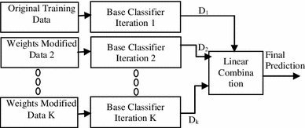
Ensemble Methods – Boosting method - AdaBoosting:
Training data from base data with focus on instances which were incorrectly classified by earlier model (if any)
Voting could be simple or weighted
K similar classifiers created in sequence with respective training data with focus on addressing the misclassified data, not the usual cost functions
It is called Adaptive Boosting as the weights are re-assigned to each instance, with higher weights to incorrectly classified instance
Source: https://link.springer.com/article/10.1007/s13721-013-0034-x

Slide 27
Ensemble Methods – Boosting Method – AdaBoosting :
Two prominent boosting algorithms are AdaBoost, short for Adaptive Boosting and Gradient Descent Boosting
In AdaBoost, the successive learners are created with a focus on the ill fitted data of the previous learner
Each successive learner focuses more and more on the harder to fit data i.e. their residuals in the previous tree

Slide 28
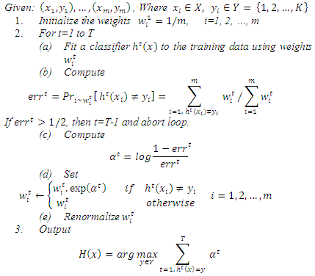
Ensemble Methods – Boosting Method – AdaBoosting :
Adapting weights with focus on erroneously classified instances
Initialize weights, equal weights to all instances
Generate first classifier with equal focus on all instances
Total up weights of all error instances, express it as a ratio to total weights
If error ratio is > 50%
Calculate predictor weights (i.e. weight of the classifier)
Assign new weights to instances misclassified, else keep the weights same
Renormalize the weights across all the instances and fit next classifier
For a test instance use weighted voting to identify the class

Slide 29
Ensemble Learning – AdaBoosting:
Lab- 7 Improve defaulter prediction of the decision tree using Adaboosting
Description – Sample data is available at local file system as credit.csv
The dataset has 16 attributes described at https://archive.ics.uci.edu/ml/datasets/statlog+(german+credit+data)
or in the notes page of this slide
Sol: Adaboost+Credit+Decision+Tree.ipynb
Notes:
Attribute 1: (qualitative) Status of existing checking account A11 : ... < 0 DM A12 : 0 <= ... < 200 DM A13 : ... >= 200 DM / salary assignments for at least 1 year A14 : no checking account Attribute 2: (numerical) Duration in month Attribute 3: (qualitative) Credit history A30 : no credits taken/ all credits paid back duly A31 : all credits at this bank paid back duly A32 : existing credits paid back duly till now A33 : delay in paying off in the past A34 : critical account/ other credits existing (not at this bank) Attribute 4: (qualitative) Purpose A40 : car (new) A41 : car (used) A42 : furniture/equipment A43 : radio/television A44 : domestic appliances A45 : repairs A46 : education A47 : (vacation - does not exist?) A48 : retraining A49 : business A410 : others Attribute 5: (numerical) Credit amount Attibute 6: (qualitative) Savings account/bonds A61 : ... < 100 DM A62 : 100 <= ... < 500 DM A63 : 500 <= ... < 1000 DM A64 : .. >= 1000 DM A65 : unknown/ no savings account Attribute 7: (qualitative) Present employment since A71 : unemployed A72 : ... < 1 year A73 : 1 <= ... < 4 years A74 : 4 <= ... < 7 years A75 : .. >= 7 years Attribute 8: (numerical) Installment rate in percentage of disposable income Attribute 9: (qualitative) Personal status and sex A91 : male : divorced/separated A92 : female : divorced/separated/married A93 : male : single A94 : male : married/widowed A95 : female : single Attribute 10: (qualitative) Other debtors / guarantors A101 : none A102 : co-applicant A103 : guarantor Attribute 11: (numerical) Present residence since Attribute 12: (qualitative) Property A121 : real estate A122 : if not A121 : building society savings agreement/ life insurance A123 : if not A121/A122 : car or other, not in attribute 6 A124 : unknown / no property Attribute 13: (numerical) Age in years Attribute 14: (qualitative) Other installment plans A141 : bank A142 : stores A143 : none Attribute 15: (qualitative) Housing A151 : rent A152 : own A153 : for free Attribute 16: (numerical) Number of existing credits at this bank Attribute 17: (qualitative) Job A171 : unemployed/ unskilled - non-resident A172 : unskilled - resident A173 : skilled employee / official A174 : management/ self-employed/ highly qualified employee/ officer Attribute 18: (numerical) Number of people being liable to provide maintenance for Attribute 19: (qualitative) Telephone A191 : none A192 : yes, registered under the customers name Attribute 20: (qualitative) foreign worker A201 : yes A202 : no

Slide 30
Ensemble Methods – Averaging Method – Gradient Descent Boosting :
Each learner is fit on a modified version of original data (original data is replaced with the x values and residuals from previous learner
By fitting new models to the residuals, the overall learner gradually improves in areas where residuals are initially high

Slide 31
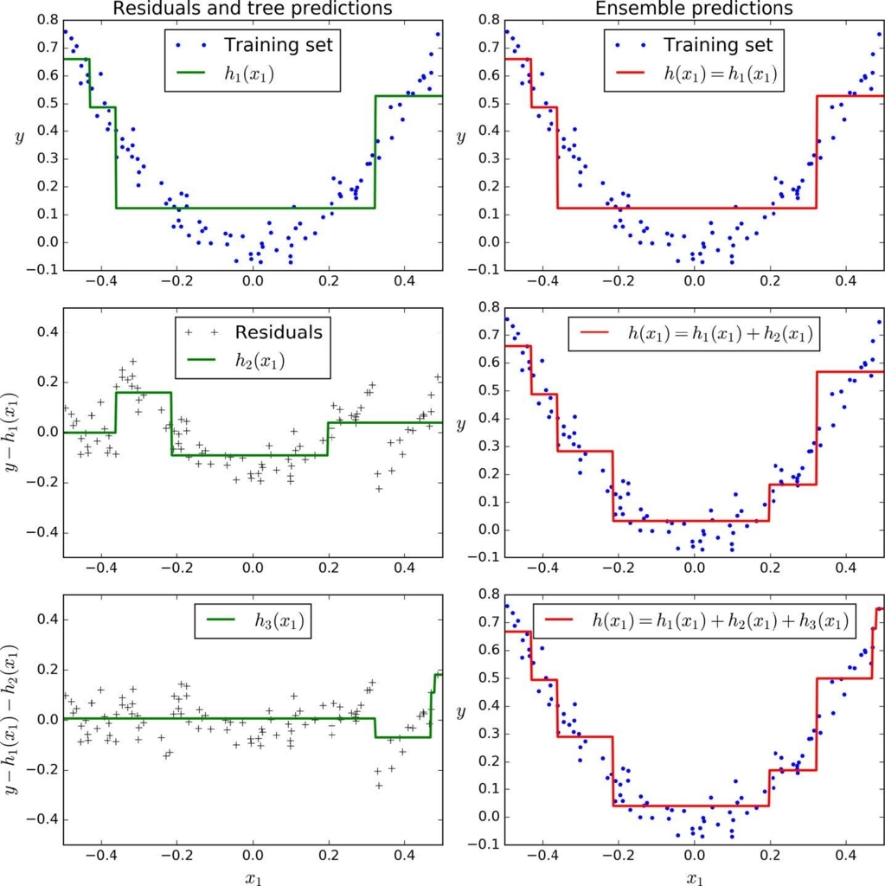
Ensemble Methods – Averaging Method – Gradient Descent Boosting :
First learner results in residuals (dots that fall above and below the surface. The result (red) is same as first classifier
Next classifier focuses on the residuals of the first classifier to reclassify them as correctly as possible
The combined effect of this surface and previous classifier surface is shown in red
The third learner focusses on the residuals of the previous classifier
The combine result of the new surface with the previous surface is shown in red

Slide 32
Ensemble Learning – Gradient Boosting:
Lab- 8 Improve defaulter prediction of the decision tree using Gradient boosting
Description – Sample data is available at local file system as credit.csv
The dataset has 16 attributes described at https://archive.ics.uci.edu/ml/datasets/statlog+(german+credit+data)
or in the notes page of this slide
Sol: GRB+Credit+Decision+Tree.ipynb
Notes:
Attribute 1: (qualitative) Status of existing checking account A11 : ... < 0 DM A12 : 0 <= ... < 200 DM A13 : ... >= 200 DM / salary assignments for at least 1 year A14 : no checking account Attribute 2: (numerical) Duration in month Attribute 3: (qualitative) Credit history A30 : no credits taken/ all credits paid back duly A31 : all credits at this bank paid back duly A32 : existing credits paid back duly till now A33 : delay in paying off in the past A34 : critical account/ other credits existing (not at this bank) Attribute 4: (qualitative) Purpose A40 : car (new) A41 : car (used) A42 : furniture/equipment A43 : radio/television A44 : domestic appliances A45 : repairs A46 : education A47 : (vacation - does not exist?) A48 : retraining A49 : business A410 : others Attribute 5: (numerical) Credit amount Attibute 6: (qualitative) Savings account/bonds A61 : ... < 100 DM A62 : 100 <= ... < 500 DM A63 : 500 <= ... < 1000 DM A64 : .. >= 1000 DM A65 : unknown/ no savings account Attribute 7: (qualitative) Present employment since A71 : unemployed A72 : ... < 1 year A73 : 1 <= ... < 4 years A74 : 4 <= ... < 7 years A75 : .. >= 7 years Attribute 8: (numerical) Installment rate in percentage of disposable income Attribute 9: (qualitative) Personal status and sex A91 : male : divorced/separated A92 : female : divorced/separated/married A93 : male : single A94 : male : married/widowed A95 : female : single Attribute 10: (qualitative) Other debtors / guarantors A101 : none A102 : co-applicant A103 : guarantor Attribute 11: (numerical) Present residence since Attribute 12: (qualitative) Property A121 : real estate A122 : if not A121 : building society savings agreement/ life insurance A123 : if not A121/A122 : car or other, not in attribute 6 A124 : unknown / no property Attribute 13: (numerical) Age in years Attribute 14: (qualitative) Other installment plans A141 : bank A142 : stores A143 : none Attribute 15: (qualitative) Housing A151 : rent A152 : own A153 : for free Attribute 16: (numerical) Number of existing credits at this bank Attribute 17: (qualitative) Job A171 : unemployed/ unskilled - non-resident A172 : unskilled - resident A173 : skilled employee / official A174 : management/ self-employed/ highly qualified employee/ officer Attribute 18: (numerical) Number of people being liable to provide maintenance for Attribute 19: (qualitative) Telephone A191 : none A192 : yes, registered under the customers name Attribute 20: (qualitative) foreign worker A201 : yes A202 : no

Slide 33
Ensemble Methods – Random Forest:
Each tree in the ensemble is built from a sample drawn with replacement (bootstrap) from the training set
In addition, when splitting a node during the construction of a tree, the split that is chosen is no longer the best split among all the features
Instead, the split is picked is the best split among a random subset of the features
As a result of this randomness, the bias of the forest usually slightly increases (with respect to the bias of a single non-random tree)
Due to averaging, its variance decreases, usually more than compensating the increase in bias, hence yielding overall a better result
Source: scikit-learn user guide , chapter 3 , page 231

Slide 34

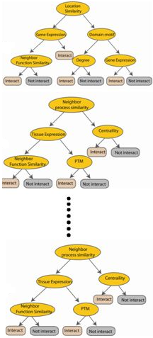



Ensemble Methods - Random Forest:
Used with Decision Trees. Create different trees by providing different sub-features from the feature set to the tree creating algorithm. The optimization function is Entropy or Gini index
Randomly selected sub feature set
Independent trees created in parallel
N instances
Original number of features

Slide 35
Ensemble Learning – Random Forest:
Lab- 9 Improve defaulter prediction of the decision tree using Random Forest
Description – Sample data is available at local file system as credit.csv
The dataset has 16 attributes described at https://archive.ics.uci.edu/ml/datasets/statlog+(german+credit+data)
or in the notes page of this slide
Sol: RF+Credit+Decision+Tree.ipynb
Notes:
Attribute 1: (qualitative) Status of existing checking account A11 : ... < 0 DM A12 : 0 <= ... < 200 DM A13 : ... >= 200 DM / salary assignments for at least 1 year A14 : no checking account Attribute 2: (numerical) Duration in month Attribute 3: (qualitative) Credit history A30 : no credits taken/ all credits paid back duly A31 : all credits at this bank paid back duly A32 : existing credits paid back duly till now A33 : delay in paying off in the past A34 : critical account/ other credits existing (not at this bank) Attribute 4: (qualitative) Purpose A40 : car (new) A41 : car (used) A42 : furniture/equipment A43 : radio/television A44 : domestic appliances A45 : repairs A46 : education A47 : (vacation - does not exist?) A48 : retraining A49 : business A410 : others Attribute 5: (numerical) Credit amount Attibute 6: (qualitative) Savings account/bonds A61 : ... < 100 DM A62 : 100 <= ... < 500 DM A63 : 500 <= ... < 1000 DM A64 : .. >= 1000 DM A65 : unknown/ no savings account Attribute 7: (qualitative) Present employment since A71 : unemployed A72 : ... < 1 year A73 : 1 <= ... < 4 years A74 : 4 <= ... < 7 years A75 : .. >= 7 years Attribute 8: (numerical) Installment rate in percentage of disposable income Attribute 9: (qualitative) Personal status and sex A91 : male : divorced/separated A92 : female : divorced/separated/married A93 : male : single A94 : male : married/widowed A95 : female : single Attribute 10: (qualitative) Other debtors / guarantors A101 : none A102 : co-applicant A103 : guarantor Attribute 11: (numerical) Present residence since Attribute 12: (qualitative) Property A121 : real estate A122 : if not A121 : building society savings agreement/ life insurance A123 : if not A121/A122 : car or other, not in attribute 6 A124 : unknown / no property Attribute 13: (numerical) Age in years Attribute 14: (qualitative) Other installment plans A141 : bank A142 : stores A143 : none Attribute 15: (qualitative) Housing A151 : rent A152 : own A153 : for free Attribute 16: (numerical) Number of existing credits at this bank Attribute 17: (qualitative) Job A171 : unemployed/ unskilled - non-resident A172 : unskilled - resident A173 : skilled employee / official A174 : management/ self-employed/ highly qualified employee/ officer Attribute 18: (numerical) Number of people being liable to provide maintenance for Attribute 19: (qualitative) Telephone A191 : none A192 : yes, registered under the customers name Attribute 20: (qualitative) foreign worker A201 : yes A202 : no

Slide 36
Ensemble Methods – Stacking:
Similar to bagging, but apply several different models to original data
The weights for each model is determined based on how well they perform on the given input data
Similar classifiers usually make similar errors (bagging), so forming an ensemble with similar classifiers may not improve the classification rate
Presence of a poorly performing classifier may cause performance deterioration in the overall performance
Similarly, even on presence of a classifier that performs much better than all of the other available base classifiers, may cause degradation in the overall performance
Another important factor is the amount of correlation among the incorrect classifications made by each classifier
If the consistent classifiers tend to misclassify the same instances, then combining their results will have no benefit
In contrast, a greater amount of independence among the classifiers can result in errors by individual classifiers being overlooked when the results of the ensemble are combined.

Slide 37
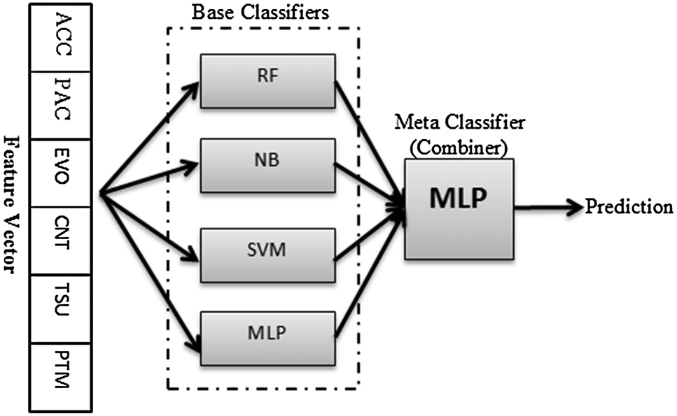
Ensemble Methods – Stacking:
Source: http://pubs.rsc.org/-/content/articlelanding/2014/mb/c4mb00410h/unauth#!divAbstract

Slide 38
Ensemble Learning – Stacking:
Lab- 10 Improve defaulter prediction of the decision tree using Stacking
Description – Sample data is available at local file system as credit.csv
The dataset has 16 attributes described at https://archive.ics.uci.edu/ml/datasets/statlog+(german+credit+data)
or in the notes page of this slide
Sol: Stacking+Credit+Decision+Tree.ipynb
Notes:
Attribute 1: (qualitative) Status of existing checking account A11 : ... < 0 DM A12 : 0 <= ... < 200 DM A13 : ... >= 200 DM / salary assignments for at least 1 year A14 : no checking account Attribute 2: (numerical) Duration in month Attribute 3: (qualitative) Credit history A30 : no credits taken/ all credits paid back duly A31 : all credits at this bank paid back duly A32 : existing credits paid back duly till now A33 : delay in paying off in the past A34 : critical account/ other credits existing (not at this bank) Attribute 4: (qualitative) Purpose A40 : car (new) A41 : car (used) A42 : furniture/equipment A43 : radio/television A44 : domestic appliances A45 : repairs A46 : education A47 : (vacation - does not exist?) A48 : retraining A49 : business A410 : others Attribute 5: (numerical) Credit amount Attibute 6: (qualitative) Savings account/bonds A61 : ... < 100 DM A62 : 100 <= ... < 500 DM A63 : 500 <= ... < 1000 DM A64 : .. >= 1000 DM A65 : unknown/ no savings account Attribute 7: (qualitative) Present employment since A71 : unemployed A72 : ... < 1 year A73 : 1 <= ... < 4 years A74 : 4 <= ... < 7 years A75 : .. >= 7 years Attribute 8: (numerical) Installment rate in percentage of disposable income Attribute 9: (qualitative) Personal status and sex A91 : male : divorced/separated A92 : female : divorced/separated/married A93 : male : single A94 : male : married/widowed A95 : female : single Attribute 10: (qualitative) Other debtors / guarantors A101 : none A102 : co-applicant A103 : guarantor Attribute 11: (numerical) Present residence since Attribute 12: (qualitative) Property A121 : real estate A122 : if not A121 : building society savings agreement/ life insurance A123 : if not A121/A122 : car or other, not in attribute 6 A124 : unknown / no property Attribute 13: (numerical) Age in years Attribute 14: (qualitative) Other installment plans A141 : bank A142 : stores A143 : none Attribute 15: (qualitative) Housing A151 : rent A152 : own A153 : for free Attribute 16: (numerical) Number of existing credits at this bank Attribute 17: (qualitative) Job A171 : unemployed/ unskilled - non-resident A172 : unskilled - resident A173 : skilled employee / official A174 : management/ self-employed/ highly qualified employee/ officer Attribute 18: (numerical) Number of people being liable to provide maintenance for Attribute 19: (qualitative) Telephone A191 : none A192 : yes, registered under the customers name Attribute 20: (qualitative) foreign worker A201 : yes A202 : no

Slide 39
ThankYou

