Slide 1
MOST POPULAR COMPONENTS
Presented by
Vigneshwaran R
SF4013

Slide 2
LIST OF COMPONENTS
DATAGRID
CHARTS
LISTVIEW
SCHEDULER
DIAGRAM
PDF VIEWER
EXCELLIBRARY

Slide 3
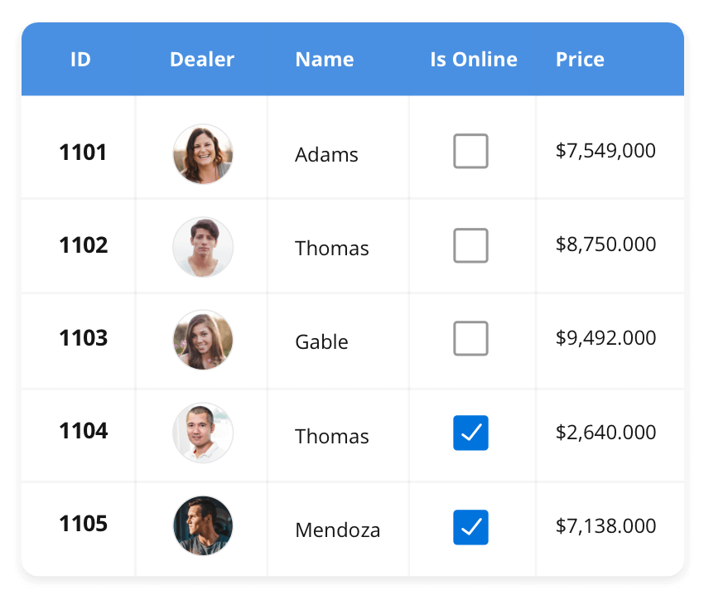



DATA GRID
The DataGrid control is a high-performance grid component that helps display and manipulate large amounts of data in a tabular format. Its rich feature set includes functionalities like data binding, sorting, grouping, editing, filtering, swiping, dragging, resizing, loading more items, pull-to-refresh, and exporting to Excel and PDF file formats.
SUPPORTED PLATFORMS
JavaScript Angular React Vue Blazor Flutter jQuery ASP.NET MVC ASP.NET Core ASP.NET Web Forms
WinForms WPF WinUI Flutter Xamarin UWP
Xamarin Flutter UWP

Slide 4
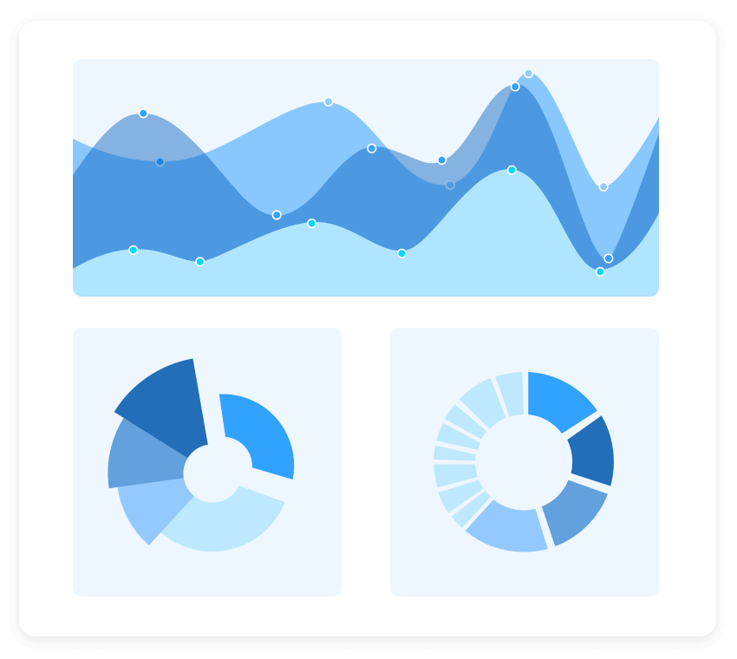
CHARTS
The Charts control can plot a wide range of chart types, ranging from line charts to specialized financial charts. Its rich feature set includes functionalities like data binding, multiple axes, legends, animation, data labels, annotations, trackballs, tooltips, and zooming.
SUPPORTED PLATFORMS
JavaScript Angular React Vue Blazor Flutter jQuery ASP.NET MVC ASP.NET Core ASP.NET Web Forms
WinForms WPF WinUI Flutter Xamarin UWP
Xamarin Flutter UWP

Slide 5
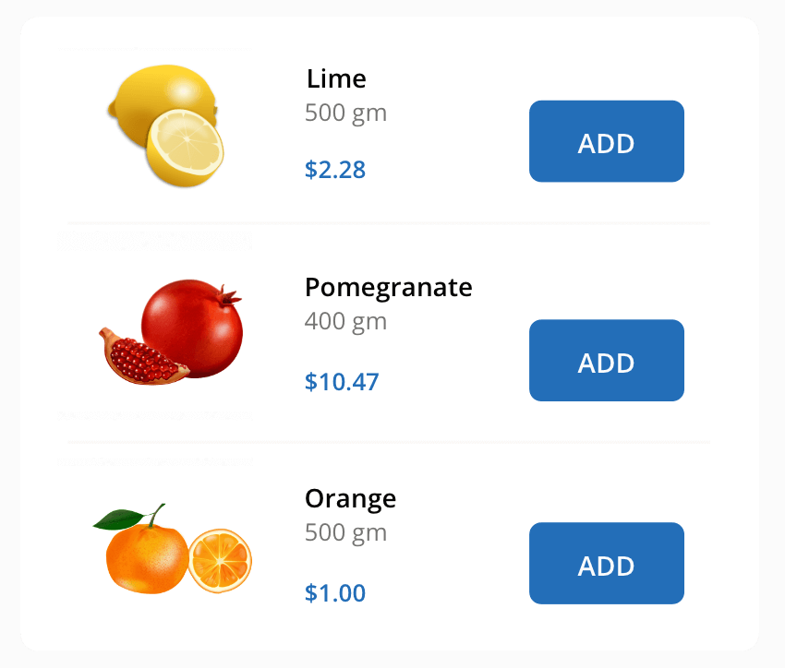
LIST VIEW
The ListView renders a set of data items with UI views or custom templates. It has many features like grouping, sorting, filtering, paging, swiping, multiple selection, drag and drop, and different layout types. The ListView control has been optimized to work with large amounts of data.
SUPPORTED PLATFORMS
JavaScript Angular React Vue Blazor jQuery ASP.NET MVC ASP.NET Core ASP.NET Web Forms
WinForms .NET MAUI Xamarin
.NET MAUI Xamarin

