Slide 1



Autonomous AI Retail Decision Intelligence
Theme: AI FOR BUSINESS
TEAM: MINDSPARKS
JHANANISHRI B
SHREE JOSSHITHA B
DURKADEVI S
SHWETHA M
VIGNESHWARAN SP

Slide 2
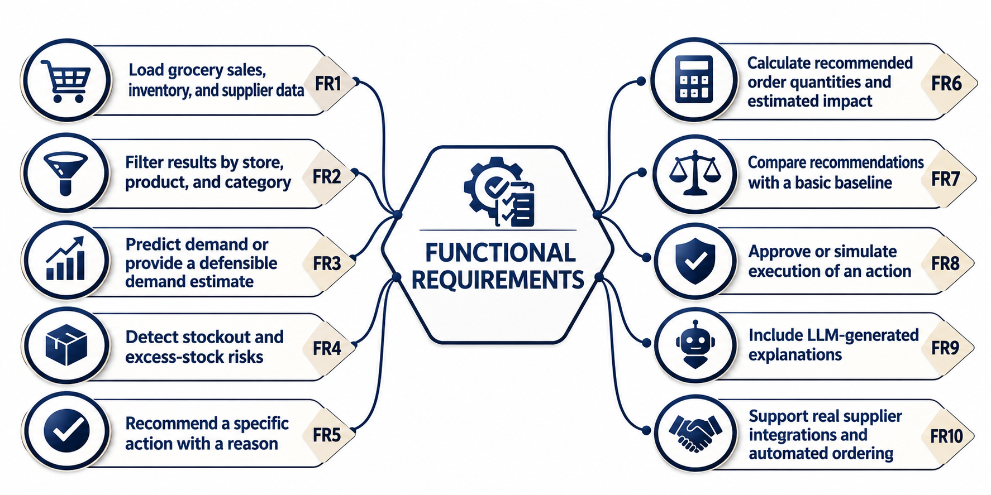
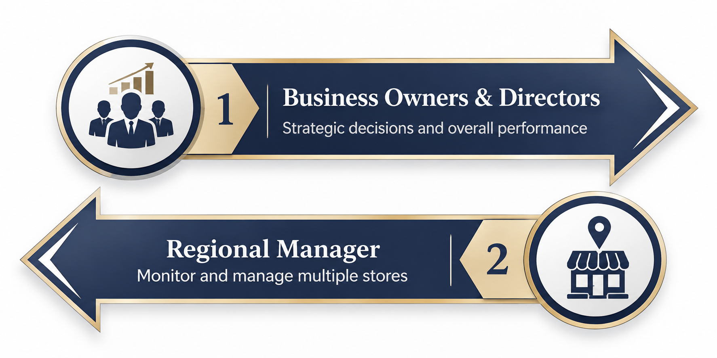
ABSTRACT
Problem Statement
Demand Prediction: Difficulty predicting customer demand across different stores and products.
Inventory Management: Facing Stock shortages, excess stock and product expiry.
Replenishment & Logistics: Challenges in deciding when, how much and where to deliver products.
Profit Management: Discounts, rising costs and poor decisions reducing profits.
Decision-Making: Lack of connection to improve business operations and customer satisfaction.
Target Avenues

Slide 3
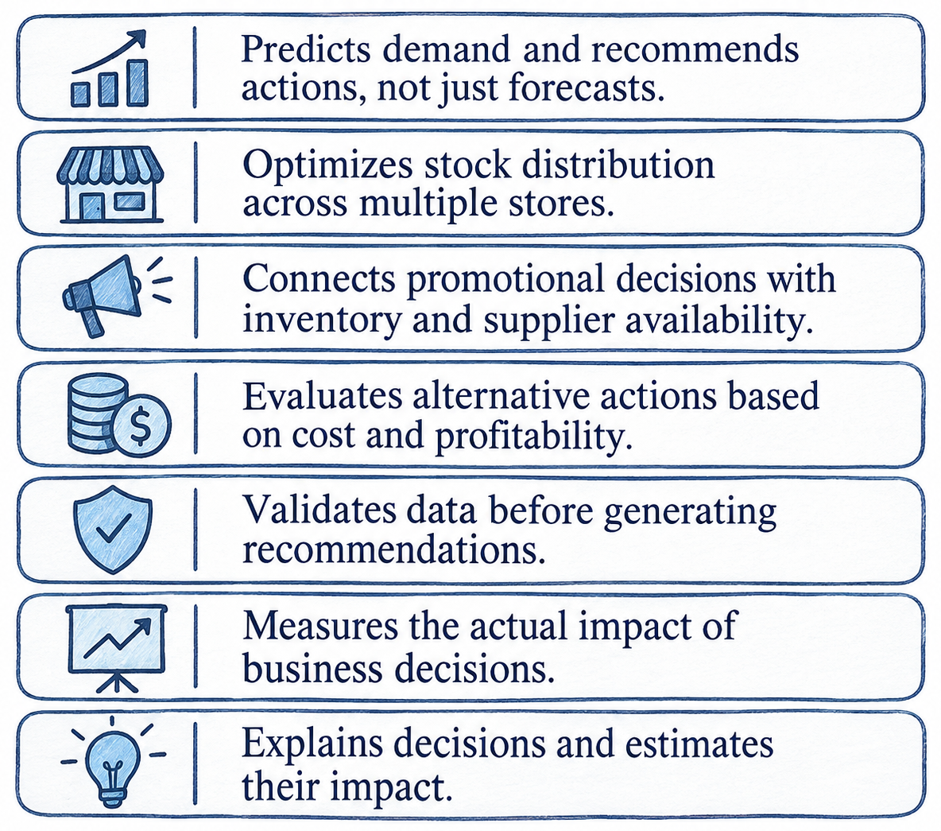
KINTRAL – CENTRALZED PLATFORM
Proposed Solution
Innovation and Uniqueness
Centralized Retail Data Monitoring: Collects and validates sales, inventory and supplier data from multiple stores.
Demand Forecasting & Risk Prediction: Predicts demand and identifies stock shortages, excess stock and expiry risks.
Intelligent Decision & Optimization Engine: Evaluates stock transfers, replenishment, supplier alternatives and discount options.
Explainable Recommendations & Impact Analysis: Suggests the best action with reasons, costs and expected benefits.
Action Execution & Performance Measurement: Allows managers to approve or simulate actions and measure their business impact.

Slide 4
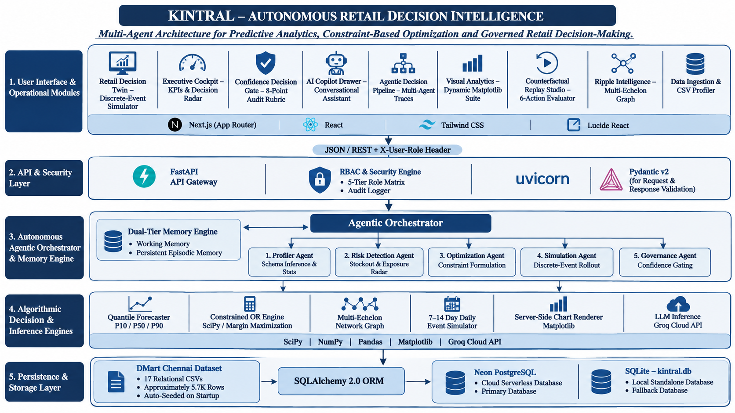
TOOLS AND TECHNOLOGIES

Slide 5
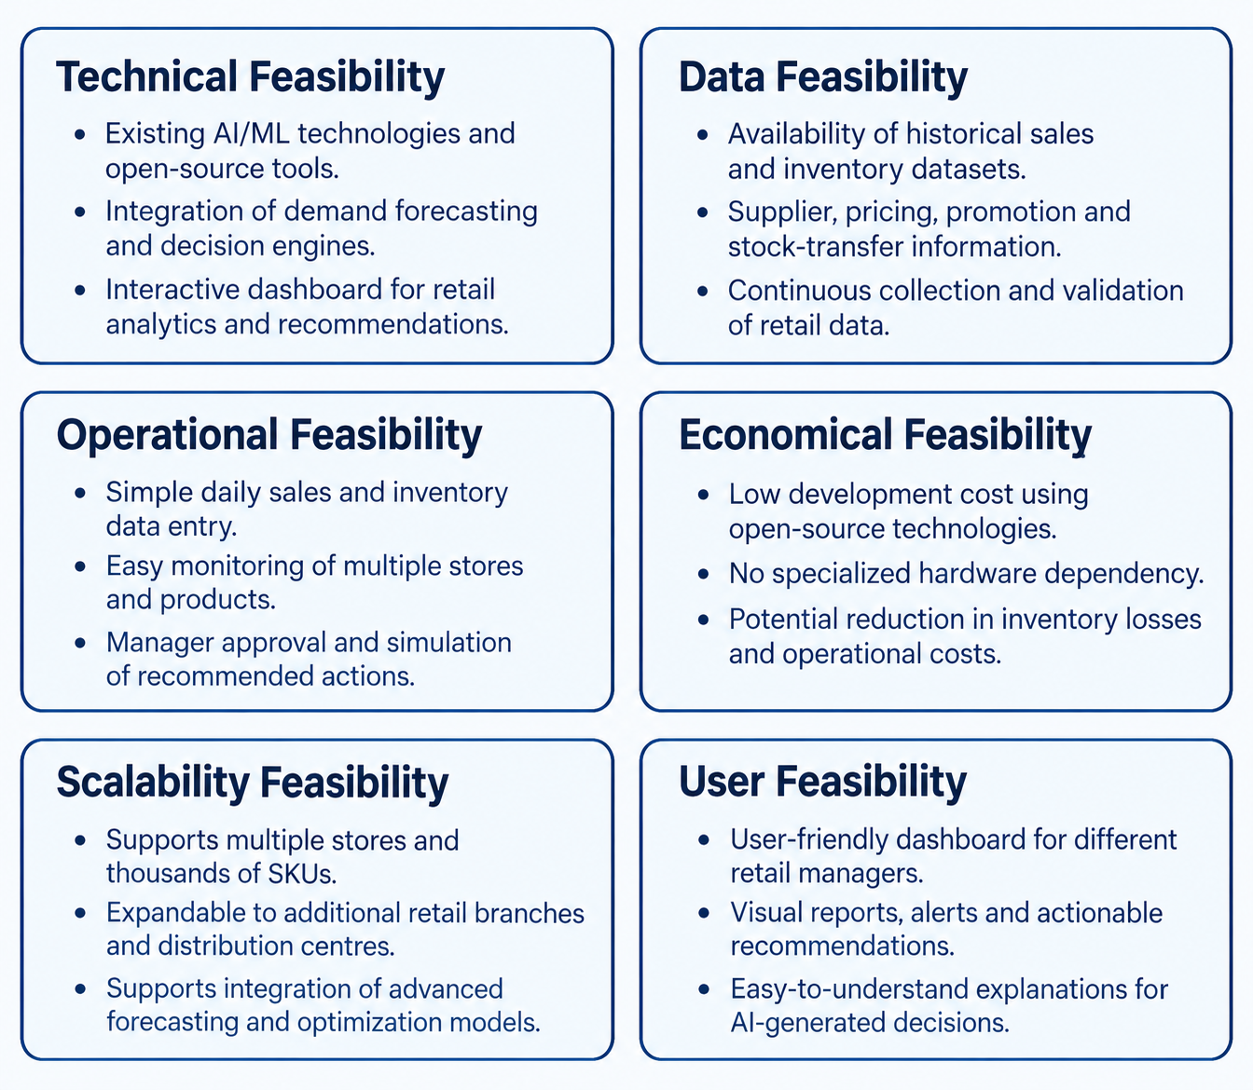
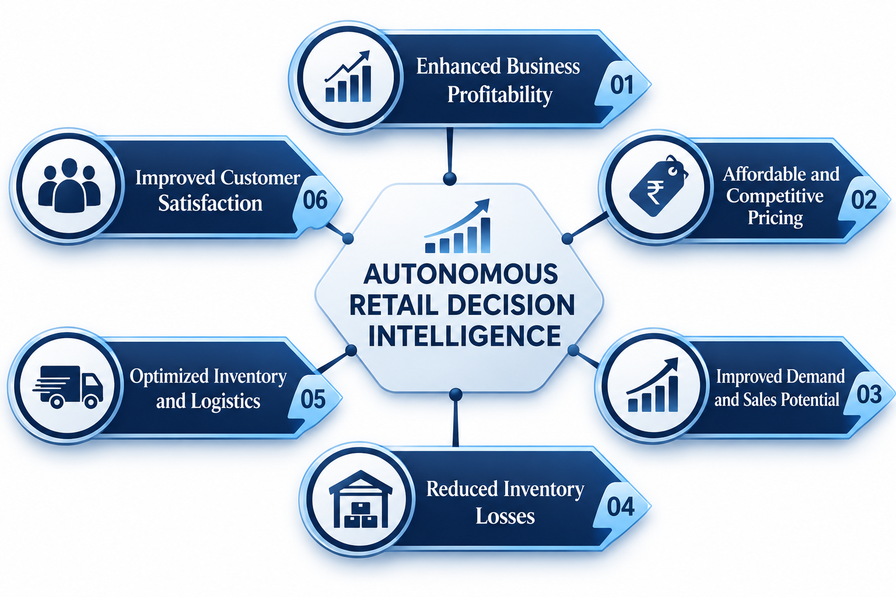
IMPACT AND FEASIBILITIES

Slide 6
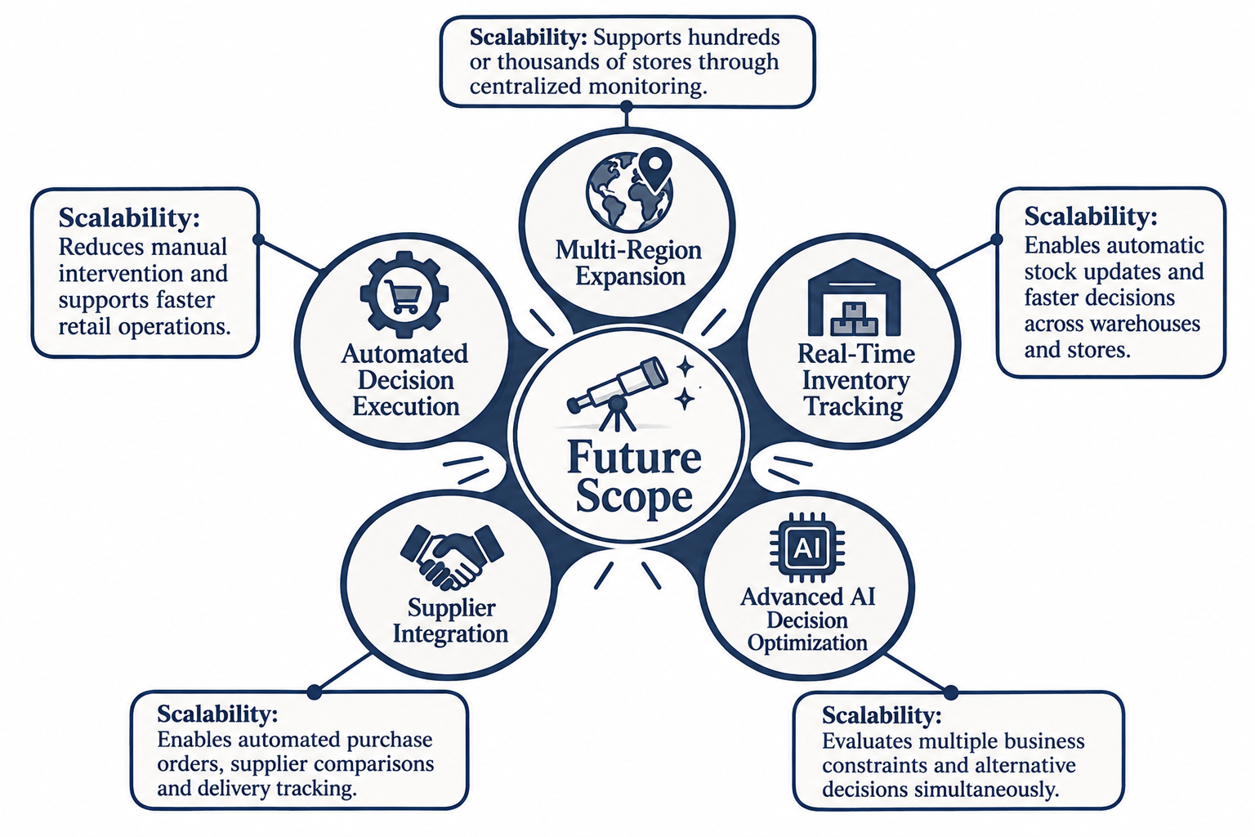
FUTURE SCOPE AND SCALABILITY

