Slide 1
Global Sourcing Support – Infosys
Weekly Status for week 04-Mar-2017 to 10-Mar-2017 (Week 06)
13-March-2017

Slide 2
WSR – Table of Contents
Operational Metrics
Appendix
Activities Update
SLAs
Problem Ticket Status

Slide 3
Executive Summary
Total Ticket Volume: Decrease in the overall ticket volume compared to weekly average of FYE17 by 28% (36/50).
Incident Volume: Decrease in Incident inflow for Week 06 compared to weekly average of FYE17 by 27% (26/36).
Request Volume: Decrease in the Request inflow for Week 06 compared to weekly average of FYE17 by 35%(09/14)
Problem Volume: created one PKE for custom questionnaire different in GDP and TA.
Closed 22 Sourcing incidents in Week 06. Closed 7 Requests in week 06.
Other Updates
Imptcr server outage for SAN upgrade was performed successfully.
CRQ for Honts8020 migration to phonts80020us is implemented and corresponding changes in effected programs have been done.
CRQ for cancelling un-used templates for GB,CA has been implemented successfully.
Due to unexpected outage on webstgvi02 server, 4 PLM servers which had logical partitioning on this server went down. The issue was resolved after replacing cooling parts on webstgvi02 server.
Operational Metrics
3

Slide 4
Operational Metrics

Slide 5
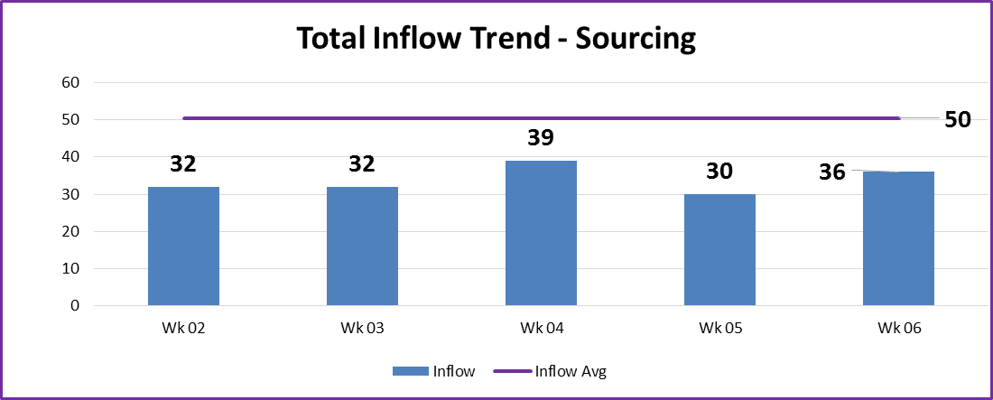
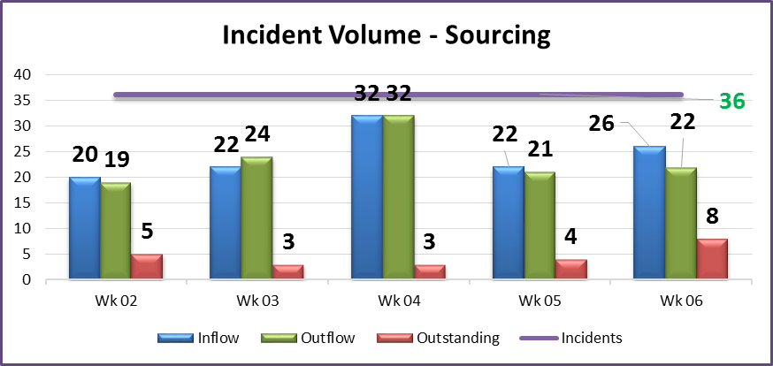
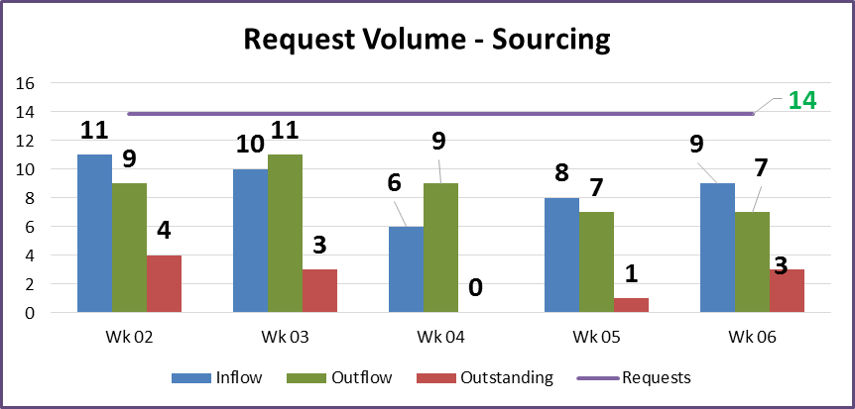
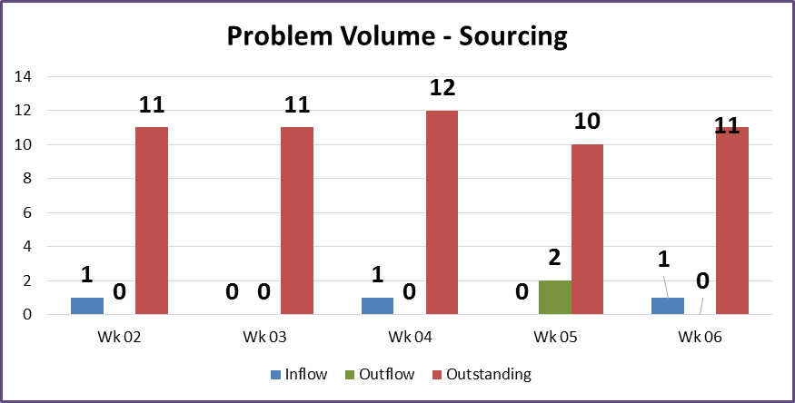
Total Ticket Volume Summary- Sourcing

Slide 6
Weekly Response and Resolution SLAs
Weekly Response SLA Trend - Sourcing
Priority/Week | Target | Week02 | Week03 | Week04 | Week05 | Week06
1-Critical | 95% | 100% | 100% | 100% | 100% | 100%
2-High & 3-Medium | 90% | 100% | 100% | 100% | 100% | 100%
4-Low | 90% | 100% | 100% | 100% | 100% | 100%
Weekly Resolution SLA Trend - Sourcing
Priority/Week | Target | Week02 | Week03 | Week04 | Week05 | Week06
1-Critical | 95% | 100% | 100% | 100% | 100% | 100%
2-High & 3-Medium | 90% | 100% | 100% | 100% | 100% | 100%
4-Low | 90% | 100% | 100% | 100% | 100% | 100%
Observations:
Response and resolution SLAs met adherence levels in Week 06

Slide 7
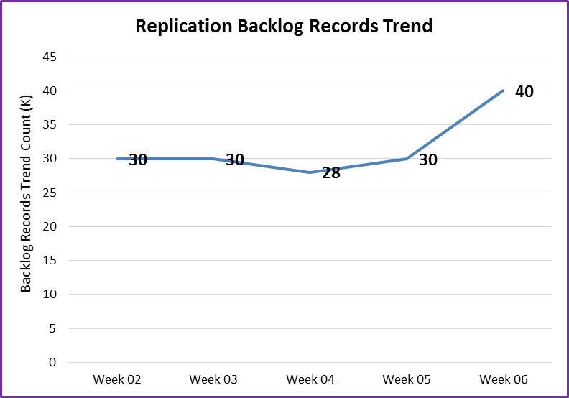
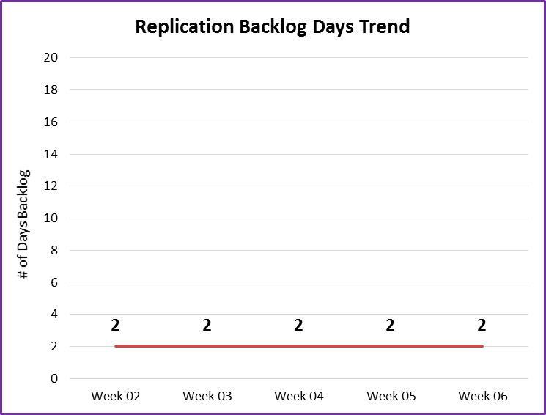
Replication Backlog Trend
Observations:
The value represented in the graph is taken at 03/10/2017 7:00 A.M C.S.T

Slide 8
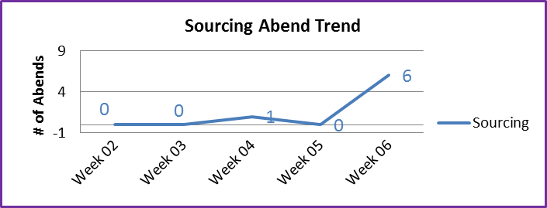
Abend Trend Weekly
Observations:
6 Sourcing abend occurred in week 06.
WCQUS005(4),PO0674D(2) abends were due to ftp issue on phonts80020us server

Slide 9
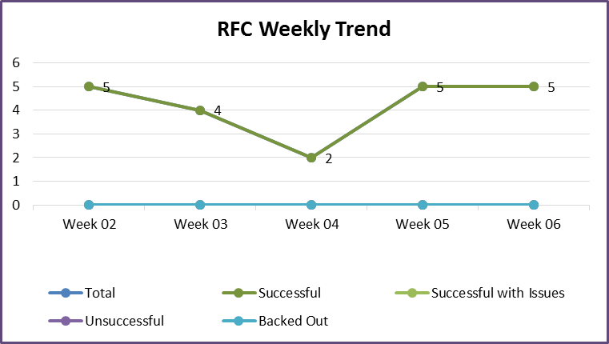
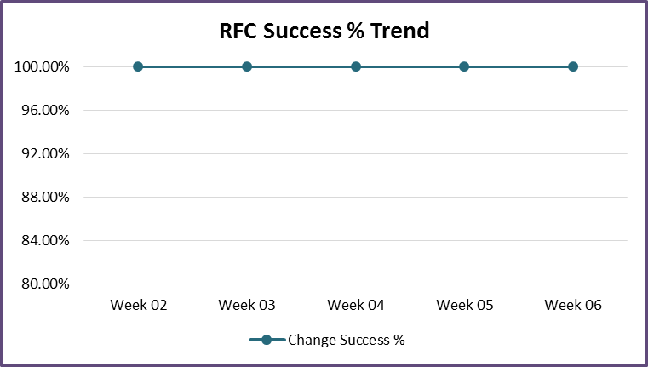
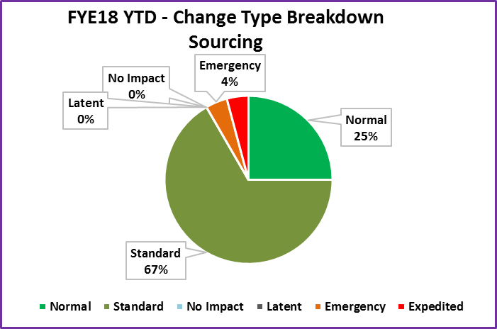
Change Control - Metrics
Observations:
6 CRQs created in this week 6.
3 CRQ’s were created to handle PLM server outage i.e. to nox cross platform jobs and to put jobs on hold.
CRQ to install MPA 3.2 to pilot users
Notes:
CRQ000080650758 obsoleted old questions “Wearing Apparel, Footwear, Hardlines and Food” for Canada company
CRQ000080650408 /M Noxing cross platform jobs due to server outage
CRQ000080650149 Noxing cross platform jobs due to server outage on osei5785 and osei5779.
CRQ000080649455 !$/ Put hold on PBUS001
CRQ000080648472 To Install MPA 3.2 to pilot users
CRQ000080635504 Cancel the un used templates from database as requested by GB,UK DI

Slide 10
Activities Update

Slide 11
Problem Ticket Status

Slide 12
Problem Tickets Status Summary
Stage | # of Tickets
Analysis (PKE000080053907, PKE000080077101, PKE000080078901) | 3
Coding (PKE000080049900, PKE000080072504, PKE000080073706, PKE000080072503) | 4
Pending Production Install (PKE000080071008) | 1
Pending/Monitoring (PKE000080034003, PBI000080026973, PBI000080073739) | 3
Grand Total | 11
Please refer Appendix for details.

Slide 13
Appendix

Slide 14
Problem Tickets (In Progress)
Entry-Id | Issue Description | Priority | Status | ETA(MM/DD/YY) | ISD Owner | PBI/PKE Owner | Tickets reduced
PKE000080049900 | Some Parallel paths quotes skipping preclass | Medium | Working on code changes | 03/30/2017 | Paul | Sulabh | 4/Month
PKE000080053907 | There are several PO's in mainframe that should have been deleted years ago. Need to analyze purge process in mpa. \\honts8020\Shares\DirectImports\Impexes\RPT\poprgrpt.csv | Medium | Analyzing je_exception criteria for purge selection of PO’s. | 03/30/2017 | Paul | Vignatha | NA
PKE000080073706 | Modify jobs PO@@674 to use SFTP instead of ftp, new ssh keys need to be defined in mainframe and windows server | Medium | SFTP requests have been rejected due to invalid Source ID. | 03/30/2017 | Arturo | Sulabh | 2/Month

Slide 15
Problem Tickets (In Progress)
Entry-Id | Issue Description | Priority | Status | ETA(MM/DD/YY) | ISD Owner | PBI/PKE Owner | Tickets reduced
PKE000080034003 | Algorithm calculation of pack var qty and NFC in shipment summary needs reviewed | Medium | Working on rolling the changes to Pilot | 03/30/2017 | Arturo | Vignesh | 3/Month
PKE000080077101 | Replication Outstanding changes growing. Need to research the source of increase | Medium | Analyzing the issue | 03/31/2017 | Paul | Sulabh | 2/Month
PKE000080078901 | Quotes being sent back to GDP due to difference in custom questionnaire in GDP and TA | Low | Analyzing the issue | 05/31/2017 | Burt | Prashanthi | 2/Month

Slide 16
Problem Tickets (In Progress)
Entry-Id | Issue Description | Priority | Status | ETA(MM/DD/YY) | ISD Owner | PBI/PKE Owner | Tickets reduced
PKE000080071008 | INC000095323694(Automated Transit Mode Screen Not Updating when ALL Modes Selected) | Medium | Validation completed in Pilot. Working for Production roll out. | 03/15/2017 | Arturo | Vignesh | 1/Month
PKE000080072503 | This PKE is necessary to correct the issue with EDI 315 slowness. Currently K1 is running long which is impacting all other markets. | Medium | Working on code changes to run EDI 315 separately for different countries | 03/30/2017 | Paul | Shashikanth | NA
PKE000080072504 | crontab monitor and disk space monitoring for import systems | Medium | Working on code changes | 03/30/2017 | Paul | Sravani | 3/Month

Slide 17
Problem Tickets (Pending/Monitoring)
Entry-Id | Issue Description | Priority | Status | ETA(MM/DD/YY) | ISD Owner | PBI/PKE Owner | Tickets reduced
PBI000080026973 | Retail link threshold count is high on osei630a/b | Low | Pending status (Team will be adding the incident details when ever recycling of app pools happens) | 03/31/2017 | Burt | Showri | NA
PBI000080073739 | IPOR duplicating products and packs | Medium | Pending Status – Team will work as soon as we get any new examples of duplicates. | 03/31/2017 | Paul | Sulabh | 2/Month

Slide 18
Thank You
Notes:
To reproduce this slide simply create a new slide, right click and select layout and apply the Notes&Disclaimer layout.

