Slide 1
Monthly Status Report
Global Sourcing
February 2017

Slide 2
Agenda
Operational Metrics
Performance Measures
Abends & Replication
Change Controls
Business Value Adds
Executive Summary
Ishikawa Analysis
Appendix
Problem Ticket Status
Scorecard
Automation & Dashboards
Issues / Concerns / Risks

Slide 3
Executive Summary
Incident Volume –
7% Decrease compared to January’17
57% Decrease compared to February’16
Problem Volume –
50% Decrease compared to January’17
100% Increase compared to February’16
Request Volume –
22% Decrease compared to January’17
51% Decrease compared to February’16
Total Volume –
12% Decrease compared to January’17
55% Decrease compared to February’16
Closed 95 Incidents, 40 Requests in February 2017.
Operational Metrics
Business Value Add
BVA’s worth $240K were submitted in February 2017.
Other Updates
Honts80015 was migrated to phont80015us and corresponding changes have been handled
Users reported issues in Freight and Pack pages in GDP application worked with W23K team and resolved it. Reason:W23K changes had conflict with changes of Ronald which were backed out.
Replication Reseed activity has been completed successfully
Users reported issue in accessing Transport Tools application and reason was clusters went down on both nodes A & B on old server i.e. honts5700 sql server. Worked with Win serve team who powered off both nodes and powered back node A and started Cluster A and all resources online and issue resolved.
cants80001 server has been migrated to new hardware and accepts SFTP connections only.

Slide 4
Scorecard
Parameter | Measure | Goal | Actual | Status | Remarks
Incident Volume (MoM) | Trend |  |  |  | 95 incidents in February’17 against 102 in January’17 month. (220 in February’16)
Reduction on All (P1, P2,P3,P4) incidents (YTD) | % | -5 | -57 |  | Inflow of 95 YTD incidents against 220 by this month last year.
Total Incidents Reduced (YTD) | # | NA | 4 |  | 4 incidents reduced per month via 5 root cause fixes.
P1,P2,P3,P4 incidents pending > 14 days | # | 0 | 0 |  | No Pending incidents more than 14 days
Reduction on MTTR for (P1,P2,P3,P4) incidents (LYTM-TYTM) | % | NA | -8% |  | 2887 Mins in February’17 v/s 3148 Mins in February’16.
Reduction in mainframe job abend count (YTD) | % | 0 | -80% |  | Abends decreased to 1 against 5 YTD. (1 in February’17 against 5 in February‘16)
No of failed CRQs (YTD) | # | 2 | 0 |  | 13 of 13 Successfully implemented changes YTD. No failed CRQ in February month
Meet vendor adherence resolution SLAs for P1 & P2 incidents(Monthly) | % | 90 | 100 |  | Met Response and Resolution SLA Targets
G
G
G
G
G
G
G
G

Slide 5
Operational Metrics

Slide 6
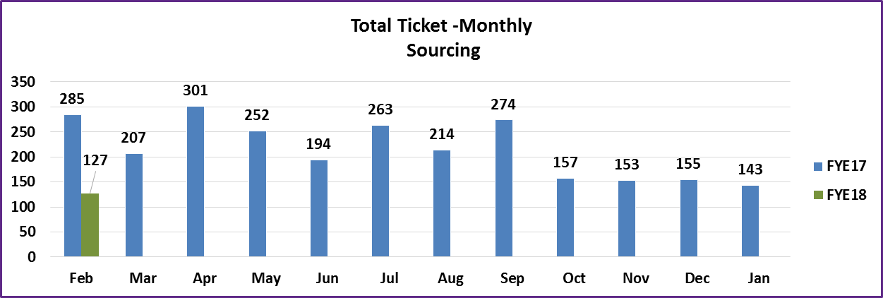
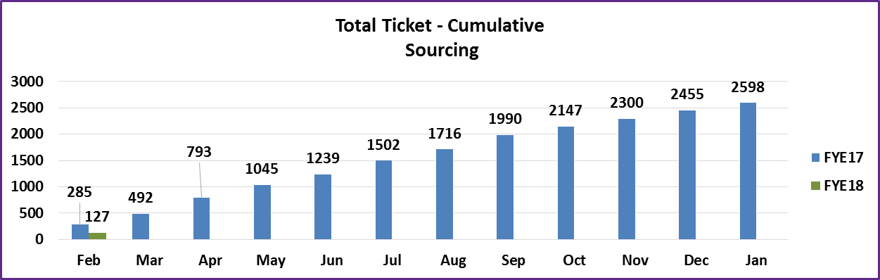
Total Tickets Volume Trend
Observations for the month of February 17:
Inflow Trend
Major contributors for ticket inflow in February’17 are GDP(20),MPA(20)
Tickets reduced majorly in the applications MPA(60/20) ,FlexPLM(40/7) ,Sourcing others(23/7) ,GDP/SQ(37/20) .*Last year February/This year February
Total ticket inflow for Sourcing is 120 & 7 for PLM.
74% of total tickets are incidents where as 24% are requests.
Cumulative
NA

Slide 7
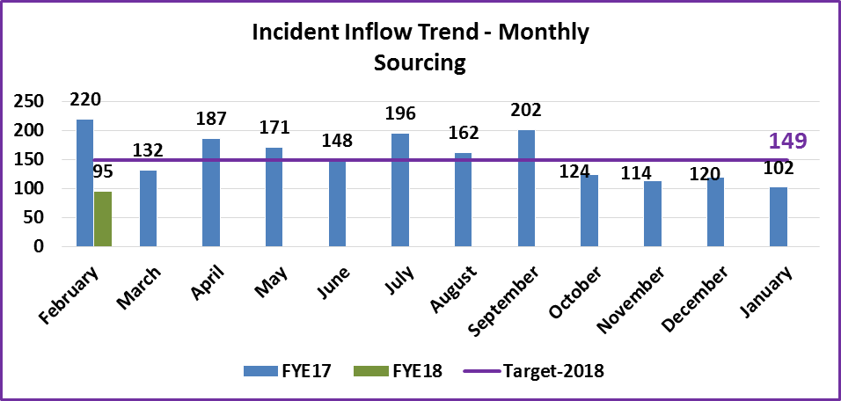
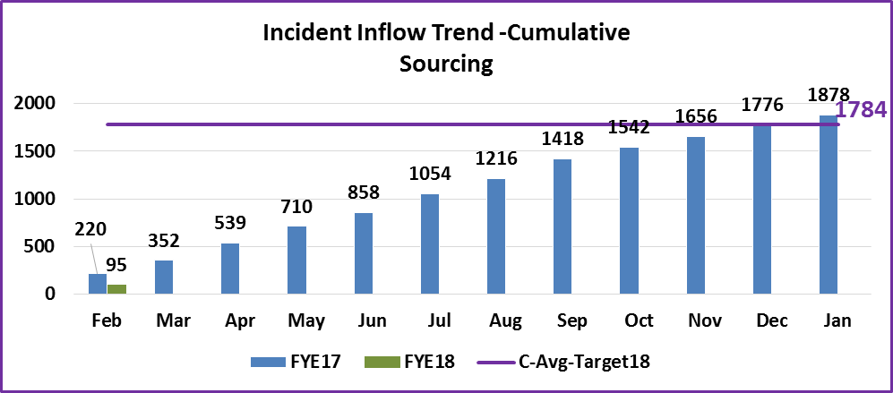
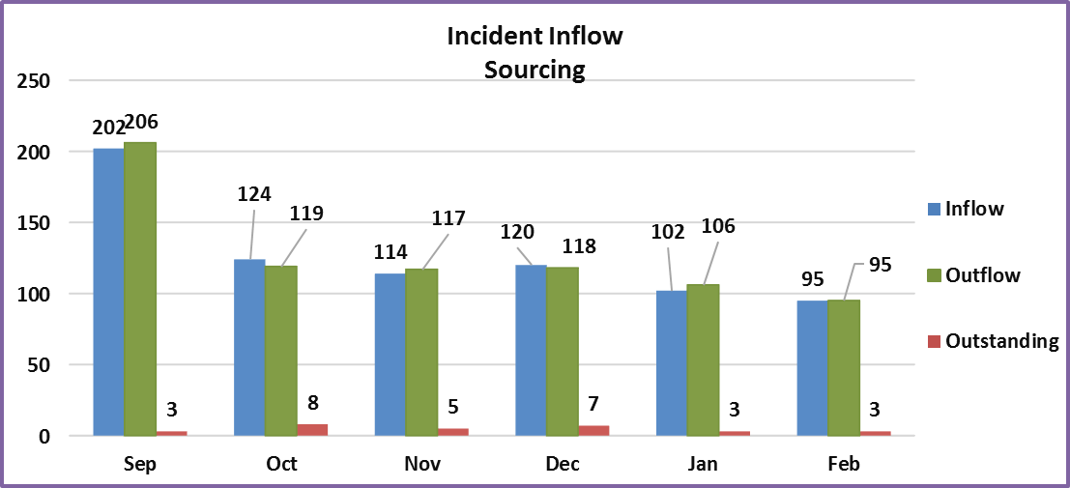
Incidents Volume Trend
Observations for the month of February-17:
Inflow Trend
94 incidents are from Sourcing and 1 incident for PLM

Slide 8
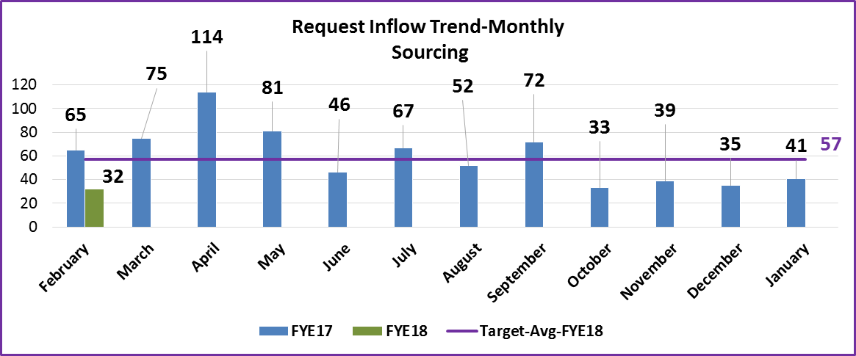
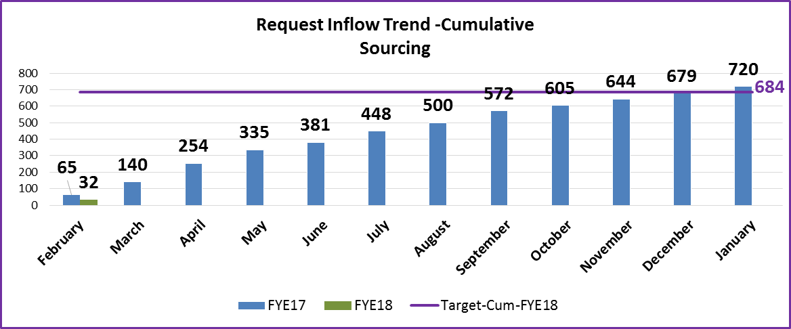
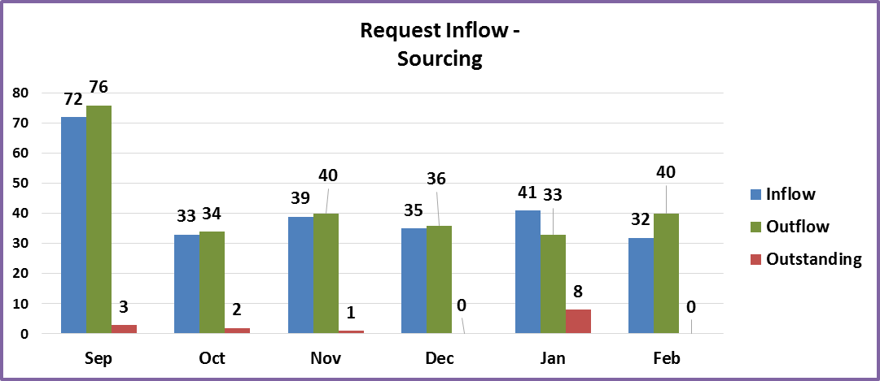
Requests Volume Trend
Observations for the month of February-17 :
Decrease in request inflow by 49%(32/65) in February’17 compared to February’16.
26 requests are for sourcing and 6 are for PLM

Slide 9
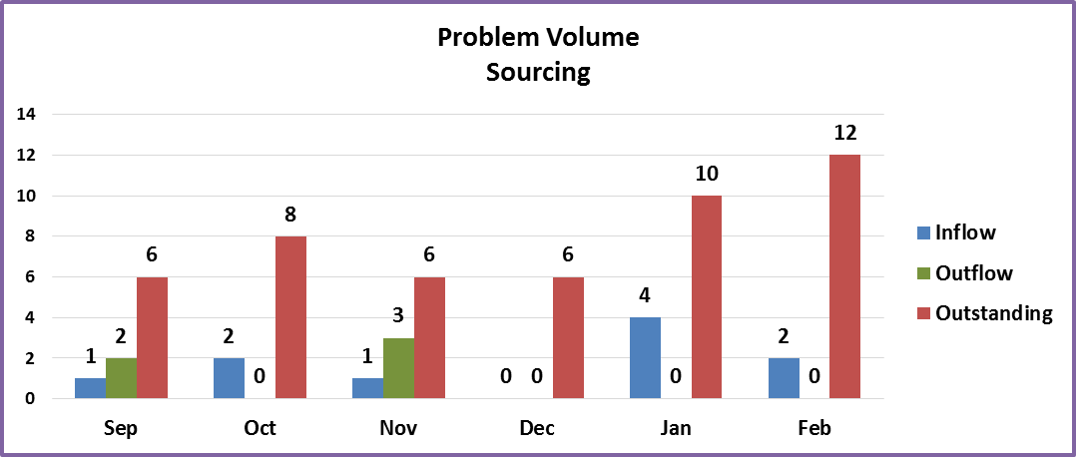
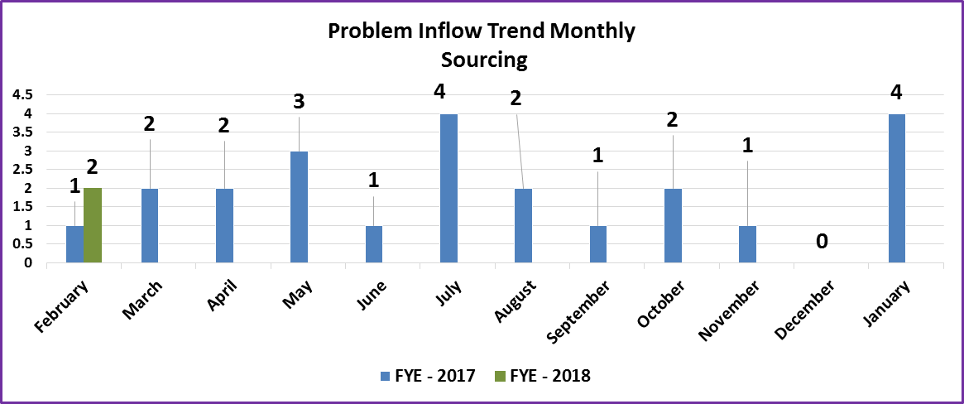
Problems Volume Trend
Observations for the month of February-17:
Inflow of PKEs/PBIs:
PKE000080073706 - Modify jobs PO@@674 to use SFTP instead of ftp, new ssh keys need to be defined in mainframe and windows server
PKE000080077101 – Replication outstanding changes growing. Need to research source of increase
Outflow of PKEs/PBIs:
None
Notes:
PKE000080073706 - Modify jobs PO@@674 to use SFTP instead of ftp, new ssh keys need to be defined in mainframe and windows server
PKE000080077101 – Replication outstanding changes growing. Need to research source of increase

Slide 10
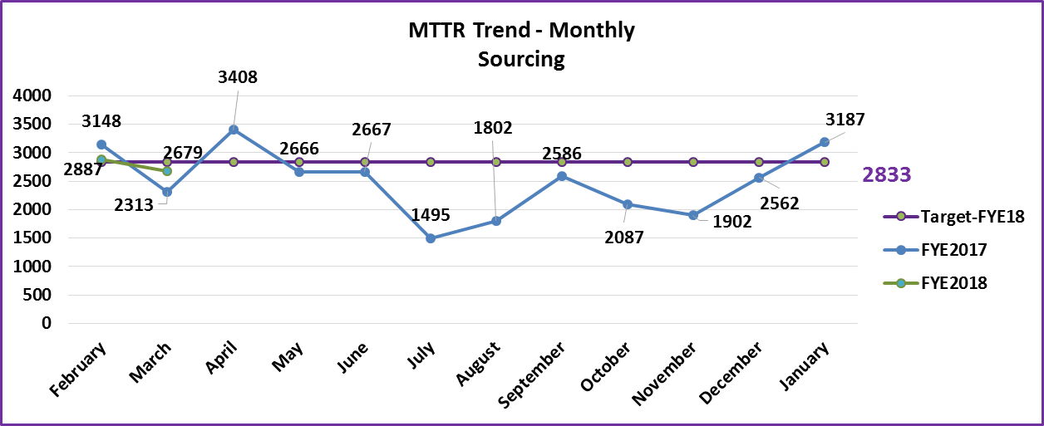
Incident Tickets – MTTR Summary
Observations for the month of February - 17 :
Decrease in MTTR compared to February’16 by 8%.
Comparison is against all P1,P2,P3,P4 incidents for FYE’17.

Slide 11
Performance Measures

Slide 12
Response & Resolution SLA
Monthly Response SLA Trend - Sourcing
Priority/Month |  |  | September |  | October |  | November |  | December |  | January |  | February
 | Target | Sourcing + PLM |  |  | Sourcing + PLM |  | Sourcing + PLM |  | Sourcing+ PLM |  | Sourcing + PLM |  | Sourcing + PLM
1 - Critical | 95% | 100% |  | 100% | 100% | 100% | 100% | 100% | 100% | 100% | 100% | 100% | 100% | 100%
2-High & 3 - Medium | 90% | 100% |  | 100% | 100% | 100% | 100% | 100% | 100% | 100% | 100% | 100% | 100% | 100%
4-Low | 90% | 100% |  | 100% | 100% | 100% | 100% | 100% | 100% | 100% | 100% | 100% | 100% | 100%
Monthly Resolution SLA Trend - Sourcing
Priority/Month |  |  | September |  | October |  | November |  | December |  | January |  | February
 | Target | Sourcing + PLM |  |  | Sourcing + PLM |  | Sourcing + PLM |  | Sourcing + PLM |  | Sourcing + PLM |  | Sourcing + PLM
1 - Critical | 95% | 100% |  | 100% | 100% | 100% | 100% | 100% | 100% | 100% | 100% | 100% | 100% | 100%
2-High & 3 - Medium | 90% | 100% |  | 100% | 100% | 100% | 100% | 100% | 100% | 100% | 100% | 100% | 100% | 100%
4-Low | 90% | 100% |  | 100% | 100% | 100% | 100% | 100% | 100% | 100% | 100% | 100% | 100% | 100%
Observations for the month of February-17 :
Both Response and resolution SLAs are under adherence levels.

Slide 13
Abends & Replication

Slide 14
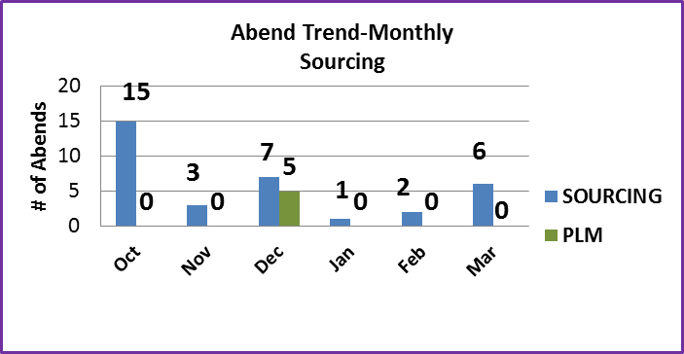
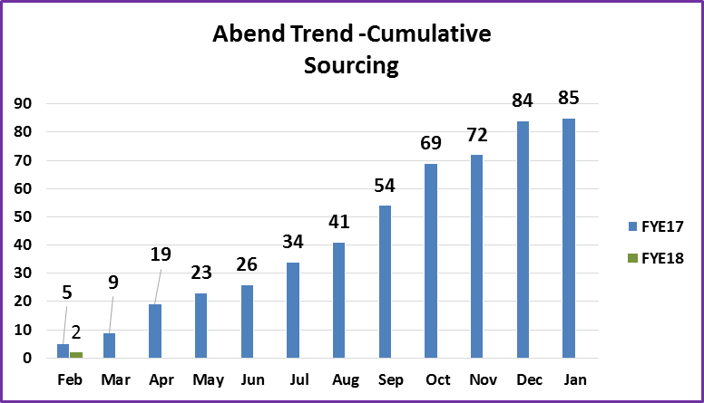
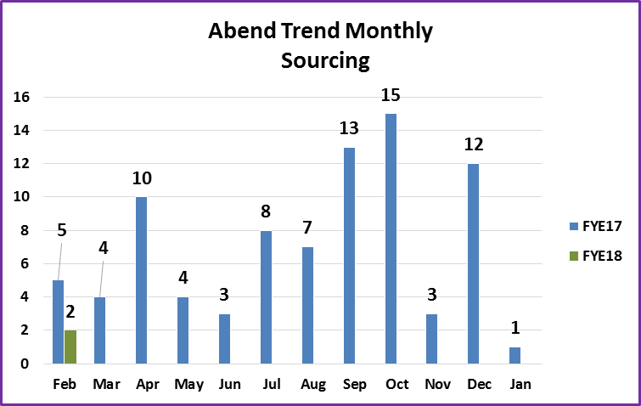
Abend Trend
Observations for the month of February -17 :
1 abend reported in February’17.
PO0670D
Notes:
PO0670D – Job failed because deadlock on db2 table. We have raised JIRA request#ISDEMIB-23176 to find the root cause.

Slide 15
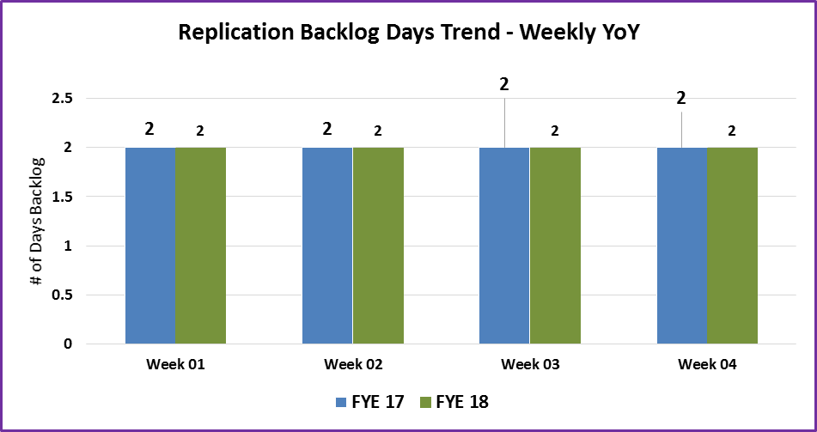
Replication Trend
Observations for the month of February -17 :
Replication is under adherence levels for February’17.
Values taken FYE’18 are 7:00 A.M C.S.T of each Friday for that week.

Slide 16
Change Controls

Slide 17
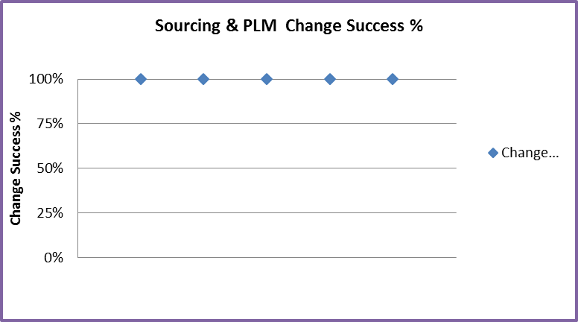
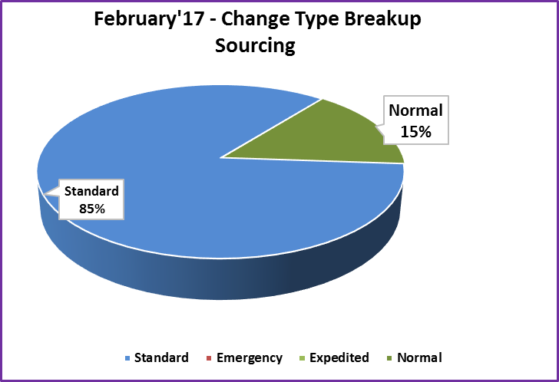
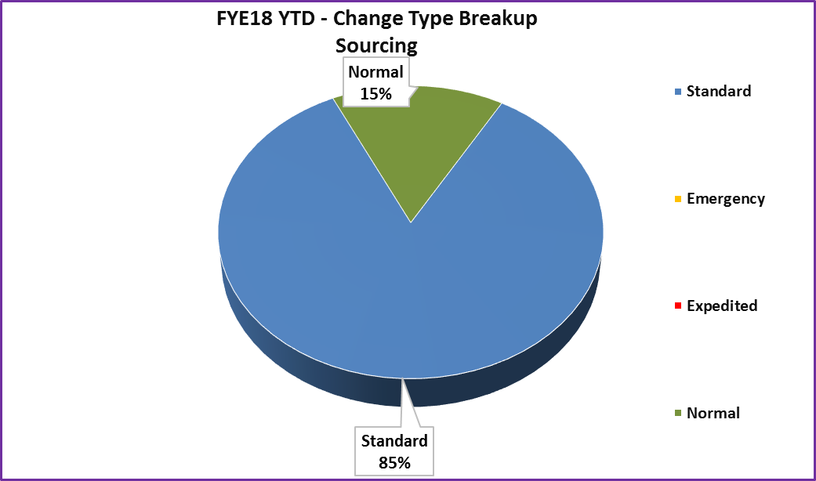
Change Controls
Observations for the month of February -16 :
13 changes rolled out in February.
No Emergency /No Expedited CRQs
Notes:
CRQ000080603149 CRQ to nox the job(POCA674 and POC0676D ) that is abending.
CRQ000080595314 Po2Edi alert script change
CRQ000080607287 Please create Base for the GDG mentioned in Notes section.
CRQ000080603103 For include member IMSP120Z changes done to have the copy of file created for WME, present in JAMOH3
CRQ000080602717 "For 1. New JCL IMUS120E is present in JAMOH.LIBR.FILE"
CRQ000080602548 "4. For schedule changes PFA, SCR sheet"
CRQ000080599868 Fix POUS694 abend
CRQ000080617207 Hiding Multi Indicator question for creating or open quotes SQ and MPA
CRQ000080606337 Install the External SSL SHA-2 certificate for US Flex-PLM Application for secure Connection.
CRQ000080603975 sm_daily change for SFTP for CA
CRQ000080601838 Reset Sourcing Replication change_id on importsp
CRQ000080628604 Adding new workflow(VENDOR->GP->SOURCING->BUYER->IPOR) for Canada company in AUR application
CRQ000080608537 Restrict the number of retries in case of error SQLCODE 259 in osa2gss.sh Unix script.

Slide 18
Problem Ticket Status

Slide 19
Problem Tickets Status Summary
Stage | # of Tickets
Analysis (PKE80053907, PKE80077101) | 2
Coding (PKE80049900, PKE80072504, PKE80073706, PKE80072503) | 4
Pending Install (PKE80071008) | 1
Pending/Monitoring (PKE80034003, PBI80026973, PBI80073739) | 3
Pending Closure (PKE80062004, PKE80070406) | 2
Grand Total | 12
Note:- This problem ticket status summary is as on 2/27/2017

Slide 20
Automation & Dashboard

Slide 21
List of Automations and Dashboard
# | Type of item | Item Name | Item Description | Status | Issue Type | Action Item
1 | Dashboard | IPOR inbox | To display count of revisions pending in each IPOR inbox | In Progress | Request
2 | Dashboard | Disk space monitoring | To display disk space utilization of sourcing servers | In Progress | Incident
3 | Automation | Cancel SPT | Handle all requests of Cancel SPT using slack bot automation | In Progress | Request
4 | Automation | Vendor resend | Handle vendor resend request through IAP | Complete | Incident
5 | Automation | DA% refresh on template quotes | To trigger DA% refresh on template quotes using IAP | Complete | Request

Slide 22
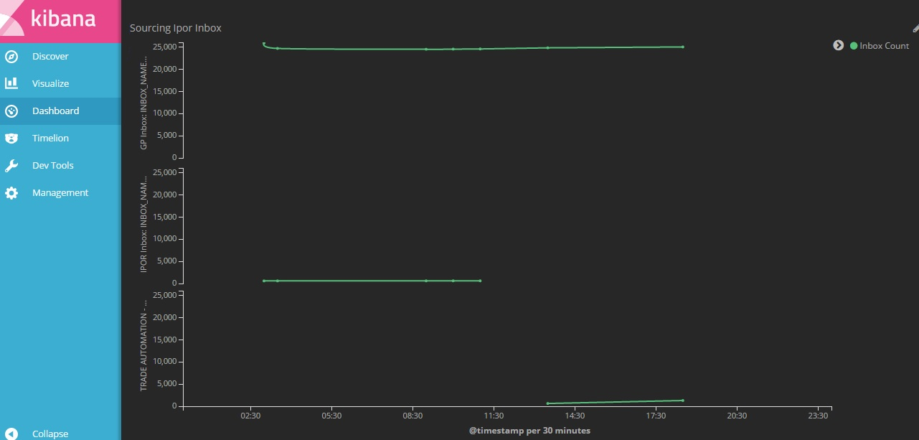
IPOR inbox(Kibana Dashboard)

Slide 23
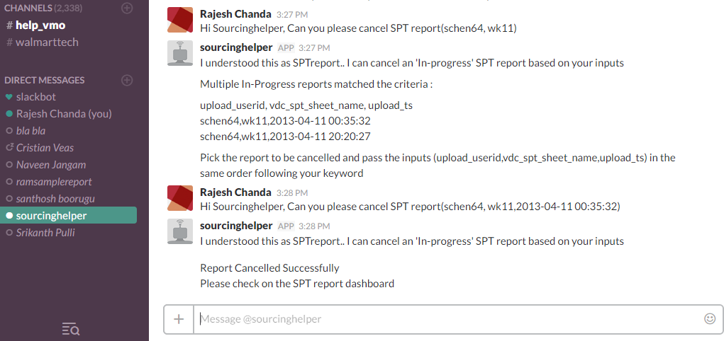
Cancel SPT(Slackbot automation)

Slide 24
Ishikawa Analysis

Slide 25
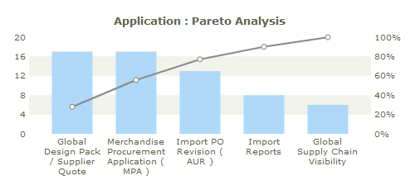

Sourcing Trending Ticket analysis by Application
# | Application Name | Dec’16(#)
1 | GDP/SQ | 20
2 | MPA | 20
3 | IPOR | 13
4 | Import Reports | 8
5 | GSCV | 6
Observations for the month of February’ 17 :
3 incidents on users receiving errors while saving info in GDP
2 incidents on sailing message info not available for PO in MPA
2 requests on change of service type code in QC inspections
2 requests for WIP access
Notes:
Sourcing others -27 (8 replication alerts, 12 job abends, 1 diskspace alert)
GDP/SQ-24
MPA-22
IPOR-12
QC Inspection-10

Slide 26
Business Value Adds

Slide 27
Business Value Adds (Soft Savings)
February 2017:
Value Add Category | Count | Tickets Reduced (Per Month) | MIPS Savings (Per Month) | Sum of Dollar Savings (Per Year)
Increased System Efficiency | 2 | 3 | 0 | $1,740
User effort saving | 1 | 0 | 0 | $1,350
Abend’s reduction | 1 | 1 | 0 | $192
Business benefit | 1 | 0 | 0 | $237,600
Total | 5 | 4 | 0 | $240,882
YTD:
Value Add Category | Count | Tickets Reduced (Per Month) | MIPS Savings (Per Month) | Sum of Dollar Savings (Per Year)
Increased System Efficiency | 2 | 3 | 0 | $1,740
Support Reduction Category | 0 | 0 | 0 | $0
User effort saving | 1 | 0 | 0 | $1,350
Abend’s reduction | 1 | 1 | 0 | $192
Business benefit | 1 | 0 | 0 | $237,600
Total | 5 | 4 | 0 | $240,882
Notes:
BVA submission in December month
Submitted BVA to fix new line character in ‘New Shipment schedule’.
Submitted BVA for win2k3 migration support provided by team

Slide 28
Business Value Adds (Soft Savings)
Details of BVA submission for February-17 :
Submitted BVA for stored procedure changes in transport tools to get allocation details to all selected countries.
Submitted BVA to remove pending reason code P2 auto notification email in QC Web application and result parser
Submitted BVA for Migration of honts8020 to phonts80020us shared path.
Submitted BVA for cants 851 migration, SM_daily folder was moved to new server
Submitted BVA for POUS691 abend i.e. made changes to program to handle null scenarios for sailing_msg date.

Slide 29
Issues/Concerns/Risks

Slide 30
Issues/Concerns/Risks
Application’s status after Win2k3 Migration
Issue | Lab url not working | Pilot Url not Working | Code Build Unsuccesfull In local | Not able to run Code in local | Automated build e-mail not triggered after check in | Build Unsuccessful in Jenkins | Error Handling not done by migration team
# of Apps (19 of 23) | 9 | 3 | 0 | 9 | 9 | 12 | 11

Slide 31
Thank You
Notes:
To reproduce this slide simply create a new slide, right click and select layout and apply the Notes & Disclaimer layout.

Slide 32
Transitions to Operations

Slide 33
Application Details-FYE17
Application/Project | Scope | Cut Over date | Additional Budget | Status | Remarks
GTDP KT session | New | NA | NA | In Progress | GTDP dev team has given session on UI of GTDP and database design
Win2k3 migration projects | New | NA | NA | Completed | Win2k3 team conducted a KT session on web.config encryption/decryption changes for impacted applications
WIP pair programming | New | NA | NA | Pair programming completed | Pair pogromming is completed. Team will work on the tickets starting form 10/12/2016
WIP Hands on session | New | NA | NA | More details about WIP project and IBM BPM are provided | Follow up session is scheduled. No ETA yet

Slide 34
Application Details-FYE16
Application/Project | Scope | Cut Over date | Additional Budget | Status | Remarks
WIP project kick start session | New | NA | NA | Initial KT give on WIP project using IBM BPM.. | Follow-up session is scheduled on 07/21/2016 7:00 A.M CST
IE8 remediation changes for Supplier Profile | Existing | NA | No | KT done on 02/19/2016 | Team attended KT session .No functional changes only cosmetic changes are validated in IE11
IE8 remediation changes for Transport Tools | Existing | NA | No | KT done on 02/23/2016 | Team attended KT session .No functional changes only cosmetic changes are validated in IE11
IE8 remediation changes for Transport Tools and supplier Onboarding | Existing | NA | No | KT done on 05/20/2016 | Team attended KT session for RL header changes.
First Sale Design review | New | NA | No | Review done on 08-Oct-15 | Team attended design review meeting through Web ex.

Slide 35
Application Details-FYE16
Application/Project | Scope | Cut Over date | Additional Budget | Status | Remarks
Global Food Sourcing | Existing | NA | No | KT Done on 24-Sept-15 | Web ex session on Global Food sourcing changes
GSCV Reports-filtering criteria | Existing | NA | No | KT Done on 23-Jul-15 | Web ex session on GSCV reporting filters criteria.
SLI | Existing | 08/15/15 | No | KT Done on 16-Jul-15 | Few changes to database schema

Slide 36
The End
Notes:
To reproduce this slide simply create a new slide, right click and select layout and apply the Notes & Disclaimer layout.

