Slide 1


L'ORÉAL
FROM AI DISCOVERY
TO MEASUREMENT
How L'Oréal could extend its existing measurement capabilities into conversational AI discovery — without needing to own the AI touchpoint.
L'ORÉAL · BUSINESS ANALYTICS & AI MEASUREMENT · 2026

Slide 2
CHAPTER 1 · DIGITAL CHANNEL PERFORMANCE
E-COMMERCE SHARE OF SALES DIDN'T ALWAYS RISE
E-commerce share fell 1.9 pp from 2021–2023, then recovered to 28.2% in 2024 and reached 30.2% in 2025.
The decline did not mean e-commerce sales were falling — total L'Oréal sales were growing faster in 2022 and 2023.
2025: €13.3bn in e-commerce sales — 30.2% of Group sales.
Source: L'Oréal Annual Reports, 2021–2024; 2025 Universal Registration Document.
L'ORÉAL · BUSINESS ANALYTICS & AI MEASUREMENT · 2026
02 / 14

Slide 3
CHAPTER 1 · DIGITAL CHANNEL PERFORMANCE
GROWTH SLOWED WHILE MARGIN KEPT RISING
LFL sales growth fell from 16.1% in 2021 to 4.0% in 2025, while operating margin increased from 19.1% to 20.2%.
LFL SALES GROWTH (%)
The latest data therefore shows slowing top-line growth alongside continued margin expansion.
Source: L'Oréal Annual Reports, 2021–2025.
OPERATING MARGIN (%)
Two metrics moved in opposite directions — this chart does not establish a causal relationship between them.
L'ORÉAL · BUSINESS ANALYTICS & AI MEASUREMENT · 2026
03 / 14

Slide 4
CHAPTER 2 · THE AI MEASUREMENT CHALLENGE
IF A MEASURED CHANNEL BEHAVES THIS UNEVENLY,
WHAT ABOUT AN UNMEASURED ONE?
Across five years, L'Oréal's reported e-commerce data shows that digital growth is not a straight line: share declined for two years before recovering, while overall sales growth slowed even as margin improved.
The next measurement challenge is different. AI can influence discovery and consideration before a customer reaches a retailer or L'Oréal's own channels — creating a new layer of activity that may be harder to observe.
June 2026: L'Oréal announced a partnership with OpenAI covering AI-powered discovery, virtual try-on and advertising initiatives.
Source: L'Oréal, 17 June 2026 VivaTech announcement. Publicly announced scope; L'Oréal-specific measurement implementation is not detailed in public sources.
L'ORÉAL · BUSINESS ANALYTICS & AI MEASUREMENT · 2026
04 / 14

Slide 5
CHAPTER 2 · THE AI MEASUREMENT CHALLENGE
ATTRIBUTION ≠ INCREMENTALITY
A purchase tagged "AI-referred" is not proof AI caused it.
ATTRIBUTION
INCREMENTALITY
AI Discovery → Referral → Retailer Visit → Purchase ✓
AI Discovery → Referral → Retailer Visit → Purchase ?
This purchase happened, and a tracking signal linked it to an AI referral.
This purchase might have happened even without the AI referral — attribution alone can't tell you.
A tracking signal can attribute a conversion; a comparison-group test is needed to estimate incremental lift.
L'ORÉAL · BUSINESS ANALYTICS & AI MEASUREMENT · 2026
05 / 14

Slide 6
CHAPTER 2 · THE AI MEASUREMENT CHALLENGE
WHAT WOULD L'ORÉAL NEED TO MEASURE THIS CREDIBLY?
Estimating a credible MDE depends on data and design inputs — here's which ones public data can and can't provide.
Input Needed | Status | Why It Matters
Market-level outcome variance | Not publicly available | Estimates the natural outcome variability an effect must be distinguished from
Eligible comparable test/control markets | Not publicly available | Determines the feasible sample size and comparison structure
Baseline outcome level (e.g. market-level sales) | Not publicly available | Defines the scale against which an incremental lift is evaluated
Sufficient pre-test market history | Not publicly available | Captures baseline trends and seasonality before the intervention
Test duration | Decidable in advance | Determines the observation window and contributes to detectable effect size
No L'Oréal-specific MDE can be calculated from public data. The target effect, alpha and statistical power should be pre-specified as part of the experiment design.
L'ORÉAL · BUSINESS ANALYTICS & AI MEASUREMENT · 2026
06 / 14

Slide 7
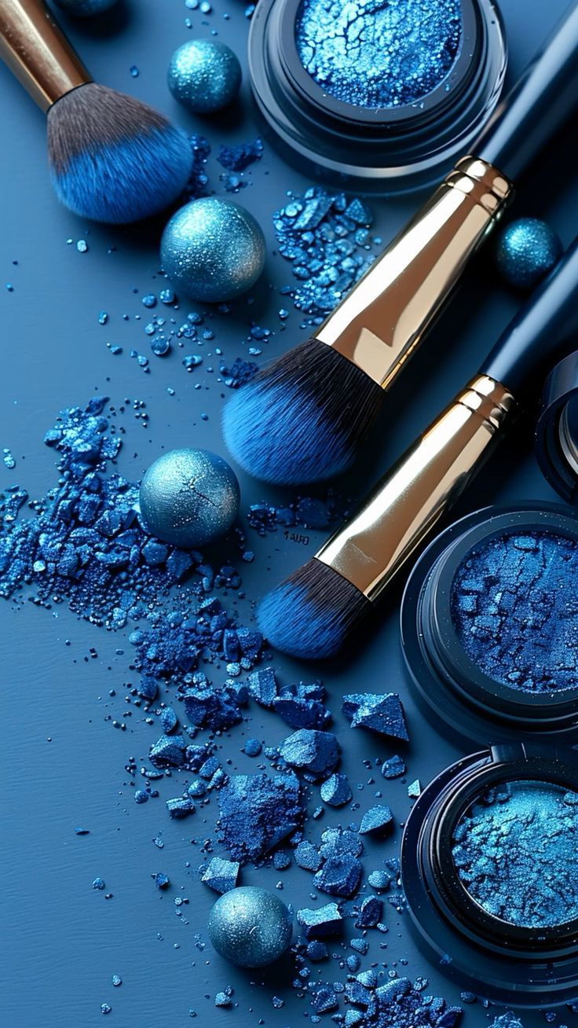
CHAPTER 3 · PROPOSED MEASUREMENT FRAMEWORK
WHAT COULD BE MEASURED — AND WHAT STILL REQUIRES DATA
A proposed framework — not a description of L'Oréal's current measurement systems.
VISIBILITY PROXY
INTERACTION
REFERRAL
CONVERSION
INCREMENTALITY
REPEAT VALUE
AI Answer
Mention Rate
AI-Assisted
Session Rate
AI Referral Rate
AI-Referred
Conversion Rate
Incremental
Sales Lift
AI-Originated Repeat
Purchase Rate
Share of standardized test prompts producing a L'Oréal brand/product mention — not real consumer exposure
Sessions with a verified AI-origin signal reaching a L'Oréal or partner destination
Share of AI-originated sessions/referrals identifiable through instrumented links
Conversions following an identified AI referral
Difference in outcome change between exposed/test markets and matched controls
Repeat purchase rate for customers with a reliably identified AI-originated journey
MEASUREMENT DEPENDENCY
Standardized prompt testing
Platform and/or referral data
Referral instrumentation
L'Oréal DTC or retailer transaction data
Controlled experiment
Origin-tagged CRM data
L'ORÉAL · BUSINESS ANALYTICS & AI MEASUREMENT · 2026
07 / 14

Slide 8
CHAPTER 3 · PROPOSED MEASUREMENT FRAMEWORK
WHAT I WOULD TEST FIRST
A feasibility-gated pilot for paid ChatGPT placement.
01
02
FEASIBILITY CHECK
TEST + CONTROL MARKETS
Confirm whether L'Oréal's specific ChatGPT ad placement — not just the platform's general capability — supports the market-level targeting/assignment and reporting required for the test.
Test markets with paid ChatGPT placement active vs. matched control markets without it.
If the required market-level assignment or reporting is unavailable for this partnership specifically: establish the measurement arrangement before running the test.
Market count should be determined from the pre-test power calculation and the eligible market pool.
03
04
INCREMENTAL SALES LIFT
APPLY DECISION RULE
Compare pre/post sales changes in exposed markets against matched controls. Primary metric: Incremental Sales Lift.
Predefine the minimum business-relevant lift and decision rule; use the pre-test power calculation to determine whether the design can detect it.
Inconclusive ≠ no effect. If statistical power is insufficient, redesign the test — do not call it zero impact.
Data required: sufficient pre-test market history · confirmed placement eligibility/assignment · platform/retailer measurement access.
SELF-CORRECTION
I initially framed the pilot around a geo-holdout test. I then checked whether public evidence established the targeting and reporting needed to run one. It didn't — so feasibility became Stage 1 rather than an assumption.
L'ORÉAL · BUSINESS ANALYTICS & AI MEASUREMENT · 2026
08 / 14

Slide 9
APPENDIX 1 · REPORTED GROWTH VS. LFL
REPORTED SALES GROWTH IS NOT THE SAME AS LFL GROWTH
Two different questions, calculated two different ways, from the same underlying business.
Year | Reported Sales YoY | LFL Sales Growth
2022 | 18.50% | 10.9%
2023 | 7.64% | 11.0%
2024 | 5.60% | 5.1%
2025 | 1.30% | 4.0%
Reported growth includes currency/scope effects; LFL growth is L'Oréal's like-for-like measure. They answer different questions.
Source: L'Oréal Annual Results / reported net sales, 2021–2025.
L'ORÉAL · BUSINESS ANALYTICS & AI MEASUREMENT · 2026
09 / 14

Slide 10
APPENDIX 2 · CAGR & INDEXING
CAGR AND INDEXING: TWO LENSES, ONE PATH
TOTAL SALES CAGR, 2021–2025
E-COMMERCE CAGR, 2021–2025
8.08%
9.36%
Both CAGRs cover the same 2021–2025 period.
Year | Total Sales Index | E-commerce Index
2021 | 100.00 | 100.00
2022 | 118.50 | 116.13
2023 | 127.55 | 120.43
2024 | 134.69 | 132.26
2025 | 136.44 | 143.01
Source: L'Oréal Annual Results press releases, 2022–2025 (reported net sales, €m); 2025 Universal Registration Document (e-commerce sales).
L'ORÉAL · BUSINESS ANALYTICS & AI MEASUREMENT · 2026
10 / 14

Slide 11
APPENDIX 3 · EXTERNAL CONTEXT — FRED
A U.S. RETAIL BENCHMARK — CONTEXTUAL ONLY
L'Oréal is global beauty; FRED covers U.S. health & personal-care retail. Different geography, different category.
Year | U.S. Health & Personal Care Retail | L'Oréal LFL
2022 | +4.28% | +10.9%
2023 | +8.25% | +11.0%
2024 | +2.94% | +5.1%
2025 | +7.42% | +4.0%
Directional match in 3 of 4 years; contextual only. L'Oréal is global beauty, while FRED covers U.S. health & personal-care retail.
Source: FRED series MRTSSM446USS (U.S. Census Bureau via Federal Reserve Economic Data) — monthly, seasonally adjusted, aggregated to annual.
L'ORÉAL · BUSINESS ANALYTICS & AI MEASUREMENT · 2026
11 / 14

Slide 12
APPENDIX 4 · EUROPEAN DIGITAL ADOPTION
EUROSTAT: CONSUMER VS. ENTERPRISE ADOPTION
Two sides of digital adoption, 2021 vs. 2025 — contextual background, not a L'Oréal benchmark.
CONSUMER ONLINE-PURCHASE ADOPTION (%)
% of individuals — last online purchase in the last 3 months
ENTERPRISE B2C WEB-SALES ADOPTION (%)
% of enterprises (10+ employees) with web sales to consumers
Geography | 2021 | 2025 | Δ pp
EU-27 | 56.94 | 62.35 | +5.41
Germany | 69.00 | 70.41 | +1.41
France | 65.60 | 70.31 | +4.71
Spain | 55.22 | 59.65 | +4.43
Italy | 39.78 | 43.79 | +4.01
Geography | 2021 | 2025 | Δ pp
EU-27 | 15.23 | 17.17 | +1.94
Germany | 13.75 | 16.42 | +2.67
France | 13.04 | 14.45 | +1.41
Spain | 18.17 | 21.10 | +2.93
Italy | 13.99 | 15.29 | +1.30
SPAIN, 2024 → 2025: SAME MARKET, OPPOSITE MOVEMENT
Consumer online-purchase adoption: +2.95 pp · Enterprise B2C web-sales adoption: −1.24 pp
Same market, opposite movement — a reminder that consumer demand and business-side digital adoption are not interchangeable measures.
Source: Eurostat isoc_ec_ib20 (consumer online purchases); isoc_ec_esels (enterprise B2C web sales).
L'ORÉAL · BUSINESS ANALYTICS & AI MEASUREMENT · 2026
12 / 14

Slide 13
APPENDIX 5 · AI EVIDENCE AUDIT
WHAT IS ANNOUNCED, DOCUMENTED, AND STILL UNKNOWN
Every AI-related claim used in this project, classified against public evidence.
Platform capabilities are publicly documented; the precise access, eligibility and market-level measurement available to L'Oréal's specific implementation are not publicly established.
Claim | Status
L'Oréal × OpenAI collaboration | ANNOUNCED
AI-powered discovery initiatives | ANNOUNCED
Maybelline Virtual Try-On in ChatGPT | ANNOUNCED
AI advertising initiatives involving L'Oréal brands | ANNOUNCED
ChatGPT Ads geographic targeting | DOCUMENTED
ChatGPT Ads impression/reporting metrics | DOCUMENTED
L'Oréal-specific eligible market assignment for its placement | UNKNOWN
L'Oréal-specific access to the required campaign-level reporting fields | UNKNOWN
Actual consumer exposure volume from organic AI discovery | UNKNOWN
CRM linkage from organic AI discovery | UNKNOWN
Sources: L'Oréal × OpenAI announcement, 17 June 2026; OpenAI ChatGPT Ads documentation, current as of September 2026.
L'ORÉAL · BUSINESS ANALYTICS & AI MEASUREMENT · 2026
13 / 14

Slide 14
APPENDIX 6 · SOURCES & METHODOLOGY
SOURCES & METHODOLOGY
L'Oréal Annual Reports / Universal Registration Documents, 2021–2025
L'Oréal 2025 Annual Results
Eurostat isoc_ec_ib20
Eurostat isoc_ec_esels
U.S. Census Bureau via FRED — MRTSSM446USS
L'Oréal × OpenAI — 17 June 2026 VivaTech announcement
OpenAI — Create Campaigns for ChatGPT Ads
OpenAI — Ads in ChatGPT / Measure Results
OpenAI — Conversion Measurement documentation
Public data only. External datasets are contextual rather than like-for-like benchmarks. Proposed AI measurement constructs are analytical recommendations, not claims about current L'Oréal systems.
L'ORÉAL · BUSINESS ANALYTICS & AI MEASUREMENT · 2026
14 / 14

