Slide 1
Comparative Analysis of Boosting Algorithms
AdaBoost, XGBoost, LightGBM
Presented by: [Vigneshwari.T]
Date: May 12, 2025

Slide 2
Introduction to Boosting Algorithms
• Ensemble learning combining weak learners
• Boosting improves accuracy and robustness
• Focus: AdaBoost, XGBoost, LightGBM

Slide 3
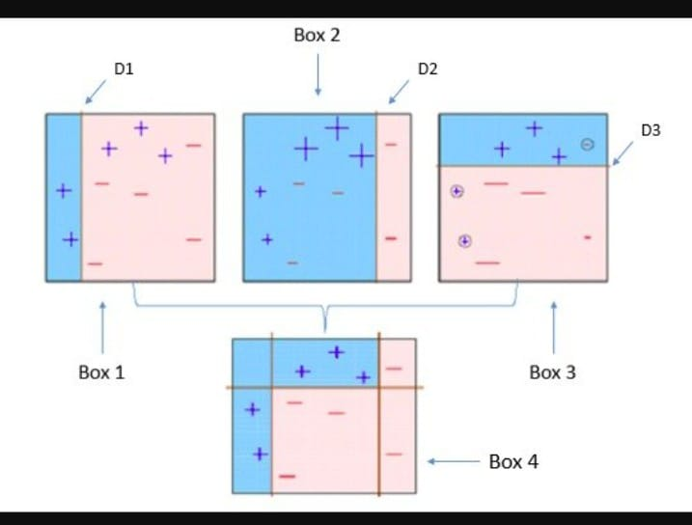
AdaBoost Overview
• Adaptive Boosting
• Uses decision stumps
• Focuses on misclassified samples

Slide 4
AdaBoost – Pros & Cons
How to Implement the AdaBoost Algorithm?
Pros:
• Simple
• Less overfitting
• Good for small data
Cons:
• Sensitive to noise
• Slower on big data

Slide 5
AdaBoost – Real-World Applications
• Retail Sales Prediction
• Medical Diagnosis
• Credit Risk Evaluation

Slide 6
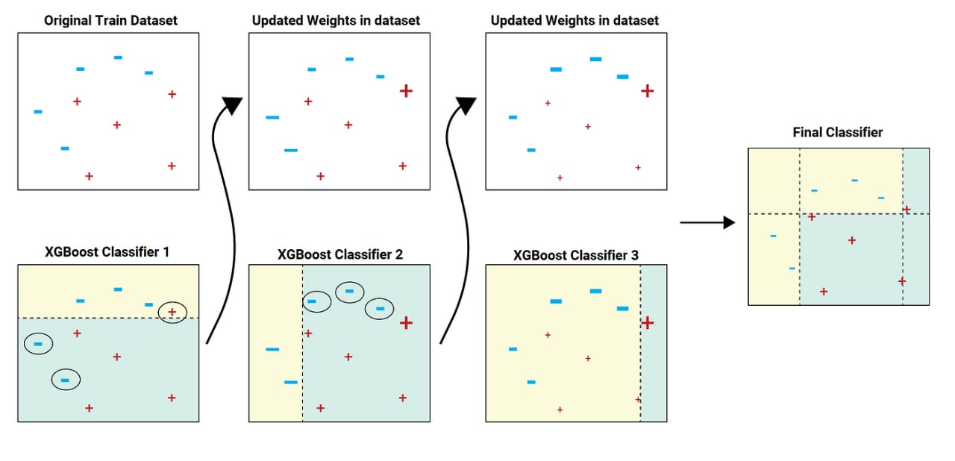
XGBoost Overview
• Extreme Gradient Boosting
• Regularization, parallelization
• Handles missing data

Slide 7
XGBoost – Pros & Cons
Pros:
• Accurate
• Handles missing data
• Fast
Cons:
• Complex tuning
• Can overfit

Slide 8
XGBoost – Real-World Applications
• Fraud Detection
• Customer Churn Prediction
• Search Ranking

Slide 9
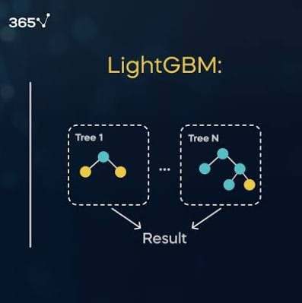
LightGBM Overview
• Light Gradient Boosting
• Leaf-wise tree growth
• Histogram optimization

Slide 10
LightGBM – Pros & Cons
Pros:
• Very fast
• Efficient memory use
• Supports categorical features
Cons:
• Can overfit small data
• Harder to interpret

Slide 11
LightGBM – Real-World Applications
• E-commerce personalization
• Large-scale financial modeling
• Health analytics

Slide 12
Comparative Summary
AdaBoost: Simple, slower
XGBoost: Accurate, scalable
LightGBM: Fastest, good for big data

Slide 13
Conclusion
• Choose AdaBoost for simplicity
• Use XGBoost for high accuracy
• Pick LightGBM for large, complex datasets

Slide 14
THANK YOU

