Slide 1
Time And Productivity Analysis
TEAM MEMBERS
1.Monika D [711715104041]
2.Vigneshwari R [711715104703]
3.Vignesh k [711715104068]
Facultyguide : Industrial Guide:
Vivekanandhan .V ShanmugaPriya
Assistant professor
Department of CSE
Department of CSE, KGiSL Institute of Technology, Coimbatore

Slide 2
Abstract
Productivity Analysis is conducted to identify areas for potential productivity improvement projects based on statistical data collected during the analysis. The analysis also pinpoints areas of delays and interruptions that cause loss of productivity.
In any productivity improvement initiative is to understand the current state of the operation. Productivity analysis provides baseline indicators that will also yield data which will be used to determine possible productivity improvement objectives and potential cost savings.
Department of CSE, KGiSL Institute of Technology, Coimbatore

Slide 3
Area Introduction-Existing system
In ancient days to improve productivity the log details are maintained in the notebooks manually,later it is computerised.
Even though it does not have any detailed information about where the employees spend more time.
Department of CSE, KGiSL Institute of Technology, Coimbatore

Slide 4
Proposed System
Advantages over existing methods:
Monitor performance and provide feedback
Diagnose problems
Facilitate planning and control
Future enhancement:
In future Artificial Intelligence can be used to overcome the disadvantages of distractions and fear of missing out.
Department of CSE, KGiSL Institute of Technology, Coimbatore

Slide 5
Literature Review
Drawbacks of existing methods
Strong self-discipline
Distractions
Resisting the fear of missing out(FOMO)
References
https://ideas.repec.org/cgi-bin/htsearch?form=extended&wm=wrd&dt=range&ul=&q=Productivity+analysis+in+IT+company&cmd=Search%21&wf=4BFF&s=R&db=&de=
Department of CSE, KGiSL Institute of Technology, Coimbatore

Slide 6
Architectural Design (DFD and/or ER diagram)
Graphical representation
documentation
Database
design
Login
testing
Report generate
User
Register

Slide 7
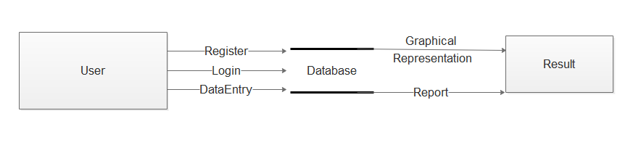
DFD
Level 0: Presized View Productivity analysis

Slide 8
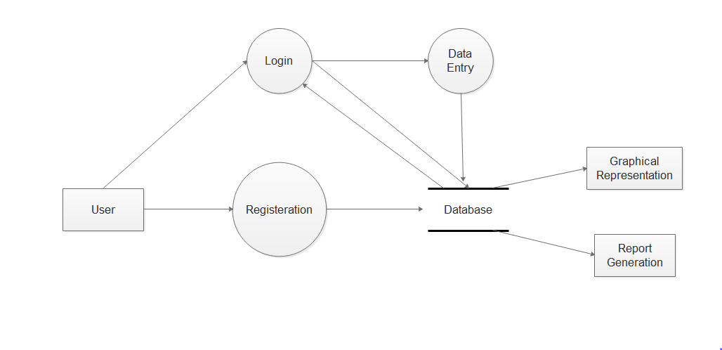
Level 1: General View Of The Process

Slide 9
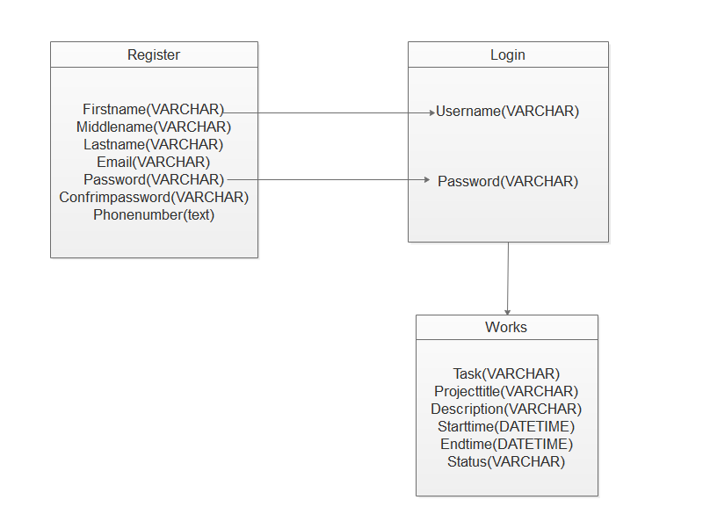
ER Digram:

Slide 10
Module Splitup
Module 1 :
System study
Module 2:
User Interface
Module 3:
Graphical Representation
Module 4:
Report Generation

Slide 11
SCREEN SHOTS OF MODULES UNDER PROGRESS.

Slide 12
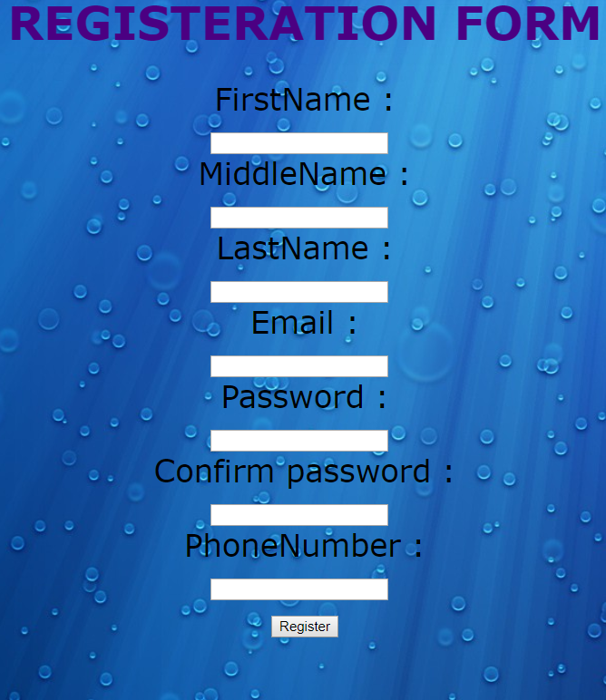
REGISTERATION

Slide 13

LOGIN

Slide 14
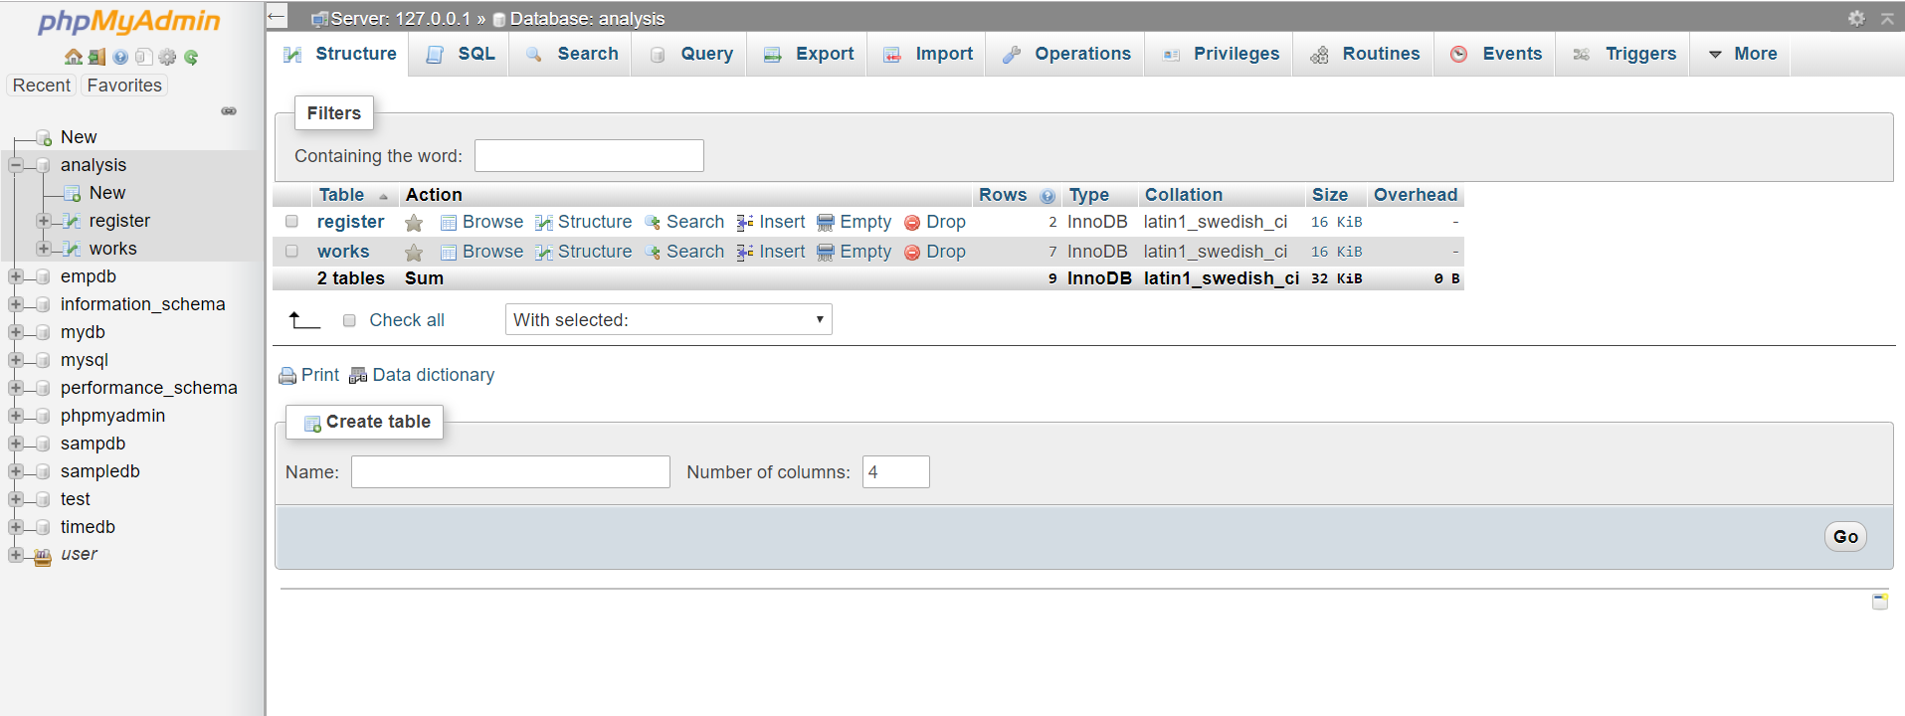
DATABASE

Slide 15
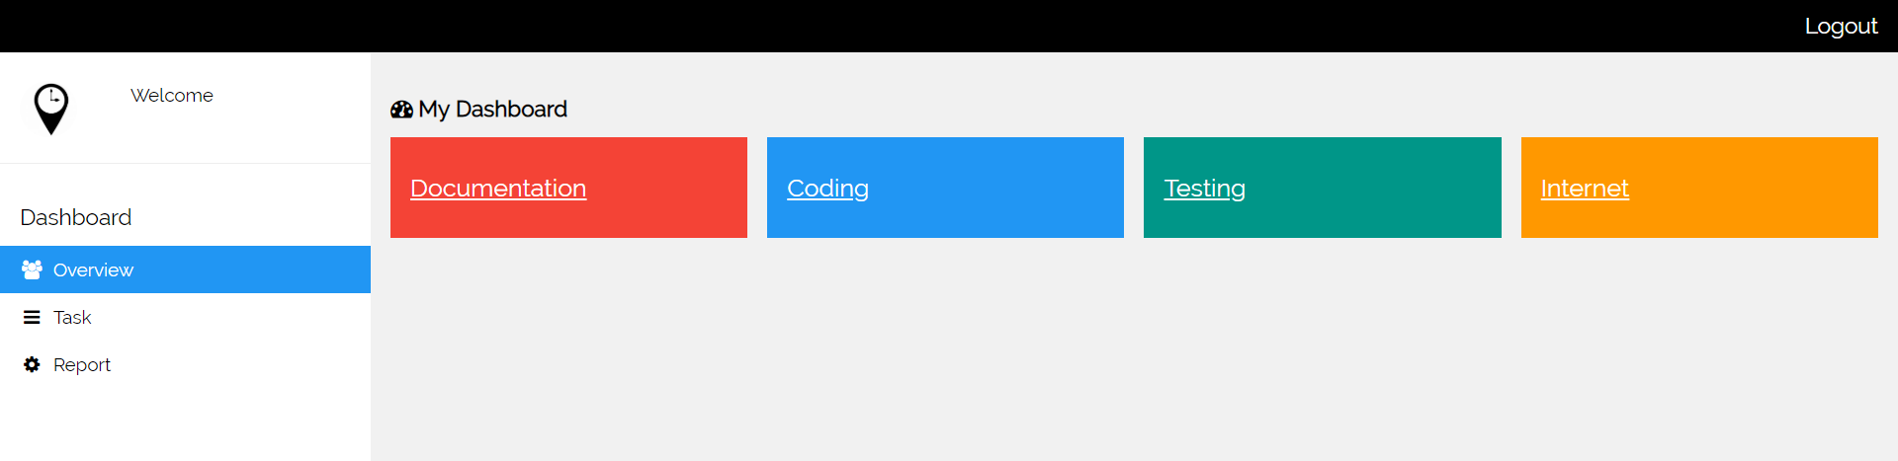
Dashboard

Slide 16
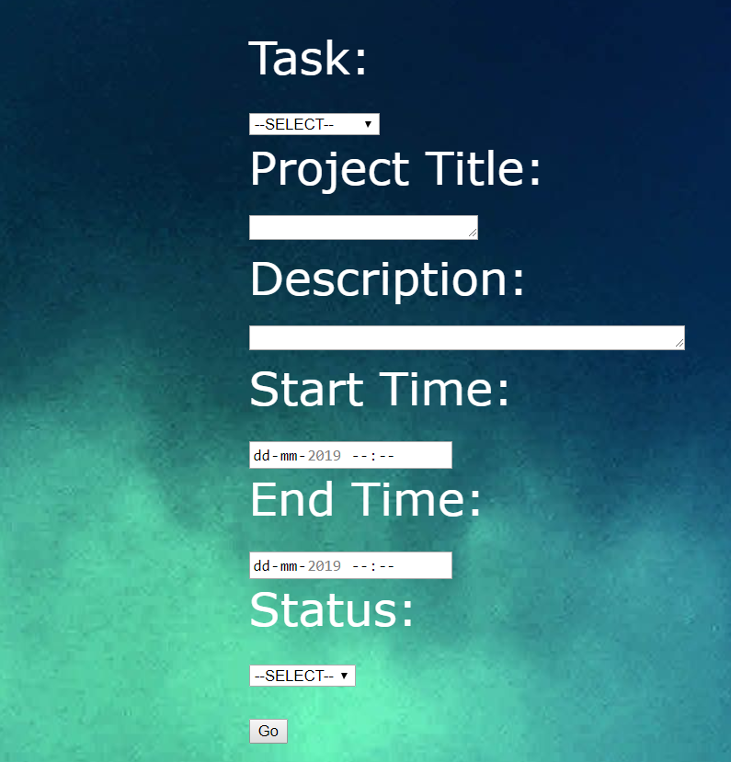
Task

Slide 17
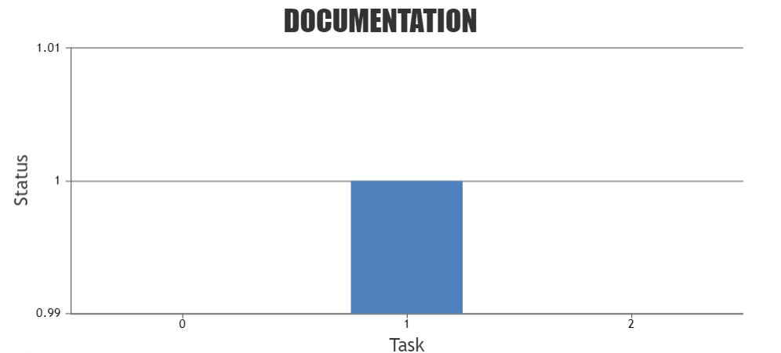
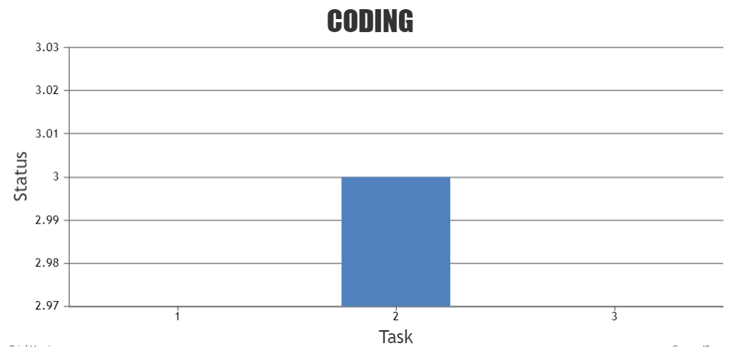
Graphical View

Slide 18
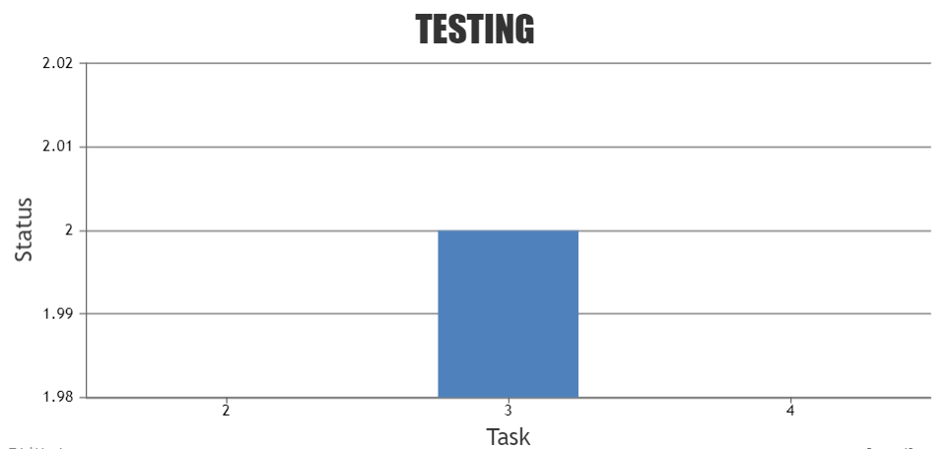
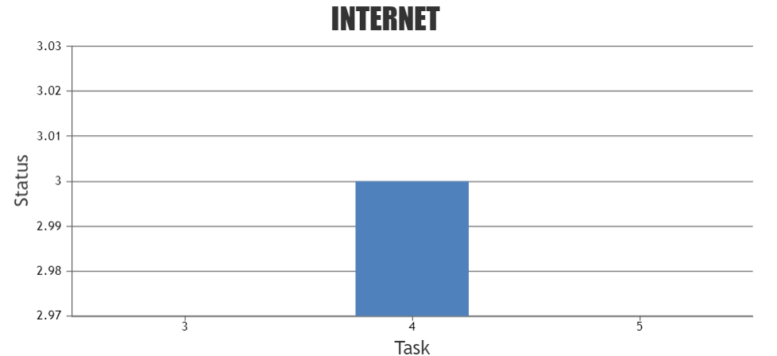
Graphical View

Slide 19
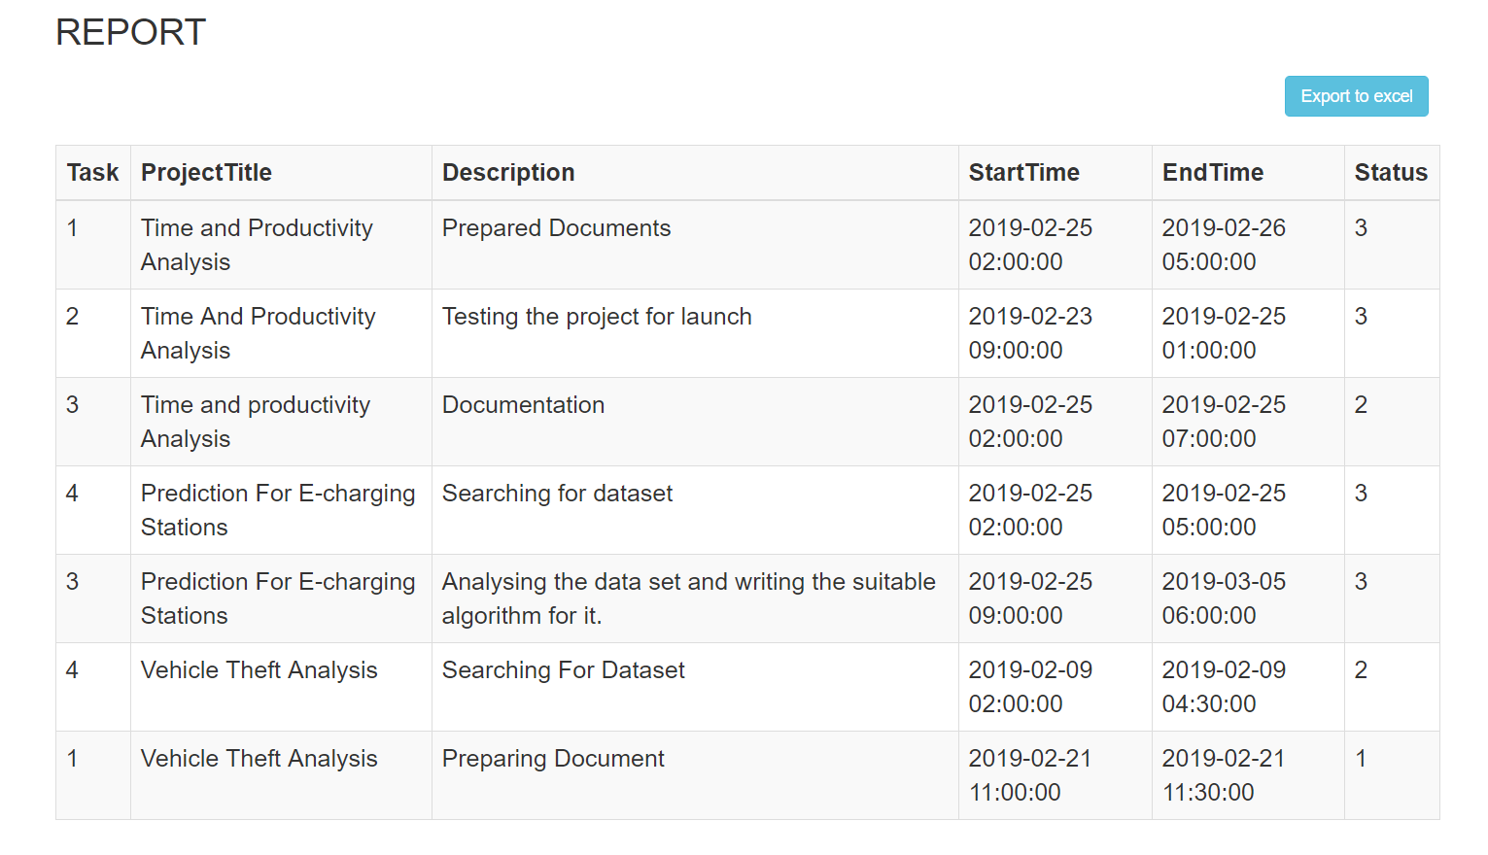
Report

Slide 20
CONCLUSION
The user interface has been designed.A database has been created to store the details of the user or employees. And also the user interface is connected to the database.The Grapical view and Report generation for each task has been completed.

Slide 21
Thank You!!!

