Slide 1
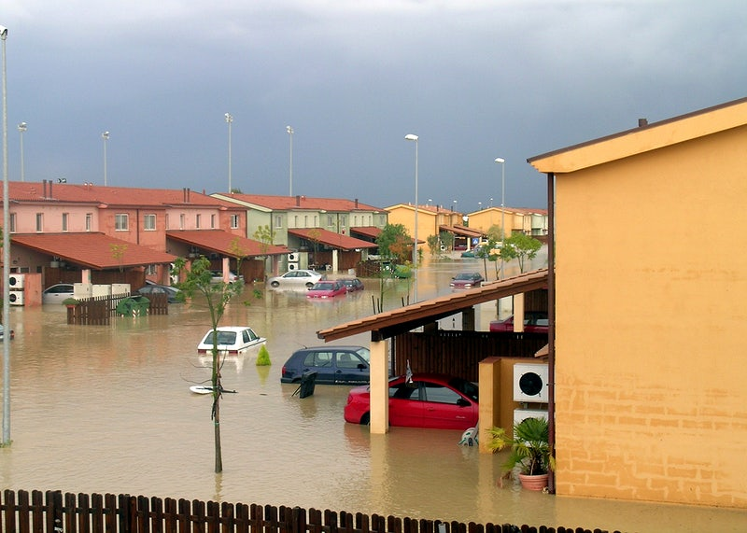


FACILITATING FLOOD RESPONSE USING GEOSOCIAL MEDIA
VIGNESWARAN S
M.Tech Geoinformatics
DEV DINESH
M.Tech Geoinformatics

Slide 2
INTRODUCTION
The quantity of available Geoinformation from remote sensing, crowdsourced geosocial media (CGSM), and geo-computation techniques has greatly increased during the past two decades.
There is a need to create a reproducible scientific workflow for processing the CGSM data for different application.
Determining affected or vulnerable areas of flood from CGSM is a crucial and challenging step in successful disaster response for which geosocial media as of now has still untapped potential.

Slide 3
PROBLEM STATEMENT
During disaster satellite data cannot be immediately used for mapping flood affected area. Alternately we can use geosocial media data for creation of geospatial footprint of flood affected region.

Slide 4
OBJECTIVE
To create a reproducible scientific workflow for processing the crowdsourced geosocial media data and disseminating the results over web.
SUB-OBJECTIVE
Identification of area affected by the flood..
Data visualization over the Web.
Use crowdsourcing for validation of results.

Slide 5
METHODOLOGY
DATA PROCESSING MODEL
Filtering
DATA PUBLISHING
DATA VISUALIZATION
Twitter API
Text Processing
WMS SERVICE
WEB APP
Geocoding
Storing data in DB
DATA ANALYSIS
DATA VALIDATION
Identifying high risk areas using population data
Crowdsourcing using web app

Slide 6
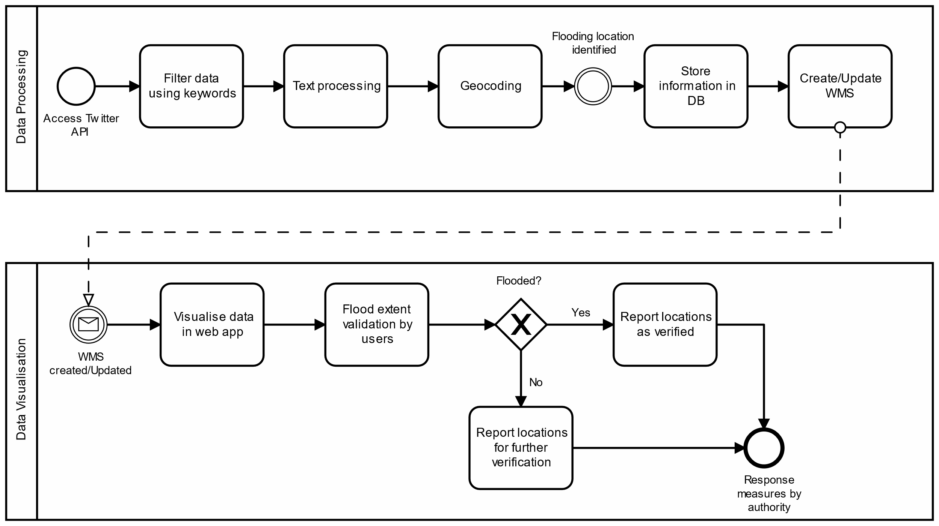
BPMN Diagram

Slide 7
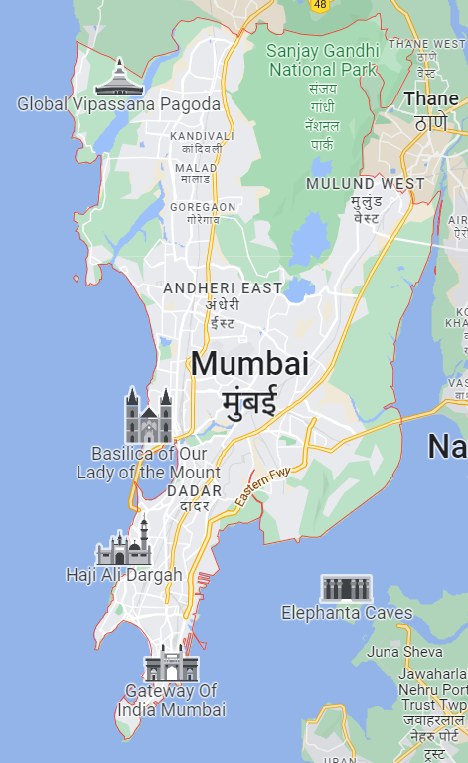
STUDY AREA
Mumbai (19.0760° N, 72.8777° E), India formerly called Bombay is a densely populated city on India’s west coast. A financial center, it's India's largest city.
Area: 603.4 km²
Elevation: 14 m
Source: Google Map
PRE-REQUISITES
Twitter developer account with Elevated Access to Twitter API v2 endpoint.
API Key for Google Maps Platform

Slide 8
SOFTWARE AND API USED
API
Twitter API v2
Google Geocoding API
Software
KNIME Analytics Platform with extensions
PostgreSQL + PostGIS
Geoserver

Slide 9
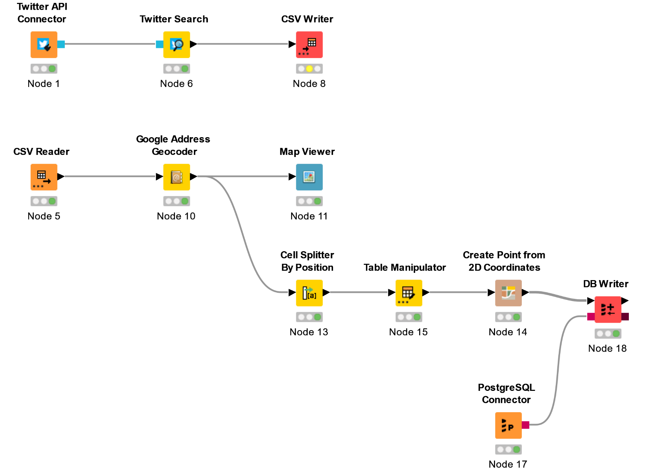
DATA PROCESSING WORKFLOW IN KNIME

Slide 10
TWEET SEARCH
Keywords
Mumbai Rain
Water logging
Tweet with location information
"Andheri Subway shut right now due to water logging caused by heavy & incessant rain. Some pockets of Mumbai have already started sinking??#MumbaiRains #Maharashtra"

Slide 11
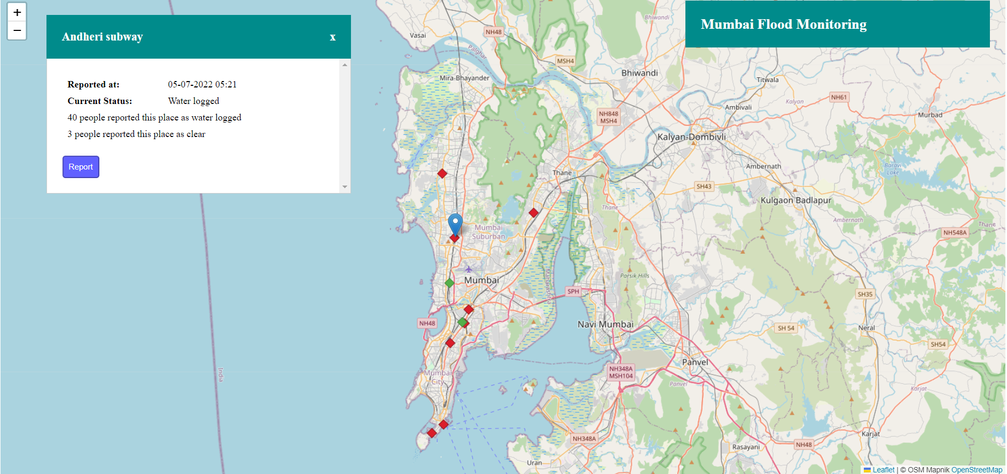
DATA VISUALIZATION

Slide 12
RESULTS
Created a reproducible scientific workflow for processing the crowdsourced geosocial media data.
Developed a web app for information dissemination over the web.

Slide 13
REFERENCES
V. Cerutti, C. Bellman, A. Both, M. Duckham, B. Jenny, R. L. G. Lemmens & F. O. Ostermann (2021) Improving the reproducibility of geospatial scientific workflows: the use of geosocial media in facilitating disaster response, Journal of Spatial Science, 66:3, 383-400, DOI: 10.1080/14498596.2019.1654944.
https://developer.twitter.com/en/docs/twitter-api/getting-started/about-twitter-api
https://developers.google.com/maps/documentation/geocoding/
https://www.knime.com/knime-analytics-platform

