Slide 1
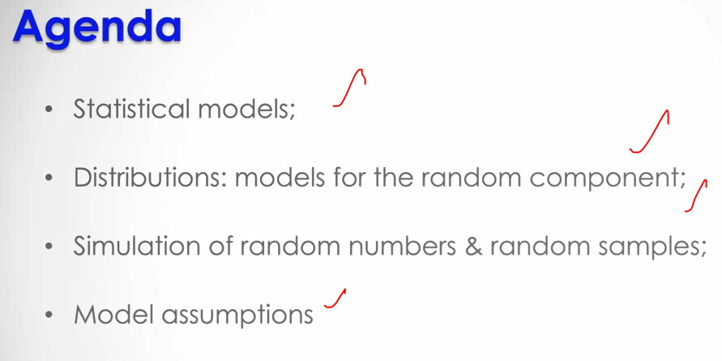

Slide 2
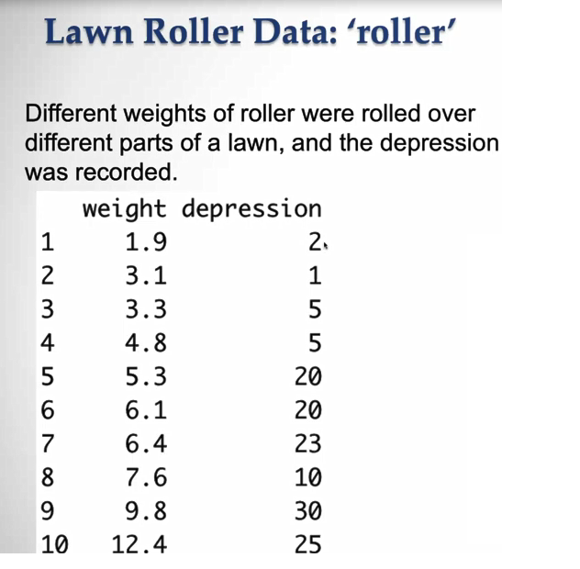

Slide 3
As weight increases depression is likely to increase
Check the scatter plot in the next slide as there is broadly like increasing trend

Slide 4
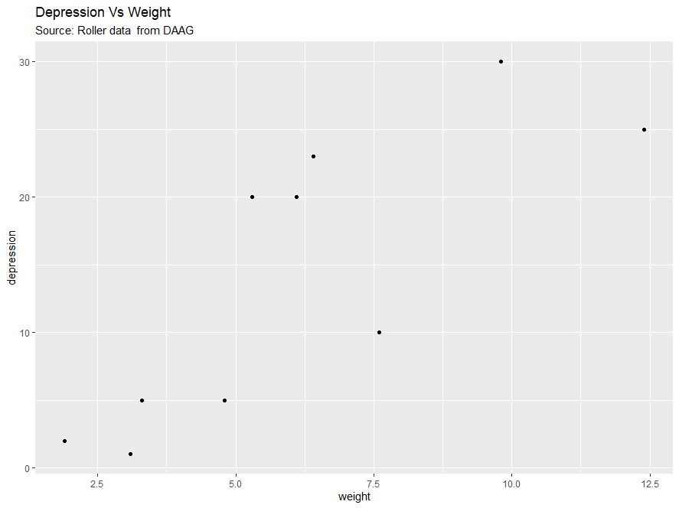

Slide 5

In scatter plot X axis variables are called independent variables Y axis variables are called dependent variables
Sometimes X variables are also called predictors.
Y variables are otherwise called as response variables
X – cause , Y - affect

Slide 6
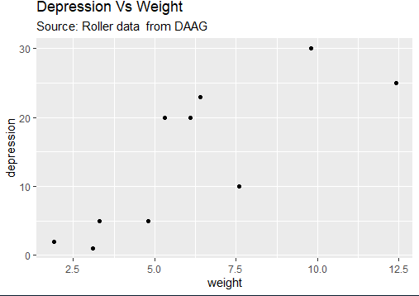
Simple linear regression model
As you can see from the scatter plot it’s not perfectly linear but overall, its increasing
As x increases y also increases
We can use simple linear regression model here
Build a model and see how they are behaving

Slide 7
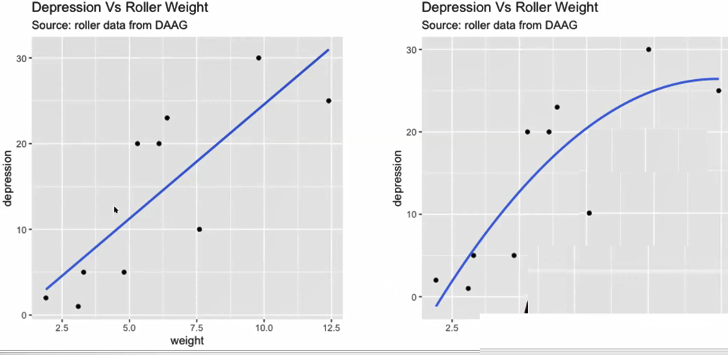
Linear or Nonlinear model ?

Slide 8
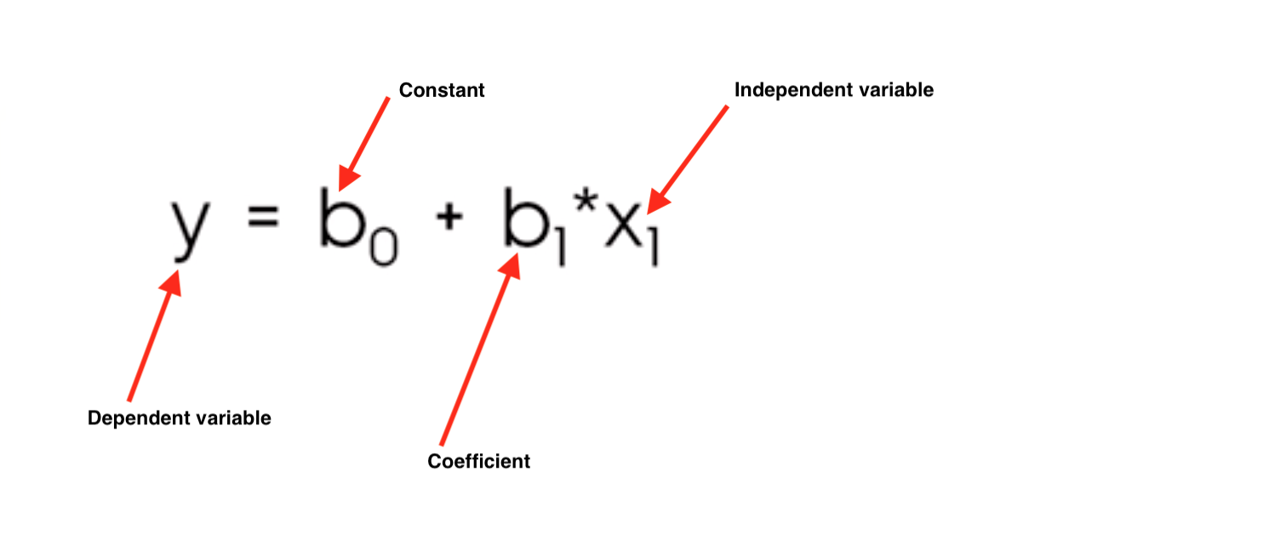
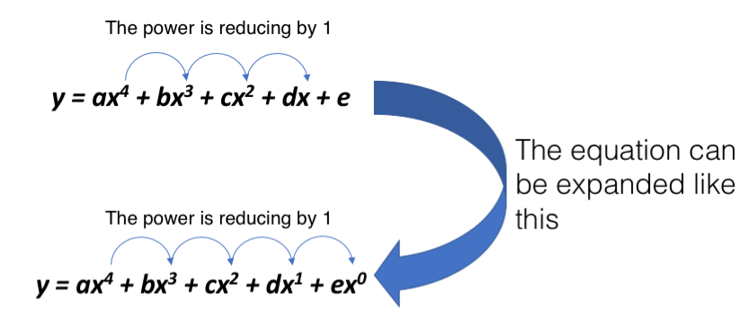
Linear vs Non-linear

Slide 9
Which one is the best ?

Slide 10
You can check the R square value and see how close the line fits the data
The higher the R square , the more likely you chose that one
You can go intuitively with the law of diminishing returns like if you keep on adding weights you will have the depression

Slide 11
If performance wise both situations are same, then go with the first one because we should always go for simpler models
If there are improvements on some aspects of the model, then you go with the second one
See, the more complex the model the more difficult it will be to explain, and it is also more expensive

Slide 12
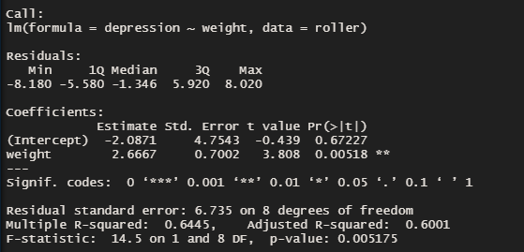

Slide 13
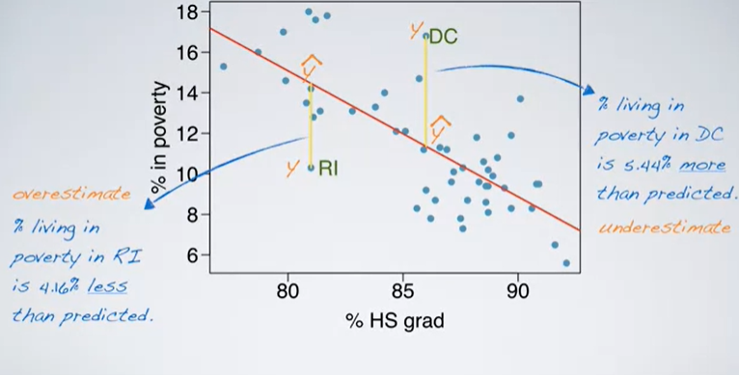

Slide 14
Interpretation
Y-intercept tell where the line of best fit cuts the y-axis
If weight increases by one unit, the depression is likely to increase by 2.6667 units. So, any unit change in weight is going to change the response variable by 2.6
So, you can also check the p-value of the last column. If you see * then the variable is statistically significant. The number of * indicate what is the level of significance
R squared value – It tells that there is 64.4% of variability in depression

Slide 15
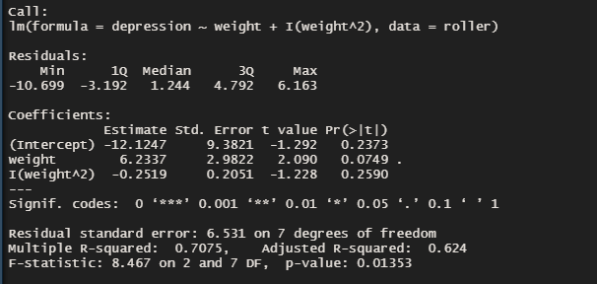

Slide 16
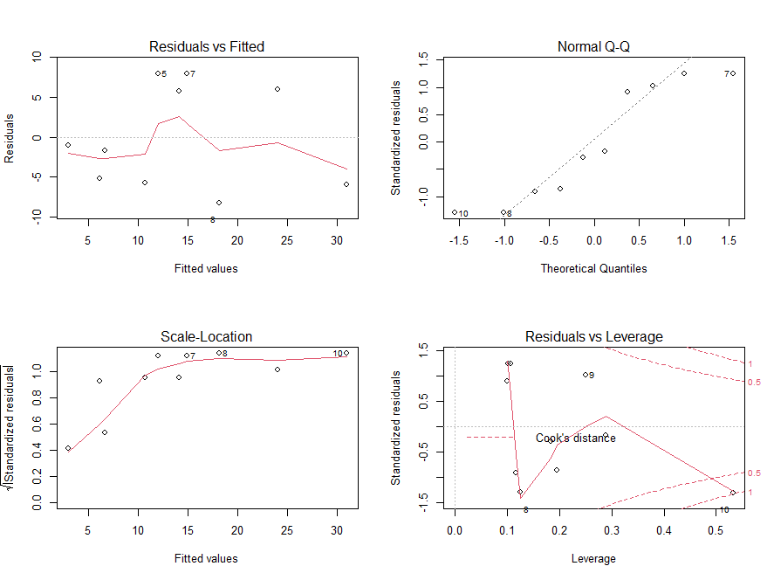
Linearity, normality, Homogeneity of variance , High leverage points (These plots will help us determine whether the assumptions have been met or not or there any red flags)

Slide 17
Interpretation
Trim the data set but replace outliers with the nearest “good” data, as opposed to truncating them completely. (This called Winsorization.) ... Replace outliers with the mean or median (whichever better represents for your data) for that variable to avoid a missing data point.
High leverage points – the points that have high impact on the model and evaluate them using cook's distance

Slide 18
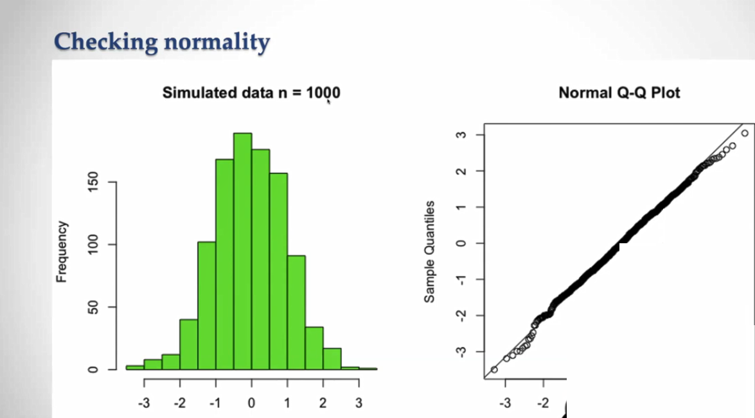

Slide 19
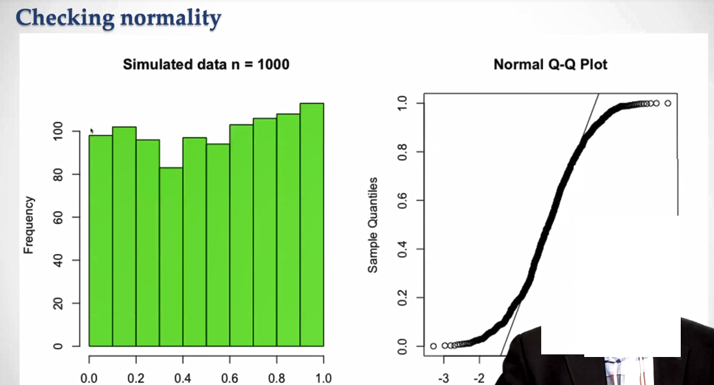

Slide 20
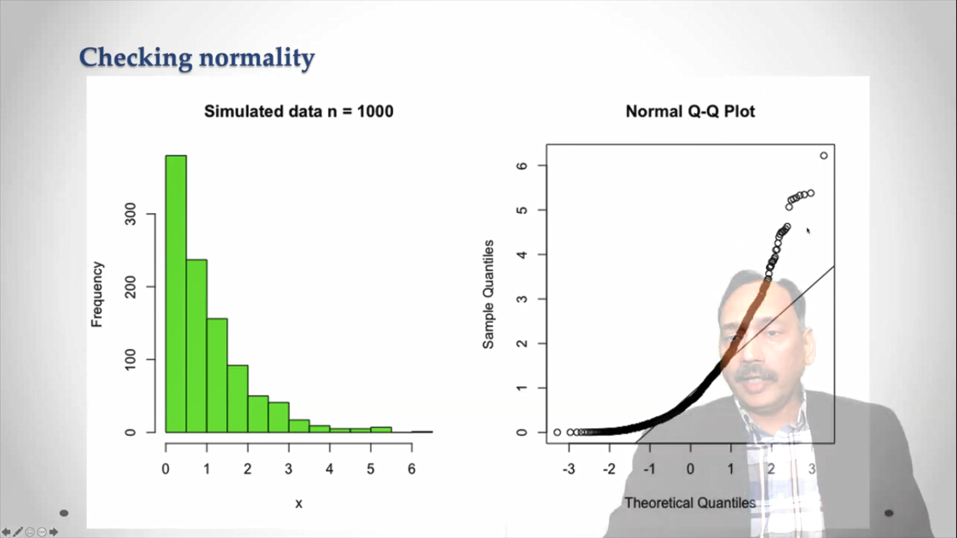

Slide 21
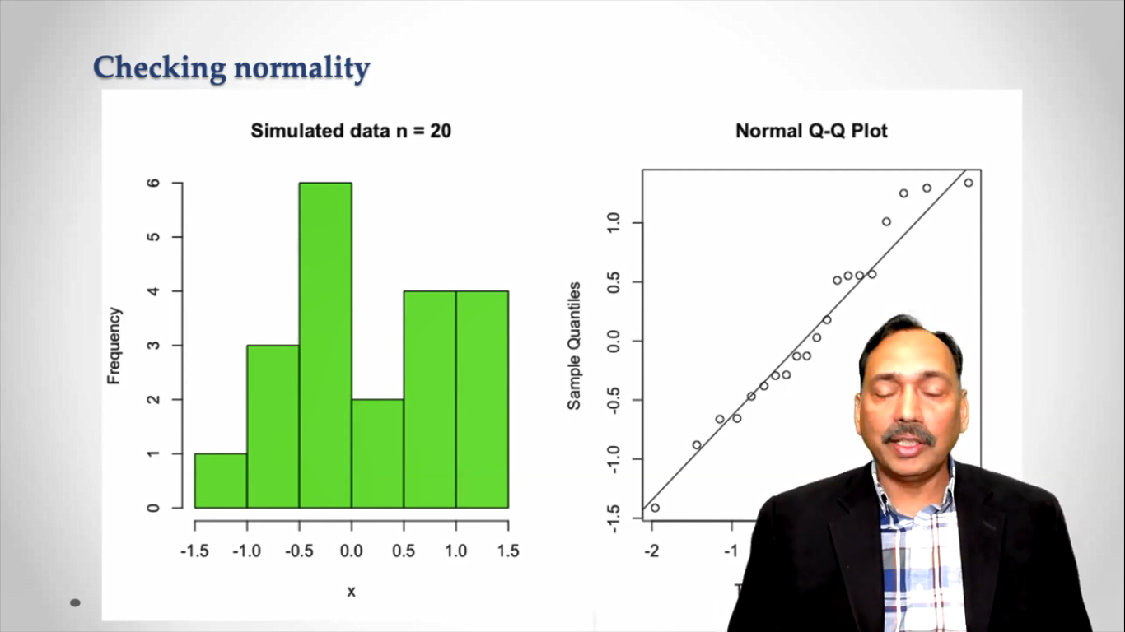

Slide 22
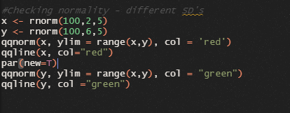
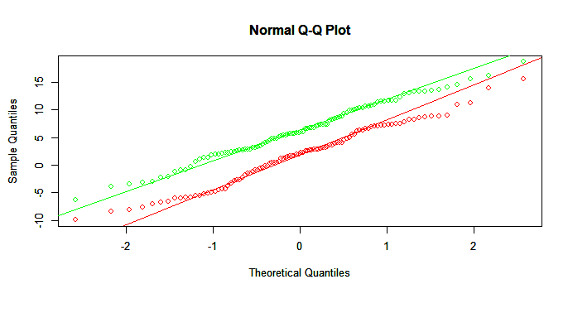
Same standard deviation :- (Comparing Distributions)

Slide 23
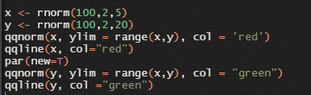
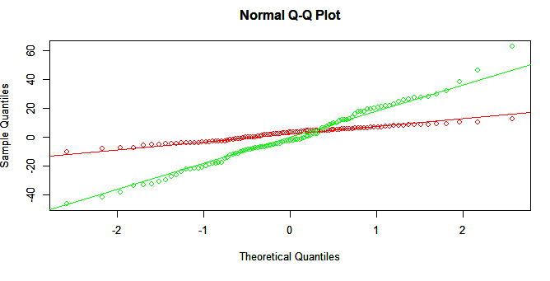
Different standard deviation

Slide 24
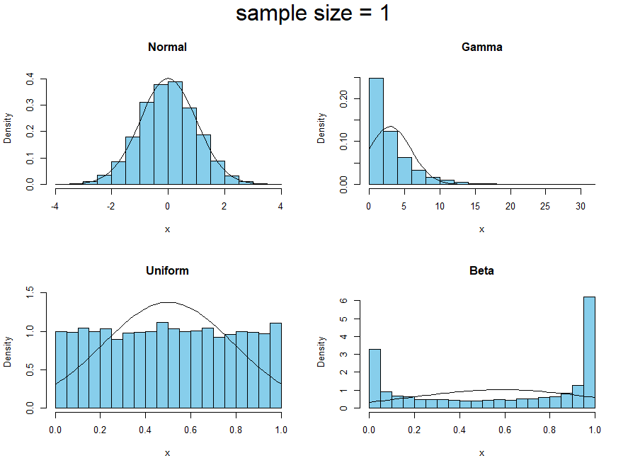

Slide 25
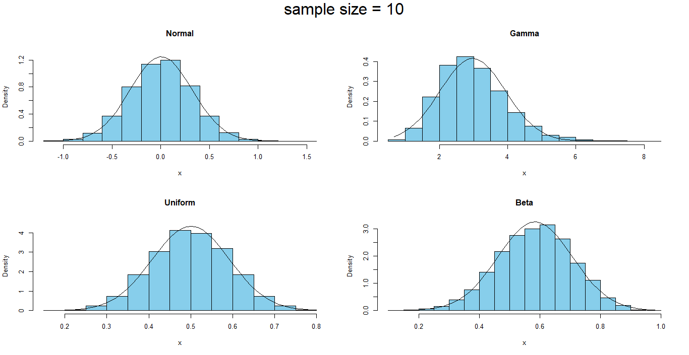

Slide 26
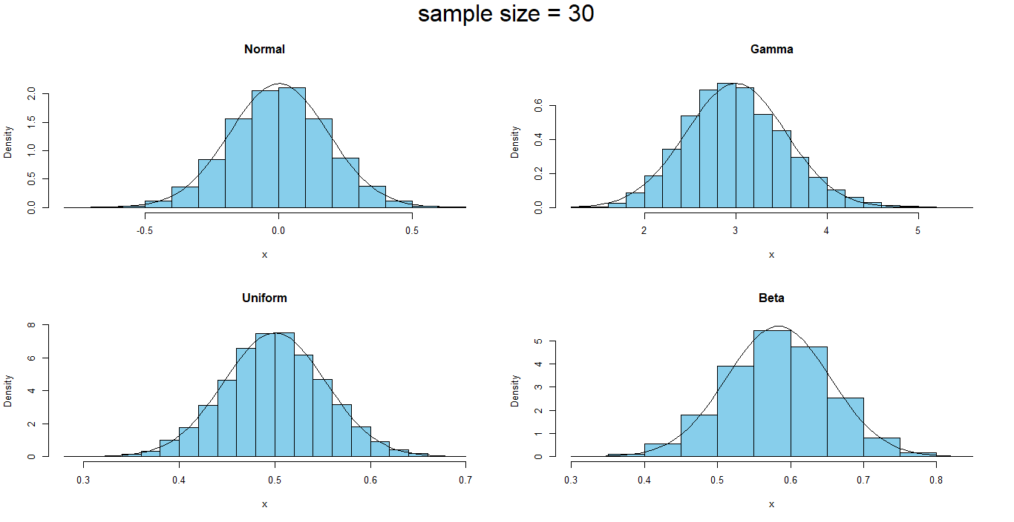

Slide 27
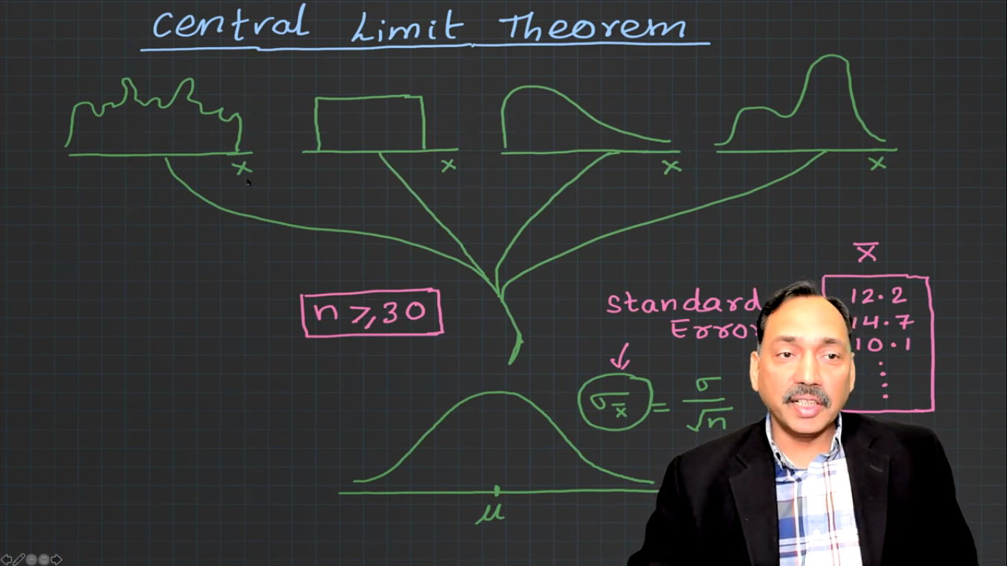

Slide 28
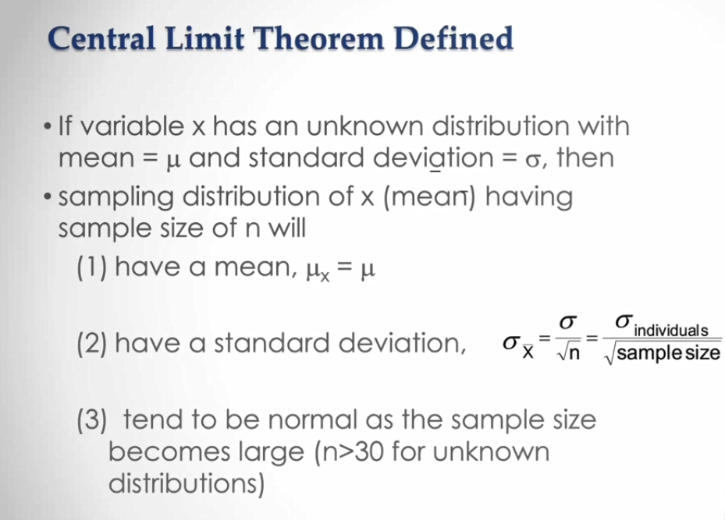

Slide 29
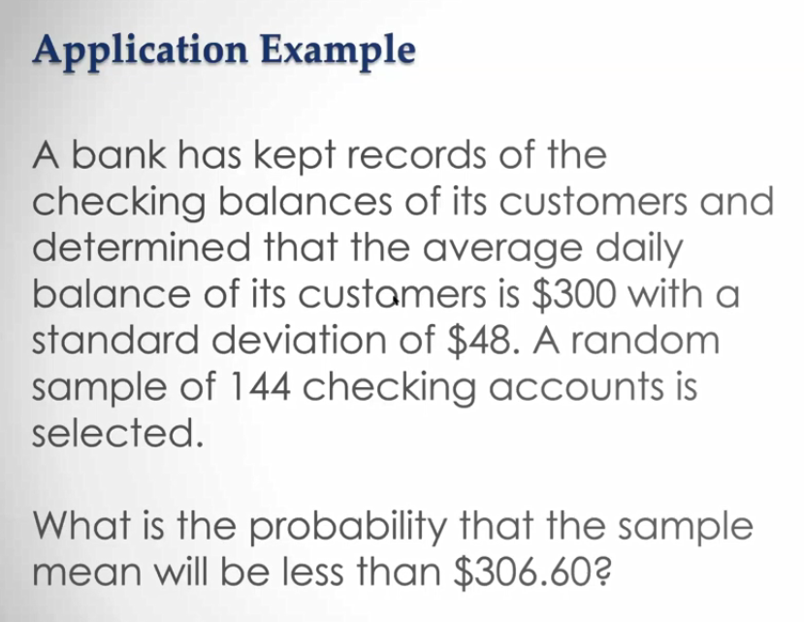

Slide 30
They are not talking about one customer
Here the sample size is 144 much higher than 30, so definitely it will be normal distribution

Slide 31
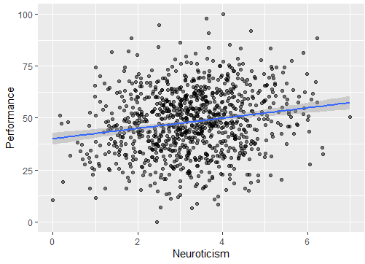
Simpson’s paradox

Slide 32
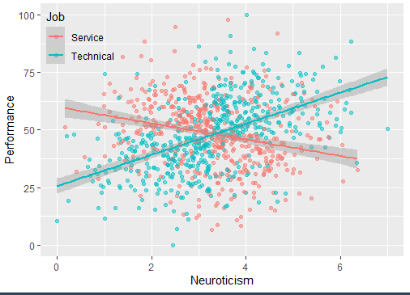

Slide 33
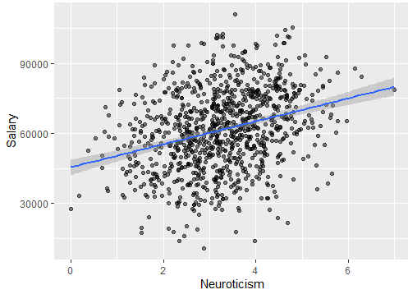

Slide 34
