Slide 1

Real-Time Traffic Congestion Prediction Using
Graph-Based Stream Mining
Team_No: 09
Sl. No. | Reg. No. | Name of the student
1 | BL.EN.U4CSE22004 | Neeraja
2 | BL.EN.U4CSE22014 | Ch. Mounika Begum
3 | BL.EN.U4CSE22030 | K. Vigneswara Reddy
4 | BL.EN.U4CSE22050 | R. Henry Koushal
Faculty: Dr. Nalini Sampath

Slide 2
Introduction
Urban traffic congestion presents a persistent challenge in modern cities, affecting mobility, travel time, and overall transportation efficiency. Traditional static analytical approaches are unable to capture the rapidly evolving dynamics of traffic flow. With the availability of high-frequency, GPS-enabled taxi trip data, it is now possible to analyze and predict congestion conditions in real time. This project develops a fully leakage-free, streaming congestion prediction system using NYC Yellow Taxi data, integrating spatial tiling, temporal windowing, and machine learning models designed for real-time operation.

Slide 3
Problem Statement
Urban traffic conditions change rapidly, making real-time congestion forecasting difficult for traditional models that rely only on historical averages. This project addresses the challenge of converting continuous taxi trip streams into spatial–temporal windows and designing strictly causal, leakage-free features for prediction. The goal is to accurately forecast congestion in each grid tile for the next time window using only past traffic information.

Slide 4
Objectives
Build spatial grid tiles from taxi GPS coordinates
Segment trip data into fixed time windows
Create leakage-free temporal features (lag, EWMA, history)
Define adaptive congestion labels using percentile thresholds
Train and compare multiple ML models
Deploy a real-time streaming prediction pipeline
Evaluate model performance window-by-window

Slide 5
Literature Survey
Sl.No. | AUTHORS | PAPER | INFERENCE
1 | Dai & Ye (2024) | Hybrid Time-Varying Graph Neural Network (HTVGNN) | Proposes HTVGNN with a time-aware multi-attention mechanism and hybrid static + dynamicgraph learning. Achieves higher accuracy than latest spatio-temporal GNNs on four real datasets (best long-term prediction performance). Limitation: Model complexity is high; requires large computational resources for dynamic graph learning.
2 | Francies et al. (2025) | Continual Learning STGNN-CL | Introduces a continual-learning STGNN using EWC, MAS, SI and KLD-based traffic pattern fusion for real-time forecasting. Shows significant error reduction across PeMS datasets; improved long-term prediction stability vs baseline STGNN models. Limitation: Continual learning requires repeated model updates, increasing training overhead and memory demand.
3 | Abbas et al. (KTH) (2023 ) | Streaming Graph Algorithms for Congestion Detection | Uses streaming Connected Components and community detection algorithms for real-time congestion detection on sensor graphs. Achieves up to ≈94% accuracy using Connected Components and ≈88% using DenGraph on Stockholm highway data. Limitation: Fails on sparse or irregular road networks (e.g., Louvain Modularity algorithm performs poorly).

Slide 6
Literature Survey
Sl.No. | AUTHORS | PAPER | INFERENCE
4 | Tran et al. (2023 ) | Multi-Structured GNN (MSGNN) for Incident Prediction | Proposes MSGNN that fuses multiple graph structures to predict traffic incidents across any sub-area using a single model. Outperforms classical ML and recent DL models across both 15-min and 60-min prediction horizons on two city networks. Limitation: Requires well-defined sub-area sampling; model performance depends heavily on accurate graph construction.
5 | Yuqian Wu. (2023 ) | Deep Learning with GCN + Attention + TCN | Introduces a dual-stage model combining GCN with attention for spatial learning and TCN with causal/dilated convolutions for temporal patterns. Demonstrates improved spatiotemporal feature extraction and higher prediction accuracy than traditional DL baselines. Limitation: Heavy dependence on dense sensor data; performance degrades with missing or noisy input.
6 | Abbas et al. (2020 IEEE) | Real-Time Traffic Jam Detection with Streaming Graph Analytics | Presents a pure-streaming congestion detection framework using Apache Flink and weighted directed sensor graphs. Real-time traffic light control reduces travel time by up to 27% and 8% on average. Limitation: Framework depends on intersection sensors only; lacks integration of historical or GPS trajectory datasets.

Slide 7
Literature Survey
Sl.No. | AUTHORS | PAPER | INFERENCE
7 | Jin et al. (2022) | Spatio-Temporal Graph Neural Point Process (STGNPP) | Proposes STGNPP combining spatio-temporal graph learning with neural point processes for predicting congestion event time + duration. Outperforms existing deep models on two datasets with superior continuous-time prediction accuracy. Limitation: Predicting sparse events requires high-quality event logs; difficult to apply in noisy environments.
8 | Zhao et al. (2019) | T-GCN (Temporal Graph Convolutional Network) – | Introduces T-GCN combining GCN (spatial) and GRU (temporal) for urban road network forecasting. Consistently outperforms ARIMA, KNN, and classical models in speed/flow prediction accuracy on multiple real datasets. Limitation: Struggles with rapidly changing traffic patterns; limited support for long-range temporal dependencies.
9 | Zhang et al. (2021) | Large-Scale Graph Forecasting with Network Partitioning | Proposes SMP (Speed-Matching-Partitioning) to partition large traffic networks and train parallel GCN-based predictors. Improves prediction accuracy and training efficiency on three large datasets; enhances scalability. Limitation: Partition quality heavily depends on speed similarity; sub-optimal partitioning reduces model accuracy.

Slide 8
Literature Survey
Sl.No. | AUTHORS | PAPER | INFERENCE
10 | Chen et al. (2022) | TrafficStream (GNN + Continual Learning for Streaming Data) | Develops TrafficStream using GNN + continual learning with pattern fusion and parameter smoothing to handle evolving traffic networks. Demonstrates high efficiency and strong long-term prediction accuracy on streaming datasets. Limitation: Requires frequent pattern mining updates; performance sensitive to drift-detection thresholds.
11 | Pan et al. (2023 ) | Physics-Guided Spatio-Temporal GNN (PG-STGNN) | Introduces PG-STGNN integrating physics-based traffic constraints with spatio-temporal GNN for intersection flow prediction. Achieves lowest MAPE (9.45%), MAE (2.485), RMSE (4.364), outperforming ARIMA, KNN, RF, T-GCN, STGCN, ST-ED-RMGC. Limitation: Focused on intersections only; requires domain-specific tuning of physics-guided parameters.

Slide 9
Summary
Most existing research focuses on spatio-temporal traffic modelling using advanced graph neural networks, continual learning strategies, adaptive graph construction, and streaming graph analytics. These works primarily address sensor-based traffic flow prediction, incident detection, or dynamic graph learning across road networks, and many achieve strong forecasting accuracy under controlled datasets. However, a common limitation across these studies is their dependence on predefined road graphs, dense sensor infrastructure, or extensive historical monitoring data. Many models require high computational resources, struggle with real-time causality, or are unsuitable for pure streaming environments where future information cannot be used. In contrast, the present system addresses these gaps by operating directly on taxi trajectory data without relying on fixed sensor networks or graph structures. By using spatial tiling, temporal windowing, dynamic congestion labeling, and strictly leakage-free features, the proposed framework enables real-time, window-by-window congestion prediction in a fully data-driven and deployment-realistic setting, effectively bridging the gap between trajectory-based analytics and real-time congestion forecasting.

Slide 10
System Specifications
Software Requirements
Python 3.9+
Libraries: pandas, numpy, scikit-learn, catboost, joblib, tqdm
Notebook environment: Jupyter / Google Colab
Hardware Requirements
RAM: 8–16 GB (to process monthly taxi trip data efficiently)
Storage: 5–10 GB for raw + processed trip records
Dataset Specifications
Dataset: NYC Yellow Taxi Trip Data
Records Used: Several million trip events (one-month subset)
Key Fields: pickup_datetime, pickup_latitude, pickup_longitude, trip_duration
Granularity: High-frequency, GPS-based mobility data
Usage: Supports spatial tiling, time-windowing, and real-time congestion analysis

Slide 11
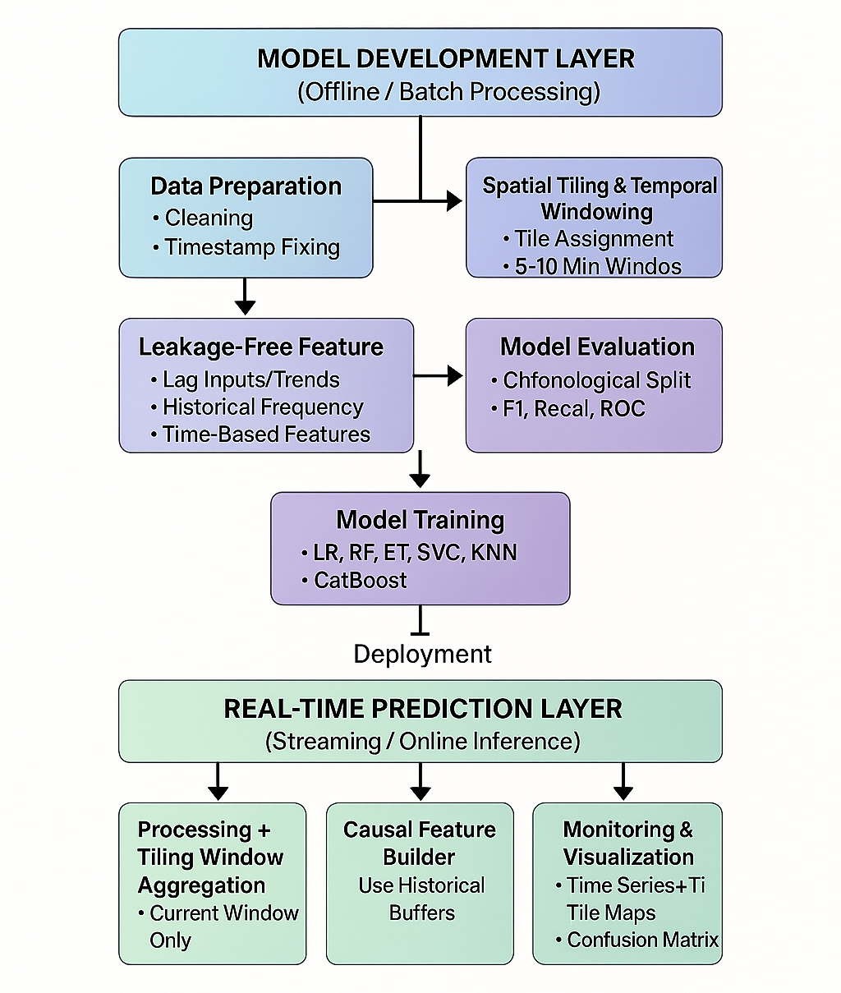
System Design

Slide 12
System Modules
Data Ingestion & Cleaning — load trips; remove invalid coords/timestamps; chronological ordering
Spatial Tiling — convert lat/long → grid tiles; assign tile IDs
Temporal Windowing — group into 5–10 min windows; compute per-tile aggregates (mean, std, count)
Dynamic Labeling — 75th-percentile threshold per window → binary congested label
Feature Engineering — lag1/lag2, EWMA, congestion frequency, log_count, hour/day/peak flags
Modeling & Tuning — train LR, RF, ET, SVC, KNN, CatBoost; RandomizedSearchCV; save best model
Streaming Prediction — sequential window inference, causal feature build, buffer updates
Monitoring & Outputs — logs, confusion matrices, ROC, feature importance, output artifacts

Slide 13
Implementation Details
1. Data preparation
Loaded NYC Yellow Taxi data; filtered missing/invalid rows; parsed pickup_datetime; sorted chronologically.
2. Spatial tiling
Defined bounding box & tile size; mapped every pickup to a tile id; stored tile→coords mapping.
3. Window aggregation
Binned trips into fixed 5–10 minute windows; computed per-tile window statistics: mean duration, std, count, timestamp.
4. Dynamic labeling
For each window, computed 75th percentile of tile mean durations; labeled tiles with mean ≥ percentile as congested (1), otherwise 0.

Slide 14
Implementation Details
5. Leakage-free features
Implemented state buffers and rolling logic to compute only-from-past features: lag1_mean, lag2_mean, ewma_mean, prev_count, congestion_freq, log_count, hour_of_day, day_of_week, is_peak, is_weekend. (Removed neighbor features due to only 2 tiles.)
6. Model training & tuning
Built pipelines; trained models (LR, RF, ET, SVC, KNN, CatBoost); hyperparameter search via RandomizedSearchCV with time-aware splitting; serialized best model + preprocessing.
7. Streaming simulation (deployment emulation)
Implemented loop: for each incoming window → preprocess & tile → build causal features from buffers → predict → log output → update buffers with actual window stats.
8. Evaluation & artifacts
Saved per-window predictions and true labels; produced confusion matrices, ROC (offline), permutation feature importance, and time-series prediction plots; stored under results folder.

Slide 15
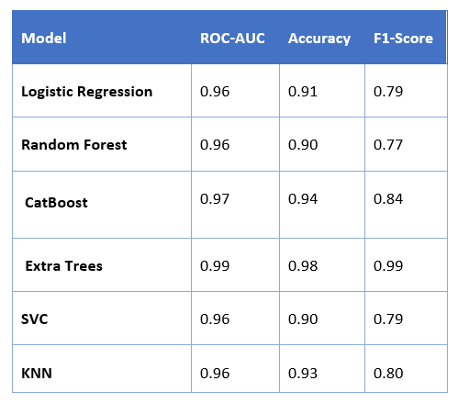
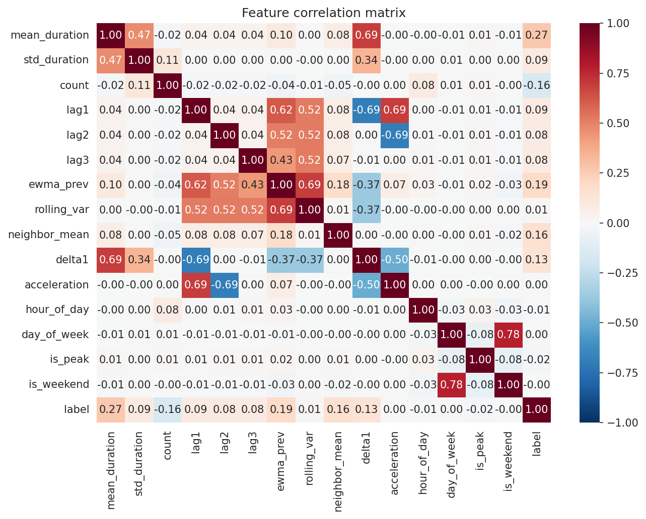
Results
Model Comparison Based on ROC-AUC, Accuracy, and F1-Score
Correlation Heat Map of Extra Trees Model

Slide 16
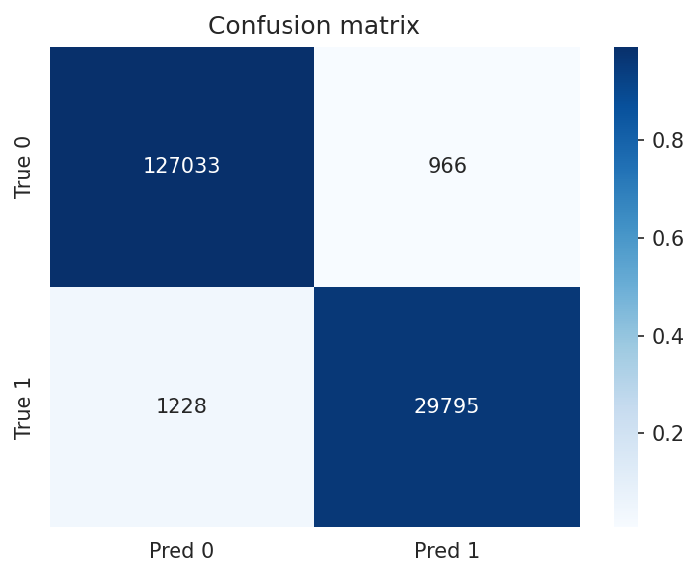
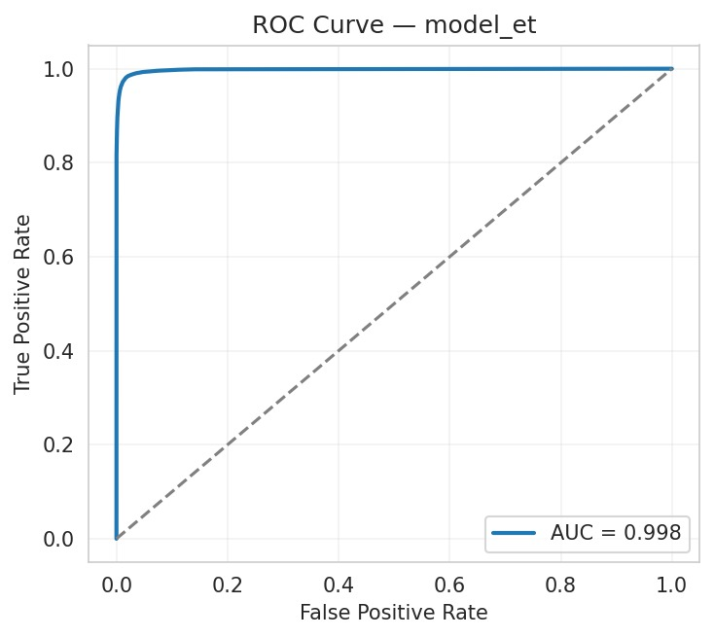
Results
Confusion Matrix of Extra Trees Model
ROC Curve of Extra Trees Model

Slide 17
Conclusion
A real-time congestion prediction system was successfully developed using NYC Yellow Taxi data with spatial tiling and temporal windowing.
Leakage-free feature engineering enabled causal, deployment-ready predictions.
The Extra Trees classifier achieved the strongest overall offline performance, with an F1-score of 0.99, demonstrating exceptional ability to separate congested and non-congested cases using the engineered spatio-temporal features.
The streaming evaluation confirmed that the system can predict congestion accurately using only past information.
Overall, the project demonstrates that simple, well-designed models can outperform complex methods in sparse and rapidly changing traffic environments.

Slide 18
Future Scope
Use a larger multi-month dataset for broader traffic coverage.
Explore Graph Neural Networks (GNNs) for richer spatial modeling.
Add external features such as weather and road-incident data.
Introduce online learning and drift-handling for long-term stability.
Deploy as a real-time system using Kafka / FastAPI / Spark Streaming.
Develop a live dashboard with congestion heatmaps and predictions.

Slide 19
References
1. Dai, B.-A., & Ye, B.-L. (2024). Hybrid Time-Varying Graph Neural Network for Traffic Flow Forecasting. arXiv:2401.10155.
2. Francies, M. L., Khalil, A. T., Amer, H. M., & Ata, M. M. (2025). Continual Learning STGNN for Real-Time Traffic Forecasting. Springer Journal, 2025.
3. Abbas, Z., Sigurdsson, T. T., Al-Shishtawy, A., & Vlassov, V. Evaluation of Streaming Graph Processing Algorithms for Road Congestion Detection. KTH Royal Institute of Technology.
4. Tran, T., He, D., Kim, J., & Hickman, M. MSGNN: Multi-Structured Graph Neural Network for Real-Time Incident Prediction. University of Queensland.
5. Wu, Y. (2023). Real-Time Traffic Flow Monitoring and Congestion Prediction Using Deep Learning. Beijing Normal University.
6. Abbas, Z., Sottovia, P., Hassan, M. A. H., Foroni, D., & Bortoli, S. (2020). Real-Time Traffic Jam Detection Using Streaming Graph Analytics. IEEE Big Data 2020.
7. Jin, G., Liu, L., Li, F., & Huang, J. STGNPP: Spatio-Temporal Graph Neural Point Process for Congestion Event Prediction. NUDT & HK PolyU.
8. Zhao, L., Song, Y., Zhang, C., Liu, Y., Wang, P., Deng, M., Li, H., & Lin, T. T-GCN: A Temporal Graph Convolutional Network for Traffic Prediction. IEEE Transactions.
9. Zhang, C., Zhang, S., Zou, X., Yu, S., & Yu, J. J. Q. Large-Scale Graph-Based Traffic Forecasting with Network Partitioning. IEEE Transactions on ITS.
10. Chen, X., Wang, J., & Xie, K. TrafficStream: A Streaming Traffic Flow Forecasting Framework Based on GNN & Continual Learning. Peking University.
11. Pan, Y. A., Li, F., Li, A., Niu, Z., & Liu, Z. Physics-Guided Spatio-Temporal GNN for Urban Intersection Traffic Prediction. Pennsylvania State University.

Slide 20
THANK YOU

