Slide 1
Scientific Calculator using Lex and Yacc
19CSE401 Compiler Design
Team_No: 22
Project Advisor:
Ms. Kavitha C.R.
Asst. Prof.(Sr.Gr.) CSE Dept.
S.No | Reg.No | Name of the Student | Section
1 | BL.EN.U4CSE22004 | Adhi Neeraja | CSE A
2 | BL.EN.U4CSE22014 | Chimakurthy Mounika Begum | CSE A
3 | BL.EN.U4CSE22030 | Kamalapuram Vigneswara Reddy | CSE A
4 | BL.EN.U4CSE22050 | Rebbavarapu Henry Koushal | CSE A

Slide 2
Problem Definition
Conventional scientific calculators perform direct evaluations using built-in functions and lack compiler-level processing. This project aims to develop a scientific calculator compiler that interprets and evaluates mathematical expressions through Lex (Flex) and Yacc (Bison), applying lexical and syntax analysis to achieve accurate computation and expression parsing.

Slide 3
Objectives
To design and implement a scientific calculator that functions as a mini-compiler.
To utilize Lex (Flex) for lexical analysis and Yacc (Bison) for syntax parsing of expressions.
To accurately evaluate arithmetic, trigonometric, logarithmic, and exponential computations.
To develop a Flask-based web interface for seamless user interaction with the calculator.
To ensure efficient error detection and handling during expression evaluation.
To illustrate the practical application of compiler design principles in real-world computation.

Slide 4
Literature Survey
S.No | Author Name(s) | Full title of the paper with year | Inference from the paper (based on methodology, technology) | Open problem (for your proposed work)
1 | Krishna Vignesh, Mudumba Hanumat, Nallapareddy Vamsidhar Reddy, Sake Mohith Sai, Meena Belwal | ToY Language Compiler using Lex and YACC, 2024 | Uses Flex, Bison, and Java to build a parser and type-checker for the ToY language, ensuring proper syntax and semantic validation. | Lacks interactive execution and real-time evaluation; your work adds a GUI-based expression compiler for better user interaction.
2 | Likhith Arlagadda Naga, Kothuru Gurunadh, Vimal Chinthapalli, Meena Belwal | Compiler For Mathematical Operations Using English Like Sentences, 2023 | Utilizes Lex and YACC to design a compiler that interprets English-like mathematical expressions, converting natural language into executable code for ease of use. | Focuses only on language interpretation; your work extends it by supporting complex mathematical operations with a GUI and real-time evaluation interface.
3 | Ch Rahul AN Sharma, Bedadala Mohaneeswar Reddy, Dutta Swetchana, Niharika Panda | Compiler Design for recognizing different Programming Languages, 2024 | Proposes a multi-language recognition compiler using Python-Lex-Yacc, focusing on lexical and syntax analysis to identify programming languages like C++, Java, and Python. | Concentrates on language detection, not computation; your work focuses on implementing mathematical expression evaluation and syntax parsing for real-time calculations.

Slide 5
Literature Survey
S.No | Author Name(s) | Full title of the paper with year | Inference from the paper (based on methodology, technology) | Open problem (for your proposed work)
4 | P. Mokshit, P. Syam Prasad, N. Sumanth Reddy, Meena Belwal | Pseudocode to Python - A Compiler Approach, 2024 | Develops a compiler that converts pseudocode into Python using lexical, syntax, and code generation phases, simplifying programming education and algorithm understanding. | Focused on language translation; our work extends compiler utility by directly evaluating expressions and providing a user-friendly computation interface.
5 | Francisco Ortin, Jose Quiroga, Oscar Rodriguez-Prieto, Miguel Garcia | An empirical evaluation of Lex/Yacc and ANTLR parser generation tools, 2022 | Conducts an empirical comparison between Lex/Yacc and ANTLR based on usability, maintainability, and developer productivity, showing ANTLR’s advantages in educational settings. | Focuses on tool comparison rather than implementation; our work applies Lex/Yacc practically to build a functioning mathematical expression compiler demonstrating real use-case efficiency.
6 | Sashank Sridhar, Sowmya Sanagavarapu | A Compiler-based Approach for Natural Language to Code Conversion, 2020 | Proposes a compiler model that converts natural language instructions into C code using Lex for tokenization, Yacc for parsing, and Flask for web-based execution. | Primarily targets code generation from text; our work focuses on mathematical expression evaluation and real-time GUI integration for improved user interaction.

Slide 6
Literature Survey
S.No | Author Name(s) | Full title of the paper with year | Inference from the paper (based on methodology, technology) | Open problem (for your proposed work)
7 | Vaikunta Pai T, P. S. Aithal | A Systematic Literature Review of Lexical Analyzer Implementation Techniques in Compiler Design, 2021 | Reviews various lexical analyzer implementation techniques, highlighting advances in tokenization and parallelization to optimize compiler efficiency and performance. | Focuses on multi-core optimization; our project focuses on integrating lexical and syntax analysis with a real-time web interface using Flex, Bison, and Flask for instant expression compilation and user interaction.
8 | Mohit Upadhyaya | Simple calculator compiler using Lex and YACC, 2011 | Demonstrates how Lex and YACC can be combined to design a simple calculator compiler that tokenizes input and constructs syntax trees for expression evaluation. | Limited to arithmetic computation; our project extends this by integrating lexical, syntactic, and semantic analysis to process natural language inputs and evaluate them in real time through a web-based interface.

Slide 7
Literature Survey
S.No | Author Name(s) | Full title of the paper with year | Inference from the paper (based on methodology, technology) | Open problem (for your proposed work)
9 | Abhishek B. Sai, Balam Ruchith Balaji, Chillakuru ari, and Meena Belwal | C to Python Translator using LEX & YACC, 2024 | Focuses on translating C programs to equivalent Python code using Lex for lexical analysis and YACC for syntax parsing, preserving logic and structure during translation. | Restricted to cross-language translation; our work advances this by enabling real-time expression evaluation from natural language input, incorporating semantic interpretation and interactive user feedback rather than direct language-to-language conversion.
10 | Bruce Hahne and Hiroyuki Satō | Using yacc and lex with C++ | Demonstrates integrating Lex and YACC with C++ to construct syntax trees using object-oriented features like classes, constructors, and virtual functions for improved compiler structure and maintainability. | Limited to traditional syntax parsing; our work extends this by integrating lexical and syntax analysis within a web-based environment to process and evaluate user-entered arithmetic expressions in real time, enhancing interactivity and execution feedback.

Slide 8
Justification
This project aims to bridge the gap between theoretical concepts of compiler design and their practical implementation. Unlike conventional calculators, it utilizes Lex and Yacc to perform lexical analysis, syntax parsing, and expression evaluation, thereby demonstrating how compilers interpret and execute user input. The addition of a Flask-based web interface enhances accessibility, providing an interactive environment for real-time computation and compiler visualization.

Slide 9
Tools & Technologies
Compiler Tools
Lex (Flex): Performs lexical analysis and token generation.
Yacc (Bison): Defines grammar rules and evaluates expressions.
GCC: Compiles Lex and Yacc outputs into an executable backend.
Programming Languages
C Language: Implements core compiler logic and evaluation.
Python (Flask): Connects frontend input with backend processing.
Web Technologies
HTML, CSS, Bootstrap: Builds an interactive and responsive interface.
Flask Framework: Handles input/output flow between user and compiler.
Environment
Operating System: Linux (Kali / Ubuntu).
Libraries: math.h, stdlib.h, string.h.

Slide 10
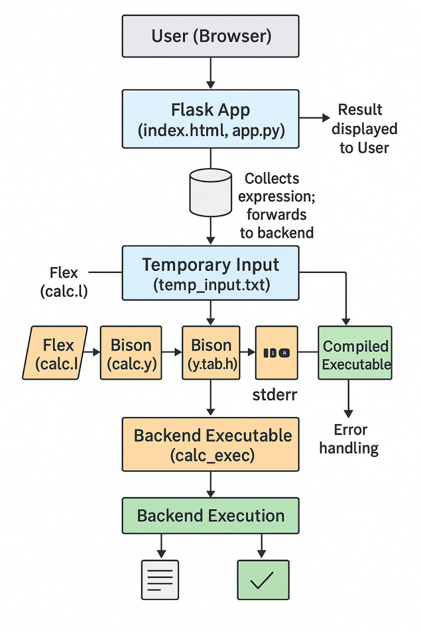
Work Flow

Slide 11
Methodology
The project follows a modular compiler-based approach, consisting of backend compiler construction and a frontend web interface to achieve accurate computation and real-time interaction.
Backend – Compiler Construction
Lexical Analysis (Flex / calc.l): Scans and identifies tokens such as numbers, operators, functions, and constants for parsing.
Syntax Analysis (Bison / calc.y): Defines grammar rules, operator precedence, and evaluates expressions using semantic actions in C.
Compilation & Execution: Generates an executable (calc_exec) using GCC to perform computation and produce output.
Frontend – Web Interface
Developed using Flask, HTML, CSS, and Bootstrap.
Acts as a bridge between the user and compiler backend.
Accepts input expressions, forwards them to the compiler, and dynamically displays the evaluated result

Slide 12
Implementation Details
The project is implemented through four primary components:
calc.l (Lexer): Defines token patterns for numbers, operators, functions, and constants using Flex.
calc.y (Parser): Specifies grammar rules and evaluation logic using Bison, with semantic actions in C.
app.py (Flask App): Handles user input, invokes the compiled backend (calc_exec), and displays results on the webpage.
index.html (Frontend): Provides an interactive interface for entering expressions and viewing output.
Each module performs a distinct role in the overall compiler workflow, ensuring modularity and clarity in design.

Slide 13
Testing & Validation
Unit Testing: Verified token recognition, grammar parsing, and arithmetic evaluation.
Integration Testing: Ensured smooth communication between the Flask frontend and the compiler backend.
Functional Testing: Validated trigonometric, logarithmic, and arithmetic function accuracy.
Error Handling: Checked detection of invalid inputs and division by zero.

Slide 14
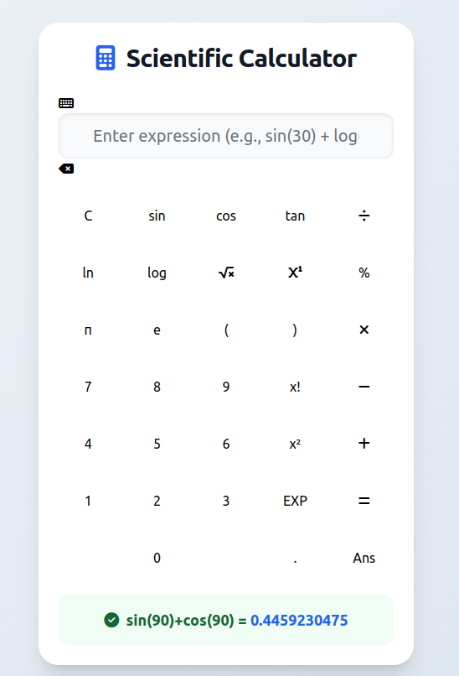
Result and Analysis

Slide 15
Demonstration

Slide 16
Conclusion
The project successfully demonstrates the integration of compiler design concepts into a functional scientific calculator.
Lex is utilized for lexical analysis, and Yacc for syntax parsing, enabling efficient expression processing.
The system accurately evaluates arithmetic, trigonometric, logarithmic, and exponential operations.
The backend compiler ensures reliable computation and precise evaluation of user-defined expressions.
The Flask-based frontend provides a responsive and intuitive interface for real-time interaction.
The project bridges the gap between theoretical compiler construction and practical software implementation.
It highlights the real-world applicability of system software principles in modern computational tools.

Slide 17
Future Scope
Incorporate advanced mathematical and statistical functions, such as matrix operations and calculus computations.
Add calculation history and memory storage features for improved usability.
Integrate graphical plotting capabilities to visualize equations and functions.
Enhance the frontend using modern frameworks like React or Angular for better interactivity.
Develop a mobile-compatible version to ensure accessibility across multiple platforms.
Implement user authentication and personalized settings for an enhanced user experience

Slide 18
References
[1] Krishna Vignesh, Mudumba Hanumat, Nallapareddy Vamsidhar Reddy, Sake Mohith Sai, and Meena Belwal. "ToY Language Compiler using Lex and YACC." Sake Mohith and Belwal, Meena, ToY Language Compiler using Lex and YACC (November 15, 2024) (2024).
[2] Likhith, Arlagadda Naga, Kothuru Gurunadh, Vimal Chinthapalli, and Meena Belwal. "Compiler for mathematical operations using english like sentences." In 2023 7th International Conference on Computation System and Information Technology for Sustainable Solutions (CSITSS), pp. 1-6. IEEE, 2023.
[3] Sharma, Ch Rahul AN, Bedadala Mohaneeswar Reddy, Dutta Swetchana, and Niharika Panda. "Compiler Design for recognizing different Programming Languages." In 2024 15th International Conference on Computing Communication and Networking Technologies (ICCCNT), pp. 1-6. IEEE, 2024.
[4] Mokshit, P., P. Syam Prasad, N. Sumanth Reddy, and Meena Belwal. "Pseudocode to Python-A Compiler Approach." In 2024 8th International Conference on Computational System and Information Technology for Sustainable Solutions (CSITSS), pp. 1-5. IEEE, 2024.
[5] Ortin, Francisco, Jose Quiroga, Oscar Rodriguez-Prieto, and Miguel Garcia. "An empirical evaluation of Lex/Yacc and ANTLR parser generation tools." Plos one 17, no. 3 (2022): e0264326.

Slide 19
References
[6] Sridhar, Sashank, and Sowmya Sanagavarapu. "A Compiler-based approach for natural language to code conversion." In 2020 3rd International Conference on Computer and Informatics Engineering (IC2IE), pp. 1-6. IEEE, 2020.
[7] Pai T, Vaikunta, and P. S. Aithal. "A systematic literature review of lexical analyzer implementation techniques in compiler design." International Journal of Applied Engineering and Management Letters (IJAEML) 4, no. 2 (2020): 285-301.
[8] Upadhyaya, Mohit. "Simple calculator compiler using Lex and YACC." In 2011 3rd International Conference on Electronics Computer Technology, vol. 6, pp. 182-187. IEEE, 2011.
[9] Abhishek, B. Sai, Balam Ruchith Balaji, Chillakuru Hari, and Meena Belwal. "C to Python Translator using LEX & YACC." Available at SSRN 5077711 (2024).
[10] Hahne, Bruce, and Hiroyuki Satō. "Using yacc and lex with c++." ACM SIGPLAN Notices 29, no. 12 (1994): 94-103.

Slide 20
Contribution of the Team Members
S.No | Reg. No. | Name | Contribution description
1 | BL.EN.U4CSE22004 | Adhi Neeraja | Developed the lexical analyzer using Flex, defining token rules for operators, numbers, and functions. Integrated the lexer with the parser and contributed to compiler testing and backend execution.
2 | BL.EN.U4CSE22014 | Chimakurthy Mounika Begum | Handled Flask–compiler integration, linking the web interface with the compiled backend (calc_exec). Ensured correct execution of compiler-generated results and smooth data exchange with the UI.
3 | BL.EN.U4CSE22030 | Kamalapuram Vigneswara Reddy | Implemented the syntax parser using Bison, defining grammar rules and semantic actions for expression evaluation. Worked on debugging and ensuring correct operator precedence in the compiler.
4 | BL.EN.U4CSE22050 | Rebbavarapu Henry Koushal | Designed the HTML/CSS user interface and performed extensive compiler output testing. Validated expressions, error handling, and end-to-end communication between the UI and compiler backend.

Slide 21
THANK YOU

