Slide 1

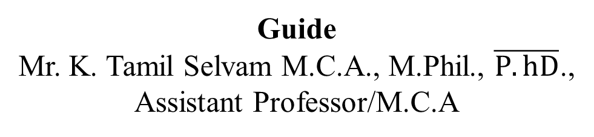
Designing Of Cloaking Wall Model With Leakage - Suppressed And Light Weight Access Control For Cloud Data Storage
Guide
Mr. K. Tamil Selvam M.C.A., M.Phil., $\overline{P.hD}$.,
Assistant Professor/M.C.A
Presented By
Vignesh A.P
(910622301057)

Slide 2
Abstract
Cloud computing transforms organizational operations with on-demand resource access.
Cross-organization data sharing faces challenges requiring agreement on data processing. Primary concern in information security and cloud computing.
Focus on developing Cloaking Wall Model for cloud storage. Four methods: Long-Term, Multi-Region, Time-based, and Geolocation-based Cloaking.
Cloaking identifies user types, ensuring content distribution to the right target. The Camouflage Data Disguise technique enhances security, using Chaffing and Winnowing with ChaCha20 encryption, distributing disguised data selectively. Methods fortify data security with confidentiality, global consistency, and timed access.

Slide 3
Existing System
Encryption Techniques:
Utilization of encryption algorithms to protect data in transit and at rest.
Common encryption methods include AES (Advanced Encryption Standard) and RSA (Rivest-Shamir-Adleman).
Access Controls and Identity Management:
Implementation of access control mechanisms to regulate user permissions.
Identity and access management solutions ensure only authorized users have access to sensitive data.
Intrusion Detection and Prevention Systems (IDPS):
Utilization of IDPS to detect and respond to potential security threats.
Helps in real-time monitoring and protection against malicious activities.

Slide 4
Disadvantages
Encryption complexity may impact system performance.
Traditional authentication methods may be vulnerable to attacks.
Relying on cloud providers' security exposes risks.
Human-related risks persist despite security training.
Firewalls may not cover all sophisticated attack vectors.

Slide 5
Proposed System
The proposed system endeavors to revolutionize cloud data security by introducing a sophisticated Cloaking Wall Model specifically designed to safeguard organizational operations in the ever-evolving landscape of cloud computing.
Long-Term Cloaking:
This method focuses on providing extended protection for sensitive data over prolonged durations. It involves concealing access patterns and data usage trends over an extended timeframe, ensuring persistent confidentiality.
Multi-Region Based Cloaking:
Recognizing the global nature of cloud services, multi-region-based cloaking involves implementing security measures that transcend geographical boundaries.

Slide 6
Proposed System
Time-Based Cloaking:
Time-based cloaking introduces temporal restrictions on data access, allowing organizations to define specific time windows during which data can be accessed.
Geolocation-Based Cloaking:
Geolocation-based cloaking involves tailoring data protection measures based on the geographical location of users.

Slide 7
Proposed System
Conditional Disguise
Disguise data selectively based on specific conditions or user roles. The Camouflage Data Disguise Generator module, integrating Chaffing and Winnowing with the robust ChaCha20 encryption algorithm, is strategically designed to elevate the security and privacy of data.
ChaCha20 Encryption
Genuine, chaff, and camouflaged data undergo encryption using the ChaCha20 algorithm.

Slide 8
Advantages
Integrates advanced security measures for comprehensive data protection.
Ensures data confidentiality at rest, in transit, and during processing.
Reduces administrative workloads through efficient certificate management.
Enhances security through defined time windows for data access.
No encryption standards

Slide 9
System Specifications
Hardware Requirements
Processors : AMD A4-4350B processor, 4 GB of Ram
Disk space : 320 GB
Operating systems : Windows® 10
Software Requirements
Server Side : Python 3.7.4(64-bit) or (32-bit)
Client Side : HTML, CSS, Bootstrap
IDE : Flask 1.1.1
Back end : MySQL 5.
Server : Wampserver 2i

Slide 10
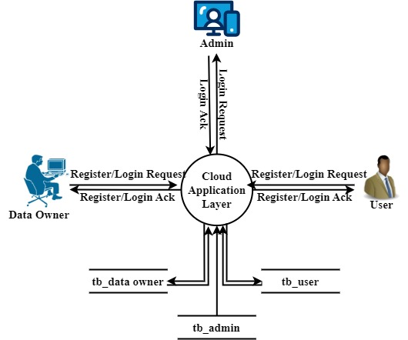
Data Flow Diagram-level 0

Slide 11
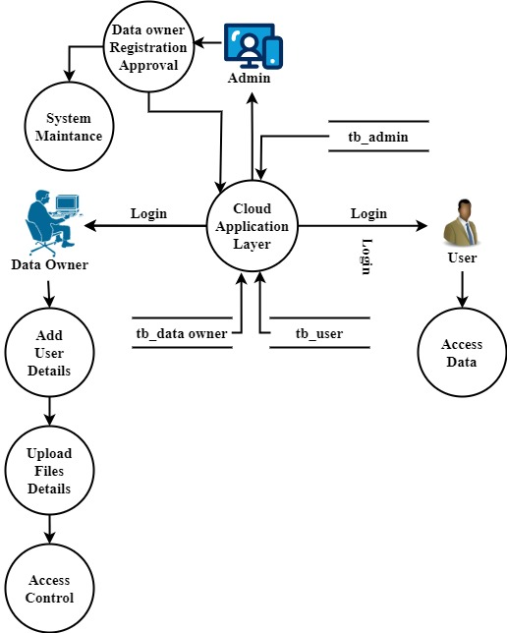
Level-1

Slide 12
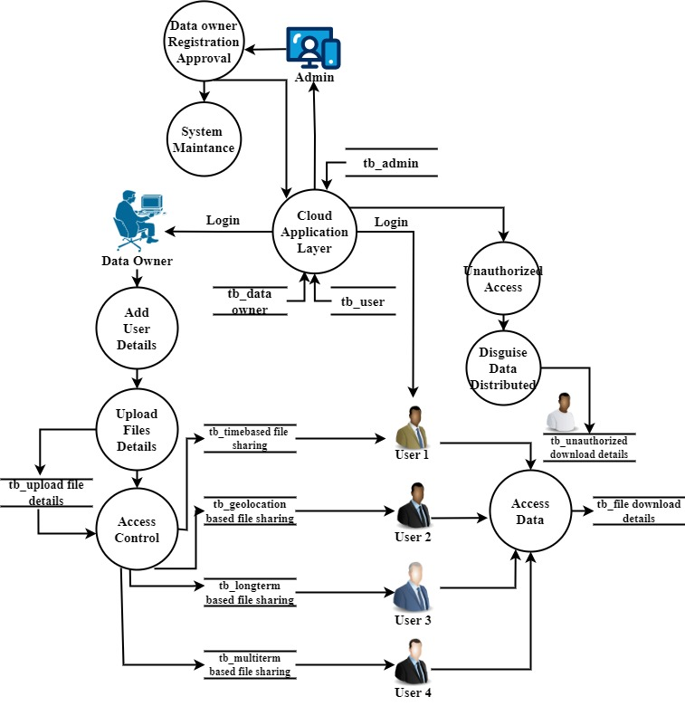
Level-2

Slide 13
Modules list
1.Cloud Service Provider
2. End User Interface
3. Cloaking Wall Modules
4. Access Policy Configurator
5. Bot Identification and Data Distribution
6. Disguise Data Generator
7. Monitoring and Auditing
8. Alerts and Notification

Slide 14
Modules description
Cloud Service Provider
The design and development of a Cloud Consumer Web App using Python, Flask and MySQL and Bootstrap.
The user authentication module serves as the entry point, ensuring secure access through robust registration and authentication processes, including multi-factor authentication for enhanced security.
The dashboard module, at the core of the application, seamlessly integrates the Cloaking Wall Model, providing users with an intuitive interface for cloud resource management while ensuring global consistency in security measures. The monitoring and alert module is essential for empowering users with real-time insights into the performance of their cloud resources and timely notifications of any irregularities.

Slide 15
2. End User Interface
2.1. Admin or Data Owner Interface
Login Module
The login module provides a secure authentication process for Admins or Data Owners, ensuring only authorized access to the cloud management interface.
Add and Manage Data
Admins can add, organize, and manage data within the cloud storage. This module allows them to upload, categorize, and control access to various datasets.
Add and Manage Users
Admins have the capability to add new users to the system, defining their roles and permissions. This module also allows them to modify or revoke access as needed.

Slide 16
Provide Login Credentials to Users:
Admins can generate and distribute login credentials for users added to the system. This ensures a secure onboarding process for new users.
Set Access Policy using Cloaking Wall Model:
Leveraging the Cloaking Wall Model, this module enables Admins to set access policies. Admins can define Long-Term Cloaking, Multi-Region based Cloaking, Time-based Cloaking, and Geolocation-based Cloaking to enhance data security.
Monitoring Data Access:
Admins can monitor and audit data access patterns using this module. It provides insights into who accessed specific data, when, and from which location, contributing to overall security and compliance.

Slide 17
2.2. Data User Interface
Login Module
Similar to the Admin interface, the login module provides secure authentication for Data Users, ensuring that only authorized individuals can access the cloud resources.
Access Data
Data Users can use this module to access the data allocated to them. The interface provides a user-friendly environment for retrieving, modifying, or analysing data based on their permissions.
Monitoring Data Access
Data Users have limited access to monitoring tools to track their own data access. This module allows them to review their activity and ensures transparency in usage.

Slide 18
3. Cloaking Wall Modules
The Cloaking Wall Model is a security framework integrated into the Cloud Consumer Web App, offering advanced data protection and access control.
3.1. Long-Term Cloaking
The Long-Term Cloaking module ensures persistent confidentiality of data access patterns over extended durations. Admins can set policies to conceal and protect access trends, preventing unauthorized inference from historical usage data.
3.2. Multi-Region Based Cloaking
This module facilitates a unified security approach across diverse geographical regions. Admins can define access controls that transcend geographic boundaries, ensuring consistent security measures globally and addressing challenges related to multi-region data access.

Slide 19
3.3. Time-Based Cloaking
Time-Based Cloaking empowers Admins to set temporal restrictions on data access. This module enhances security by allowing the definition of specific time windows during which data can be accessed, adding an extra layer of control over temporal access patterns.
3.4. Geolocation-Based Cloaking
The Geolocation-Based Cloaking module tailor’s data protection based on user location. Admins can define security policies that vary depending on the physical location of Data Users, adding a location-sensitive layer to access controls.

Slide 20
4. Access Policy Configurator
The Access Policy Configuration module is to define and customize access policies for the Cloud Consumer Web App.
This module plays a crucial role in tailoring the security measures based on Long-Term Cloaking, Multi-Region based Cloaking, Time-Based Cloaking, and Geolocation-Based Cloaking principles.
This module provides a centralized dashboard for administrators to configure comprehensive access policies.
They can set parameters, thresholds, and exceptions to align with the security requirements of the organization.

Slide 21
5. Bot Identification and Data Distribution
The Bot Identification Mechanism within the Cloaking Wall Model ensures that automated bots attempting to access the data in violation of access policies are promptly identified.
This module ensures that benign content is delivered to authentic users, while malicious content is selectively distributed to identified bots
Policy Adherence Assessment
Each user, including potential bots, is assessed against the defined access policies. Legitimate Data Users are expected to follow the specified Long-Term Cloaking, Multi-Region based Cloaking, Time-Based Cloaking, and Geolocation-Based Cloaking rules. Any entity not adhering to these policies is flagged for further scrutiny.

Slide 22
6. Disguise Data Generator
The Disguise Data Generator Module, tailored for the Injection of Non-Compliant Data specifically targeted at users violating the access policy set by the admin.
ChaCha20 Encryption
Genuine, chaff, and camouflaged data undergo encryption using the ChaCha20 algorithm.
Winnowing Process
At the recipient's end, the winnowing process disentangles the genuine data from the chaff and camouflage layers. The ChaCha20 decryption algorithm, combined with the appropriate key, unveils the original, non-compliant data.

Slide 23
7. Monitoring and Auditing
In real-time, the module monitors and captures a spectrum of activities, including user interactions, data access, and system operations.
It maintains a meticulous log of policy enforcement instances, detailing the invocation of access policies defined by the Cloaking Wall Model, along with outcomes and responses to policy violations.
Furthermore, the module diligently tracks all data access and modification events, providing insights into who accessed specific data and the nature of their interactions, aiding in forensic analysis.

Slide 24
8. Alerts and Notification
Upon detection of a policy violation, the module triggers immediate alerts, swiftly notifying administrators through various channels such as email, SMS, in-app messages, or other preferred communication methods.
These alerts are designed to provide administrators with detailed information about the nature of the policy violation, offering insights into unauthorized access attempts, data modifications beyond permitted levels, or breaches of temporal and geolocation constraints.
This proactive alerting mechanism minimizes the latency between the occurrence of a policy violation and the notification to administrators, facilitating a rapid and targeted response.

Slide 25
Testing
Functional Testing: This type of testing verifies that each function of the system operates in accordance with the requirements specified in the design documents. It includes testing features like user authentication, data management, access control policies, and monitoring capabilities.
Integration Testing: Integration testing ensures that individual components of the system work together seamlessly as a whole. It validates interactions between different modules, APIs, and external systems, including the integration of the Cloaking Wall Model with the Cloud Consumer Web App.

Slide 26
Performance Testing: Performance testing assesses the responsiveness, scalability, and stability of the system under various load conditions. It includes testing the system's ability to handle concurrent users, process requests efficiently, and maintain acceptable response times.
Security Testing: Security testing evaluates the system's resilience against potential security threats and vulnerabilities. It includes testing for authentication mechanisms, encryption protocols, access control measures, data masking techniques, and protection against common cyber threats like SQL injection and cross-site scripting (XSS).

Slide 27
Usability Testing: Usability testing focuses on assessing the system's user interface (UI) design, navigation flow, and overall user experience. It involves gathering feedback from end-users to identify any usability issues, accessibility concerns, or areas for improvement in terms of user interaction and interface design.
Compatibility Testing: Compatibility testing ensures that the system functions correctly across different platforms, browsers, devices, and operating systems. It verifies that the application is compatible with popular web browsers, mobile devices, and screen resolutions, ensuring a consistent user experience across diverse environments.

Slide 28
Conclusion
In conclusion, the project introduces a robust solution to enhance data security in cloud computing. The Cloaking Wall Model, with features like Long-Term Cloaking and Geolocation-based Cloaking, ensures persistent confidentiality and global consistency.
The Camouflage Data Disguise technique, integrating Chaffing and Winnowing with ChaCha20 encryption, adds an extra layer of defense. The Cloud Consumer Web App's modular design caters to both administrators and users, offering secure functionalities like user authentication, data management, and monitoring.
The project's testing phase, outlined in the test report, demonstrates a rigorous approach to quality assurance. The innovative Bot Identification Mechanism, coupled with the Disguise Data Generator module, adds an intelligent layer to the security framework.
By accurately identifying potential bot activity and simulating non-compliant data instances, the system actively responds to emerging threats

Slide 29
Future Enhancement
The future evolution of the system holds exciting possibilities, with key areas of focus.
Integrating machine learning algorithms stands out as a potential enhancement, enabling dynamic analysis of access patterns to adeptly respond to evolving security threats. Behavioral analytics is another avenue, offering a nuanced understanding of user behavior to distinguish normal activities from potential risks.
Additionally, exploring blockchain integration is on the horizon, aiming to enhance data integrity and transparency by leveraging the decentralized and tamper-resistant nature of blockchain technology. These enhancements collectively propel the system towards a more adaptive, context-aware, and secure future.

Slide 30
References
E. Alowaisheq, P. Wang, S. Alrwais, X. Liao, X. Wang, T. Alowaisheq, X. Mi, S. Tang, and B. Liu, ‘‘Cracking the wall of confinement: Understanding and analyzing malicious domain take-downs,’’ in Proc. Netw. Distrib. Syst. Secur. Symp., 2019.
G. Zhang, X. Chen, B. Feng, X. Guo, X. Hao, H. Ren, C. Dong, and Y. Zhang, ‘‘BCST-APTS: Blockchain and CP-ABE empowered data supervision, sharing, and privacy protection scheme for secure and trusted agricultural product traceability system,’’ Secur. Commun. Netw., vol. 2022, pp. 1–11, Jan. 2022, doi: 10.1155/2022/2958963.
Y. J. Wang, C. T. Cao, and L. You, ‘‘A novel personal privacy data protection scheme based on blockchain and attribute-based encryption,’’ J. Cryptol. Res., vol. 8, no. 1, pp. 14–27, 2021, doi: 10.13868/j.cnki.jcr. 000416.
E. Zagan and M. Danubianu, ‘‘ADLS Gen 2 for web server log data analysis,’’ in Proc. Int. Conf. Develop. Appl. Syst. (DAS), Suceava, Romania, 2022, pp. 161–166, doi: 10.1109/DAS54948.2022.9786071.
P. Zeng, Z. Zhang, R. Lu, and K.-K.-R. Choo, ‘‘Efficient policy-hiding and large universe attribute-based encryption with public traceability for Internet of Medical Things,’’ IEEE Internet Things J., vol. 8, no. 13, pp. 10963–10972, Jul. 2021.

Slide 31
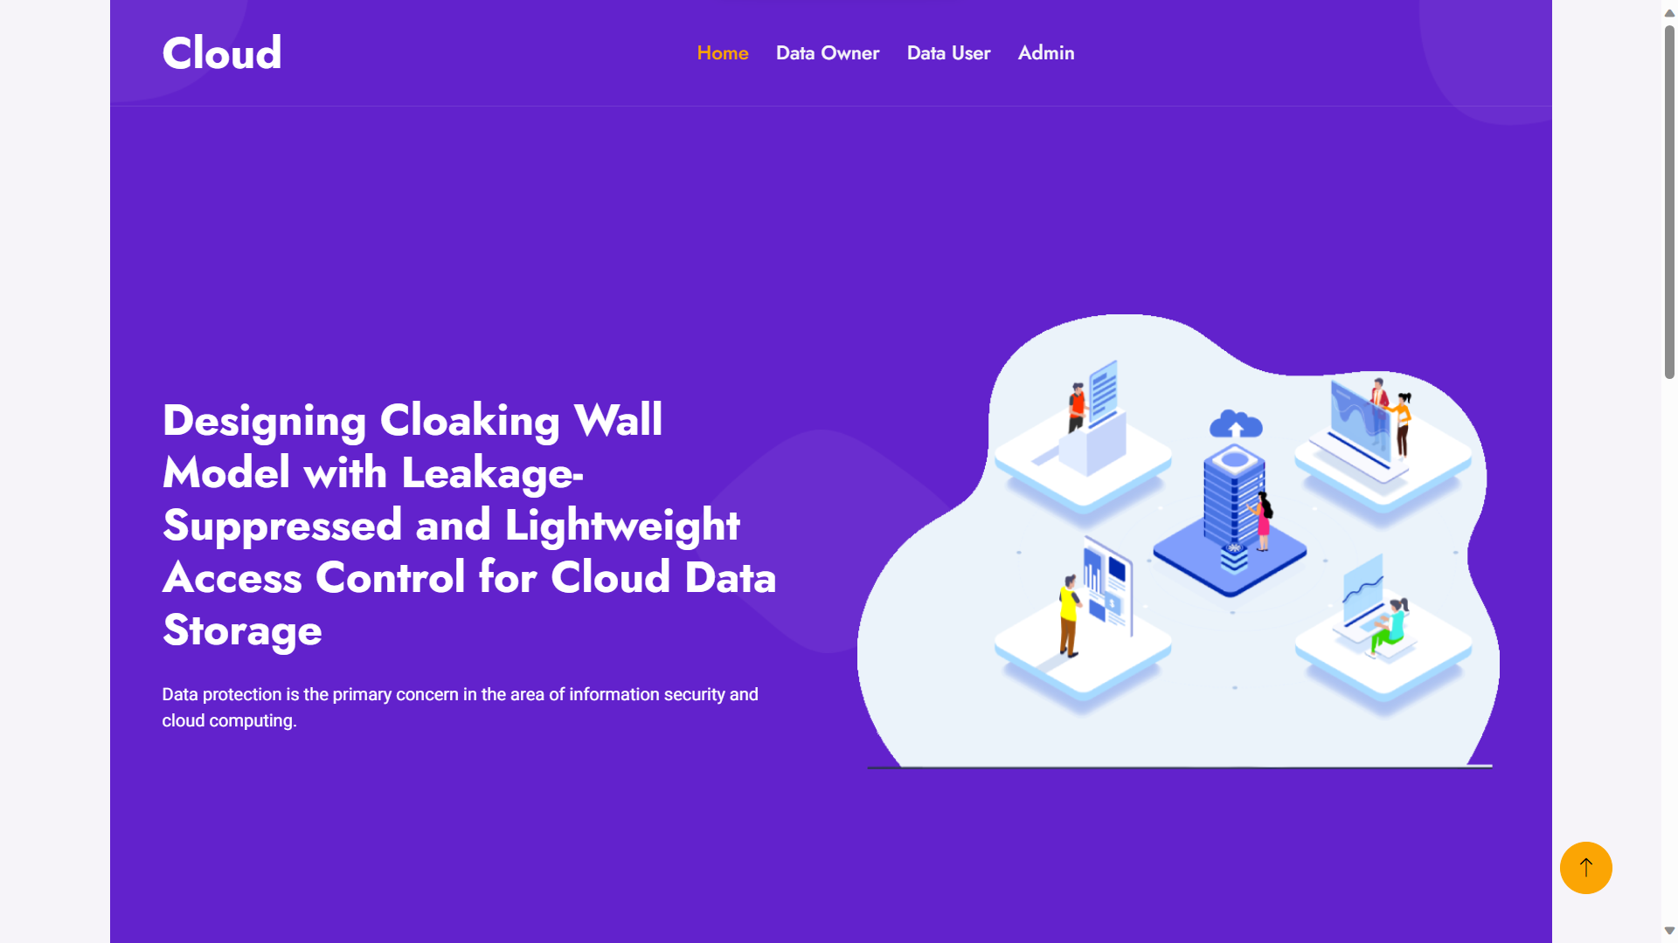
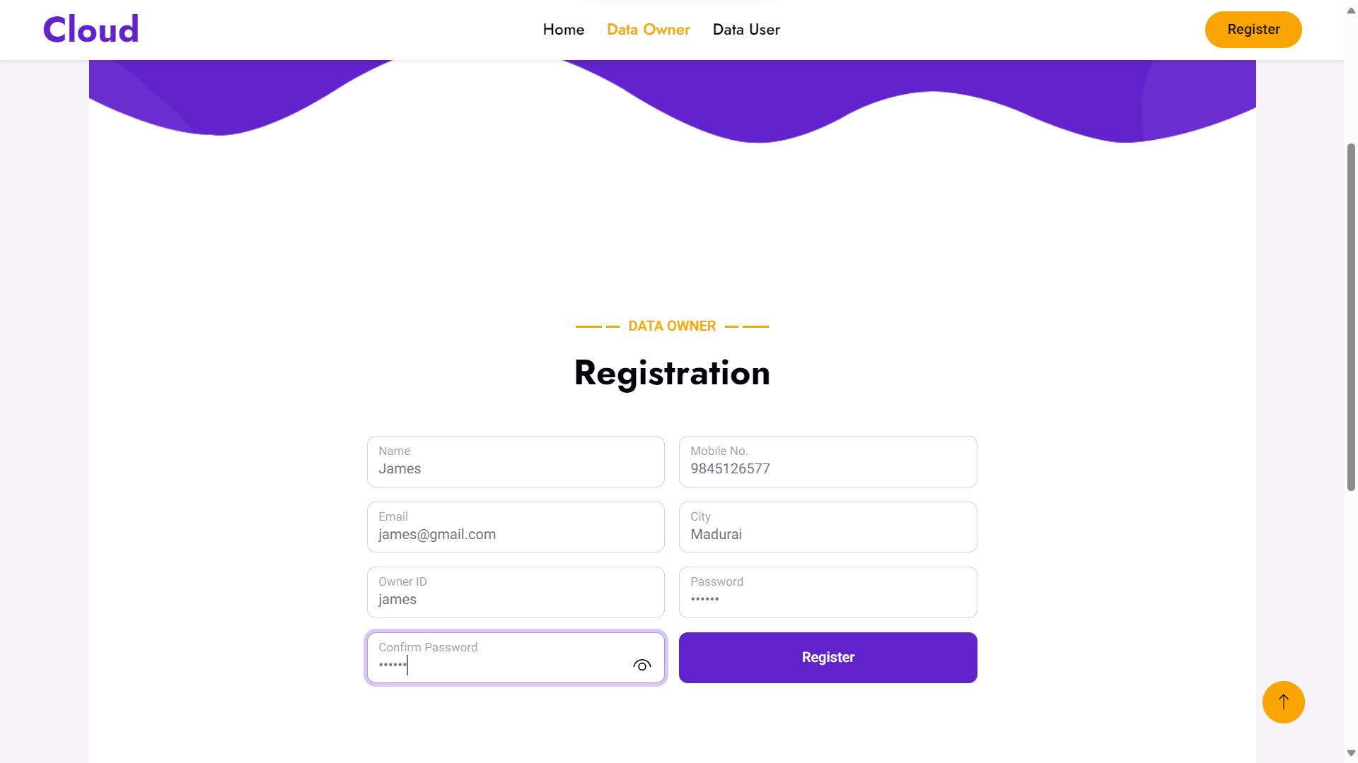
Screenshot

Slide 32
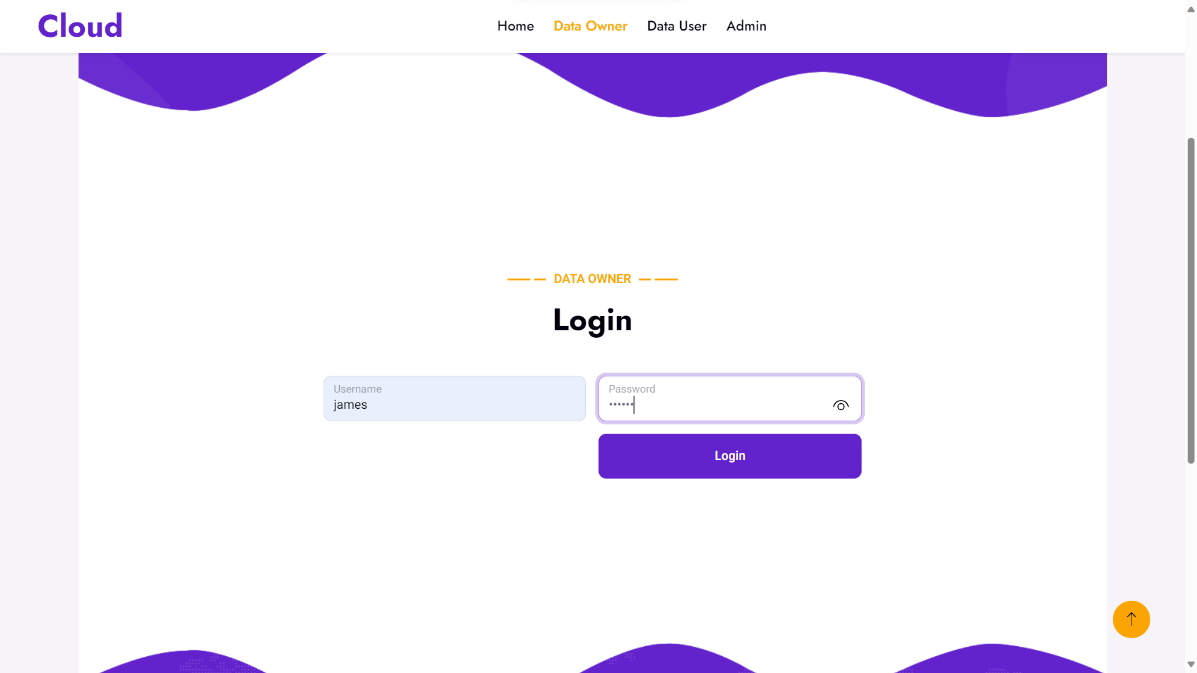
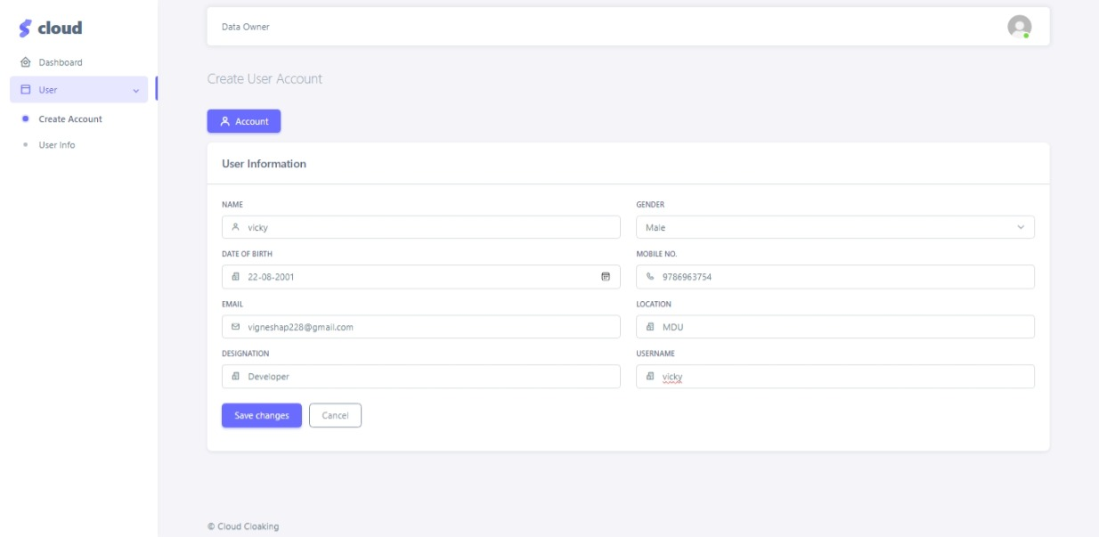
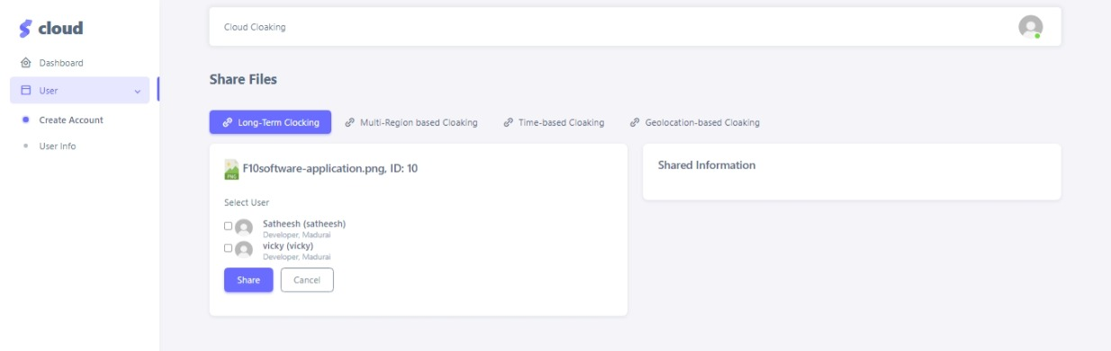
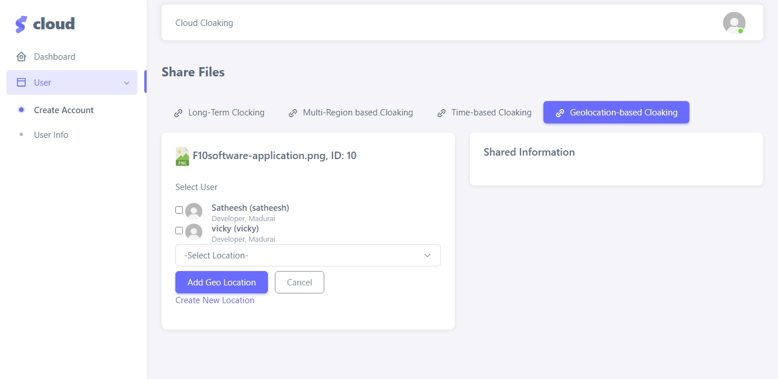
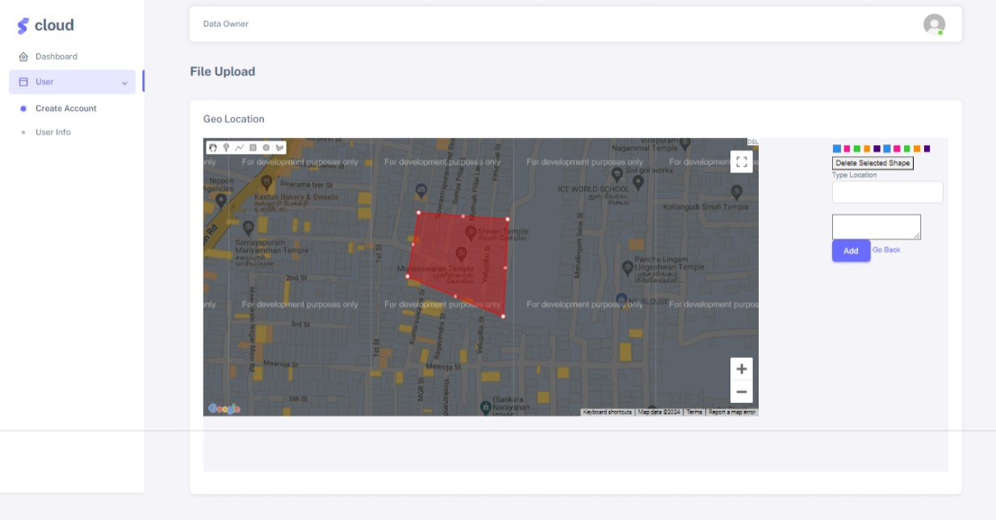
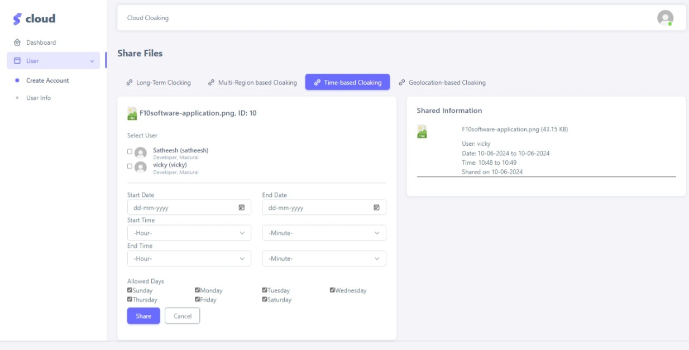
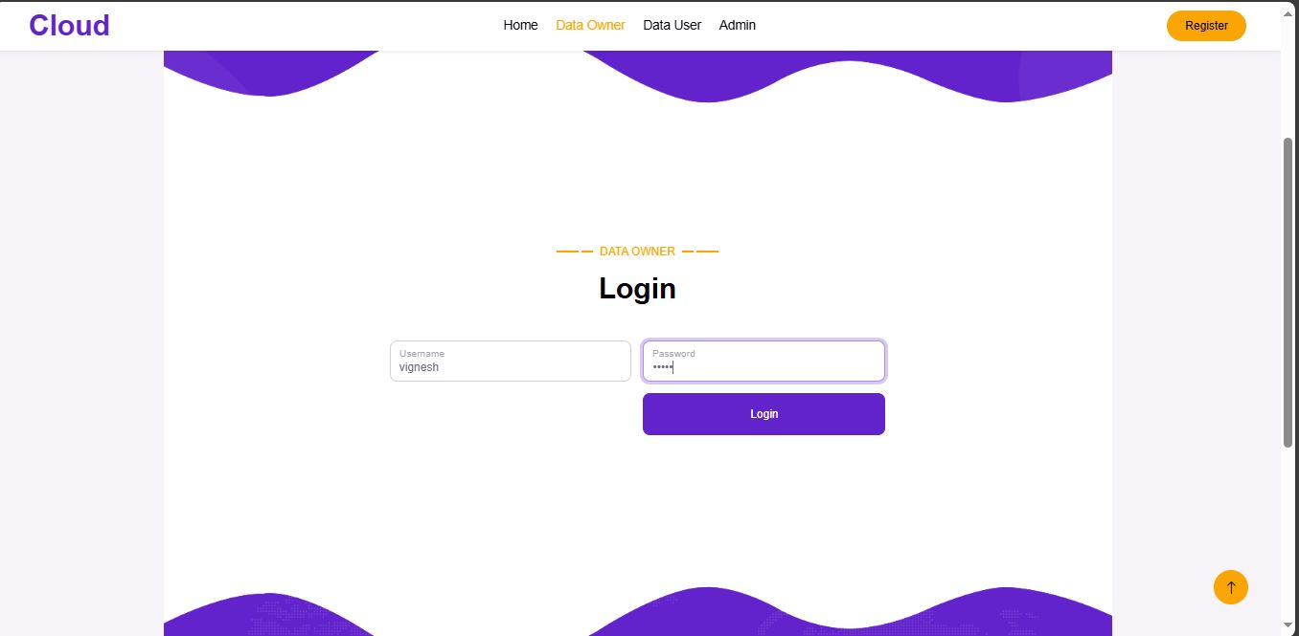
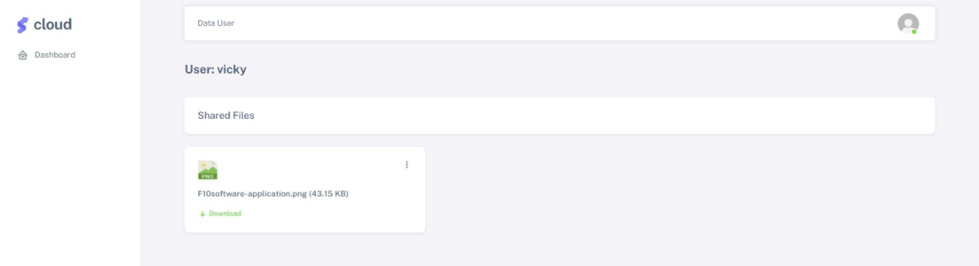
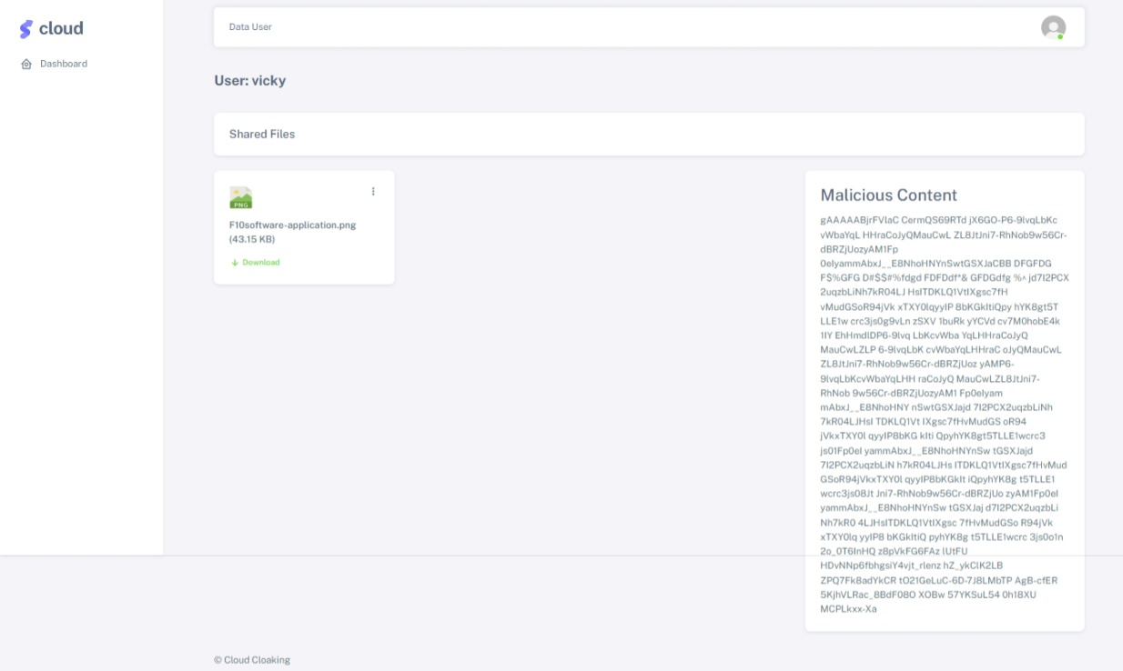
Screenshot

Slide 33
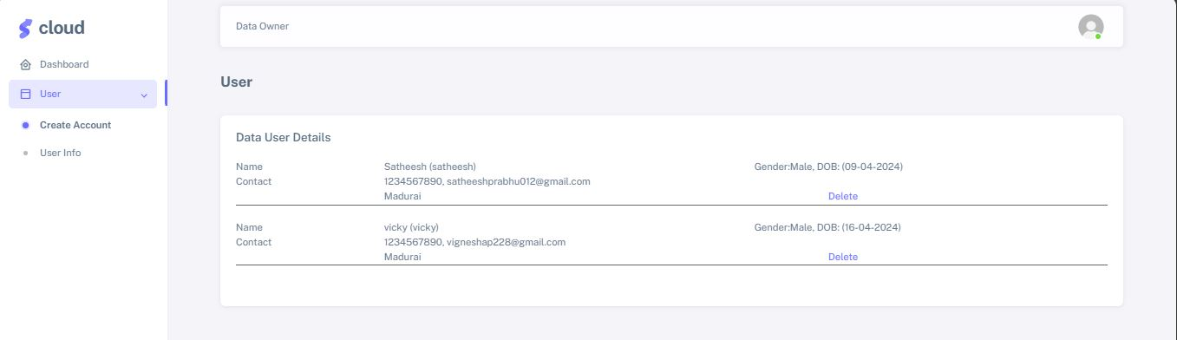
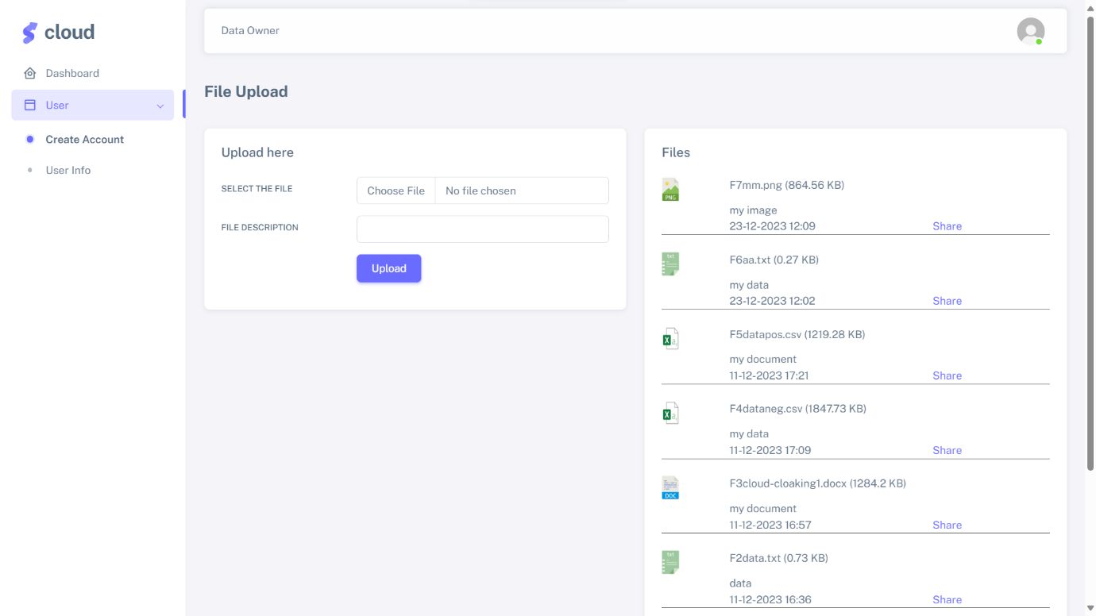

Slide 38
THANK YOU

