Slide 1
Image Put-Pack
104064552 蔡博丞
104064518 張容瑜

Slide 2
Outline
Introduction
Flow Chart
Classification
Sorting & Panorama Stitching
Results
Reference

Slide 3
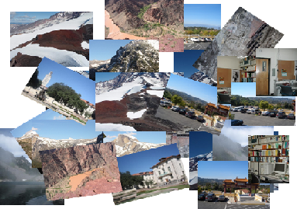

Introduction
Now, we have a lot of photos from different panorama, and all of these photos are put together.
how to classification?
how to sort the photos?

Slide 4
Flow Chart
Input:
Disordered images
Classification
Sorting
stitching
Output:
Several panorama

Slide 5
Classification
Classify different panorama from a mess of photographs.
SIFT - Calculate descriptor and matches
RANSAC – Calculate inliners
(# of Inliner) / (# of Matches) > 0.55 => same group for one panorama
Return elements in different groups for stitching
Notes:
we fix Iref as the final coordinate system, we want all other images transformed to Iref.

Slide 6
Classification
Image file input
Matches
(Sift)
Inilers
(RANSAC)
Compute
Ratio
Divide into groups
Output groups

Slide 7
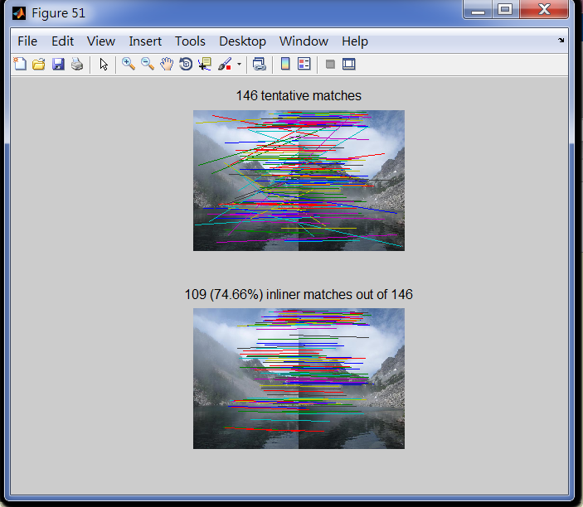
Classification-Result
Compute
(# of Inliner) / (# of Matches) for each pair of pictures
When >0.55 , consider them in a same group of panorama.

Slide 8
Classification-Result
Save the result in a matrix ‘Compute’
A1
A2
A3
A4
A5
A1
1 | 1 | 0 | 0 | 0
1 | 1 | 0 | 1 | 0
0 | 0 | 1 | 0 | 1
0 | 1 | 0 | 1 | 0
0 | 0 | 1 | 0 | 1
A2
Groups of panorama
(A1,A2,A4)&(A3,A5)
A3
A4
A5

Slide 9
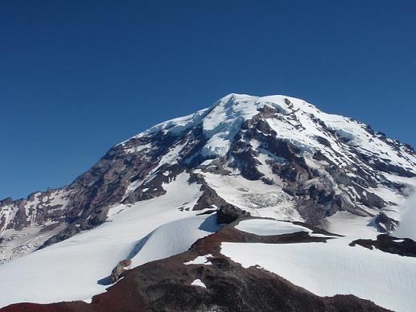
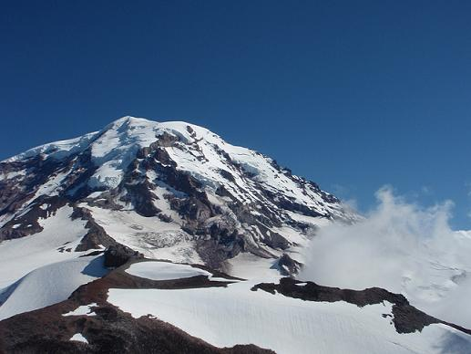
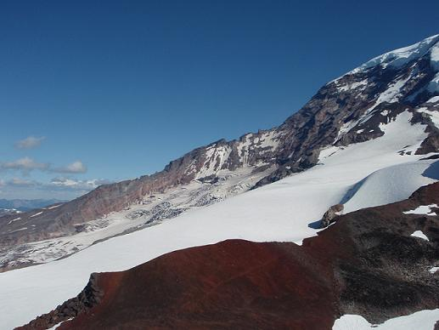
Classification-Result
function [v] = group( compute,x )
function [Z] = check( A,Size,compute )
%A=group(compute,1)
A2
A1
A4

Slide 10
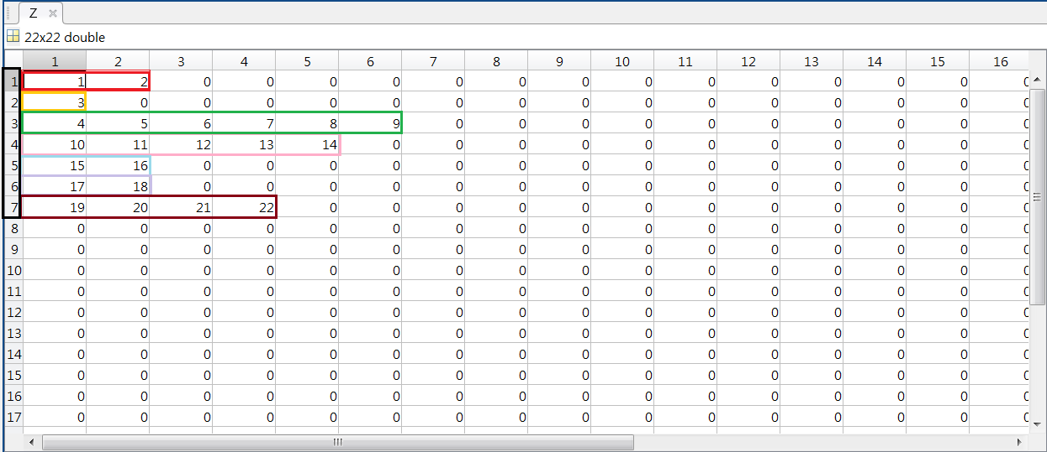
Classification-Result
A matrix Z for knowing elements in different groups

Slide 11
Sorting & Panorama Stitching
Stitches multiple images together with a chain of input images.
We choose the middle image as the reference image, and the output
panorama is in the same coordinate system as the reference image.
I1 -> I2 -> ... -> Iref -> ... -> Im-1 -> Im
Notes:
we fix Iref as the final coordinate system, we want all other images transformed to Iref.

Slide 12
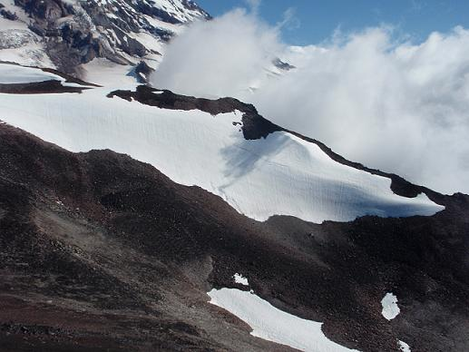
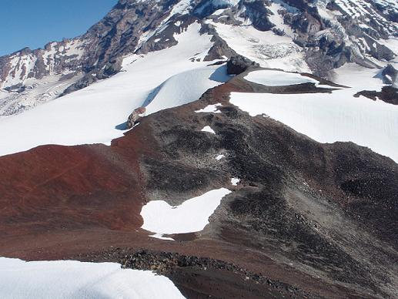
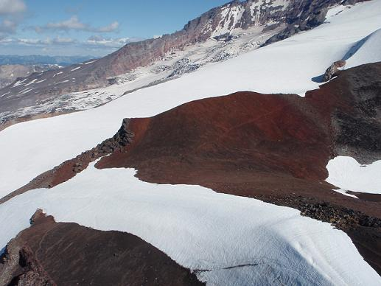
Sorting & Panorama Stitching(cont.)
Find the Iref from unordered sequence of images.
iteratively, do RANSAC for image to image
choose the highest votes as the Iref, and sort them.

Slide 13
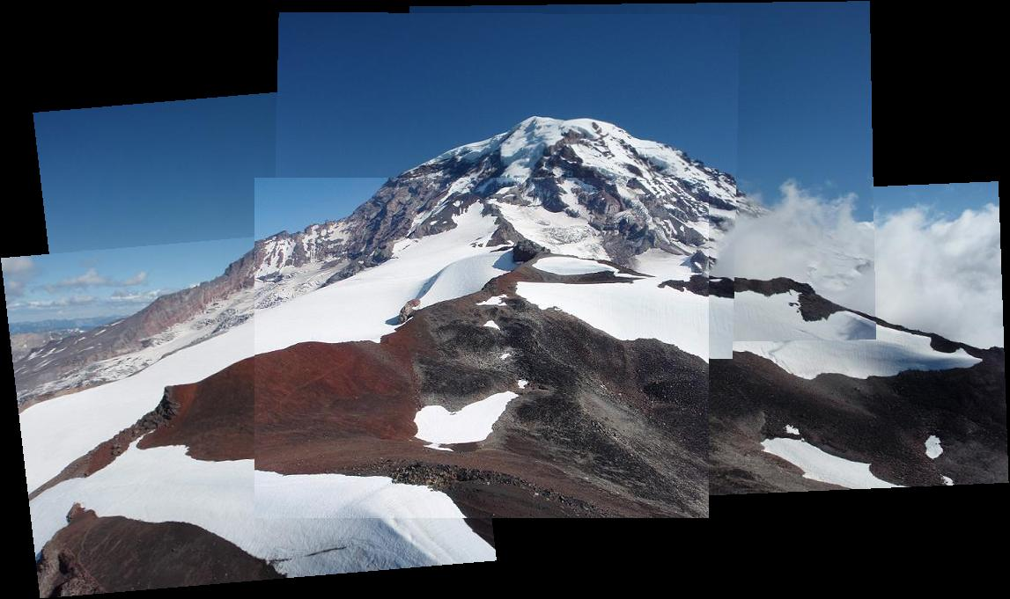
Sorting & Panorama Stitching(cont.)

Slide 14
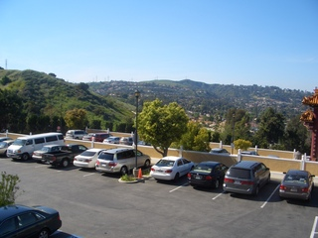
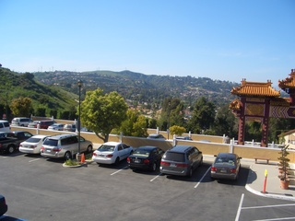
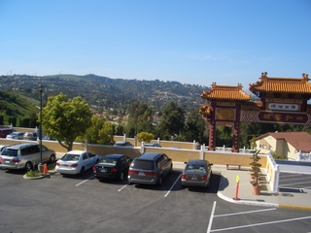
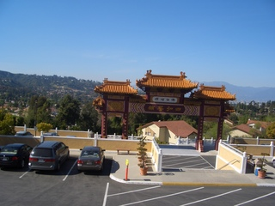
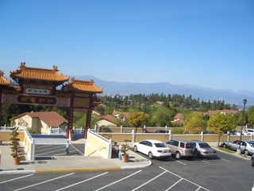
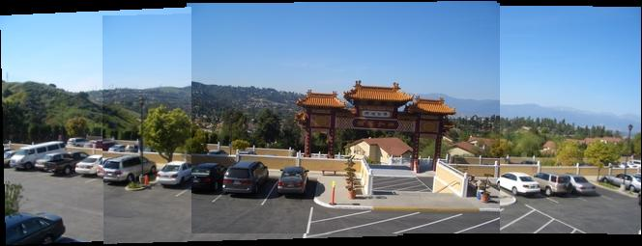
Results

Slide 15
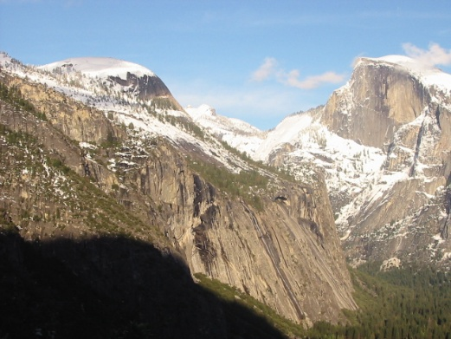
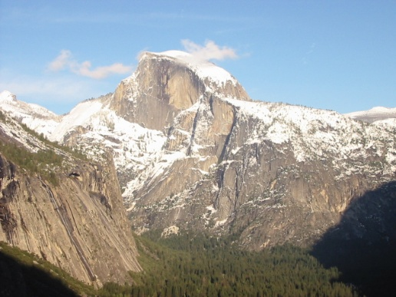
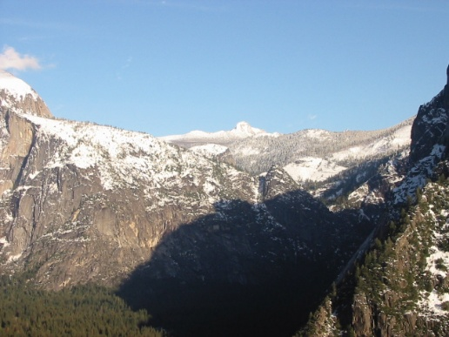
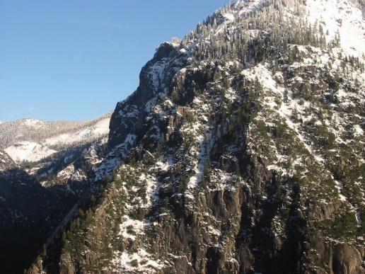
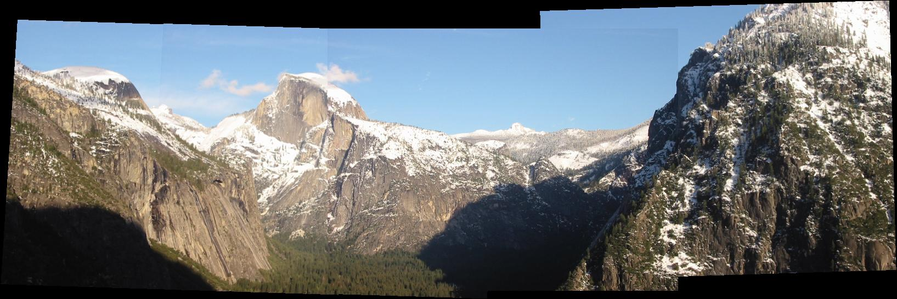
Results

Slide 16
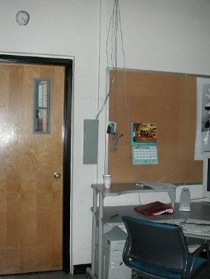
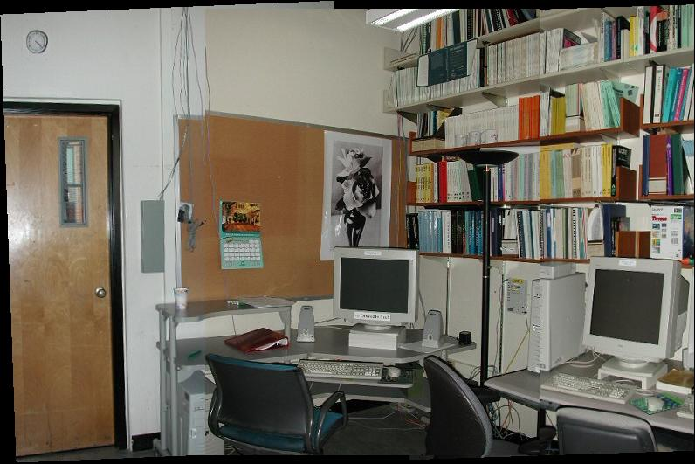
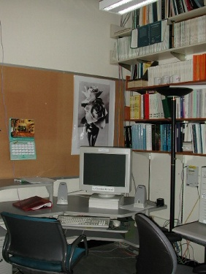
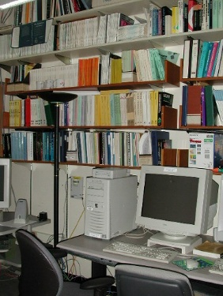
Results

Slide 17
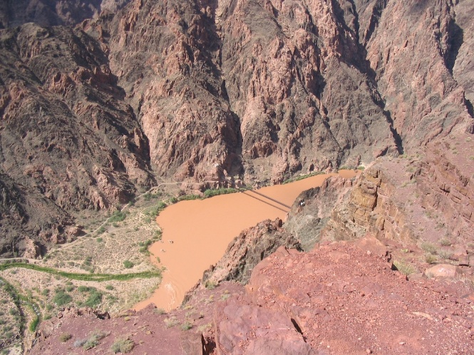
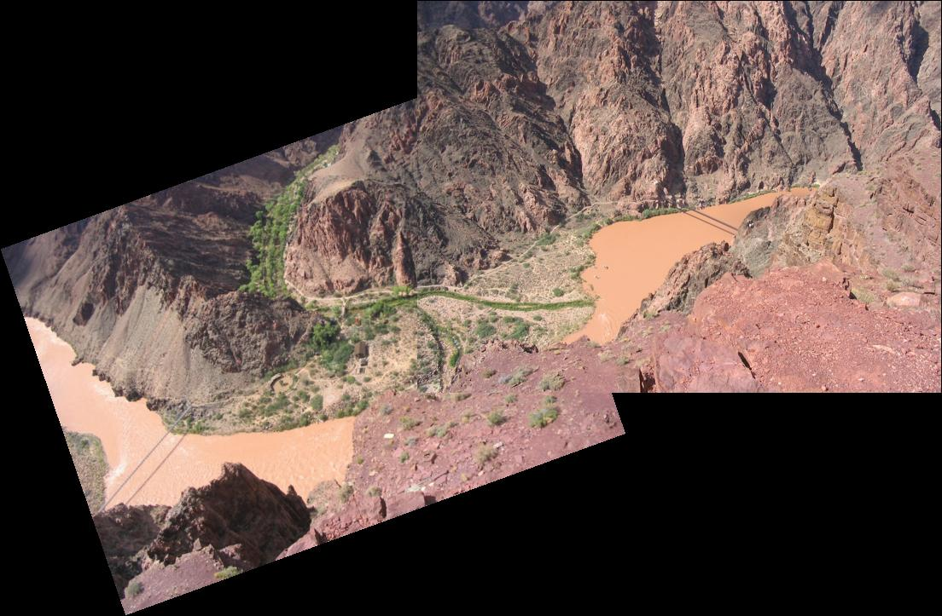
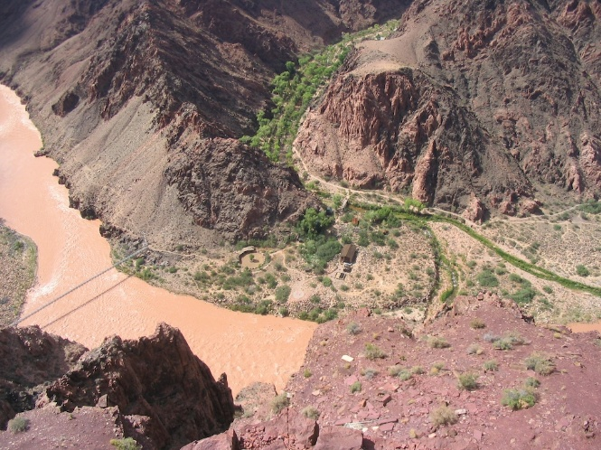
Results

Slide 18
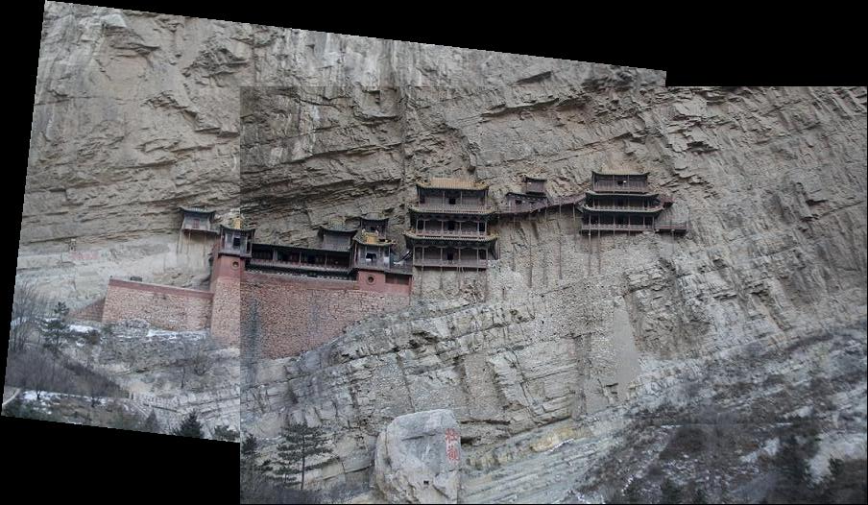
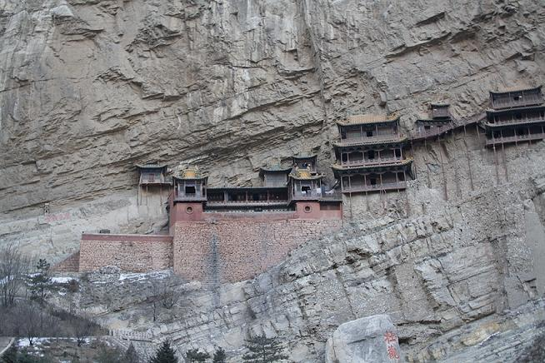
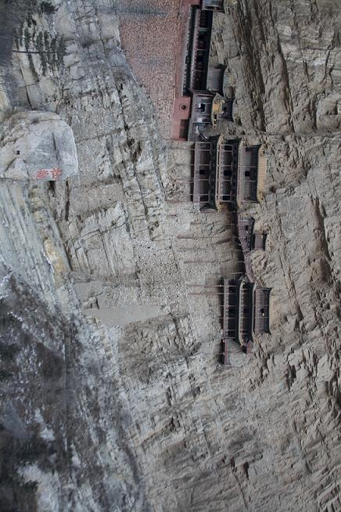
Results

Slide 19
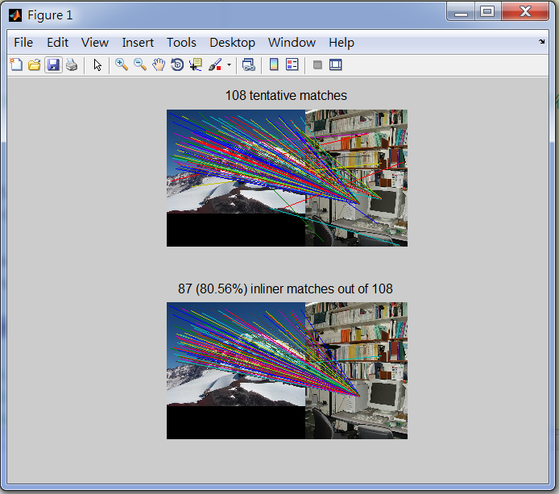
Problem

Slide 20
Reference
Brown, M. and D. Lowe. Automatic Panoramic Image Stitching using
Invariant Features. International Journal of Computer Vision. 2007.
Szeliski, R. Image Alignment and Stitching: A Tutorial.Microsoft
Research. 2004

