Slide 1
Sentiment Analysis Project
Amazon Product Reviews

Slide 2
01
Team Introduction
02
Project Overview
03
Exploratory Data Analysis
Table of
Contents
04
Forecasting Reviewer Sentiments
05
Text Preprocessing
06
Algorithms Used & Model Selection
07
Model Deployment
08
Future Scope & Challenges
09
Business Conclusion

Slide 3






Team Introduction
Sakina Ariwala
Lalitha Naidu
Viha Sharma
Rishita Chouhan
Mumbai,Maharashtra
NIIT
sakinaariwala03@gmail.com
Bangalore, karnataka
NIIT
lalithanalidu@gmail.com
Gurgaon, Haryana
NIIT
vihasharma1099@gmail.com
Indore,Madhya Pradesh
NIIT
rishitachouhan@icloud.com

Slide 4
Project Overview
PROBLEM STATEMENT
It is observed that the maximum number of customers look at product reviews before they make a purchase. Survey results show that positive product reviews are a key factor for purchasing by 57% of Amazon buyers (Statista, 2019).
As product reviews are often the deciding factor for many customers, it’s very important to have a well-automated system for monitoring them.
The traditional manual process of Amazon product reviews is time-consuming and inefficient when millions of reviews are being posted all the time. It doesn’t show any trend or patterns over time. Moreover, it is tough to understand customers’ sentiment towards any product or its delivery.

Slide 5
Project Overview
SOLUTION AGENDA
In our approach, we will be classifying Amazon customer reviews from Amazon, into 3 categories of positive,negative and neutral. We used Text Classification and Time Series Analysis to solve this problem statement.
We developed an automated system to analyze and monitor an enormous number of reviews. By monitoring the entire review history of products, we analyzed the tone, language, keywords, and trends over time to provide valuable insights that increase the success rate of existing and new products as well as marketing campaigns.
Our Prior Assumptions
Sample size of 100K examples are sufficient to represent the entire population of sales/reviews
The information we find in the text reviews of each product will be rich enough to train a sentiment analysis classifier with accuracy (hopefully) > 70%

Slide 6
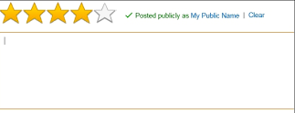
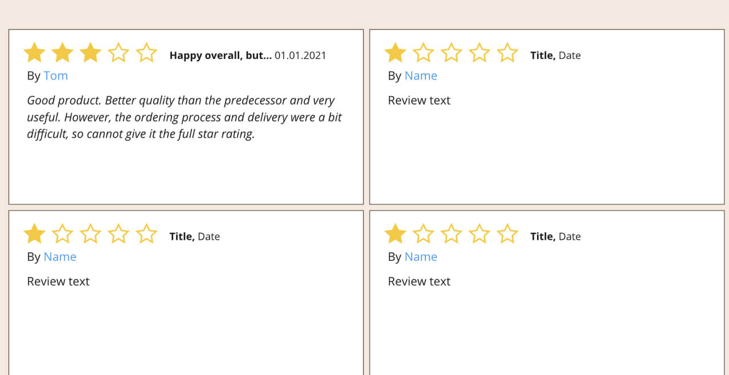
Why Sentiment Analysis?
Business-to-Customer trust is vital for a successful business.
Sentiment Analysis is an emerging tool that helps businesses differentiate and categorize opinions about their products, services and brand image. This technique is used in Natural Language Processing by converting unstructured text into data that can be analysed.
Neutral:
The service was alright. Not bad, not great.
Negative product review
Absolute waste of money, will be sending it back ASAP!
Positive:
Good quality product,I highly recommend!
BUSINESS RELEVANCE
Improving customer services & reducing customer churn
Preventing setbacks & crises
Market Research and Brand Monitoring
Tracking Advertisement &
Strategy Performance

Slide 7


Project Objectives
Improve customer support
Manage brand reputation
Detect the root cause of negative customer services to improve customer care management systems
Fix product issues to improve products based on customer needs
Identify Product Issues
Competitor Intelligence
Determine the weak areas of products based on negative customer sentiments.
ex:- 'poor quality of product',
Survey similar products by competitors to reveal popular product features

Slide 8

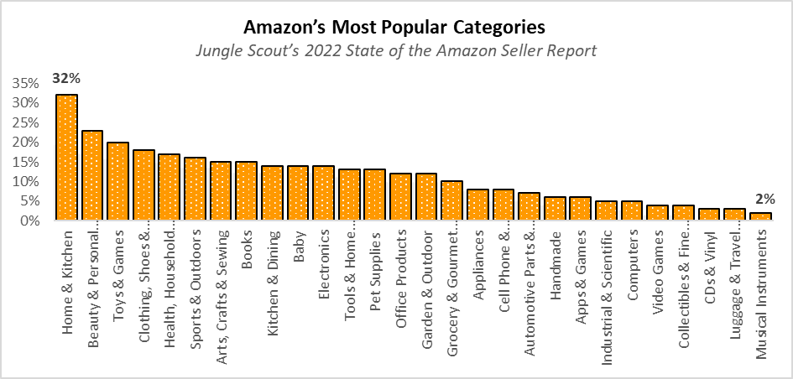
Data Source
Overview of Datasets
For our analysis, we have chosen the categories of ‘Home & Kitchen’ and ‘Musical Instruments’.
Motivation behind choosing Amazon categories
According to Jungle Scout’s 2022 State of the Amazon Seller Report, these were the most popular and least popular categories respectively.
A comparison of customer sentiments in these categories would be insightful for the dealers.
Dataset Features
FEATURE NAME | DESCRIPTION
1. ASIN | ID of the product
2. Title | Name of the product
3. Price | Price in US dollars (at time of crawl)
4. Brand | Brand name
5. Subcategory | Category that the product belongs to
6. ReviewerID | ID of the reviewer
7. Helpful | Helpfulness rating of the review
8. Review | Text of the review
9. Ratings | Rating of the product
10. Date | Time of the review

Slide 9
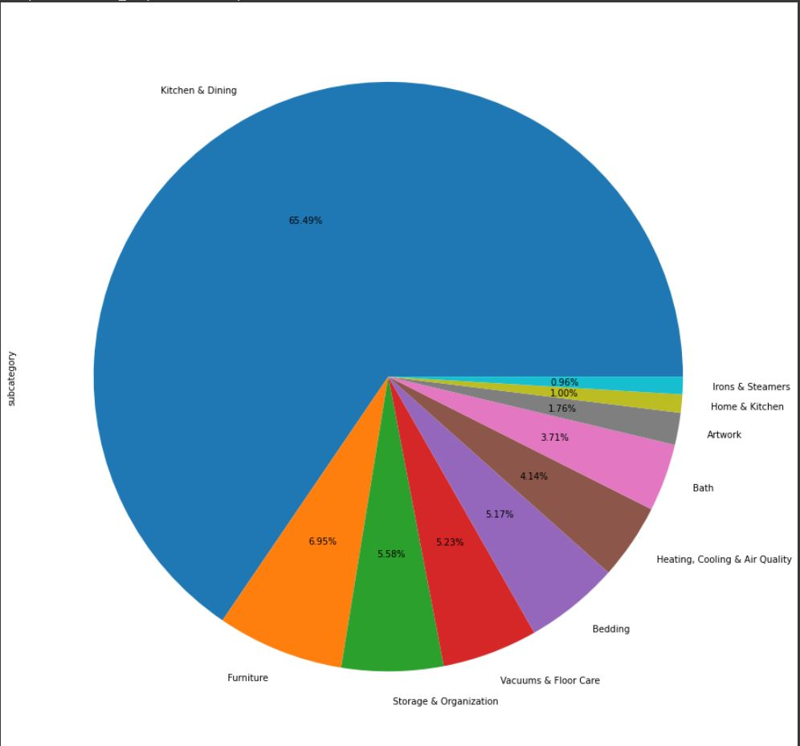
Home & Kitchen - Top 10 Most Popular Subcategories

Slide 10
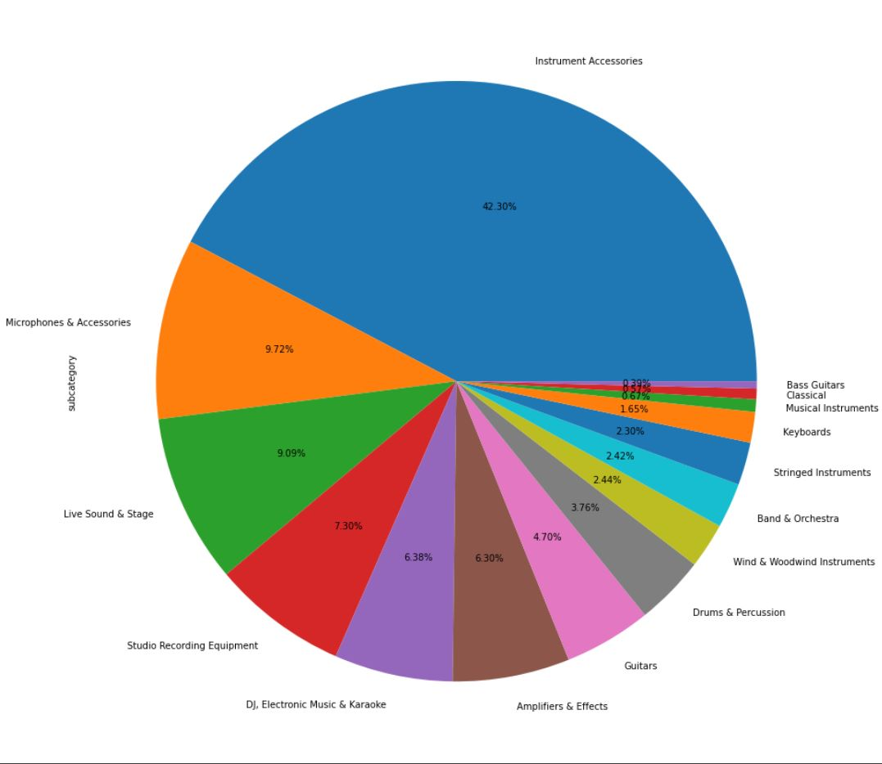
Musical Instruments - Top 15 Most Popular Subcategories

Slide 11
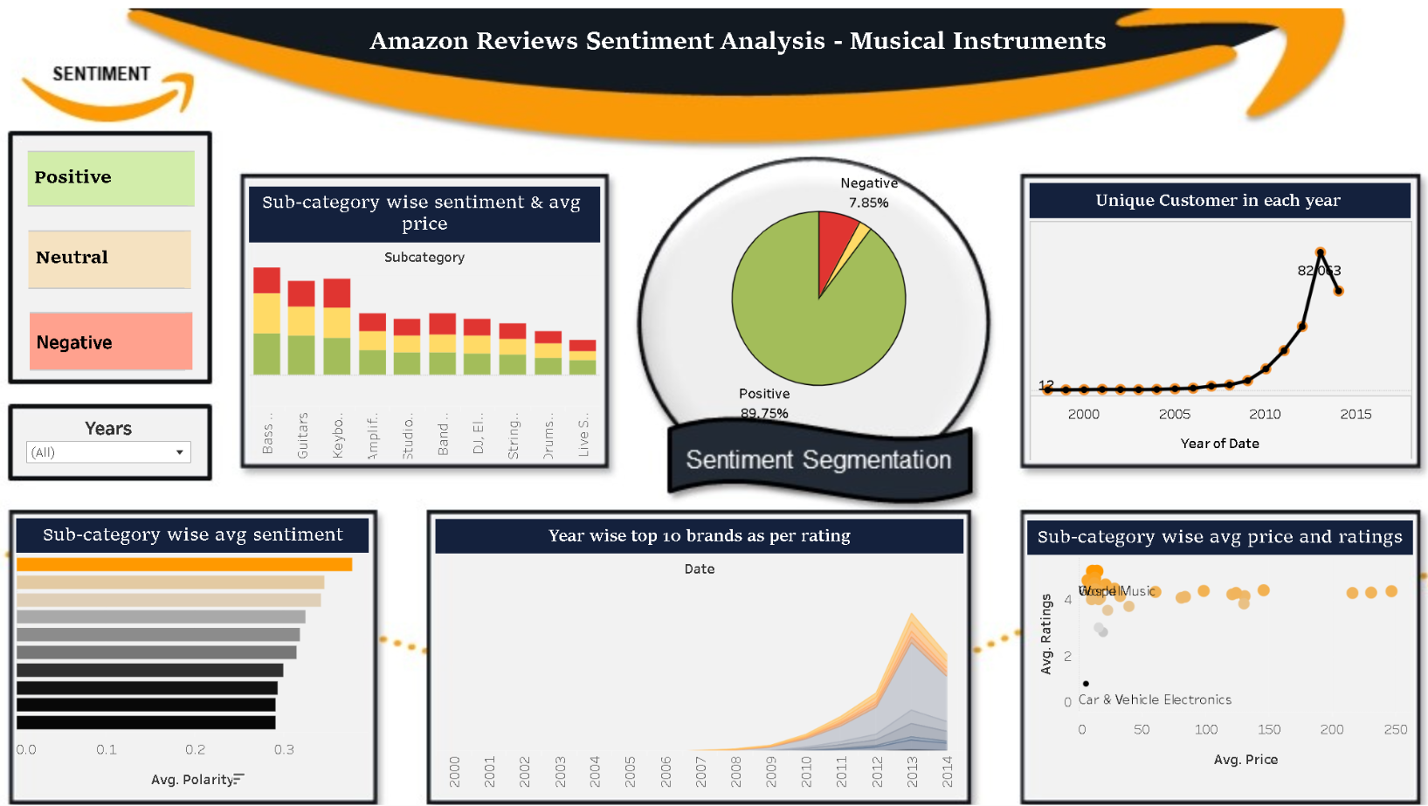
EXPLORATORY DATA ANALYSIS
Subcategory | Highest Positive Sentiment | Lowest Positive Sentiment
Home & Kitchen | Art Work | Heating, Cooling & Air Quality
Musical Instruments | Christian | Rap & Hip-Hop
Most reviews are classified as positive, in both categories
In the year of 2013 the count of unique customer is the highest for both the dataset
Musical Instrument Tableau
Home and kitchen Tableau

Slide 12
Time Series Analysis
Time Series Analysis helps in highlighting trends to forecast sentiment trends for particular subcategories in the future. Brands can discover many hidden trends in customer sentiments from historical data.
For businesses to make data-driven decisions regarding marketing strategies, inventory control, and customer support services, it is helpful to forecast future sentiments.
Time period considered:
2000 - 2014
Resample to monthly - for better model performance
Forecast period - 2015 to 2018
Due to existence of Trend and seasonality, SARIMA model was chosen.

Slide 13
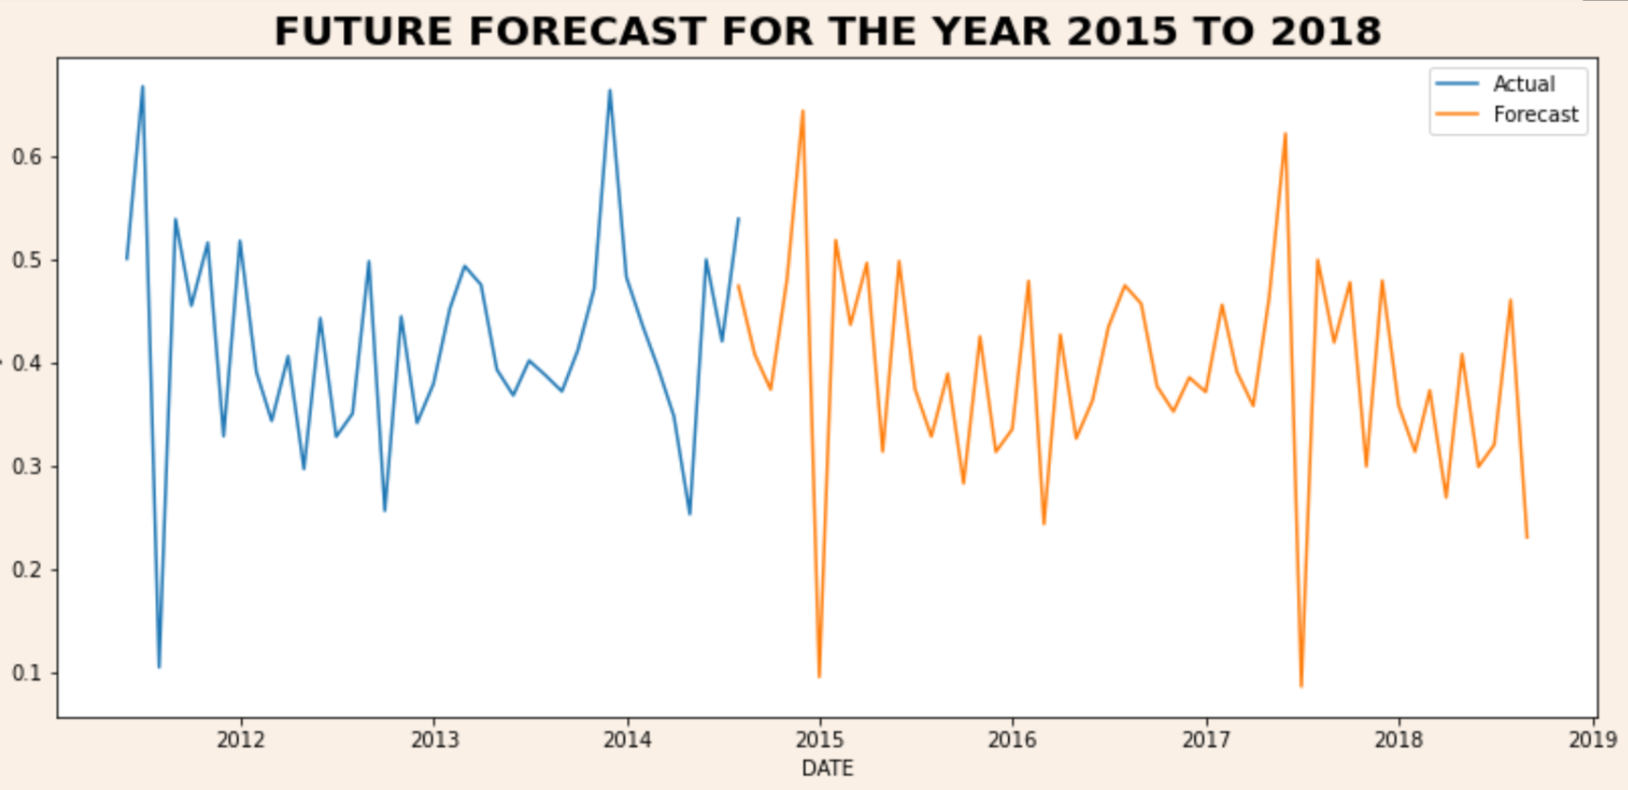
Home and Kitchen-Forecasting Sentiments
Most Popular Subcategory: Artwork
Product : Doctor Who - TV Show Poster (Van Gogh's Exploding Tardis) (Size: 36 x 24) Poster Print, 36x24
Sentiment
For the Doctor Who TV Poster, the time series graph reflects high fluctuations in sentiments from 2011 to 2015.
According to our forecasted data, the sentiments will remain positive, but may face a few dips in popularity in the future years.

Slide 14
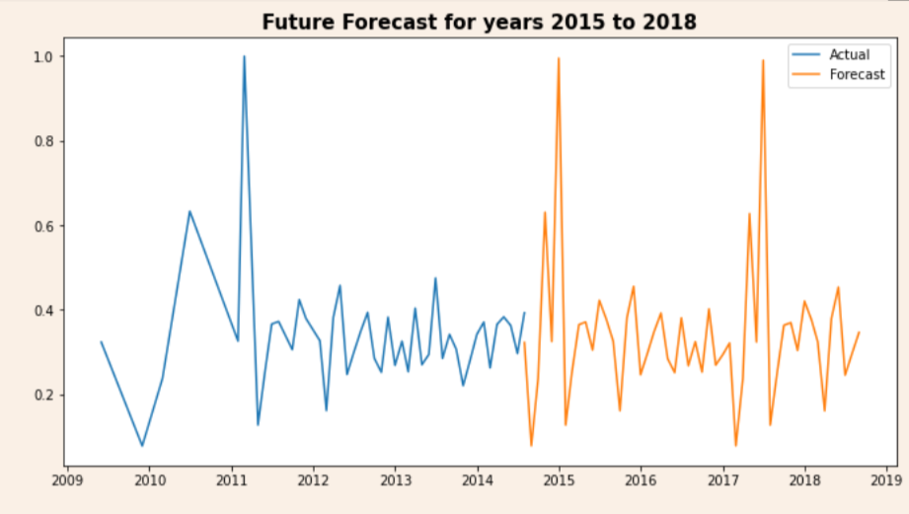
Musical Instruments-Forecasting Sentiments
Most Popular Subcategory: String Instruments
Product: Kala KA-15S Mahogany Soprano Ukulele
Sentiment
Comparitively, the sentiments for this subcategory fluctuate lesser, and vary between highly positive to nearly neutral, throughout the years .
Our forecasted data portrays that the fluctuations remain consistent with an positive customer sentiment, and may experience spikes in popularity during some future periods.

Slide 15
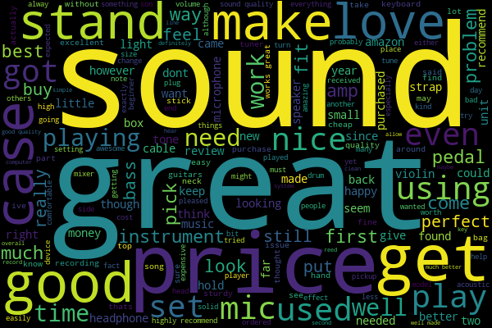
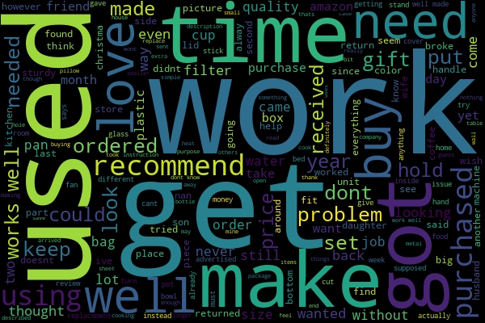
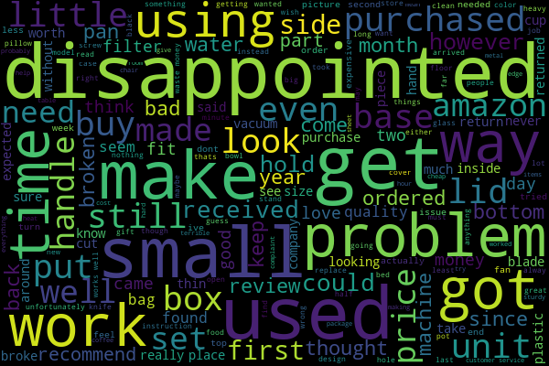
SENTIMENT - EXPLORATORY DATA ANALYSIS
POSITIVE
REVIEWS
NEUTRAL
REVIEWS
NEGATIVE
REVIEWS

Slide 16
Logistic Regression - Suggested Model
Fast
&
Efficient
Easily Handles Large Datasets
High Accuracy
(93.5%)
Easily Generalized to Multiple Classes

Slide 17
Logistic Regression - Business Solutions
REVIEW
SELECTED MODEL
PREDICTED SENTIMENT
“Quality is not good, very small size”
Logistic Regression
Negative Sentiment
Suggested Solutions based on Above Review
1. Brand Reputation
Brands can improve their image by upgrade product features such as size and quality.
2. Identify Product Issues
Successful brands can gain customer loyalty by maintaining proper quality of products with regular quality checks
3. Competitors Intelligence
Keep track of popular products of competitors’ and modify underperforming strategies accordingly.

Slide 18
Challenges faced in Sentiment Analysis
1. Different sentence length & complexity
2. Overfitting
Machine learning algorithms often face issues of overfitting implying that the model fits the train data well, but does not generalise well for unseen data - especially while dealing with textual data.
At times, models cannot handle large text inputs well- this leads to incorrect sentiment predictions.
Our approach: We have trained our model with data containing reviews that vary in length. After rigorous testing, we can confirm that our model works with large reviews as well.
Our approach: We performed hyperparameter tuning for our best performing model and balanced the sentiment classes as well.
3. Punctuation & Special Characters
If proper text cleaning is not performed, punctuations and special characters may cause lead to incorrect sentiment analysis.
Our approach: We applied regular expression techniques to avoid these complications.

Slide 19
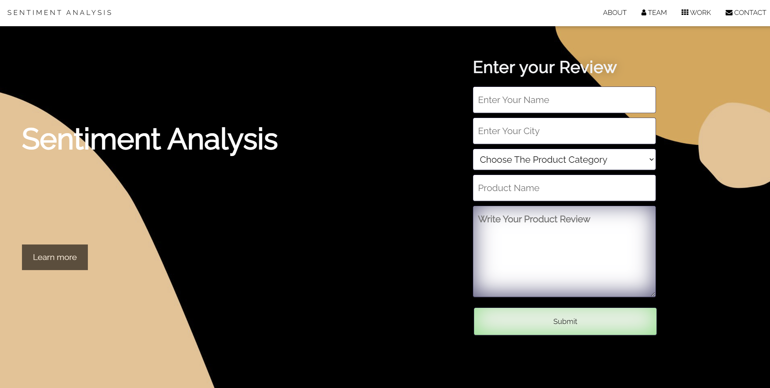
User Interface of Our Deployed Project

Slide 20
Business Insights
Strengths of Our Deployed Model
Our application can handle real-time review data as well as store the user data in a database.
Amazon sellers can segregates customer reviews (positive,negative,neutral) based on various parameters such as product category, product name, city, reviewer name, etc.
Use-cases for deploying a real-time approach to sentiment analysis
Better customer segmentation: Marketing departments can use the data to adjust their campaigns to specific customer segments.
Support Services: Customer service departments can resolve issues for dissatisfied customers immediately, thus preventing customer churn.
Inventory Management: Sentiment on a product is a useful indicator of product demand in various locations as companies can adjust stock levels in warehouses to avoid excess inventory or stock outs in specific regions.

Slide 21
Thanks!

