Slide 1
FURNITURE
SALES FORCASTING
Project by Viha Sharma
DSFT-8

Slide 2
PROJECT TIMELINE
BUSINESS
PROBLEM
DATA
EXPLORATION
TIME SERIES
MODELS
Project Brief
Project Objective
Project Goals
In-depth analysis of dataset features
Highlighting Time Series models used to tackle the problem
2
4
6
1
3
5
SOLUTION
AGENDA
DATA
INSIGHTS
BUSINESS
INSIGHTS
Performing data cleaning and preprocessing steps for time series analysis
Key inferences derived from project for end-user
Outlining the stages undertaken in this project

Slide 3
PROJECT OVERVIEW
PROJECT
STATEMENT
PROJECT
GOAL
Every business owner’s objective is to estimate the future trends – in terms of sales, profits, gains etc. The idea behind this is to find out the popularity of a certain product and how its sales can impact the business.
Every product category is unique and cater to different customer base. A thorough insight into the past performance will reveal a lot of components that will enable the business to identify the trends.
PROJECT
GOALS
Build a forecast model to predict the furniture sales of a certain store
Helps attain revenue efficiency
Understanding likely behavior of most valuable customers
Enable continuous strategic planning to reduce failure in todays fast pace market.
Efficiently manage risk, allocate resources and determine long-term financing plans.

Slide 4






SOLUTION AGENDA
EXPLORATORY DATA ANALYSIS
DATA PREPROCESSING
ANALYSING TIME SERIES COMPONENTS
CHECKING DATA STATIONARITY
MODEL BUILDING & COMPARISON
BUSINESS CONCLUSION
Dataset Overview
Generating a Profile Report
Determining correlation of features - pairplot and heatmap
Performing Univariate analysis
Checking data skewness
Building the following time series ML models:
UNIVARIATE
ARMA/ARIMA
SARIMA
MULTIVARIATE
SARIMAX
Determining if the data has:
Trend: Long-term increase or decrease in the data
Seasonality: Data experiences recurring and predictable changes each year
Irregularity: Residual time series after remove the above 2 components
Selecting relevant columns for Univariate Time Series Analysis
Missing Value Treatment
Treating Row repetitions
Setting Order Date as column index
Performing resampling (weekly and monthly)
Initial Visualizations
Checking if mean and variance vary with time using AD Fuller test, and applying differencing method if data is not stationary.
Providing insights for the client, based on time series analysis

Slide 5

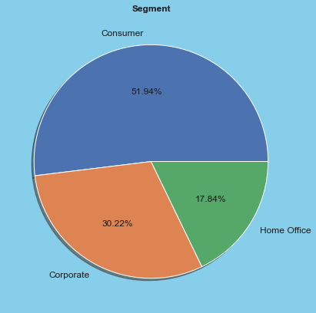
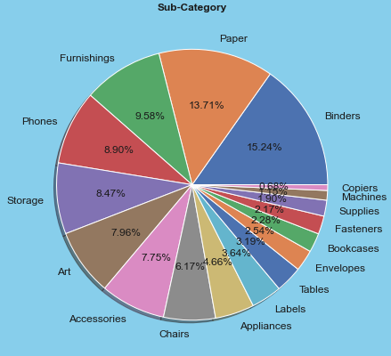
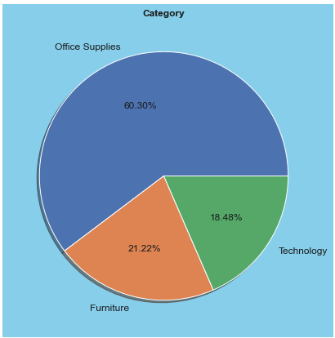
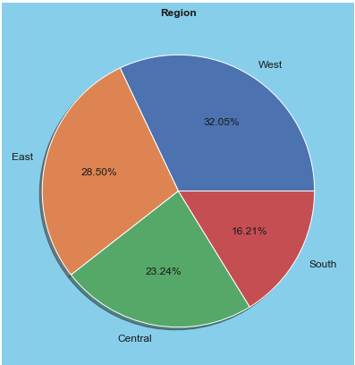
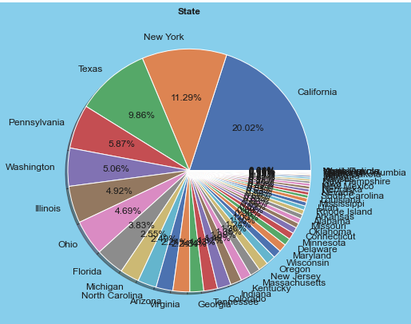
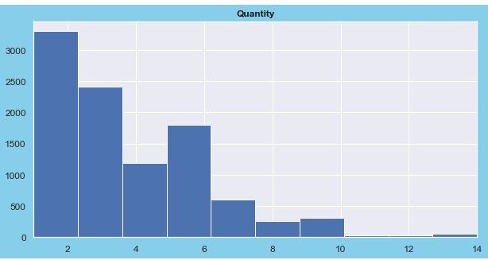
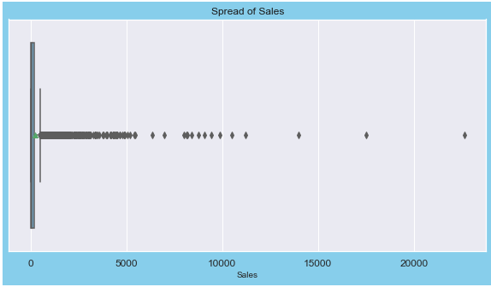
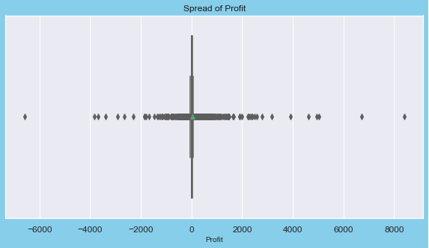
EXPLORATORY DATA ANALYSIS
Records
9994
21
Features
6 numerical
2 datetime
13 non-numerical
Key insights
1. There are many outliers in profit, quantity, discount and sales.
2. Binders have the largest proportion in the sub-category feature
3. Office-Supplies is the most common category in our dataset
4. The company only deals in USA with the highest number of orders coming from California.
5. The consumer segment has the highest demand
Business Model
Time Series Analysis Model

Slide 6
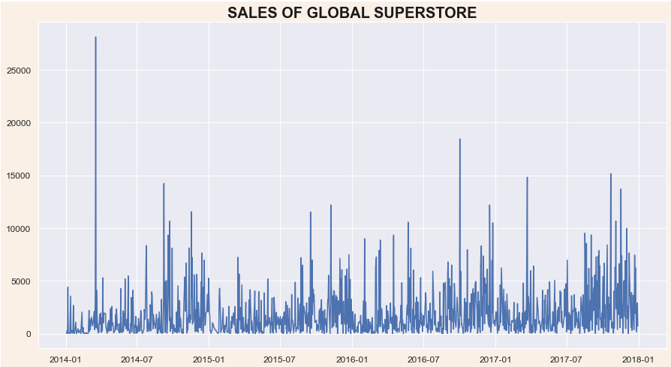
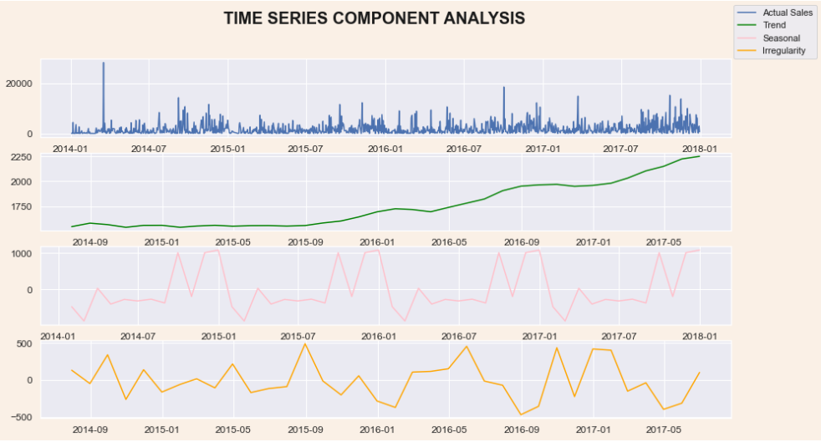
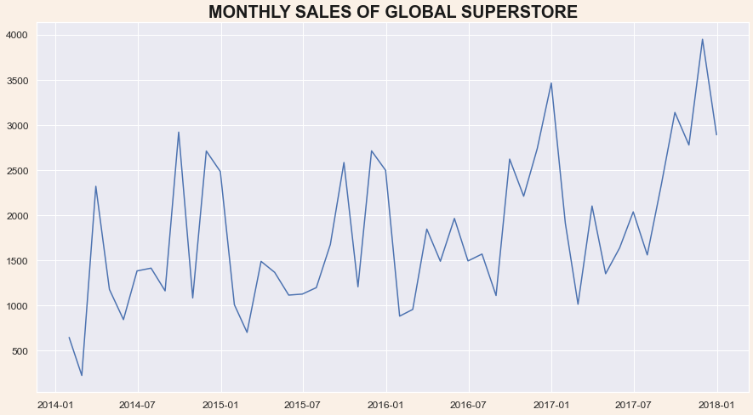
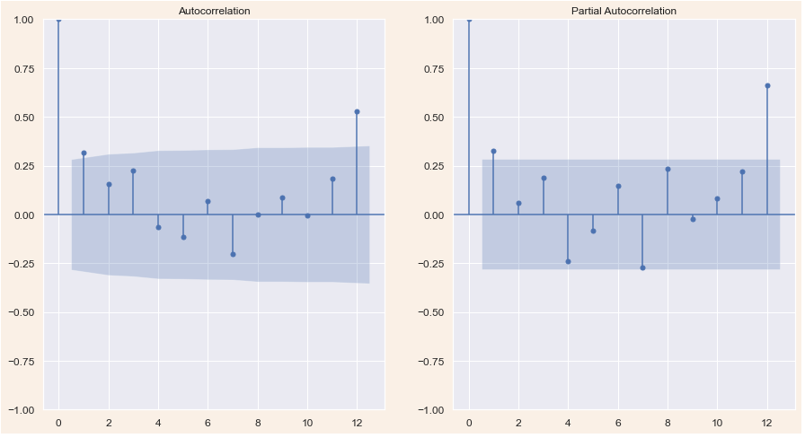
DATA INSIGHTS
RESAMPLING DATA TO MONTHLY
Time Series Components
1 .There is a positive trend in our data
2. Seasonality exists in our data
Correlogram Plot
Lags =12, as we consider monthly resampled data.
From the PACF and ACF graphs we can conclude the following:
AR(p) = [0,2]
MA(q) = [0,3]
Start Date
2014-01-03
End Date
2017-12-30

Slide 7
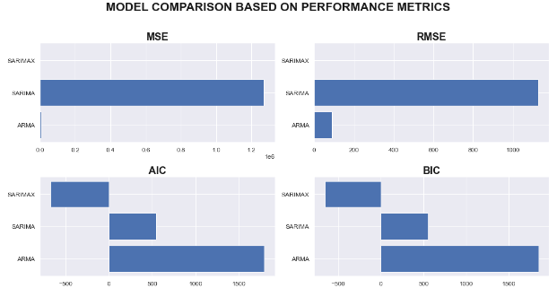
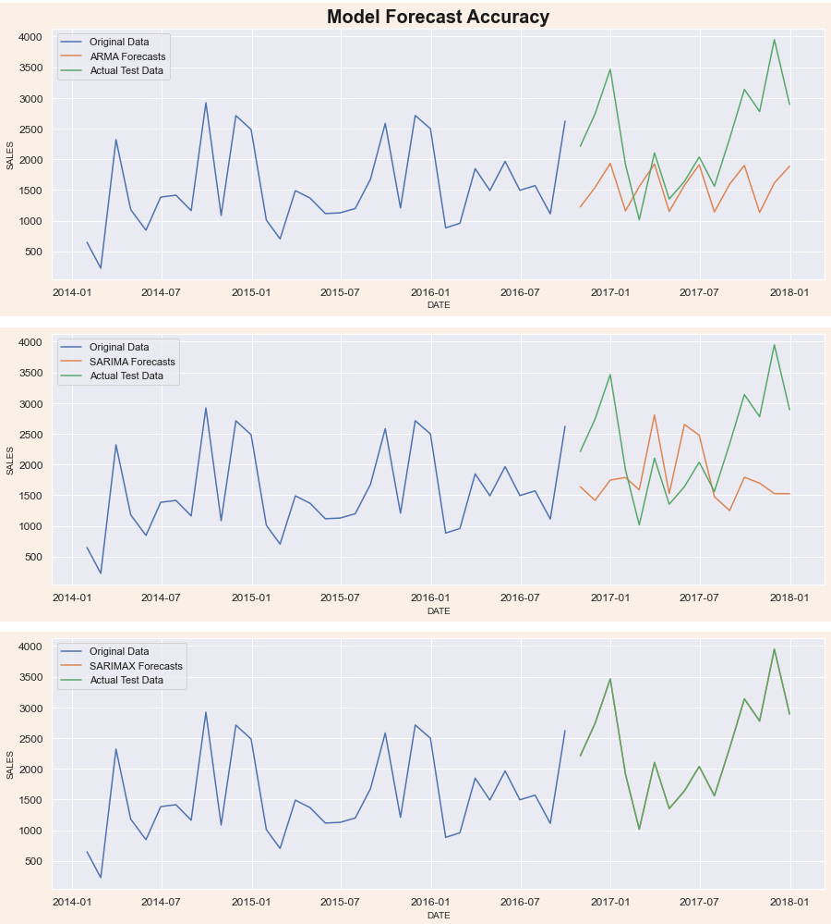
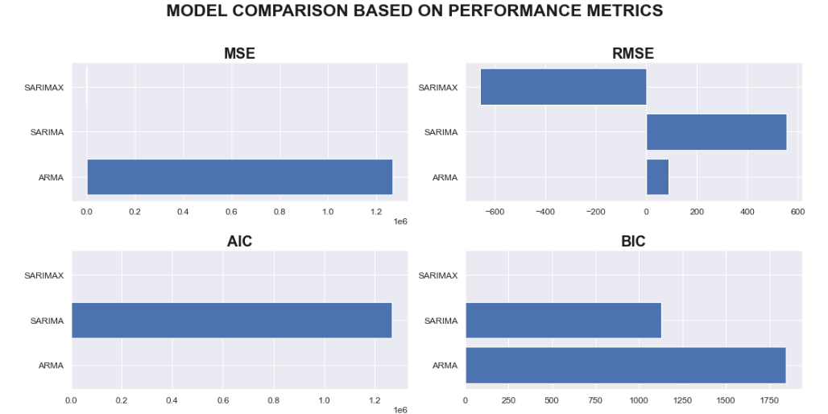
TIME SERIES MODEL EVALUATION
UNIVARIATE
As the model is stationary, we eliminate the ARIMA model from our evaluation.
ARMA model does not do justice to our actual data as its forcast fails to capture the trend or seasonality of our data.
SARIMA model is an improvement over the ARMA as it accurately captures the seasonality component, yet it cannot capture trend.
SARIMAX model captures the trend and seasonality of our time series data very well.
In conclusion, the SARIMAX model is the optimal model that can be used by the client to predict their future sales.
MULTIVARIATE

Slide 8
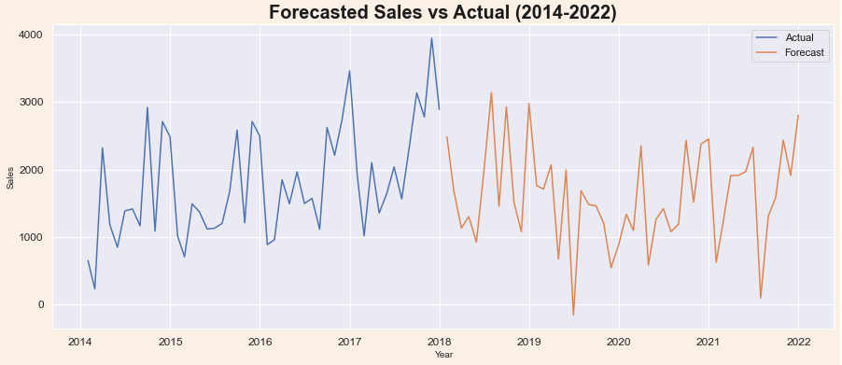
BUSINESS CONCLUSION
Apr-Jun
1
My model’s sales forecast implies that the furniture company will face dips and rises throughout the next 4 years. The marketing must place highest attention in mid-2019 as the forecasts suggest the greatest fall in sales during this period.
3
The furniture company can drive higher sales in the winter by providing customers with offers and discounts on the highest demand categories (office-supplies)
2
There is a seasonality in our dataset that shows that a low sales period will usually follow a higher sales period in a repeated fashion. The start and end of years seem to be the highest sale generating times of a year.
The furniture company can maximize their sales during this time by providing customers with offers and discounts on the highest demand categories (office-supplies)
4
The furniture company should focus on increasing the quantity they sell, as my study shows higher sales are made when higher quantities are sold. This should be implemented after ensuring proper inventory management and stock control methods are in place.

Slide 9

THANK YOU
Have more questions?
Reach out to me:
vihasharma1099@gmail.com
Linkedin | Medium

