Slide 1

Marketing Campaign Analysis
Team Members:
Aditi Pala
Viha Mashruwala
Yash Karkhanis
Yashaswini Kulkarni
Team Members:
Aditi Pala
Viha Mashruwala
Yash Karkhanis
Yashaswini Kulkarni

Slide 2
Objective
Business Use Case
In retail chain wants to offer Gold Membership to its customers. Gold Membership offers 20% discount on products for an annual fee. They are planning to launch a marketing campaign to advertise the same and would like to use data of the previous marketing campaign to enhance efficiency of this marketing campaign
The main objective of the project is to create a predictive model to identify the customers, that are likely to respond positively to the marketing campaigns, based on the past campaign data, which will help in enhancing the campaign efficiency.
Identify which customer demographic and behavioral factors influence the likelihood of a customer’s positive response. This insight will help in tailoring the marketing strategies and campaigns toward the customer segments most likely to convert to subscription services.

Slide 3
Understanding Our Customers: A Look at the Data
This dataset contains 2240 rows and 22 columns of information about each customer.
Demographics:
Year_Birth: Age of the customer
Education: Customer's level of education
Marital: Customer's marital status
Kidhome : Number of small children in customer's household
Teenhome Number of teenagers in customer's household
Family Dynamics:
ID: Unique identifier for each customer
Dt_Customer: Date of customer's enrollment with the company
Complain: Did the customer complain in the last 2 years?
Response: Did the customer respond positively to the last campaign? (1 for yes, 0 for no)
Income:
Income : Customer's yearly household income
Website Engagement:
NumWebVisitsMonth: Number of visits to the company's website in the last month
Recency:
Recency: Number of days since the last purchase
Spending Habits:
MntFishProducts: Amount spent on fish products in the past two years
MntMeatProducts: Amount spent on meat products in the past two years
MntFruits: Amount spent on fruits products in the past two years
MntSweetProducts: Amount spent on sweet products in the past two years
MntWines: Amount spent on wine products in the past two years
MntGoldProds: Amount spent on gold products in the past two years
Purchase Behaviour:
NumDealsPurchases: Number of purchases made with a discount
NumCatalogPurchases: Number of purchases made using a catalog
NumStorePurchases: Number of purchases made directly in stores
NumWebPurchases: Number of purchases made through the company's website
Data set sourced from Kaggle : https://www.kaggle.com/datasets/ahsan81/superstore-marketing-campaign-dataset/data

Slide 4
Data Preprocessing: Preparing Data for Analysis
Date Format Conversion: Ensured all dates present are in standardized format
Handling Missing Values:
Found 24 missing values in the "Income" column
Imputed missing “Income” values using the median for each education level
Categorical Variables Exploration:
Explored "Marital Status" and "Education Level" categories.
Cleaning Marital Status Categories:
Dropped irrelevant categories: "YOLO" and "Absurd" (4 rows).
Merged "Alone" with "Single."
Calculating Age and Membership Duration:
Derived customer age and years of membership by subtracting birth and enrollment dates from the assumed data collection year (2015).
Notes:
Explain – missing for graduate – then imputed median for grad category

Slide 5
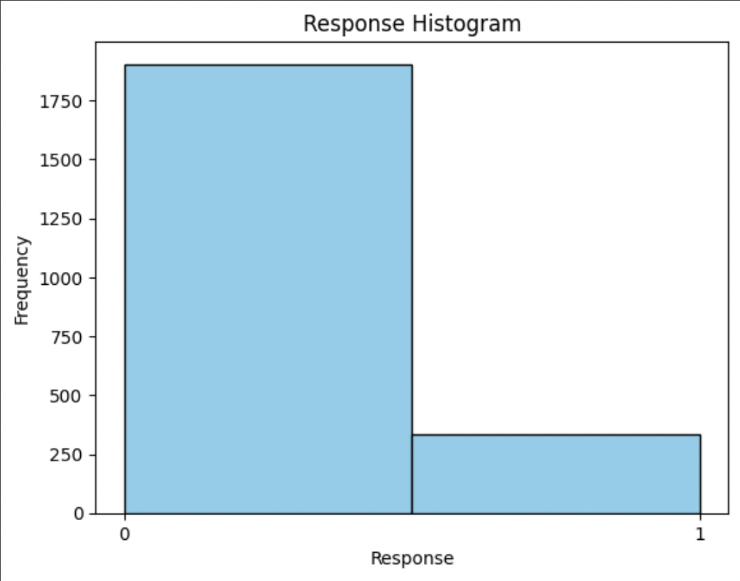
EDA - Distribution of response variable

Slide 6
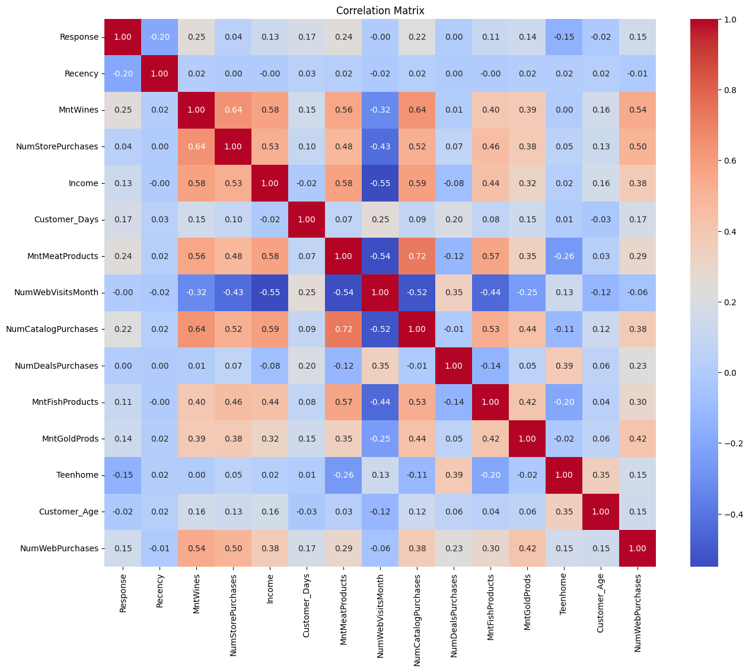
EDA - Correlation Matrix

Slide 7
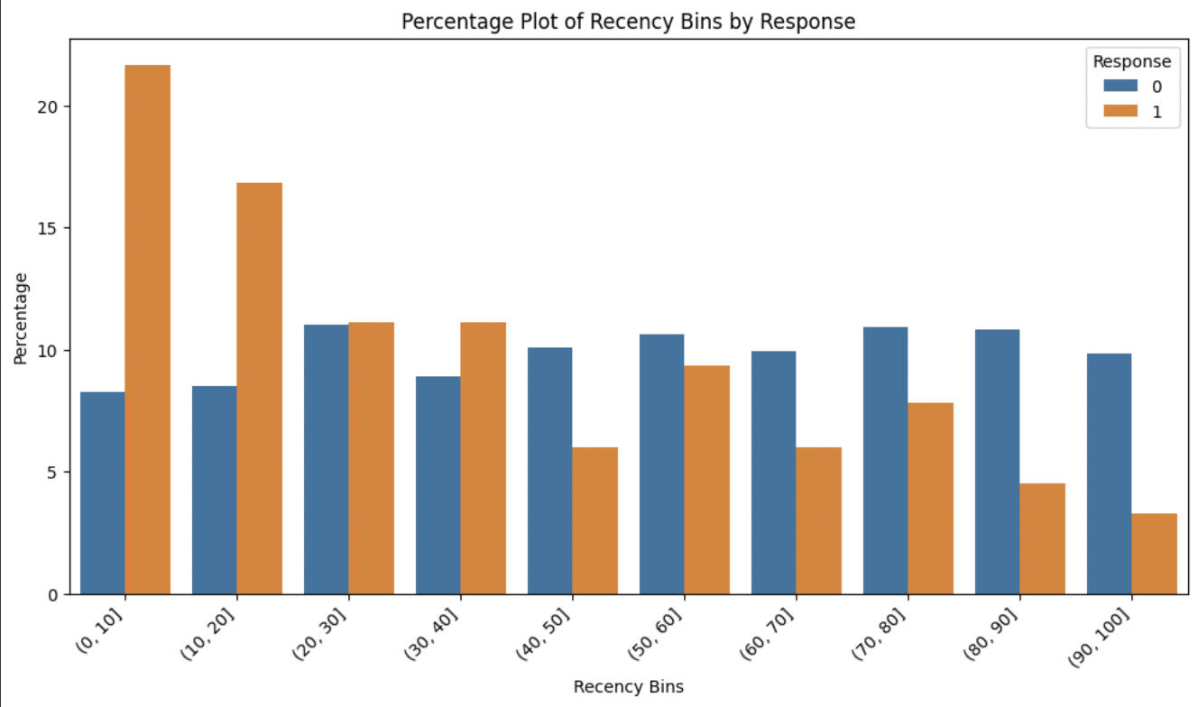
EDA – Percentage plot of Recency by Response
Notes:
This is recency – 0 to 10 since last visit – 1 is high – # response 0 doesn’t change too much - # ppl in resonse 1 changes – as recencry inc change of respoinse decrease

Slide 8
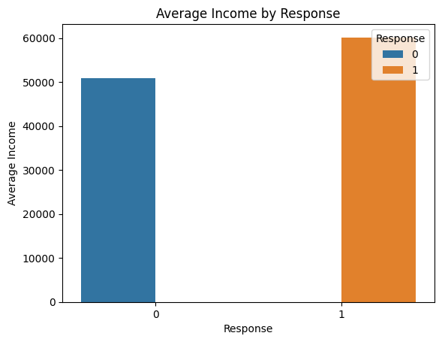
EDA – Average Income by Response
Notes:
Confirmed by income

Slide 9
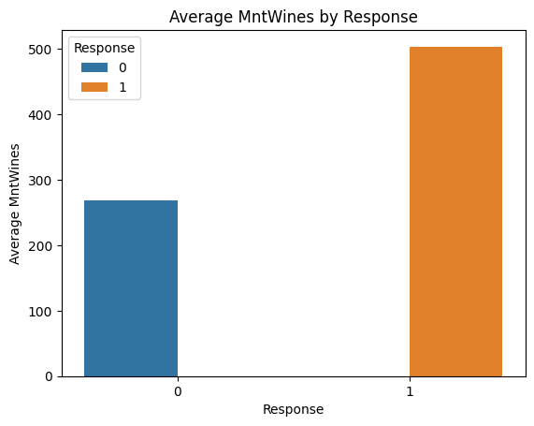
EDA – Average Amount spent on wines by Response
Notes:
Vast diff

Slide 10
Feature Engineering
One hot encoding on categorical variables [Education, marital status]
Train test Split :
80-20 train test split
Stratified sampling to maintain target variable proportions in train & test data
Scaling: Standard scaler to standardize the values
Notes:
Wheb we do train test split, the sybsets should themselves have proper distribution of 0’s and 1’s that’s why we do stratified samplong

Slide 11
Models
Use same train test split across all models to ensure we get comparative results
Using AUC as a metric for evaluating model performance
Recall of Response=1 must be high:
Since we are targeting customers who we think will buy the gold membership, we would rather target a few customers who are not likely to buy the gold membership than not reach out to people who are interested in it.

Slide 12
Regular Classification
Logistic Regression
No regularization
AUC score : 63.32
2. GBT
three-fold cross validation with AUC as metric to tune two hyper parameters – max depth and step size.
Best AUC of 65.89 with max depth = 5, and step size = 0.3.

Slide 13
Weighted Classification – Class Weights
Models are performing poorly on the imbalanced dataset. Hence we used weighted classification to help improve accuracy
Since the class distribution is 85% response = 0, and 15% response = 1, we ideally assign class weights to balance them, hence 0.85 to response = 1 and, 0.15 to response = 0
As mentioned before, the recall of class response =1 is important for our use case, hence we slightly increase the importance of response =1 by assigning the below weights – response 1=0.9 and response 0= 0.1

Slide 14
Weighted Classification- Models
Weighted Logistic Regression
Same model with class weights = {0 : 0.1, 1 : 0.9}
AUC score : 75.15
Recall of response = 1 is 83%
2. Weighted GBT
Same procedure as before with the class weights = {0 : 0.1, 1 : 0.9}
Best AUC of 77.06 with max depth = 5, and step size = 0.3.
Recall of response = 1 is 83%

Slide 15
Model Results
Model | AUC | Recall of response =1
Logistic Regression | 63.32 | 30%
Gradient Boost Tree | 65.89 | 38%
Weighted Logistic Regression | 75.15 | 83%
Weighted Gradient Boost Tree | 77.06 | 83%
Our use case is to rank customers based on their probability of responding positively to the gold membership campaign. Hence an AUC score of 77 and recall of response =1 value of 83% is sufficient

Slide 16
Sample Prediction
Customer_ID | Accept_Prob
1162 | 0.971500326
6215 | 0.948906081
5329 | 0.93108072
4096 | 0.917169054
7505 | 0.897373815
6983 | 0.877917117
2457 | 0.861664188
7224 | 0.837589703
2428 | 0.82888789
11112 | 0.818803146
3436 | 0.795263808
4286 | 0.792598967
10643 | 0.753116142
1802 | 0.740926854
2114 | 0.739952295
968 | 0.702537685
3153 | 0.693555913
6504 | 0.68901981
2495 | 0.685534838
4261 | 0.684386919

Slide 17
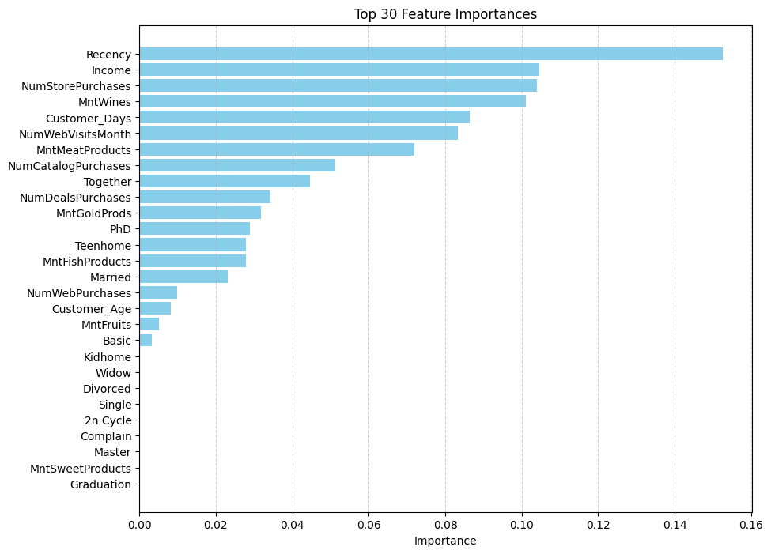
Feature Importance
Notes:
What recency is ? Why is it more important ? Income example

Slide 18
Key Insights
Customers who spend more on alcohol and meat products are more likely to buy the gold membership
Customers who visit the store are more likely to purchase gold membership than those who use other buying options
Notes:
Using this insight, the marketing campaign can be more enticing
The savings from Customers who visit the store are more likely to purchase gold membership than those who use other buying options
-

