Slide 1
Choosing How to Run Graph Algorithms
Sequential, OpenMP, MPI and CUDA baselines, and a lightweight execution selector
[team names] | [course] | November 2026

Slide 2
Why this problem
• Graph kernels run on laptops, clusters and GPUs, and the fastest choice changes with the graph and the machine
• Parallelism has fixed costs: loading, preprocessing, copies to the GPU, messages between processes
• Question 1: when does each execution model pay off, and where does the time go?
• Question 2: can a cheap model choose for us, with its own overhead counted, on graphs it has not seen?
Notes:
Set up the two questions. Stress that parallelism has fixed costs.

Slide 3
The pipeline
Graph file
(edge list / .mtx)
Convert
to CSR
Machine profile
+ graph features
Selection
policy
Run chosen
option
Result, metrics,
trace
Sweep: every option
on every graph
Dataset: features
+ decision costs
Train: tree, kNN,
size rule
offline, once per machine
Options: sequential, OpenMP, MPI, CUDA (CUDA only when a GPU is present). Decision cost = end-to-end minus load and preprocess.
Notes:
Top row is one query. Bottom row is the offline stage run once per machine. The machine profile removes CUDA when there is no GPU.

Slide 4
What we built and measured
Kernel | Method (all models) | MPI differs
BFS | Level-synchronous frontier | -
PageRank | Pull over transposed CSR | -
Connected comp. | Union-find | Label propagation
SSSP | Frontier label-correcting | -
Triangles | Sorted-list merge intersection | Graph replicated
• 34 graphs: 2 real (Facebook, web-Google), 32 synthetic (uniform, R-MAT, small-world, grid)
• Machines: Apple Silicon Mac (8 cores) and Windows/WSL2 laptop with RTX 5090
• One warm-up, three trials, medians; every run validated by an independent checker
Notes:
Same algorithm in every model except MPI connected components. Vanilla means untuned on purpose.

Slide 5
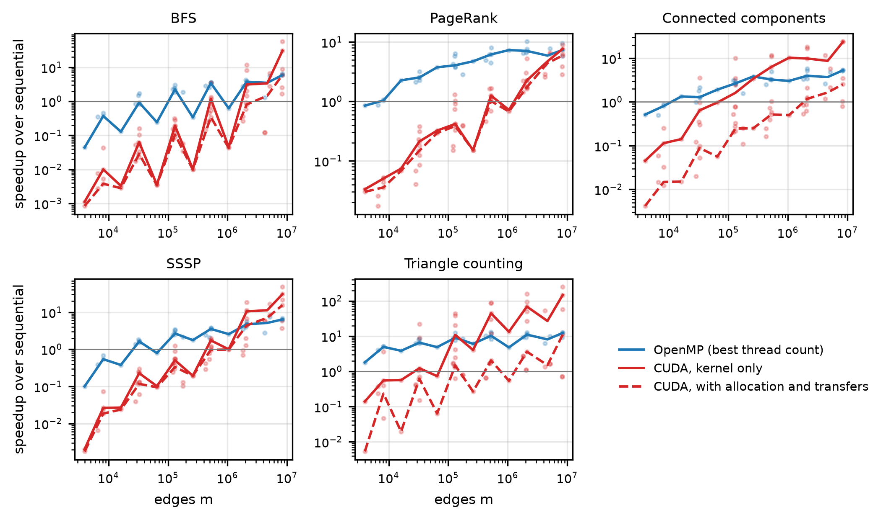
Parallel pays off above a size threshold
• Small graphs: parallel overhead dominates
• CC, PageRank, TC: parallel wins from a few thousand vertices
• BFS, SSSP: sequential still fastest on many graphs
• GPU gains shrink when transfers are counted (dashed)
Notes:
CC, PageRank and TC: sequential wins only at a few thousand vertices. BFS and SSSP keep sequential competitive on 11-14 of 34 graphs on some machines.

Slide 6
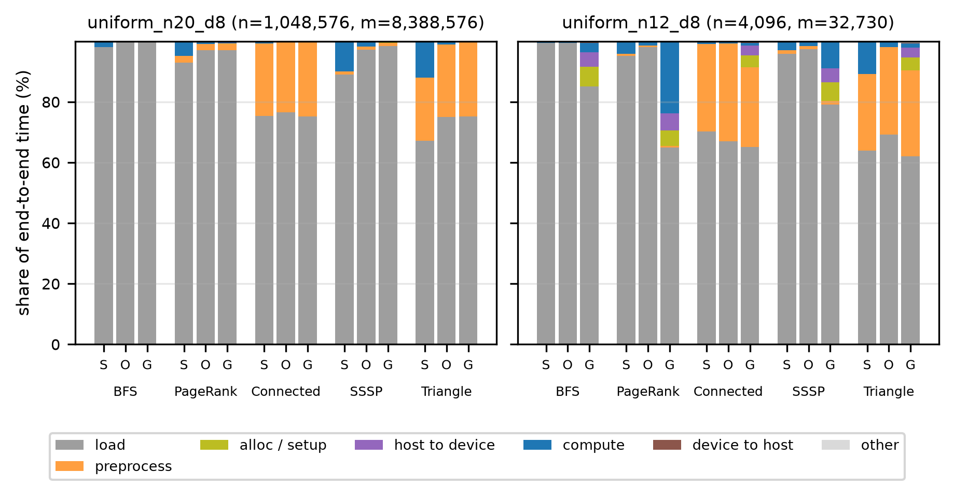
Where the time goes
S = sequential, O = OpenMP, G = CUDA. On the Mac, parsing web-Google took about 1.6 s and symmetrizing about 0.7 s; a BFS needs tens of milliseconds.
Notes:
Loading and preprocessing are identical for every option, so they dilute framework differences.

Slide 7
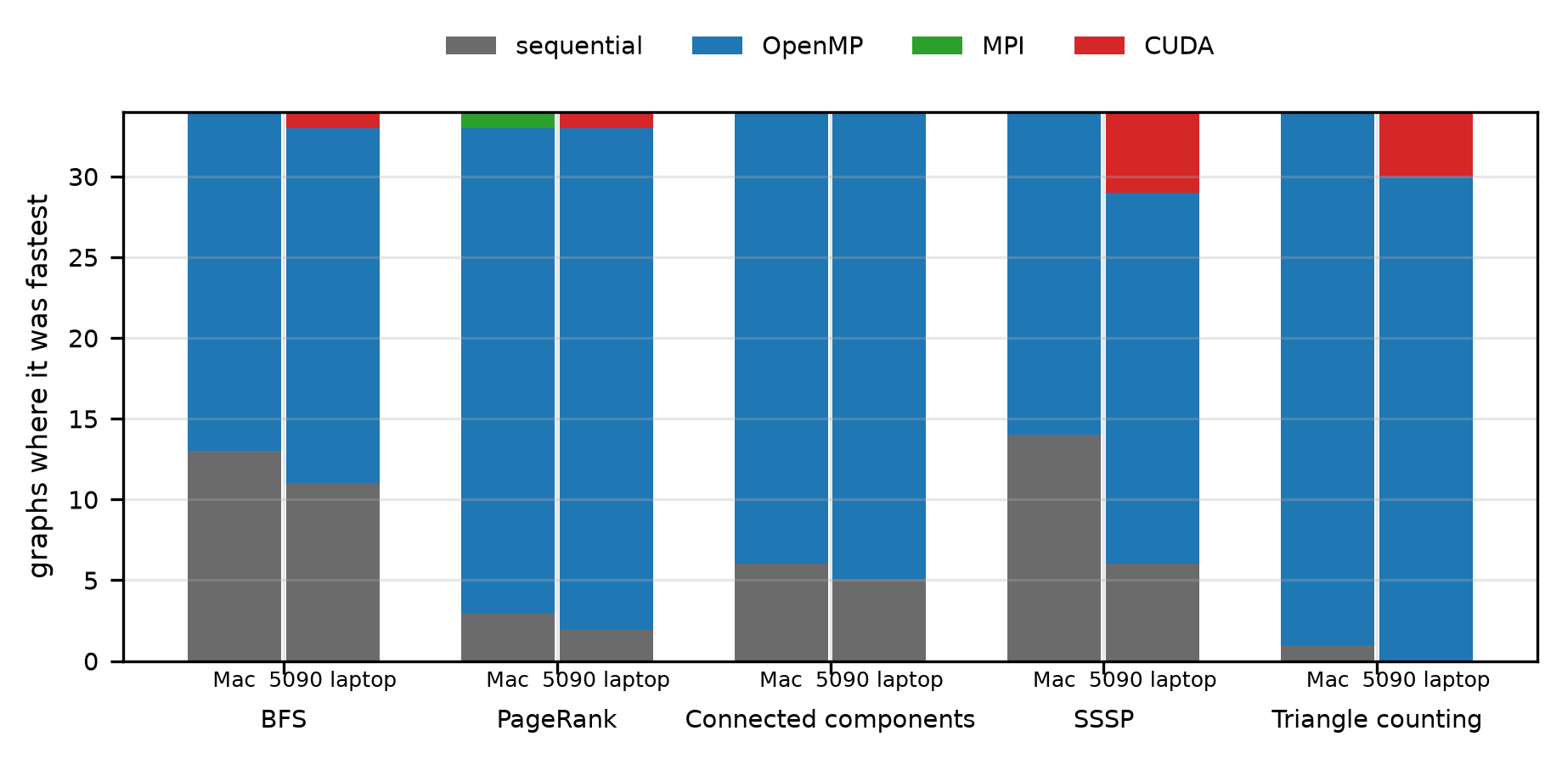
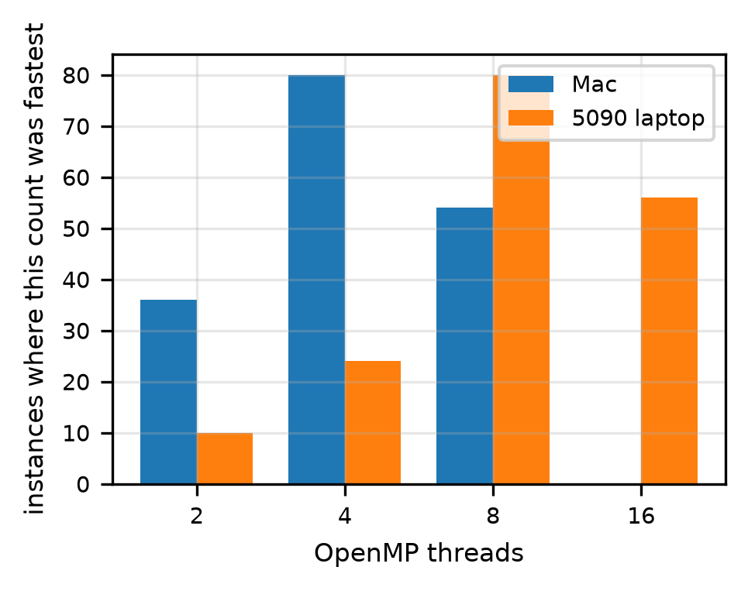
Machines differ
• OpenMP is fastest on most instances on both machines
• Single-node MPI pays for distributing the graph and gains nothing from separate memories
• Best thread count: Mac 4 (47%), laptop 8 (47%) or 16 (33%); sweeps end at 8 and 16
Notes:
Best OpenMP count: Mac mostly 4, laptop mostly 8 or 16. Sweeps stop at 8 and 16 threads. MPI won 1 of 170 instances on the Mac.

Slide 8
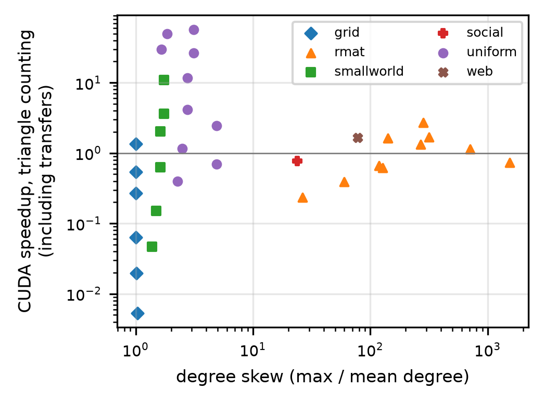
When the GPU helps, and when it does not
• GPU fastest on 11 of 170 instances, all large graphs (SSSP 5, triangles 4, BFS 1, PageRank 1)
• Triangle counting, R-MAT graph: sequential 10.2 s, OpenMP x16 1.10 s, CUDA 14.3 s
• Every graph with skew of 24 or more stayed at or below 2.7x; up to 57x on low-skew graphs
• Likely load imbalance from hub vertices (to be profiled)
Notes:
Vanilla kernel is one thread per vertex. The skew explanation is a hypothesis, not profiled.

Slide 9
The selector: design
• Instance = graph + kernel on a machine; choose among sequential, OpenMP, MPI, CUDA with worker counts
• Target: log speedup over sequential for every option; pick the largest; stay sequential if under 1.05x
• Six cheap features: size, mean degree, degree skew, out-degree variation, dangling fraction, symmetry
• Policies: size rule, kNN, decision tree (compared with always-sequential and best fixed choice)
• Why these two models: ~34 graphs per kernel, inference time is charged, and tree rules are readable
Notes:
Six O(n) features. One model per machine. Tree exported as JSON. First version used O(m) features and cost 53-58% overhead.

Slide 10
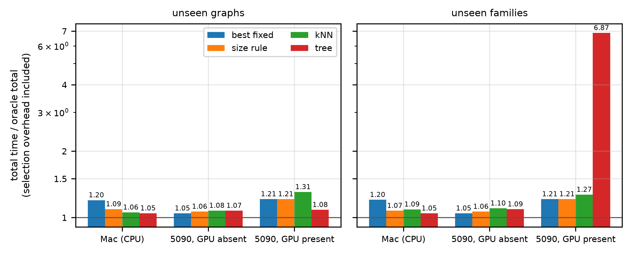
Selector results (selection overhead included)
• Unseen graphs: tree within 5-8% of the oracle
• About 12% (Mac) and 11% (GPU) less time than the best fixed choice
• No gain on the laptop CPU alone
• Unseen family: 6.87x oracle with the GPU (R-MAT triangle counting)
Total time / oracle total; 1.00 is perfect. Unseen graphs: Mac 1.05 vs best fixed 1.20; laptop with GPU 1.08 vs 1.21; laptop without GPU 1.07 vs 1.05.
Notes:
Lead with unseen graphs. Show the unseen-family failure honestly. On the laptop CPU alone a fixed choice is as good.

Slide 11
Guardrails and tools
• No GPU: CUDA is excluded from options, training and oracle; a CPU-only tree is used; tables list CUDA as excluded
• Out-of-range notice: fires on 56% of held-out-family instances, so it is a coverage notice, not a detector
• Command line: ingest, convert, profile, features, decide, run, trace
• Web page: upload a graph, pick a kernel, see the choice and the metrics
• Replay mode: GPU decisions from recorded 5090 data, clearly labelled
Notes:
Replay must be labelled as a replay. The warning was added after the failure and does not separate bad from good picks.

Slide 12
Limits and next steps
• One machine per scenario; WSL2 on the laptop; three trials
• MPI single-node and measured on the Mac only (the laptop MPI sweep aborted)
• Vanilla CUDA kernels; 32 of 34 graphs from four generators
• Design choices were made on the same graphs used for evaluation
• Next: profile and rebalance CUDA triangle counting, add structure features, more graphs and machines, mid-run switching
Notes:
Be explicit that the selector breaks outside the structures it was trained on.

