Slide 1
Swara

Slide 2

PROBLEM STATEMENT
“There is no accurate way to keep a track record of a
singer’s performance and his improvement over time.”
The context of the problem is that the singer may commit multiple
human errors while keeping track of his sessions and comparing
his singing.
The problem which is mentioned above is faced by every singer as the judgement made by humans is not so accurate and may be biased. But the feedback provided by our system is more accurate and precise since it is driven by facts and figures, and hence gives the real difference.
To overcome this, the approach we have came up with is that – “We are gonna take user input in form of a wav file and give him the option to compare the pitch of this wav file with any other wav file.”
Through this the user can keep track of his singing accurately and he can also compare the song which he is trying to imitate with the “Actual” song.

Slide 3
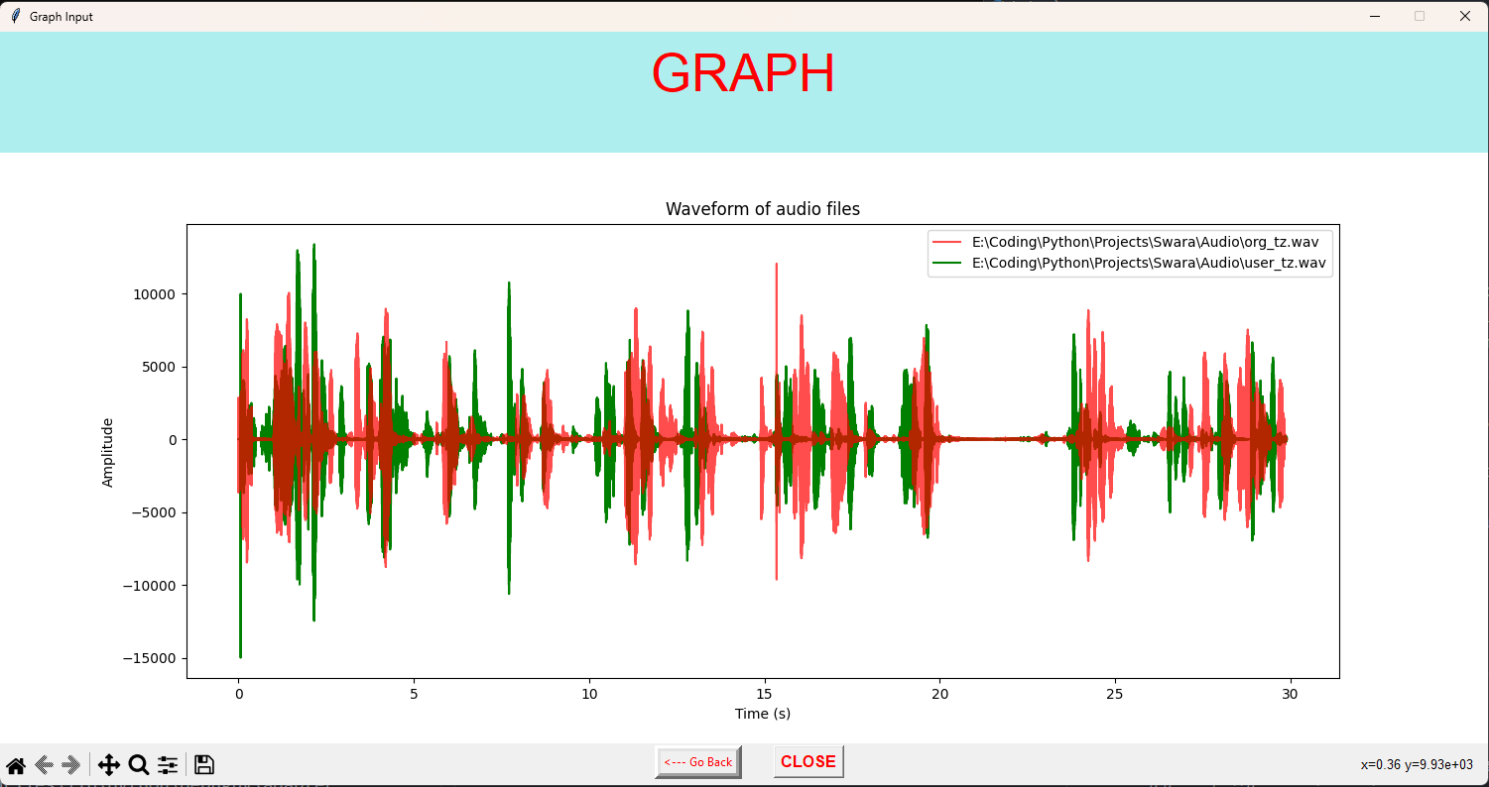
PROJECT DESCRIPTION
Helping Singers to Improve their performance and pitch.
Aim of this project is to help Singers to improve their performance by giving them appropriate feedback.
We will be comparing the singer’s voice to the original song’s audio and show how much improvement is required.
Firstly we will take the specimen audio (which user want to
compare),and then we will take the input of the original audio.
We will be plotting Graphs of both the audio on the same
axis to get the desired result.
Singer will be able to see the comparison of his performance
in percentage form i.e. how well he has performed.
By this comparison he will be able to judge his performance
and thus make him aware of his strong areas and weak ones.

Slide 4

SOLUTION PROPOSED
We want to help singers as much as possible to improve their performance.
We have delivered a user-friendly interface to the singer which can easily and
accurately trace his singing performance in a graphical/visual format to make the
judgement convenient.
If we can reach out to as many people as possible it would be surely liked and used by a large number of singers as this program provides a very convenient interface and gives accurate feedback on their progress in a visual format.
This program compares the original audio of the song with the specimen and gives back a comparison graph and performance percentage which makes it a very unique program for tracing their performance.
User can also compare his different sessions of the same song which will allow him to check his consistency and accuracy precisely.
This software would be extremely useful for people who don’t have access to studios and expensive music testing technology.
This software uniquely tackles a huge problem that is faced by music society and also by theatre artists as it helps them in practice by checking the consistency of their pitch as well as timing.

Slide 5

TECHNOLOGY USED
Data Science
MySql
VSCode
Python and its libraries.
Which includes :
Tkinter:–
We have used Tkinter to create a user-friendly interface so that any person with little or no programming skills can easily use our application and this makes our application simple and user-friendly.
Pyaudio –
We have used PyAudio for recording audio files and taking it as an input for user.
Wave –
We have used wave for processing (extracting raw data from .wav file) the various audio files provided by the user as an input.
Matplotlib –
We have used Matplotlib Library to plot superimposed graphs of the audio files provided by the user.
Numpy –
We have used Numpy for various mathematical operations and processing the raw data provided by wave library.

Slide 6
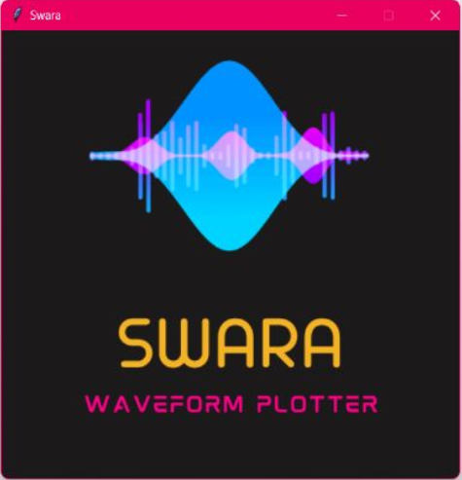
ADVANTAGE OVER EXISTING SYSTEM
It can be easily accessed by anyone unlike the expensive
services provided by the existing system.
It is more accurate and precise since it makes use of
computer logic i.e. facts and figures unlike the biases of
human ears.
It can be easily accessed, understood and utilized by
any non-programmer and hence it is user-friendly.
It is free and fun to use for singers of any age as it is
something new and unique.
If used properly it can help singers grow exponentially over time.

Slide 7
PROJECT CONSTRAINTS
Show Stoppers | Dependencies
Sometime progress generated may have errors | While recording the surrounding environment should be noise free.
Technology used may become outdated . | The audio should be in format .wav only.

Slide 8
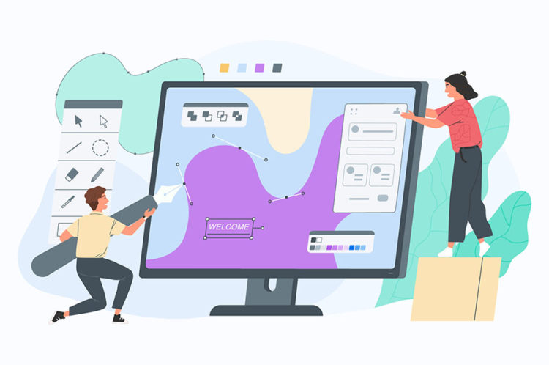
Future Enhancements
Will support mp3 , mp5 files
Will be mobile usable
Greater efficiency and performance
Track record of his previous testings
Similarity in percentage hence even more accurate
Graph of his track record to depict his/her improvement with time.

Slide 9


