Slide 1
Health Monitor
Virag Gada
Vihanga Bare

Slide 2
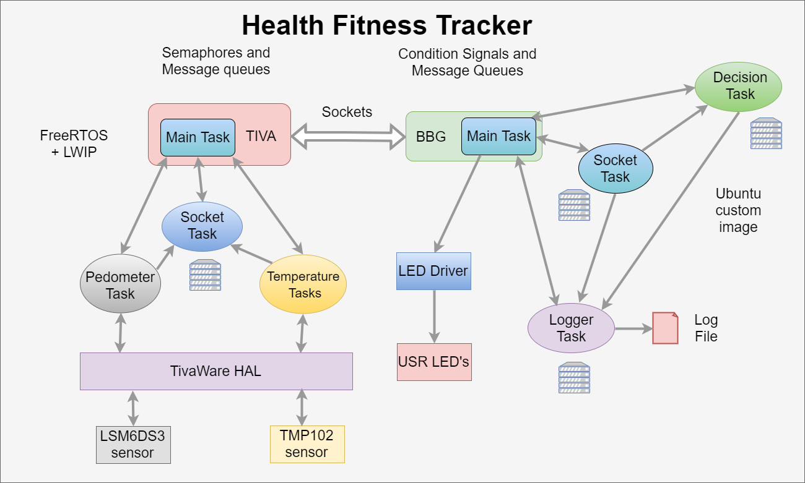
Software Architecture

Slide 3
Sensors used
LSM6DS3 Pedometer Sensor
TMP102 Temperature Sensor

Slide 4
Features Implemented
Socket Communication using LWIP sockets API
Usage of HAL libraries of FREE RTOS
Heartbeat notifications
Remote Logging
Multithreaded functionality on BBG
Error Handling

Slide 5
Testing Methods
Mock client and servers to test the sockets on BBG and TIVA side
Netcat for simulating client and server on BBG
Tests to check if the queues were initialized properly
Test to check the read-writes on the I2C sensors using ASSERTS’s on TIVA

Slide 6
Communication Interfaces
Inter process communication using Queues, Mutex and Semaphore on TIVA
Communication between BBG and TIVA using LWIP sockets API
Inter process communication using POSIX Queues, pthread mutex and pthread condition variables on BBG

Slide 7
Biggest Lesson Learnt implementation wise
Integration of FREE RTOS functionality with LWIP sockets API
Socket Communication between FREE RTOS on TIVA and BSD sockets API on BeagleBone Green
Handling priorities, task notifications, interrupt service routines and signaling in a Real time OS

Slide 8
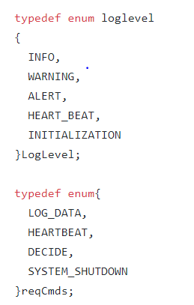
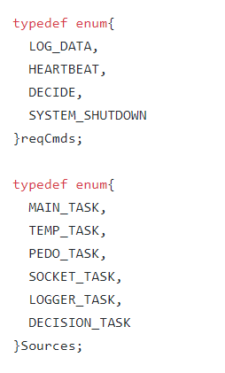
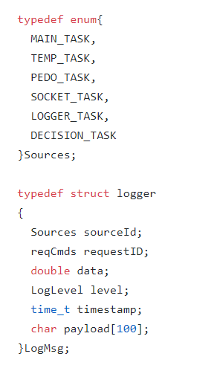
Message Structures used …

Slide 9
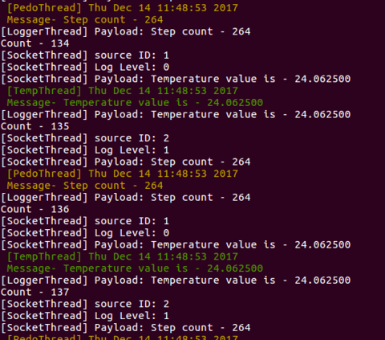
Log file implementation

Slide 10
Demo

Slide 11
Thank you

