Slide 1
Analysis of Algorithms

Slide 2
Introduction
Algorithms are evaluated based on the time and space efficiency
Runtime and memory requirement depend on
Algorithm
Size of the problem
Machine/platform
How do we isolate the influence of the latter two factors in evaluation?

Slide 3
Asymptotic Analysis
Exact CPU time or no. of bytes is not important
We consider how the running time (and memory requirement) varies with increasing the problem size.
How an algorithm scales with increased problem size?
We express this using Big-O notation.

Slide 4
Big-O Notation - O(x)
Constant time → O(constant) = O(1)
Proportional to size of the problem n → O(n)
Complexity increases quadratically with size of the problem n → O(n²)
Usually
No loop, no recursion → O(1)
loop → O(n)
K nested loops → O(n^{K})

Slide 5
Quiz
Find an item in an arbitrary array of size n.
Finding the maximum from an array of values.
Finding the sum of an array of items.
Finding the factorial of n.
Input n no. of values to an array.

Slide 6
Some Observations
O(1) = O(K) for any constant K ≠ 0
O(Kn+L) = O(n) for any two constants K ≠ 0 and L
O(polynomial) = O(degree of the polynomial)
O(n⁰) < O(log(n)) < O(n) < O(nlog(n)) < O(n²)
O(n^{k}) < O(k^{n})

Slide 7
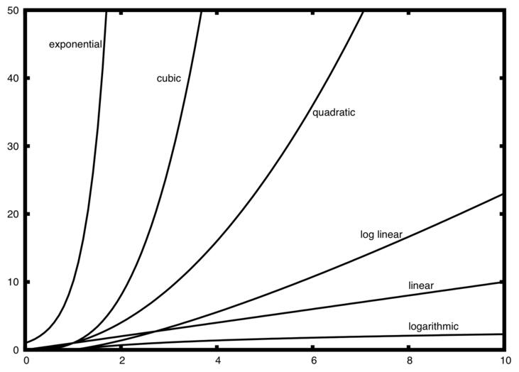
Time vs. problem size

