Slide 1
Globalization and the Digital Divide

Slide 2
Learning Objectives
Upon successful completion of this chapter, you will be able to:
Explain the concept of globalization;
Describe the role of information technology in globalization;
Identify the issues experienced by firms as they face a global economy; and
Define the digital divide and explain Nielsen’s three stages of the digital divide.

Slide 3
What Is Globalization?
Globalization refers to the integration of goods, services, and culture among the nations of the world.
We have been experiencing globalization since the days of European colonization.
Advances in telecommunication and transportation technologies accelerated globalization.
The Internet has made all nations next-door neighbors.
https://www.youtube.com/watch?v=JJ0nFD19eT8

Slide 4
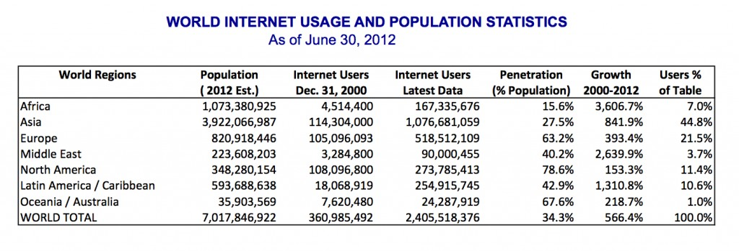
Internet usage (June 2012)

Slide 5
The Network Society
The Rise of the Network Society, 1996.
We are now into this network society, where we are all connected on a global scale.
“it is an economy with the capacity to work as a unit in real time on a planetary scale.” (Castells, 2000).
By 2005 Friedman demonstrated: The World Is Flat.

Slide 6
The three eras of globalization
Friedman unpacks the impacts that the personal computer, the Internet, and communication software have had on business, specifically the impact they have had on globalization.
Globalization 1.0
Globalization 2.0
Globalization 3.0

Slide 7
Globalization 1.0
Occurred from 1492 until about 1800.
Globalization was centered around countries.
It was about how much horsepower, wind power, and steam power a country had and how creatively it was deployed.
The world shrank from size “large” to size “medium.”

Slide 8
Globalization 2.0
Occurred from about 1800 until 2000.
Interrupted only by the two World Wars.
The dynamic force driving change was multinational companies.
The world shrank from size “medium” to size “small.”

Slide 9
Globalization 3.0
Current era
The convergence of the personal computer, fiber-optic Internet connections, and software has created a “flat-world platform.”
This platform allows small groups and individuals to go global.
The world has shrunk from size “small” to size “tiny.”

Slide 10
IT Technologies and Globalization
The graphical user interface for personal computers
The Internet infrastructure
The open source movement
Mobile technologies
The introduction of software to automate and integrate business processes.
Software that allows people to work together more easily
Software that allows different software packages and databases to integrate with each other more easily.
i.e. payment processing systems and shipping calculators

Slide 11
Advantages of Global Firms
The new era of globalization allows any business to become international.
Advantages of global firms:
The ability to locate expertise and labor around the world.
The ability to operate 24 hours a day.
A larger market for their products.

Slide 12
Challenges of Global Firms
Infrastructure differences.
Labor laws and regulations.
Legal restrictions.
Language, customs, and preferences.
International shipping.
Cultural differences.

Slide 13
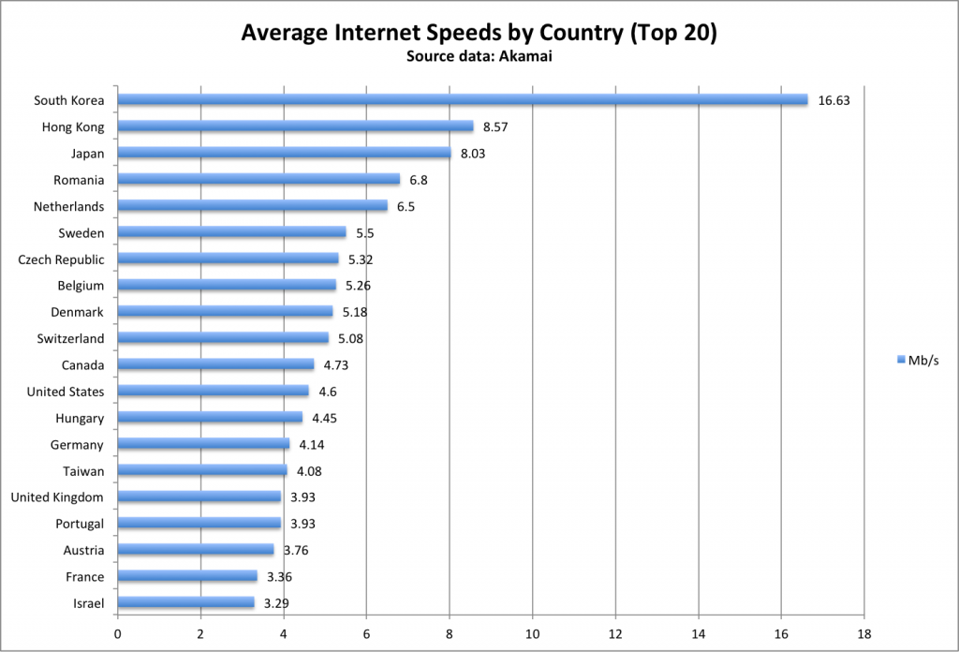
Infrastructure Differences

Slide 14
The Digital Divide
The Internet is creating a separation between those who have access to this global network and those who do not.
This separation is called the “digital divide”
Digital Divide that could prevent certain categories of people— those from low-income households, senior citizens, single-parent children, the undereducated, minorities, and residents of rural areas — from receiving adequate access to the wide variety of resources offered by computer technology. (ACM Code of Ethics)
https://www.youtube.com/watch?v=cLFDDQi9ow4

Slide 15
The Digital Divide
The digital divide can occur between countries, regions, or even neighborhoods.
In many US cities, there are pockets with little or no Internet access, while just a few miles away high-speed broadband is common.
Solutions to the digital divide have had mixed success over the years.
One laptop per child
Wi Max networks
Cyber “café” (Coffeehouses with Internet services)

Slide 16
Digital Divide
Another view of the problem was proposed by Nielsen (2006).
This author breaks the digital divide into three stages:
The economic divide
The usability divide
The empowerment divide

Slide 17
Economic Divide
What is usually called the digital divide is, in Nielsen’s terms, the economic divide.
The idea that some people can afford to have a computer and Internet access while others cannot.
Hardware is cheaper today than in the pass.
In the future computers will be cheaper and more powerful (Moore’s Law.)
Nielsen suggest that this cost is not going to be an issue in the future.

Slide 18
Usability Divide
“technology remains so complicated that many people couldn’t use a computer even if they got one for free.”
Even for those who can use a computer, accessing all the benefits of having one is beyond their understanding.
This problem is particularly evident with low literacy and senior persons.
Some authors present this problem by separating “digital natives” VS. “digital immigrants.”
We know how to solve this problem, but the solutions is not cost-effective (Nielsen)

Slide 19
Empowerment Divide
Empowerment divide is the most difficult to solve.
It is concerned with how we use technology to empower ourselves.
Very few users truly understand the power that digital technologies can give them.
Researchers report that very few people contribute content to the Internet.
Few users use advance search
Many people will limit what they can do online by accepting the basic default settings of their computers.
Users do not work to understand how they can truly be empowered.

Slide 20

Summary
Explained the concept of globalization.
Described the role of information technology in globalization.
Identified the issues experienced by firms as they face a global economy.
Defined the digital divide and explain Nielsen’s three stages of the digital divide.

Slide 21
Basic E-Commerce Concepts

Slide 22
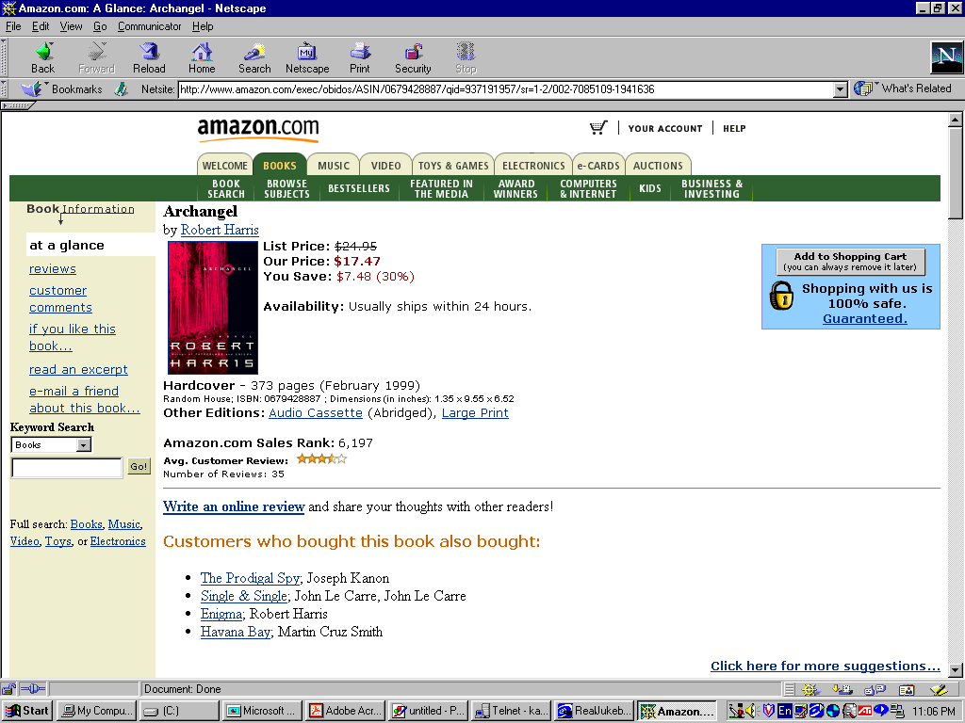
SECURITY
CONTENT
PRESENTATION
Notes:
Let’s us look at amazon.com as an example of an e-commerce store
This site shows an item (i.e. a book) on sale with necessary information such as title, author, price, shipping information etc. This is what we call “content presentation” of an e-commerce store
The site also presents “security feature”, which is of course very important to any online purchaser

Slide 23
TRANSACTION
PROCESSING
RECOMMENDER
SYSTEMS
Notes:
Amazon.com also has a built-in “recommender system”, which suggests other items for the customer to buy in addition to the presented item
An e-commerce store must have facility to process a transaction, e.g., allowing customers to place items in a shopping cart, to pay for their chosen items, to access their accounts etc.

Slide 24
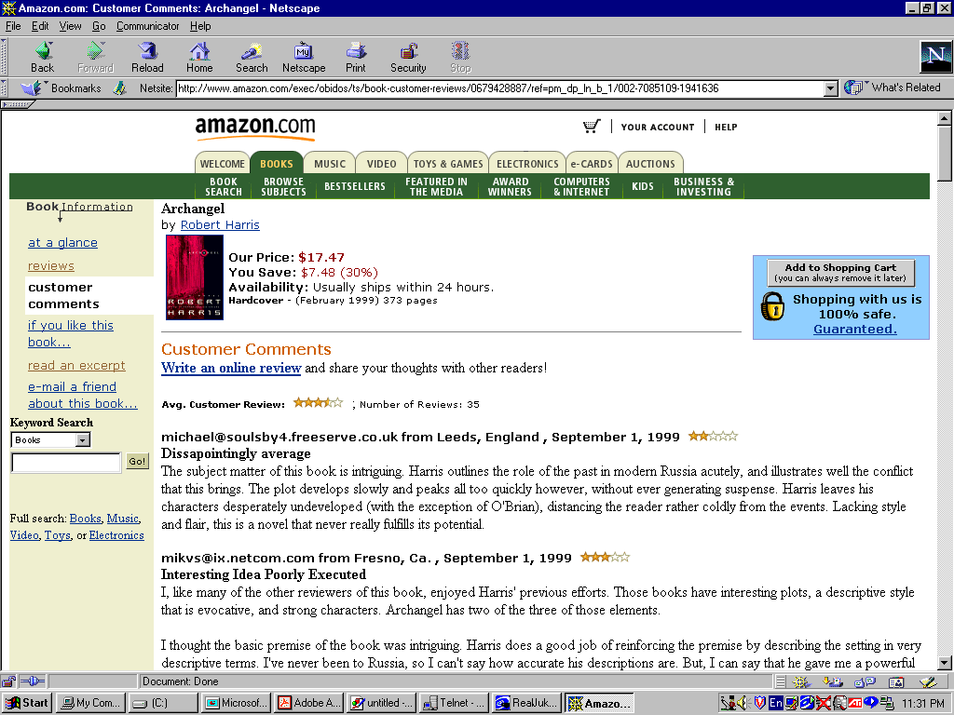
ELECTRONIC
COMMUNITY
Notes:
Nowadays, many e-commerce store also establish online communities or forums via which customers can post and exchange their opinions and comments on the store’s products

Slide 25
What do we mean by “Internet Commerce”?
By “Internet commerce”, we mean the use of the global Internet for purchase and sale of goods and services, including service and support after the sale.
Internet commerce is one type of the more general electronic commerce.
Electronic Data Interchange (EDI), originally created for linking organizations with their partners and suppliers.
EDI formats are being replaced by Extensible Markup Language (XML) that are more general, more extensible, and easier to use.
In this course, we use the terms “e-commerce” and “Internet commerce” interchangeably.

Slide 26
Why Internet Commerce?
The ability to reach new customers and create more intimate relationships with all customers
Dramatic cost reduction for distribution and customer service

Slide 27
Access to a Global Market
Every business on the Internet has a global presence.
The Internet makes it possible to work effectively and efficiently with customers, partners, and suppliers around the world
Worldwide, high-bandwidth communications
Essentially the same cost of communications (whether the parties are down the street or halfway around the world)
Technologies allow businesses to know more about their customers

Slide 28
Great Cost Reduction in Distribution and Customer Service
The ability to deliver information to customers in a low cost manner becomes an important part of making the sale.
Sending a printed brochure through postal service costs several dollars for each recipient. Sending the equivalent in e-mail costs nearly zero per recipient.
The Internet makes it possible to provide even more information at lower cost, and to have that information be always accurate, up-to-date, and searchable.
The same ideas hold for selling information products online.

Slide 29
Key Properties of the Internet
The Internet is interoperable
A computer is connected to the Internet if it can communicate with any other computer connected to the Internet.
The Internet is global
The Internet structure is based on standardized and universal connectivity.
The Web makes it easy
The WWW has made high functional multimedia content easily available to users worldwide.
The costs of the network are shared across multiple applications and borne by the end users.
Businesses and consumers pay for their own connections and then are free to use the network for their purposes.

Slide 30
Types of E-Commerce
https://www.youtube.com/watch?v=FAyit_s9eY0
List down 6 types of e-Commerce businesses.
Give one sentence explanation and an example for each.

Slide 31
Strategic Issues
Concentration versus Empowerment
The Internet allows direct access from businesses to consumers and greatly reduces the costs associated with distribution.
This could lead to a great concentration of suppliers, or to the opposite: the creation of tens of thousands of small and medium-sized suppliers.
New Competitive Challenges
The Internet can bring formerly disjoint businesses into direct competition.
Costs and efficiencies must become competitive worldwide.

Slide 32
Business Issues in Internet Commerce
Internet commerce is about business: using the network effectively to achieve business goals.
Current technology provides tools for reaching business goals.
If we do not have a clear idea of our business goals in using the network, then technology cannot help us to achieve them.

Slide 33
Business Issues (cont.)
Business goals can also be changed to take advantage of current technology.
Technology often allows new kinds of operations that were previously too expensive.
For example, it is entirely appropriate to choose a new focus on closer customer relationships, using the Internet to communicate with customers.
Without the network, such a goal might have been too expensive or difficult to achieve.

Slide 34
Business Issues (cont.)
Business issues for Internet commerce cross the entire range of business activities:
How does Internet commerce fit with our strategy? Should we change our strategy?
What does this mean to our competitive situation?
Do we expect return in the short term, or is this a long-term investment?
How much will it cost? What do we expect to accomplish?
How will we measure the success?
How does this affect our sales channels, our partners, and our suppliers?
Notes:
Business activities range from attracting customers to fulfilling their orders, from sales to accounting and after-sale customer support.
Setting up a web site may seem easy: creating a few HTML pages, hosting on a local Internet service provider, and handling some emails, etc.
Let’s compare that simple e-commerce system with a much more complicated one that allows real-time catalog updates, dynamically maintains user profiles, takes payment in multiple ways, links to inventory and fulfillment systems, and provides customer support.
One approach is to allow such functions to add in an initial web site gradually over time. The second approach is to plan for an evolving website, learning from each step and modifying the plan as appropriate.
Although a company may succeed with the first approach, it probably will not have an accurate idea of what it costs and how to measure the success.
The second approach may not provide an instant gratification of getting a web site running as soon as possible, but it does a company to measure the cost and to expect what to accomplish.

Slide 35
Technology Issues in Internet Commerce
There are two key technology issues:
Which technology to use?
How to deal with the fast pace of technological change?
First issue: How to apply Internet technology to business problems.
E-commerce applications bring together many technologies: the Web, databases, high-speed networking, cryptographic algorithms, multimedia, etc.
Putting them together to form a secure, high-performance, integrated e-commerce system can be challenging.

Slide 36
Technology Issues (cont.)
Second issue: how to deal with the fast pace of technological change?
Any commerce system must be prepared to accommodate and incorporate new technologies as they become available.
The key to such adaptability is a coherent system architecture that clearly lays out what is to be accomplished and why.
By focusing on the fundamental principles we can adopt new technologies that help us to achieve our goals, while avoiding new technologies that may seem exciting but do not really fit in with our goals or the system.
Security Issues: https://www.youtube.com/watch?v=TUOgSVRyhG4

Slide 37
Introduction to Ethics

Slide 38
What is Ethics
Ethics is the practice of making a principled choice between right and wrong
More frequently we encounter ethical situations involving computers and other forms of information technology

Slide 39
What is Ethics (2)
Ethical principles are ideas of behavior that are commonly acceptable to society
Using ethical principles as a basis for decision making prevents us from relying only on intuition or personal preference

Slide 40
Why Should we Care About Ethics
So many ethical situations that we encounter each day that we should care
Some unethical actions can violate law
Others, though not illegal, can have drastic consequences for our careers and reputations
We should care about ethics for our own self interest

Slide 41
Computer Ethics and Regular Ethics
Is computer ethics different from regular ethics?
Is there an ethical difference in browsing someone else’s computer file and browsing their desk drawer?
No!
What we have are ethical situations where computers are involved.
Computers allow people to perform unethical actions faster than ever before
Or perform actions that were too difficult or impossible using manual methods

Slide 42
Identifying Ethical Issues
A characteristic common to computer ethics is the difficulty of identifying ethical issues
Many who perform unethical practices with computers don’t see the ethical implications
When caught, their first reaction is:
“I didn’t know I did anything wrong. I only looked at the file, I didn’t take it.”
If they copy a file they say:
“I didn’t do anything wrong. The file is still there for the owner. I just made a copy.”

Slide 43
Identifying Ethical Issues (2)
Hackers often say,
“I was just testing to see how secure the system was. I was going to report the weakness to management. I was performing a valuable service.”
One goal of this course is to increase sensitivity to ethical issues involving computers
Computer ethics should have a strong link to policy or strategy
When an ethical problem is identified, a policy or strategy should be developed to prevent the problem from recurring

Slide 44
Competing Factors in Decision Making
At biological level, we are directed by drives for food, shelter, and love
On another level, we are guided by laws, established by a group like congress, a temple, kovil, church, mosque or culture.
At a higher more abstract level our behavior is modified by our understanding of what is good, right, proper, moral, or ethical

Slide 45
Competing Factors in Decision Making
Human action is rarely straightforward, at any time influences from several levels affect our behavior
Leading to competing outcomes
Individuals must weigh risks & consequences before determining how to act.

Slide 46
Consequences of Poor Value Judgments
One risk in situations involving ethics is the risk of poor judgment (list on board)
What are some small business situations involving ethics
What about a large corporation?
What about individual or personal situation
What about in computing, software development, system administration?

Slide 47
Poor Judgments (2)
A poor judgment, or low quality decision can have a wide range of results
Can hurt a persons feelings (disappoint them)
Lower employee morale
Cause a business to lose customers
Decrease profits
Cause a firm to be sued or go bankrupt

Slide 48
Wrap up of our Progress thus Far
All of us must make ethical decisions
What is ethics?
It’s not religion, although one dictionary defines it as a moral philosophy
It’s not preaching or making people believe as you do
Ethics is the practice of making principled choices

Slide 49
The Types of Ethical Choices
Choosing right from wrong
Most of us know that stealing, lying, and cheating are wrong
These three actions are taboos of a commonsense morality
Choosing right from right
Some ethical choices are harder when the situation is not as clear
Lying may be wrong but if you visit a sick friend is it wrong to exaggerate how well they look?
Some might lie about how the friend looks to achieve a perceived higher good
The quick recovery or general welfare of the patient
Is it wrong to steal food is one is starving?
Is it wrong if one’s child is starving?

Slide 50
Types of Ethical Choices (2)
Is it wrong to keep coins found in a pay telephone?
Does the money belong to the previous caller?
To the phone company?
To you?
Does the amount found make a difference?
Would you keep a small amount?
Return a large amount?
How would you give the coins back?
Would you call the operator and feed the coins back into the machine?
What if the operator wouldn’t take them?
Are you then off the hook?
Should you give them to charity?

Slide 51
Types of Ethical Choices (3)
These trivial examples ilustrate the complexity of ethical choice
The necessity to choose a course of action from two or more alternatives
Each having a desirable result
In an ethical choice then, an individual must often choose between two or more goods or the lesser of two evils

Slide 52
Practical Approaches to Ethical Decision Making
Making ethical decisions is not a science
People do it differently
In ethical decision making the individual must decide what the answer depends on
What the facts are
What harm might be done by each alternative
Which course of action results in the least harm
Some ways to do this are to use laws, guidelines, and ethical principles

Slide 53
Using Law to make Ethical Decisions
When a law tells us to do nor not to do something it implies that a recognized authority has decided that the action the law prescribes is of benefit to society
What are some laws you like?
What are some good laws?
Often, an ethical principle was used prior to a law’s construction
Remember that ethical principles are ideas of behavior that are commonly acceptable to society
So, law is often grounded in ethical principles, a good starting point for ethical decision making

Slide 54
Relationship between Ethics and Law
The relationship between ethics and law leads to four possible states
Legal Not Legal
Ethical
I
I I
Not Ethical
III
IV

Slide 55
Some Examples of the Four Categories
Ethical and Legal
Buying a spreadsheet program and using it to do accounting for clients
Firing an individual who does not perform according to expectations or who fails to follow certain contractual obligations
Increasing the price of goods when the demand for those goods increases
Ethical but not Legal
Copying copyrighted software to use only as a backup, even when the copyright agreement specifically prohibits copying for that purpose

Slide 56
Examples Continued
III. Not Ethical but Legal
Revealing data that was expected to remain confidential – for example, gossiping by data entry operators, about the salary data they are processing
Using a pirated version of a software product in a foreign country that has no software copyright laws
IV. Not Ethical and Not Legal
Pirating copyrighted software
Planting viruses in someone else’s computer system

Slide 57
Four Categories Conclusion
We’ll cover these useful ideas next
When law does not provide an answer, as in categories II and IV, it becomes necessary to consider the ethical situation by using informal or formal guidelines.

Slide 58
Using Formal Guidelines to Make Ethical Decisions
A guideline is an outline for conduct
Violating a guideline doesn’t have legal implications of breaking a law
A formal guideline is an explicit statement
Examples include a statement of a corporate policy, an associations code of ethics

Slide 59
Using Formal Guidelines
When you have an ethical situation ask yourself:
Is the act consistent with corporate policy?
Either explicitly or implicitly, corporations often tell their employees how to act.
The policy may be a rule stating that no gifts are to be accepted from vendors, or it may just be a motto, such as: “The customer is always right.”
Does the act violate corporate or professional codes of conduct or ethics?
Often companies and professional organizations adopt such codes.
Some are quite specific and can be helpful in directing the activities of the members.
Even if you do not belong to a professional society or your organization does not have a computer ethics code, it may be worthwhile to adopt a code as your personal guide.

Slide 60
Using Formal Guidelines Cont.
Does the act violate the GoldenRule?
That is, are you treating others the way you would wish them to treat you?
Does the act serve the majority rather than a minority?
Does it serve yourself only?
Generally, an outcome that benefits the majority, or serves the common good, is more desirable than one that benefits a few or even one.
Let’s take a quick look at the ACM code of Ethics
We’ll examine it more extensively later in the semester

Slide 61
The ACM Code of Ethics
The ACM, a professional society of more than 85,000 members has a Code of Ethics and Professional Conduct
See http://www.acm.org/about/code-of-ethics
Read Preamble and preview the Code
They are a formal guideline you can use to help in solving ethical problems
The responses may give contradictory advice but can help form the beginning of an ethical solution

Slide 62
Using Informal Guidelines to Make Ethical Decisions
Informal guidelines help us to quickly evaluate a situation in an attempt to resolve an ethical dilemma
Informal guidelines help us to arrive at a general direction for an ethical action
Let’s look at seven informal guidelines
For each guideline, imagine that you are in an ethical situation and must make a decision about your course of action
You are considering one action or sometimes must choose among multiple possible actions

Slide 63
Informal Guideline 1: The Mom Test
Would you tell your what you did?
Suppose you wrote a program to make up sentences from a collection of vulgar words
Would you tell your mother about it? (or some other individual who you look up to?)
Or would you hide it from her(them)?

Slide 64
Informal Guideline 2: The TV Test
How would you feel if you saw your situation described on TV or in the Savannah Morning News?
Would the story make you look good or bad?
How would the viewers or readers react?
EX) You and a friend both own computer consulting companies and decide to share your software so that only one copy needs to be purchased

Slide 65
Informal Guideline 3: The Smell Test
Does the situation smell?
Do you just feel in your bones that there is a problem but you can’t quite pin it down?
If so,
There probably is a problem because the situation has failed the smell test

Slide 66
Informal Guideline 4: The Other Persons Shoes Test
What if the roles were reversed
Would you be happy if the act were done to you?
If you were in the other persons shoes?
If you wouldn’t want the roles reversed then there is probably something wrong

Slide 67
Informal Guideline 5: The Market Test
Would you use your behavior as a marketing tool?
Ie) Does your action have enough merit to give you a marketing edge?
EX)

Slide 68
Informal Guideline 6: The Principle of Harm Minimization
This principle prescribes choosing the course of action that minimizes the amount of harm
You may recall in old Star Trek Episodes a frequent saying of Mr. Spock,
“The good of the many outweighs the good of the few”

Slide 69
Harm Minimization Continued
The principle of harm minimization can help you spot ethical problems as well as solve them
Sometimes it is useful to examine ethical dilemmas from the stakeholders perspective
A stakeholder is any person or organization with a stake in the decision
Harm refers to any act, physical or psychological, that denies a stakeholder their reasonable rights
An unethical activity is one that results in unnecessary harm or an activity that has the potential for harm

Slide 70
Informal Guideline 7: The Family Test
We’ll see this brought up in one of the videos we look at this semester
Suppose you are developing some product that could in some way impact upon someone’s life, financial well being, or other very important aspect of life.
Would you be comfortable if someone in your family used that software regularly
Examples might include medical software in today’s machines, flight control software, financial investment software, etc.

