Slide 1
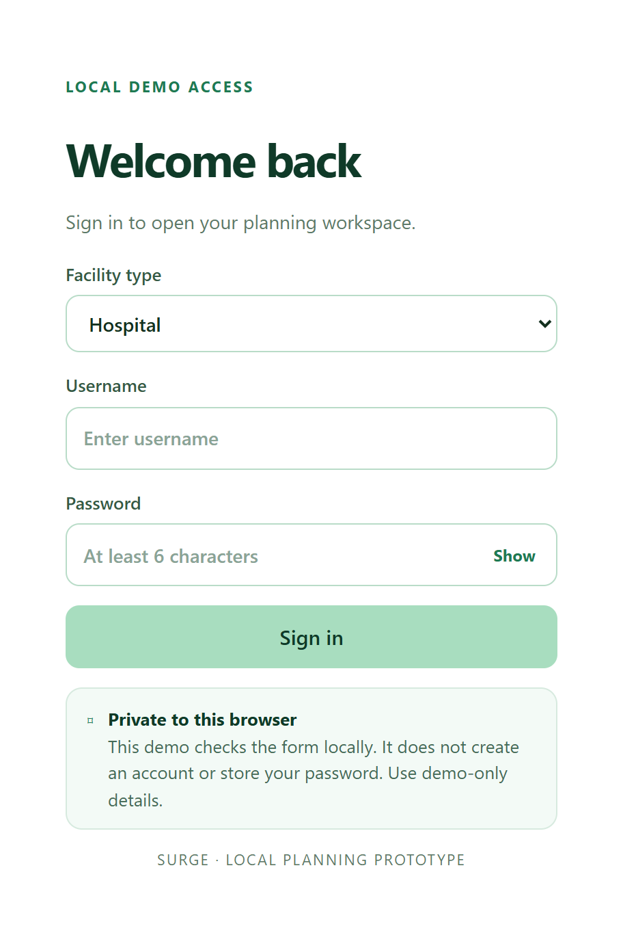
SURGE
Know what to keep powered when the grid fails
A power-outage planner for hospitals and clinics
SDG 3
SDG 7
Hospitals and clinics sign in and get their own setup and dashboard.
Notes:
0:00 to 0:15. Introduce the team and the one-line pitch: Surge tells a hospital or clinic what to keep powered when the grid fails.

Slide 2
Hospitals lose power, and staff improvise
1
Vaccines and insulin spoil
1 billion
Medicines that need a fridge are the first to go when power does.
people are served by health facilities with unreliable or no electricity
2
One generator, many demands
The ICU, the theatre and the waiting room share the same fuel.
3
No simple way to decide
WHO, World Bank and IRENA, Energizing Health, 2023
Staff guess what to switch off, often under pressure.
2 / 8
Notes:
0:15 to 0:40. About 1 billion people are served by health facilities with unreliable electricity (WHO 2023). Vaccines and insulin spoil, and the ICU and the waiting room share one generator.

Slide 3
Two goals, two kinds of user
3
SDG 3: Good Health and Well-being
7
SDG 7: Affordable and Clean Energy
Target 3.8: essential medicines and vaccines
Target 7.1: reliable energy services
Protects critical care and the cold chain first.
Makes limited fuel and battery last longer.
Who uses it
Hospital Manager or engineer ranking departments such as the ICU.
Clinic Senior nurse or manager, who also protects the medicine fridge.
3 / 8
Notes:
0:40 to 1:00. SDG 3, target 3.8: medicines and vaccines. SDG 7, target 7.1: reliable energy. Users are the manager or senior nurse of a hospital or clinic.

Slide 4
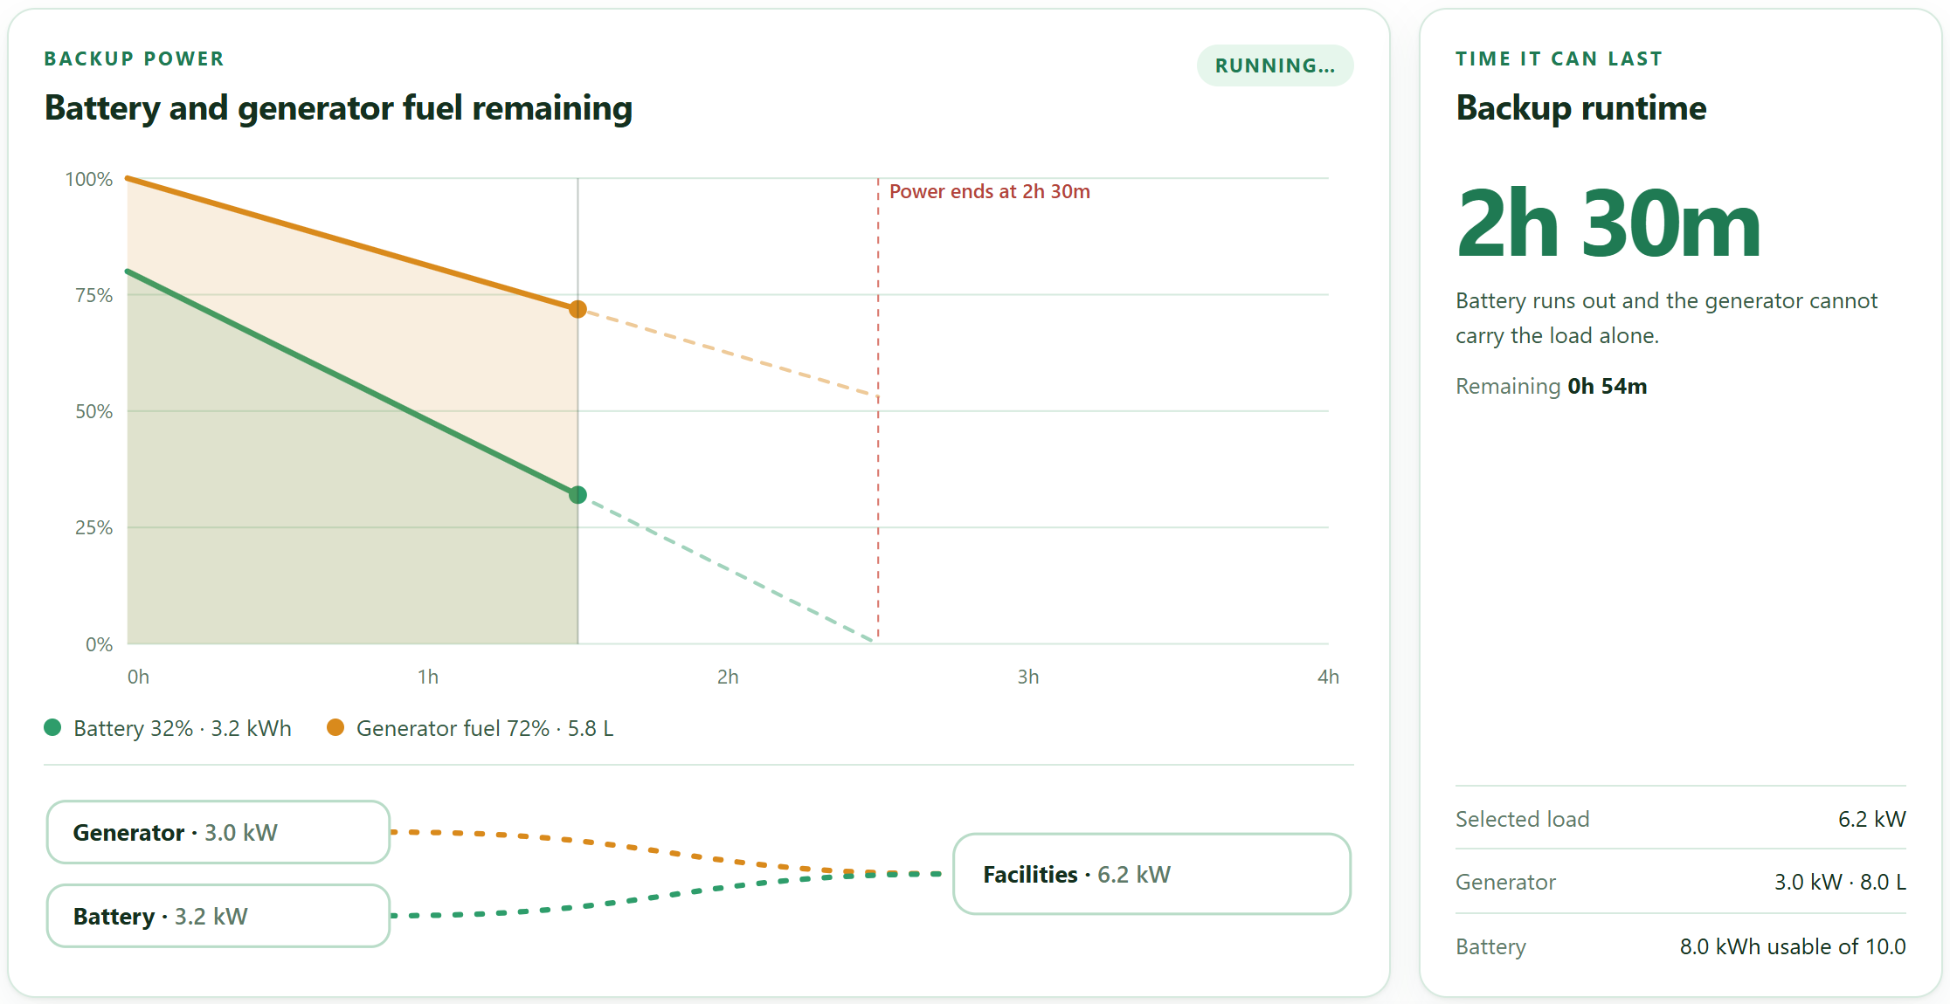
See how long the backup will last
LIVE DEMO 1
1
The graph: battery and fuel running down
2
Time it can last, updating as you choose
3
Tick what gets power, then press Run
4 / 8
Notes:
1:00 to 2:00. Switch to the app. Sign in as a clinic and press Fill in sample data. Point at the graph and the time it can last. Untick a room and show the time go up. Press Run.

Slide 5
Power fails? Press one button
LIVE DEMO 2
1
Press "Power is off"
Power is OFF
1h 00m remaining
2
Keep these on
KEEP ON · 5
SHUT OFF · 3
Intensive care unit
Operating theatre
Emergency department
Blood bank
General ward
Laboratory
Pharmacy
Outpatient dept.
3
Shut these off and tick them
Optional: ask for power for at least a number of hours, and Surge keeps only what can last that long.
5 / 8
Notes:
2:00 to 2:25. Open Current status and press Power is off. Read out the keep and shut-off lists, and tick one item as shut off. Clinics also see which medicines are at risk.

Slide 6
Medicines ranked for an outage
#
Medicine
Days outside fridge
Score
Storage
score = 0.3 × urgency + 0.7 × price
1
Penicillin injection
unconfirmed
0.56
Cold chain
2
Insulin
21
0.43
You can change the weights.
Cold chain
3
Vitamin K injection
unconfirmed
0.37
Cold chain
Everyday names like Insulin, backed by a 500-medicine list
Less time allowed outside the fridge ranks higher
It tells staff to check the label and never says a medicine can be used
4
Paracetamol
not needed
0
Room temp
5
Oxytocin
not needed
0
Room temp
6 / 8
Notes:
Clinics only. The ranking comes from the team dataset: cold-chain medicines first, scored 30 percent on shelf-life urgency and 70 percent on price. The app tells staff to check the label and never decides whether a medicine can be used.

Slide 7
How it works
1
2
3
4
Enter
Simulate
Decide
Warn
Generator, fuel, battery and facilities ranked 1, 2, 3
Every 15 minutes, using what you entered
Keep facilities in rank order while the backup covers them
Medicines at risk and a weather-based power-cut chance
Plain HTML, CSS and JavaScript. Works offline and installs like an app. 17 automated tests check the maths.
7 / 8
Notes:
2:25 to 2:45. Ranks, a simulation in 15-minute steps, the medicine priority score from our dataset, and a weather-based power-cut chance. It works offline and 17 tests check the maths.

Slide 8
Honest limits and next steps
Still an estimate
What we would do next
The battery is never recharged in the model
The fridge hold time is an assumption
The power-cut chance comes from the weather
Not yet checked with a clinician or engineer
Import real meter readings
Check the medicine data with a pharmacist
Send alerts to staff phones
Pilot in one clinic
Thank you. Questions?
8 / 8
Notes:
2:45 to 3:00. Be honest about the limits. The battery is never recharged, the fridge hold time is an assumption, and nothing has been validated with a clinician yet. Then take questions.

