Slide 1


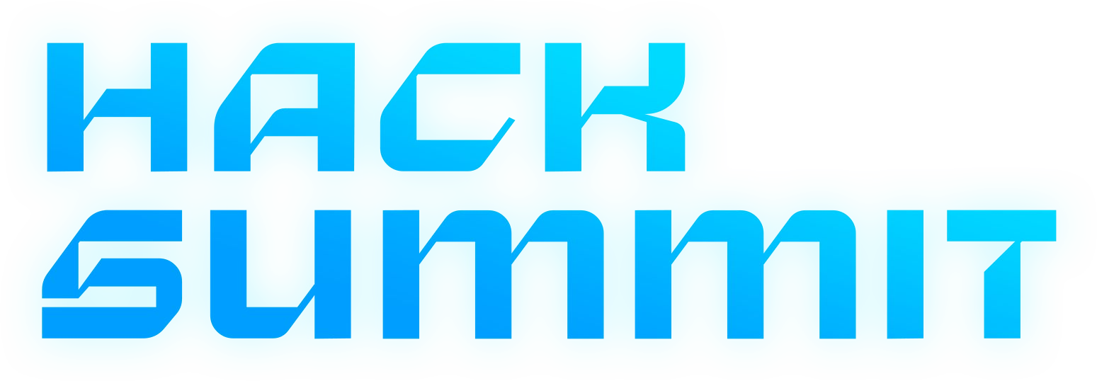

Presented by

Slide 2
TABLE OF CONTENTS
THE PROJECT | Sustainable dev app that guides users to make environmentally friendly investments.
TECHNICAL APPROACH | Python- matplotlib, customTkinter; Financial graphs and readings, ratings and database- MySQL.
FEASIBILITY & VIABILITY | This is to help people make intelligent investments towards the betterment of the future which has been an area that is neglected by society.
IMPACT & BENEFITS | Through this application, we can get people financially and both socially responsible and give companies better opportunities in exploring sustainable development.
Scalability and Scope | The app will begin with a local user base of eco-conscious investors and scale globally as demand for sustainable investments grows. It will integrate with financial platforms and ESG rating providers to handle increasing data and support multi-language, multi-currency transactions. Machine learning will personalize recommendations, improving adaptability and user experience.
PROJECT STAGES | Designing the idea – Getting Data - Making Front End – Making Back End.
OUR TEAM | Vihan Tiwari, Ra No.: RA2411030010048, vt1339@srmist.edu.in Priyanshu Swami, RA2411051010012, ps8402@srmist.edu.in Kushagra Chandra, RA2411003010214, kc9326@srmist.edu.in Naman Tyagi, .: RA2411030010073, nt9876@srmist.edu.in Varun Misra, RA2411030010052, vm8843@srmist.edu.in

Slide 3
SUSTAINABLE INVESTMENT
To create a sustainable development app that focuses on guiding users to make socially responsible and environmentally friendly investments.
The app will empower users to make more informed and conscious investment choices, promoting both financial returns and a better future.
This idea will take the savings amount at the month end from the user and give him a filter-based list of sustainable companies according to the rating of the companies, stock prices and number of stocks for the past month. It also allows user to view how eco-friendly or ethical an organization is, enabling users to align their investments with their values.
Key features:
It will display the financial performance of the green investment alongside the environmental impact such as carbon footprint reduction, water conservation etc.
It provides graphs and visual representations for more user friendliness and financial understandings.
It will also give ratings based on the ESG standards ranging from AAA to E.
HACK SUMMIT ’24

Slide 4
The Project
A sustainable development app would guide users in making environmentally friendly investments by offering real-time data on companies and projects that prioritize sustainability, such as renewable energy or ethical production practices. It would provide transparency through ESG (Environmental, Social, Governance) ratings, helping users invest in ways that align with their values. The app would also educate users about the long-term financial and environmental benefits of sustainable investing, while tracking the positive impact their choices have on the planet. Ultimately, it would make responsible investing easy, motivating users to contribute to a greener future while growing their wealth.
HACK SUMMIT ’24

Slide 5
Technical Approach
Python(Matplotlib)- for data visualization, structure and clean the data first. Leverage Matplotlib’s plotting functions, customizing charts with labels, titles, and colors to enhance clarity and storytelling.
Custom Tkinter - A custom approach using Tkinter involves designing tailored user interfaces with custom widgets, event handling, and dynamic updates. This offers flexibility, making Tkinter ideal for building specialized desktop apps.
Financial graphs and readings - A technical approach to financial graphs uses visualization tools like D3.js or Plotly to clearly represent data. Focusing on key metrics like trends and volatility, along with real-time integration, helps users gain accurate insights for effective analysis.
Ratings and database(MySQL) - MySQL is a powerful relational database management system that uses structured query language (SQL) for efficient data handling and scalable storage. Its features, such as indexing and transactions, allow for fast data retrieval and maintain data integrity, making it a popular choice for various applications.
HACK SUMMIT ’24

Slide 6
Feasibility and viability
To empower individuals to make intelligent investments for a better future, we must shine a light on an area that has long been overlooked by society. Many people lack access to the resources and knowledge necessary to invest in sustainable and ethical opportunities. By providing education, tools, and support, we can guide them toward investment choices that not only yield financial returns but also contribute to environmental sustainability and social well-being.
HACK SUMMIT ’24

Slide 7
IMPACT & BENEFITS
The app designed to guide intelligent investments can significantly enhance social impact by promoting ethical and sustainable financial choices. By empowering users with knowledge and resources, it encourages investments in companies and projects that prioritize social responsibility, environmental sustainability, and community development. This not only helps individuals achieve financial growth but also fosters a collective movement toward a more equitable society, where financial decisions contribute to positive change. Ultimately, the app cultivates a sense of community among users, uniting them in their commitment to building a better future for all.
HACK SUMMIT ’24

Slide 8
Scalability and Scope
User Base growth - The app can start with a local or small-scale user base and expand over time. Initially, target users who are environmentally conscious investors or those looking for sustainable investment options. As awareness and demand for ethical investments grow, the app can scale to larger regions and international markets.
Data Integration-To support scalability, the app should integrate with various financial platforms (like stock exchanges and financial databases) and third-party ESG rating providers globally. As the number of companies with ESG ratings and sustainable investment opportunities increase, the app must be able to scale its data processing capabilities accordingly.
Global Expansion- The app can grow by offering region-specific content and data in multiple languages, considering that ESG standards and ratings may vary across countries. By supporting multi-currency transactions and local laws, the app can scale to a broader audience globally.
Machine Learning for Recommendations- Over time, incorporating machine learning algorithms to personalize user recommendations based on their past investments, preferences, and changing market trends will make the app more effective and adaptable as it scales.
HACK SUMMIT ’24

Slide 9
PROJECT STAGES
1. Designing the Idea:
This involves in discussing initial stages of the idea of how we can make people socially, financially stable and so we divided the team.
2. Fetching Data:
Here we work on getting data from sites and important information regarding our project.
3. Front End:
Front End Team works on how and what to display the best way possible for the user interface, making things easier and sleek.
4. Back End:
Back End Team starts to put in pre stored data in the database and set it up for later use in the application.
5. Testing:
In this stage the whole team does a rechecking on the project and running it till perfection.
HACK SUMMIT ’24

Slide 10
THANK YOU

